Slide 1
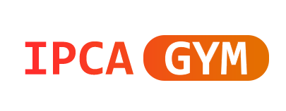
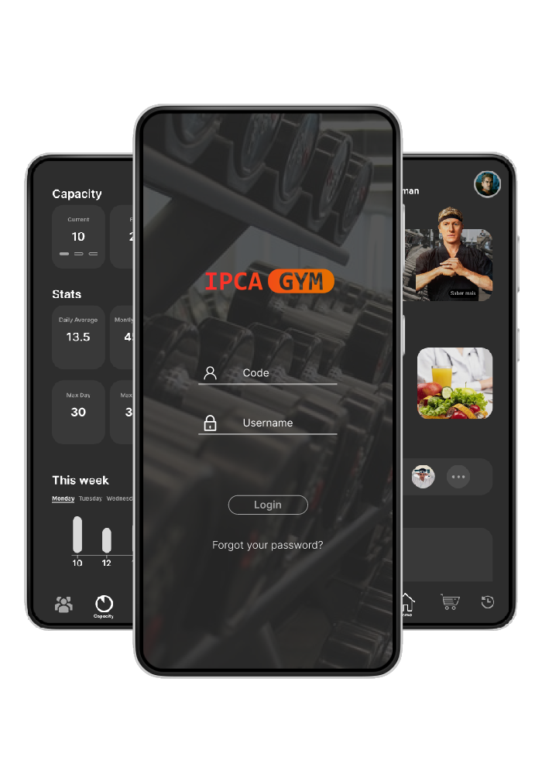

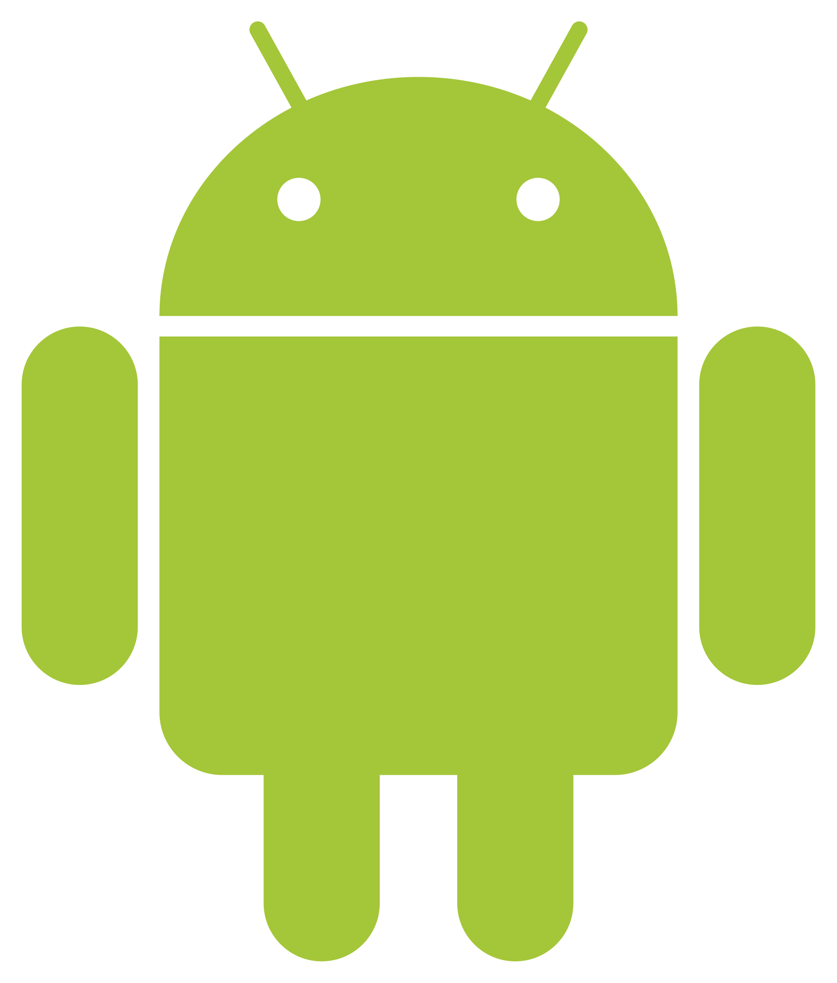
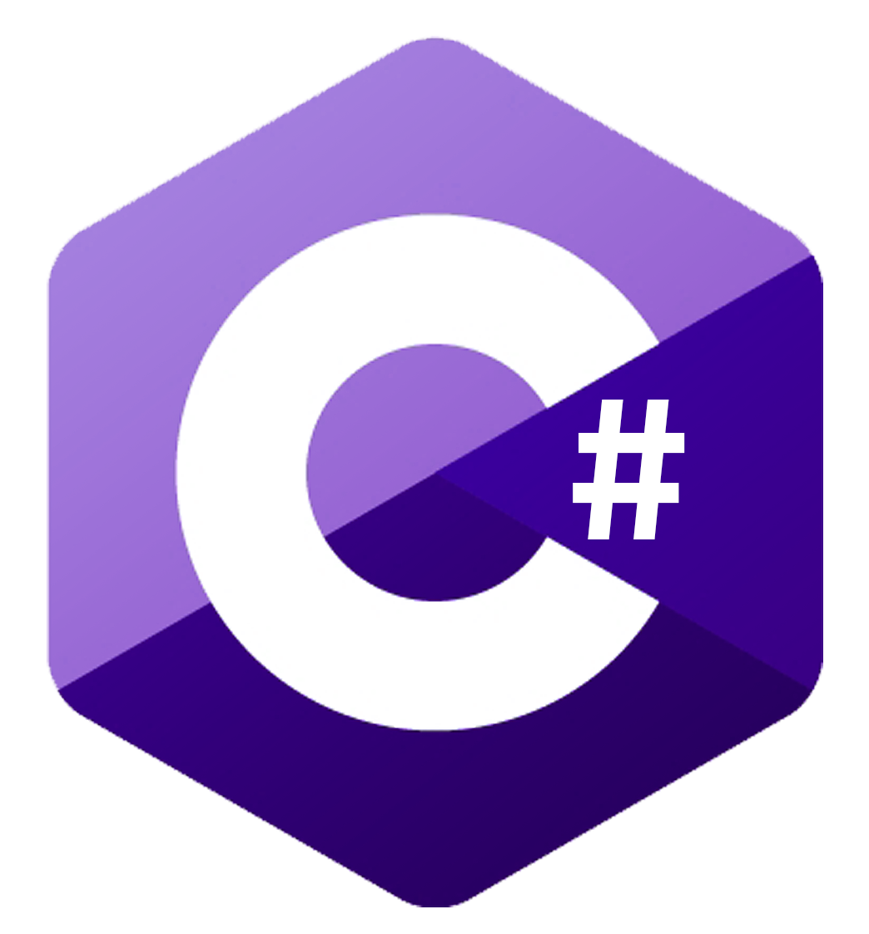

Mobile Application to manage a gym and to gym clients João Carlos da Costa Apresentação 21152
Pedro Vieira Simões 21140
Gonçalo Moreira da Cunha 21145
Student in LESI
UC - PA
Supervisor Eduardo Peixoto and Patrícia Leite
BACKGROUND
OBJECTIVES
The IGYM mobile application is a powerful tool to help gyms manage their business more efficiently. With IGYM, gyms can easily manage staff, customers, an online store, gym occupancy and much more. Additionally, IGYM offers a platform for customers to view personalized workout plans, current gym occupancy, and even nutrition plans. With IGYM, gyms have everything they need to manage their business more efficiently and provide an excellent experience for their customers.
Help gym managers to:
Manage their business more efficiently;
Manage gym capacity and flux control;
Improving customer experience;
Increasing revenue;
Reducing costs;
Increasing gym visibility.
Provide to gym clients:
Access to personalized workout plans;
Access to nutrition plans;
Monitoring gym attendance;
Access to support resources;
METHODOLOGY
The IGYM mobile application was developed using the Android platform and tools such as Kotlin, Android Studio, and Ngrok. The API was created in C# on Visual Studio and the database was created with SQL Server. During the development process, we used the Scrum project management framework and weekly sprints to efficiently deliver the project.
IGYM includes management tools for gyms and resources for customers such as personalized workout and nutrition plans. We are measuring the success of IGYM with metrics such as increased efficiency in business management, increased customer satisfaction, and increased revenue.
RESULTS AND CONCLUSIONS
BIBLIOGRAPHY
In the results and conclusions section of our poster on the IGYM mobile application, we would like to mention that the results presented were obtained through testing conducted by us during the app-building process. During these tests, we observed a significant increase in efficiency in business management for gyms using IGYM. This was achieved through the automation of repetitive tasks and access to real-time reports.
In conclusion, the testing conducted during the development process of the IGYM mobile application demonstrated that it is an effective tool to help gyms manage their business more efficiently and provide an exceptional experience to their customers. With IGYM, gyms can maximize their efficiency and offer exceptional value to their customers.
[1] - "Making GET Requests with Retrofit2 on Android using Kotlin," The Impulson, https://dev.to/theimpulson/make-get-requests-with-retrofit2-on-android-using-kotlin-4e4c
[2] - "Android Kotlin Tutorial - Retrofit + PHP + MySQL - CRUD," YouTube, https://www.youtube.com/watch?v=iEXh1-KVeVc
[3] - "Kotlin Android Tutorial - Retrofit + PHP + MySQL," YouTube, https://www.youtube.com/watch?v=jjGjkElvcfc
CONTACTS
a21152@alunos.ipca.pt (João Apresentação)
a21140@alunos.ipca.pt (Pedro Simões)
a21145@alunos.ipca.pt (Gonçalo Cunha)
epeixoto@ipca.pt (Eduardo Peixoto)

