Slide 1

v1.0

Slide 2

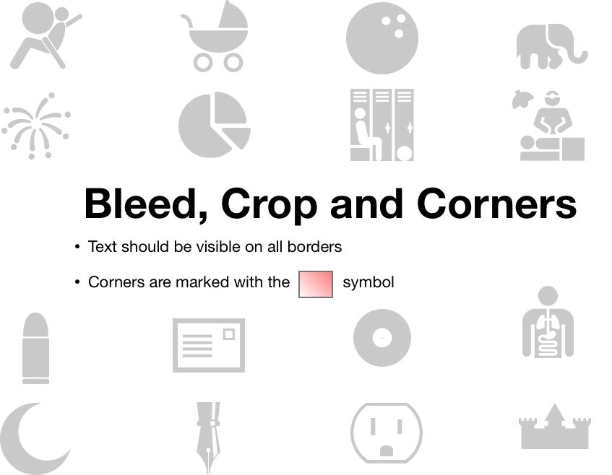
top top top top top top top top top top top top top top top top top top top top top top top top top top top top top
right right right right right right right right right right right right right right right right
left left left left left left left left left left left left left left left left left left left left left left
bottom bottom bottom bottom bottom bottom bottom bottom bottom bottom bottom bottom bottom bottom

Slide 3
Red
Purple
Blue
Orange
Green
Aqua
Brown
White
Yellow

Slide 4
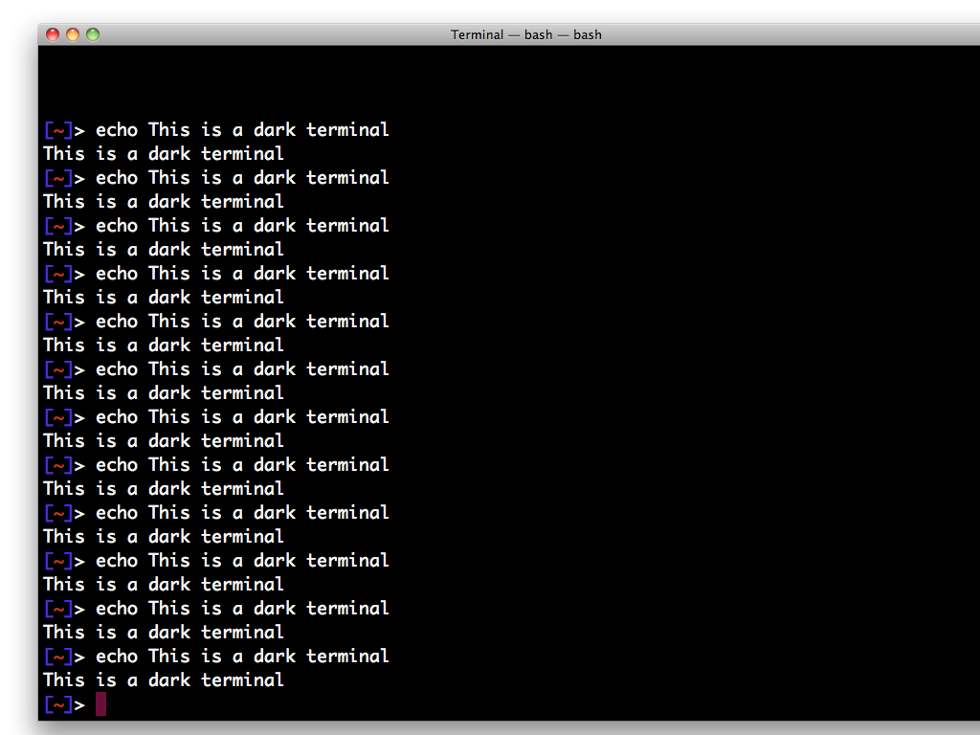
Black Terminal
Check for font legibility and brightness

Slide 5

Image Contrast
100%
25%
75%
50%

Slide 6
dead pixel search
any white dots you see are dead pixels!

Slide 7

Last Minute Checklist
Verify power connections
Close background applications
Clear WiFi preferred network cache
Clear browser history
Turn off mobile phone
Obtain lovely beverage
Check resolution (1024x768)
Put clicker in hand or pocket
Reset count-down timer
Breathe!

