Slide 1
PSCS184: Financial Causality Detection
PIP2001 Capstone Project
Viva-Voce
Batch Number: CSE-37
Roll Number | Student Name
20211CSE0209 | MEDHA JEENOOR
20211CSE0178 | V SAIPRIYA DIPIKA
20211CSE0075 | MADIHA AZIZ
20211CSE0010 | AVIJIT SAMANTRAYA
Under the Supervision of,
Dr. Sandeep Albert Mathias
Assistant Professor
School of Computer Science and Engineering
Presidency University
Name of the Program: CSE
Name of the HoD: Dr. Asif Mohammed H.B
Name of the Program Project Coordinator: Mr. Amarnath J.L & Dr. Jayanthi. K
Name of the School Project Coordinators: Dr. Sampath A K / Dr. Abdul Khadar A / Mr. Md Ziaur Rahman

Slide 2
Introduction to Financial Causality Detection
Significance of Financial Causality: In finance, even small events can trigger significant outcomes, making it critical to detect hidden drivers behind market trends, corporate actions, and economic changes​.
Challenges of Financial Language: Financial documents often include technical jargon, speculative statements, and nuanced phrasing, making causal links difficult to detect​.
Current Limitations: Traditional NLP models struggle with these complexities, as causal relationships are not always explicitly stated​.

Slide 3
Introduction to NLP & Generative AI for Finance
Project Aim: The project aims to combine causal inference with advanced NLP models to improve the detection of cause-effect relationships in financial texts​.
Handling Complex Financial Narratives: By utilizing specialized datasets from financial reports, the project will capture the nuances and variability of real-world financial events​.
Global Relevance: The project will also explore multilingual capabilities, expanding the models to analyze financial texts across different languages and markets​.

Slide 4
Literature Review
1. Text Mining and Sentiment Analysis [2]
Text mining and sentiment analysis involve extracting useful information from large amounts of text data, such as financial news, and categorizing sentiment (positive, negative, or neutral). Early approaches used machine learning models like Support Vector Machines (SVM) combined with lexicons for sentiment detection and stock market prediction.
2. Causal Inference in Machine Learning [3]:
Causal inference methods such as Granger Causality and Bayesian Networks are employed to detect causal relationships between financial events and their outcomes. These methods examine time series data to predict future financial behaviour based on past patterns and causes.
3. Causality in Natural Language Processing (NLP) [1][3]:
NLP models extract causal relationships from text data, using methods like rule-based systems, machine learning, and deep learning models. Recent advancements incorporate Causal Graphical Models and counterfactual reasoning to estimate causal effects from text.
Notes:
1.Text Mining and Sentiment Analysis:
Objective: Extract insights from vast text data (like financial news or social media) to gauge sentiment (positive, negative, neutral) and predict potential market shifts.
Techniques:
Support Vector Machines (SVM): A powerful supervised machine learning algorithm that helps in classifying sentiment, especially in well-defined binary categories.
Lexicons: Lists of words annotated with sentiment scores (e.g., "happy" as positive) that serve as a reference for detecting sentiment within text.
Applications: Widely used in stock prediction; sentiment trends in financial news can often precede stock performance, offering a predictive edge.
2.Causal Inference in Machine Learning:
Objective: Understand and predict causal links between financial events and outcomes to inform decisions.
Methods:
Granger Causality: Assesses whether past values of one variable (e.g., economic indicators) help predict another variable (e.g., stock prices).
Bayesian Networks: Probabilistic models that capture relationships between variables, allowing analysis of the likelihood of one event causing another.
Applications: Used in econometrics and financial analysis to model dependencies and anticipate shifts based on historical data.
3.Causality in Natural Language Processing (NLP):
Objective: Identify causal relationships directly from text by examining cause-and-effect links between events.
Methods:
Rule-Based Systems: Use predefined linguistic patterns or phrases (like “due to” or “caused by”) to identify causation.
Causal Graphical Models: Visual models that help capture causal relationships in complex data.
Counterfactual Reasoning: Investigates what would happen if a certain event had or hadn’t occurred, aiding in understanding causal impact.
Applications: Key in legal, medical, and financial fields, where cause-effect reasoning helps with risk analysis and regulatory compliance.

Slide 5
Literature Review
4. Deep Learning for Financial Sentiment and Causality Detection [2][3]:
Deep learning models, including Recurrent Neural Networks (RNNs) and transformers, are used for detecting sentiment and causality in financial documents. These models analyse the text to predict financial outcomes and identify causal triggers from news and reports​.
5. Knowledge-Based Approaches [6]:
These methods use manually crafted rules and predefined syntactic or semantic patterns to identify causal relationships. For example, they apply patterns involving causal connectives like "because" or "since."
6. Statistical Machine Learning (ML)-Based Approaches [1][6]:
These approaches rely on features extracted from text (e.g., syntactic structures, word embeddings) and use classifiers like Support Vector Machines (SVM) or Naïve Bayes (NB) to detect causal relationships between pairs of events.
Notes:
4.Deep Learning for Financial Sentiment and Causality Detection:
Objective: Employ advanced deep learning architectures to enhance sentiment and causality analysis.
Models:
Recurrent Neural Networks (RNNs): Effective for analyzing sequential text data, capturing dependencies over time, suitable for news or reports.
Transformers: Attention-based models (e.g., BERT, GPT) that excel in understanding nuanced language, often outperforming traditional RNNs.
Applications: Financial markets benefit from using these models for real-time sentiment monitoring and identifying causal triggers in news.
5.Knowledge-Based Approaches:
Objective: Utilize predefined linguistic knowledge to detect causality in text, often through specific patterns.
Techniques: Manually crafted rules leveraging causal connectors (e.g., "since," "because") or semantic patterns.
Applications: Useful in fields where rules can be standardized, like legal documents, where causality patterns follow structured language.
6.Statistical Machine Learning (ML)-Based Approaches:
Objective: Detect causal relationships by learning from statistical patterns in text data.
Methods:
SVMs and Naïve Bayes (NB): Classifiers used to detect causality, relying on features like word embeddings or syntactic structure.
Applications: Often applied in social science and finance, where historical data informs the likely causality between events, such as consumer behavior analysis in response to economic changes.

Slide 6
Literature Review
7. Deep Learning Approaches [4][5][6]:
These methods, including transformer models like BERT and T5, utilize pre-trained language models and attention mechanisms to capture complex, contextual dependencies in text. They often frame causal detection as a sequence generation problem.
8. Granger Causality [7][8][10]:
Granger causality measures whether the historical values of one variable can predict another variable's future values. It examines time-series data to identify directional relationships between variables, making it a key tool for detecting causality in financial systems.
9. Transfer Entropy [7][11]:
Transfer entropy is a nonlinear, information-theoretic approach used to quantify the amount and direction of information flow between two variables. It captures both linear and nonlinear dependencies, making it suitable for detecting complex relationships between financial variables, such as market sentiment and stock price movements.

Slide 7
Literature Review
10. Causal Link Detection Between Financial News and Stock Movements [9]:
This method applies various text and time-series distance metrics (e.g., TF-IDF for news, Pearson correlation for stock prices) and statistical tests (e.g., Spearman's correlation) to detect causal links between financial news and stock market outcomes. It seeks to predict stock movements based on prior news coverage.
11. Deep Learning for Causality Detection (FinCausal Task) [8]:
Deep learning models like BERT and RoBERTa are used to automatically detect explicit and implicit causal links in financial documents. These models can process complex, unstructured financial text and identify cause-effect relationships, even when causality is implied or spread across multiple sentences.

Slide 8
Literature Review
12. Kernel-based Methods [11]:
Kernel-based methods extend the concept of Granger causality by employing kernel functions to map data into higher-dimensional spaces. This transformation allows for the detection of nonlinear relationships that are often present in complex financial systems.
13. Deep Learning Models (Causal-BERT) [12]:
Causal-BERT leverages language models to detect cause-effect relationships in natural language text. It is particularly effective in identifying implicit and explicit causal patterns from unstructured financial reports.

Slide 9
Advantages
Improved Accuracy: Deep learning models combined with machine learning enhance prediction accuracy, especially for sentiment and causality detection in financial data. (Methods: 1,2,4,5,11)
Wide Application: These methods are useful for analyzing large-scale datasets from various sources, such as financial news. (Method: 1)
Automation: Machine learning (ML) methods automate feature extraction and sentiment classification, reducing manual intervention and enhancing scalability. (Methods: 1,4,6)
Handling Complex Interactions: Capable of modeling intricate relationships between multiple variables, providing more robust financial predictions. (Methods: 2,13)

Slide 10
Advantages
Improved Interpretability: Causal models explain the reasons behind financial changes, making results more interpretable for decision-makers. (Method: 3)
Multilingual Capability: These methods support multilingual analysis, allowing them to handle global financial data from various languages. (Methods: 4,7, 11)
Scalability: These techniques can process vast amounts of data, making them suitable for large-scale financial analysis. (Method: 3)
Flexibility: Capable of handling both textual and numerical data, allowing for adaptable analysis across different types of information sources. (Methods: 10, 12)
10. Handling Unstructured Data: NLP models can efficiently analyze and extract insights from unstructured text like financial reports and news articles. (Method: 3)

Slide 11
Research Gap Identified
Dependence on Quality of Data: Model accuracy relies heavily on the quality and consistency of input data, which can often be noisy or inconsistent. (Methods: 1,7)
Requires Large Datasets: Causal inference methods often require large, diverse datasets to be effective, making them less useful for smaller datasets. (Methods: 2,8,9,13)
Black-Box Nature: Deep learning models are often less interpretable, making it difficult to understand how they arrive at certain predictions.(Methods: 4,7,13)
Language Ambiguity: NLP models struggle with ambiguous language, which can lead to inaccurate results, especially in financial texts.(Method: 3)

Slide 12
Research Gap Identified
Implementation Complexity: These models can be technically challenging to implement and interpret, especially when dealing with complex data. (Methods: 2,3,5,12)
Overfitting Risk: There is a risk of overfitting the model to specific datasets, which reduces generalizability across different datasets. (Methods: 4,11)
Data Quality Sensitivity: The accuracy of causal link detection is highly sensitive to the quality of the input data, with noisy data leading to incorrect conclusions. (Methods: 1,5,11)
High Computational Cost: Training these models requires substantial computational power, which may not be accessible to all organizations. (Method: 7)

Slide 13
Methodology – Spanish QA Model
Objective: Implement XLM-RoBERTa-based model to handle multilingual QA tasks.
Steps
Model Setup: Load XLM-RoBERTa pretrained on multilingual data (e.g., SQuAD2).
QA Functionality: Define answer_question() to process input question and context.
Prediction Generation: Read the input CSV file with multilingual context. Extract ID, Context, and Question for prediction.
Output: Append answers to rows and export a new CSV.
Key Features
Multilingual Compatibility: Supports languages like Spanish.
GPU Independence: Configured for CPU usage.
Notes:
Cross-Lingual Language Model
Robustly Optimised BERT Approach
B

Slide 14
Methodology – English QA Model
Objective: Utilize a BERT-based model fine-tuned on SQuAD to predict answers to given questions.
Steps:
Model Initialization: Load the BERT large uncased model with the fine-tuned tokenizer.
Question-Answer Function: Define a function answer_question() to process questions and context, generating predictions via the model.
Read the input CSV file containing ID, Context, and Question.
Iterate through each row, extracting relevant data.
Pass the data to the answer_question() function for prediction.

Slide 15
Methodology – English QA Model
Output Preparation
Append predictions to the existing data.
Write the results into a new CSV file with an additional column for answers.
Key Features
Language-Specific Model: Optimized for English QA.
Input/Output Configuration: Handles CSV files seamlessly.

Slide 16
Algorithm for Spanish Subtask
Load the XLM-RoBERTa model using the Transformers pipeline.
Define answer_question():
Accept question and context.
Predict answers via the pipeline.
Open the input CSV:
Extract necessary fields.
Generate answers row-wise using answer_question().
Save the results to a new CSV file.

Slide 17
Algorithm for English Subtask
Load the BERT model and tokenizer using the Transformers pipeline.
Define `answer_question()`:
Accepts question and context as inputs.
Calls the pipeline model to predict the answer.
Read input CSV:
Extract rows with ID, Context, and Question.
For each row:
Call `answer_question()` to get the answer.
Append the answer to the row.
Write predictions to a new CSV file.

Slide 18
Objectives
The goal is to improve causal extraction by leveraging Universal Dependencies and hint expressions to capture syntactic and semantic details, tackling challenges like context sensitivity, polysemy, and implicit causation, with uses in event analysis and finance. [4] [5] [6] [8]
This project aims to enhance the identification of implicit causal interactions by addressing challenges in detecting latent links. [12]
The focus is on applying causal inference to financial texts by identifying cause-effect links, improving the interpretation of financial outcomes, and developing specialized NLP tools for causality detection. [1] [7] [8] [9]

Slide 19
Objectives
The aim is to explore causal inference in sectors like banking and insurance by evaluating the effects of economic policies and external shocks on markets, offering clearer insights into financial interactions and aiding informed decision-making. [3] [11]
The goal is to develop a generative AI system for Financial Causality Detection to identify and explain cause-effect relationships in English and Spanish datasets, improving methods to detect causal links between financial news and stock market performance, and testing its applicability in real-world trading. [1] [2] [3] [9]

Slide 20
System Design and Implementation
Modules
Data Ingestion
Question-Answering Pipeline
Answer Extraction
Output Generation

Slide 21
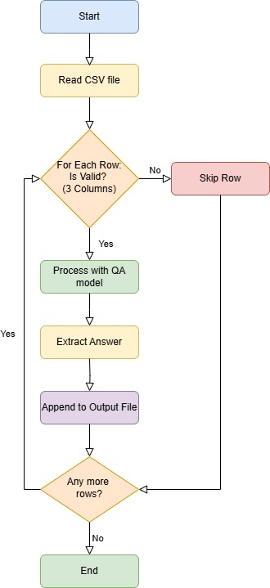
System Design and Implementation
Architecture

Slide 22
System Design and Implementation
Hardware/Software Components
Programming Language: Python
Libraries and Frameworks:
a. Hugging Face Transformers
b. CSV Module
c. File I/O Utilities.
Pre-Trained Models:
deepset/xlm-roberta-large-squad2 (Spanish)
bert-large-uncased-whole-word-masking-finetuned-squad (English)
Execution Environment: Google Colab
CPU: For faster processing of the models and for handling file operations.
Memory (RAM): For loading and inference.
Storage: For input and output CSV files.

Slide 23
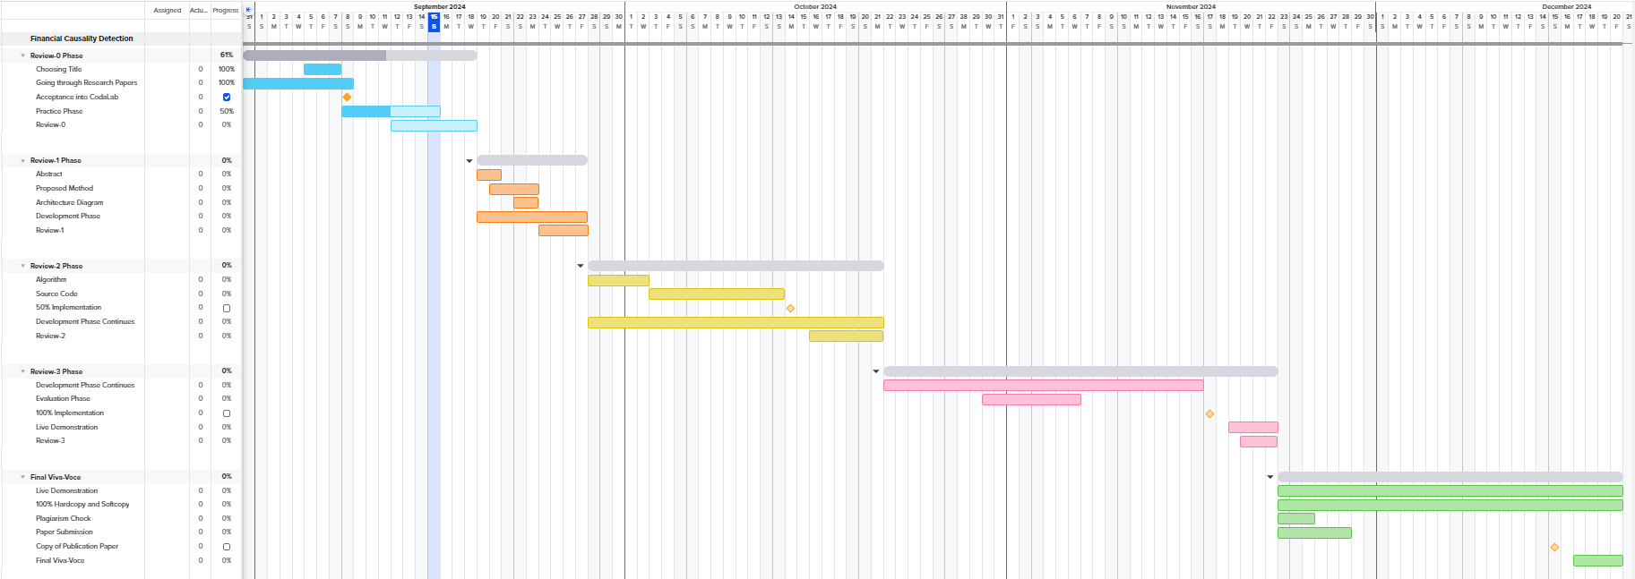
Timeline of Project
https://prod.teamgantt.com/gantt/list/?ids=4073182&public_keys=jdMlaW6dZfeu#

Slide 24
Outcomes
CSV file generated with the predicted answers to the questions
Each row contains the Id, Text, Question, and the predicted Answer
Causal relationships are extracted from financial texts in Spanish and English
Our model is evaluated using the metrics SAS and EM
Notes:
1. Improved Multilingual Causal Understanding in Financial Contexts
Using the XLM-RoBERTa model, the pipeline will handle diverse languages and will extract causal relationships from financial texts written in Spanish. This approach will overcome language barriers, enabling a broader range of financial datasets to be analyzed for causality.
2. High-Precision Causal Link Identification in English Texts
The BERT model will focus on analyzing English financial texts to extract precise causal links by interpreting semantic and syntactic structures.
By utilizing advanced tokenization and context padding, the system will ensure consistency and accuracy in predictions. This will make it a reliable tool for identifying critical financial insights from English-language documents.
3. Accurate Event Impact Assessment
The pipeline will use contextual embeddings from the BERT and XLM-RoBERTa models to evaluate the causal impact of specific events in financial texts. By pairing questions with relevant contexts, the models will provide precise answers. This functionality will ensure a refinement understanding of event consequences.

Slide 25
Conclusion
Our BERT and XLM-RoBERTa based transformer models demonstrated the capability to extract and predict cause-effect relationships from financial data. This system not only enhances the analytical process of complex multi-lingual financial documents but also fosters data-driven decision-making to promote economic stability. While the model did not achieve the best overall performance, it exhibited a strong semantic understanding of the data. However, further refinements and fine tuning would help us achieve better verbatim matching and a better understanding with domain-specific nuances in diverse datasets.

Slide 26
Github Link
https://github.com/Presidency-University-CSE-G39

Slide 27
References
Feder, A., Keith, K. A., Manzoor, E., Pryzant, R., Sridhar, D., Wood-Doughty, Z., Eisenstein, J., Grimmer, J., Reichart, R., Roberts, M. E., Stewart, B. M., Veitch, V., & Yang, D. (2021). Causal inference in natural language processing: estimation, prediction, interpretation and beyond. arXiv (Cornell University). ​
Day, M.-Y., & Lee, C.-C. (2016). Deep learning for financial sentiment analysis on Finance News Providers. 2016 IEEE/ACM International Conference on Advances in Social Networks Analysis and Mining (ASONAM). ​
Kumar, S., Vivek, Y., Ravi, V., & Bose, I. (2023). Causal inference for banking finance and insurance a survey. Satyam Kumar. ​
Man, H., Nguyen, M., & Nguyen, T. (2022). Event causality identification via generation of important context words. Proceedings of the 11th Joint Conference on Lexical and Computational Semantics, 323–330. ​
Sakaji, H., & Izumi, K. (2023). Financial causality extraction based on Universal Dependencies and Clue expressions. New Generation Computing, 41(4), 839–857. ​
Yang, J., Han, S. C., & Poon, J. (2022). A survey on extraction of causal relations from natural language text. Knowledge and Information Systems, 64(5), 1161–1186. ​

Slide 28
References
7. Scaramozzino R., Cerchiello P., & Aste T. (2021). Information theoretic causality detection between financial and sentiment data. Entropy, 23(5), 621. ​
8. Mariko D., Abi-Akl H., Labidurie E., Durfort S., de Mazancourt H., & El-Haj M. (2020). Financial document causality detection shared task (FinCausal 2020). YseopLab, France, & Lancaster University, UK. ​
9. Qu, H., & Kazakov, D. (2019, May). Detecting Causal Links between Financial news and stocks. In 2019 IEEE Conference on Computational Intelligence for Financial Engineering & Economics (CIFEr) (pp. 1-8). IEEE.​
10. Hong, Y., Liu, Y., & Wang, S. (2009). Granger causality in risk and detection of extreme risk spillover between financial markets. Journal of Econometrics, 150(2), 271-287.​
11. Zaremba, A., & Aste, T. (2014). Measures of causality in complex datasets with application to financial data. Entropy, 16(4), 2309-2349.​
12. Khetan, V., Ramnani, R., Anand, M., Sengupta, S., & Fano, A. E. (2020). Causal BERT: Language models for causality detection between events expressed in text. arXiv preprint arXiv:2012.05453.​

Slide 29

Project work mapping with SDG
Decent Work and Economic Growth (SDG 8)
Enabling better financial decision-making
AI-driven detection of causal relationships
Promoting economic stability and sustainable growth.
Notes:
Outcome: The project contributes to **Decent Work and Economic Growth (SDG 8)** by improving the analysis and understanding of financial documents, which aids in identifying the factors driving economic changes. By detecting causal relationships in financial data, the project helps businesses and financial institutions make informed decisions, fostering sustainable economic growth and promoting transparency, leading to better work conditions and economic stability.
Justification: By enhancing the explainability of financial data through AI, the project enables institutions to better anticipate economic shifts, optimize operations, and strengthen economic resilience, which are key to promoting inclusive and sustainable economic growth.
Outcome: The project supports **Decent Work and Economic Growth (SDG 8)** by enabling better financial decision-making through AI-driven detection of causal relationships, promoting economic stability and sustainable growth.
Justification: Improved financial analysis helps institutions anticipate economic shifts and optimize decisions, fostering inclusive and resilient economic growth.

Slide 30
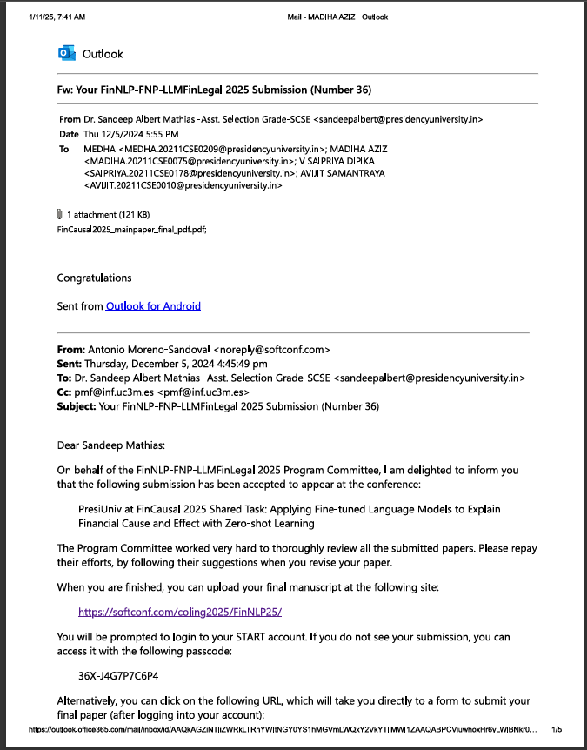
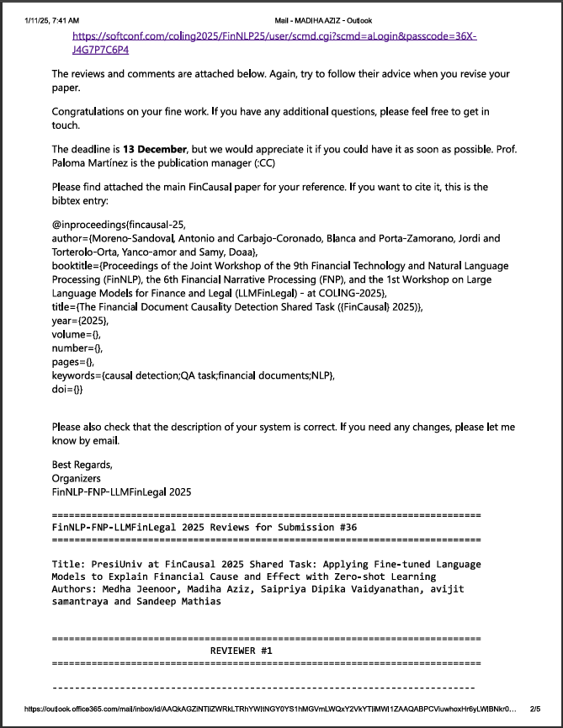
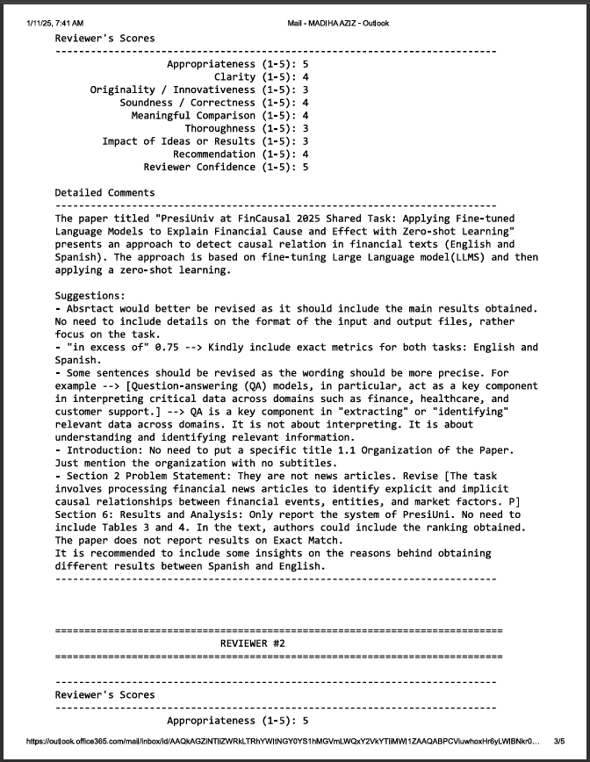
Publication Details
Acceptance Mail

Slide 31
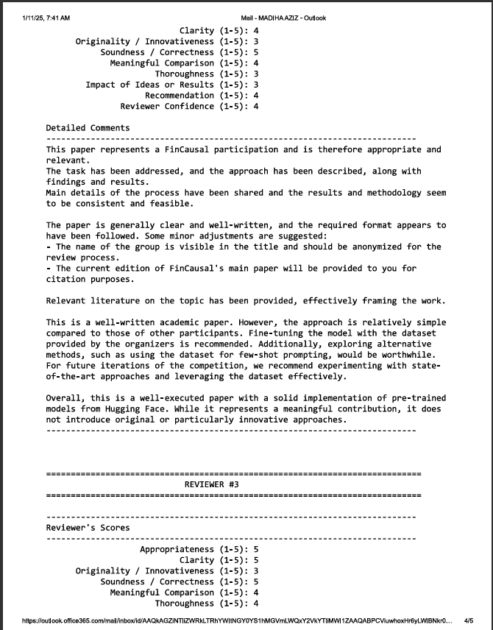
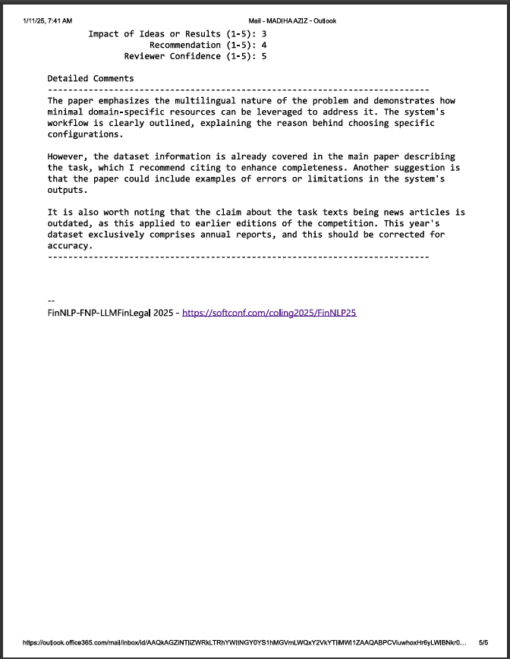
Publication Details

Slide 32
Achievements
The Joint Workshop of the 9th Financial Technology and Natural Language Processing (FinNLP), the 6th Financial Narrative Processing (FNP), and the 1st Workshop on Large Language Models for Finance and Legal (LLMFinLegal) is scheduled on 19th and 20th January, 2025.
Forty teams signed up, and half of them submitted datasets. In the end, 11 teams in each subtask (EN and ES) completed their submissions.

Slide 33
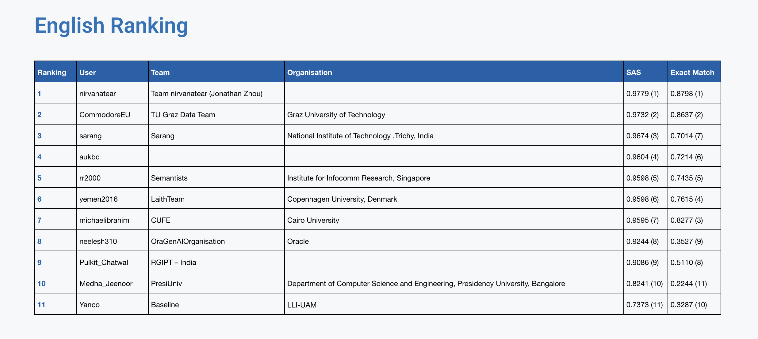
Achievements

Slide 34
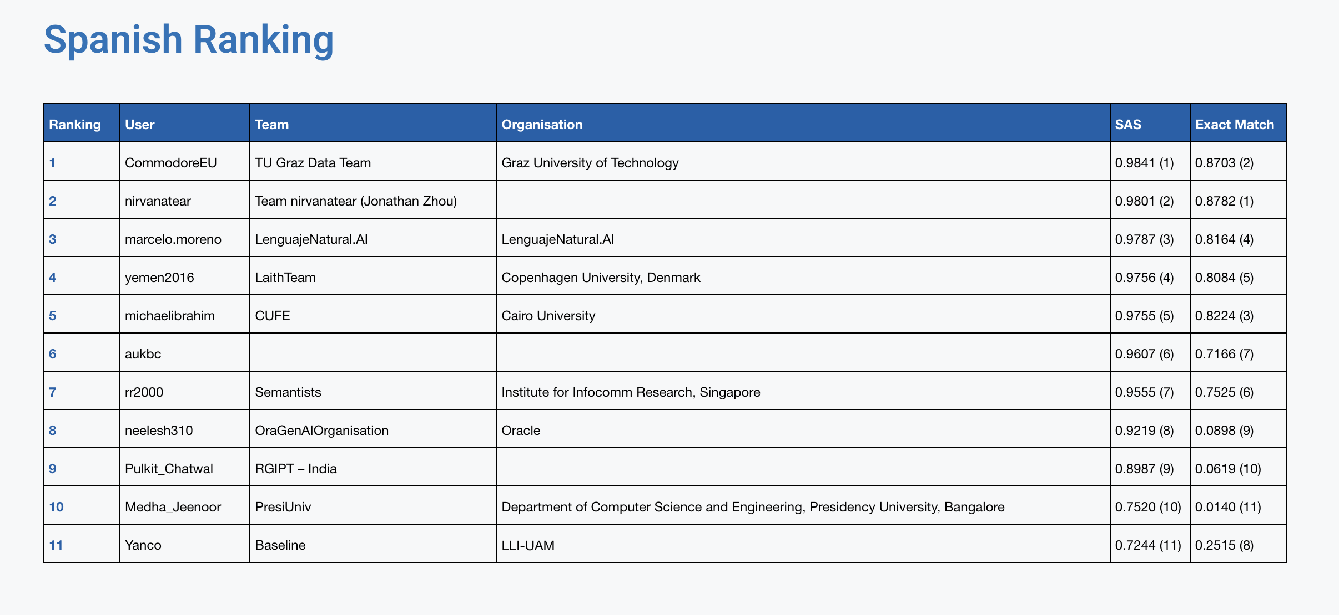
Achievements

Slide 35
Thank You

