Slide 1
Legal Document Summarization using Transformers
25GK24
Ritu Kumari 2301CS75
Pragya Mahajan 2302CS05
Parul Shrivastava 2301CS74

Slide 2
Roles & Responsibilities
Name | Role and Responsibilities
Ritu Kumari Singh | Preprocessing Lead Responsible for dataset selection, cleaning, tokenization, and visualization.
Pragya Mahajan | Modeling Lead & Research Specialist Responsible for the literature review, implementing the baseline summarization pipeline, and fine-tuning models.
Parul Shrivastava | Training & Evaluation Lead Responsible for developing the hybrid model, evaluating performance, and documenting results.

Slide 3
Introduction
Motivation
Objective
Problem Statement
1. Establish Baseline: Fine-tune BART on BillSum.
2. Develop Hybrid Model: Engineer a two-stage Extractive-Abstractive pipeline.
3. Quantitative Evaluation: ROUGE, BLEU, and BERTScore metrics.
We are driven by the need to create automated summarization systems that can produce accurate, factually complete and concise summaries of legal texts. Our work is a direct attempt to overcome the established flaw of information loss due to truncation in current models.
The legal domain is defined by lengthy and complex documents. This complexity makes manual analysis a time-consuming, expensive and inefficient process for legal professionals and the public, leading to significant information overload.

Slide 4
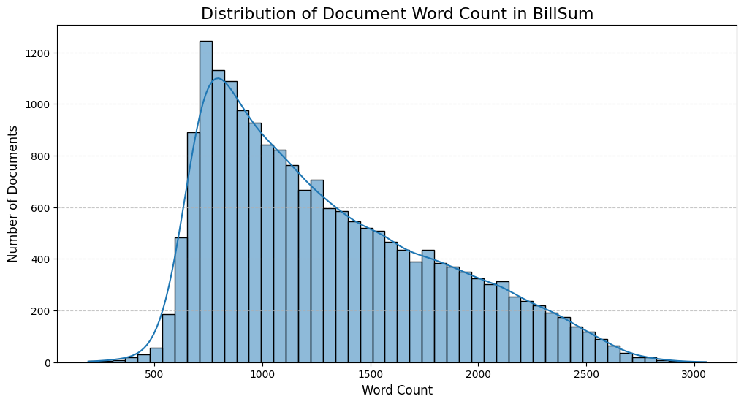
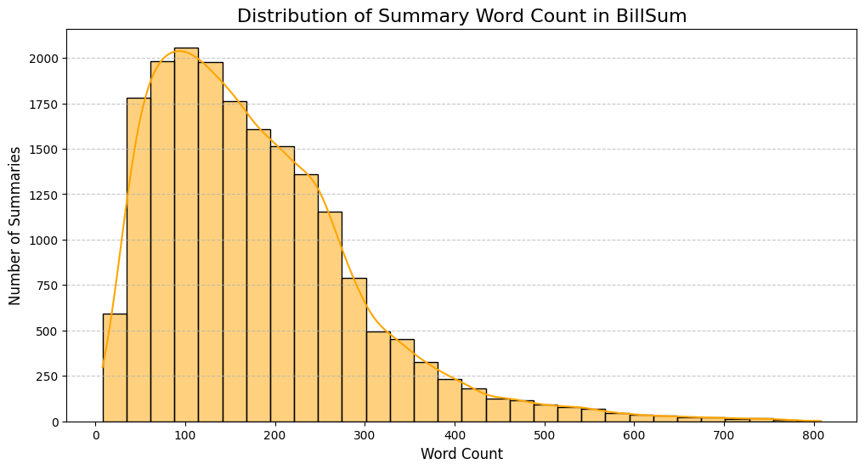
DataSet and Preprocessing
BillSum
18949
Dataset Name
Train data size
3269
1237
Test data size
CA test size
Source Text: Mean is high, with a large number of documents over 5,000 words.
Summary: Primarily concentrated between 100 and 300 words.
Preprocessing Strategy
Baseline
Hybrid
Simple Truncation
Intelligent Condensation
The input is tokenized and truncated at 512 tokens.
The full text is pre-processed by a dedicated extractive filter to select around 20 key sentences. This condensed text is then tokenized and padded to 1024 tokens.

Slide 5
Key Prior Work and Citations
BillSum
This corpus, introduced by Kornilova and Eidelman, serves as the primary dataset for this task. Prior summarization research had not focused on legislation. These documents are long, technical and complex, making it difficult for individuals to quickly process the key details
Extractive Methods
We looked at prior work by Klaus et al. on European laws. They successfully used a 'Hybrid' method, where they first used standard algorithms like TextRank to pre-filter important sentences before summarizing. This directly validates our plan to use an extractive front-end to improve our model's input quality.
BART Architecture
We selected BART as our baseline. It is a 'denoising' model designed specifically for text generation. In our main reference paper by Gurrapu et al., they explicitly concluded that BART generated the most fluent and human-like summaries compared to other models like T5, making it the strongest foundation for our experiments.

Slide 6
Gaps in Research
01
03
02
04
Information Loss Due to Truncation
Bias/Quality Issues in Data
BART and similar abstractive models must truncate long legal documents due to limited input token capacity (e.g. 512 tokens). This results in the loss of critical facts often found in the latter half of the legislation.
The greedy algorithm used to create extractive summaries for training on the EUR-LexSum corpus resulted in a highly imbalanced training set, yielding only 21 sentences instead of the desired 32. This lack of high-quality, balanced training data likely limited the performance of the fine-tuned Transformer models.
Sub-optimal Pure Extractive Summaries
Underexplored Hybrid Architecture
While extractive methods (like TextRank in the Klaus et al. study) solve the context issue and ensure factual correctness, their output can lack coherence and is not human-like.
Previous hybrid attempts (e.g., the simple TextRank pre-filtering in the Klaus et al. study) were basic and resulted in performance losses on certain ROUGE metrics, suggesting the need for more sophisticated neural combinations.

Slide 7
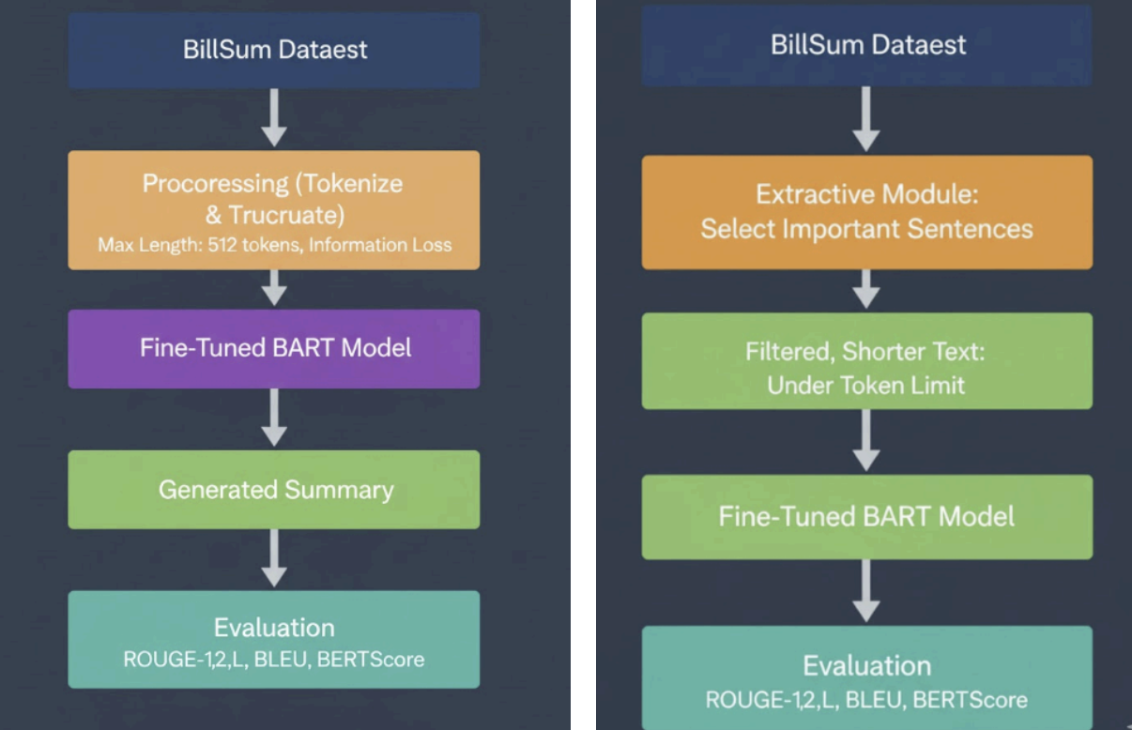

Baseline Model
BART Base
Parameter | Value
Max Input Length | 512 tokens
Max Output Length | 128 tokens
Batch Size | 16
Epochs | 3
Learning Rate (LR) | 3 * 10 -5
The BillSum source text is fed directly into the BART tokenizer.
The tokenizer is forced to cut the document off at a hard limit of 512 tokens (or the model's max context size).
The vast majority of BillSum documents are longer than 512 tokens. This results in the loss of critical information and provisions located after the truncation point.
Epoch | ROUGE-1 | ROUGE-L | BERTScore | BLEU Score
3 | 0.5013 | 0.3948 | 0.8887 | 26.57
Epoch | ROUGE-1 | ROUGE-L | BERTScore | BLEU Score
4 | 0.5046 | 0.3973 | 0.8894 | 27.18
Notes:
(High BLEU): The BLEU score of 26.57 confirms that BART successfully generates grammatically correct, fluent, and human-like sentences. This meets BART's primary strength.
Low Factual Overlap (ROUGE & BERTScore): The scores for ROUGE (content overlap) and BERTScore (semantic similarity) are the lowest of all models in the project.

Slide 8
Hybrid Model
BERT - Hybrid
Parameter | Value
Max Input Length | 1024 tokens
Max Output Length | 128 tokens
Batch Size | 8
Epochs | 4
Learning Rate (LR) | 5 * 10 -5
Procedure:
Find “Center”: Reads entire long document and to understand overall context and find center for all the document's topics.
Score Sentences: Scores every sentence based on how close they are to that "center."
Pick the Winners: It returns the sentences with the highest scores (e.g., your 20 best sentences).
Fine Tuning: Top sentences are then fine tuned by Bart to generate abstractive summary.
Model | ROUGE-1 F1 | ROUGE-L F1 | BERTScore F1 | BLEU Score
BERT Hybrid | 0.5091 | 0.4018 | 0.8917 | 26.63
The filtered text contains the 20 most factually informative sentences, focusing on key provisions and changes.

Slide 9
Hybrid Model
SBERT - Hybrid
Parameter | Value
Max Input Length | 1024 tokens
Max Output Length | 128 tokens
Batch Size | 8
Epochs | 4
Learning Rate (LR) | 5 * 10 -5
Procedure:
Find the Main Idea: Read sentences to convert it into "vector" (a list of numbers) that represents its meaning then averages all vectors to create one "average vector"representing main idea.
Find Similar Sentences: Uses a math calculation (cosine similarity) to find the sentences whose vectors are closest to the document's "average vector".
Pick the Winners: Returns the top-scoring sentences.
Fine Tuning: Top sentences are then fine tuned by Bart to generate abstractive summary.
Model | ROUGE-1 F1 | ROUGE-L F1 | BERTScore F1 | BLEU Score
SBERT Hybrid | 0.5111 | 0.4013 | 0.8913 | 27.03
The filtered text contains the 20 most thematically central sentences, forming a cohesive input.

Slide 10
Conclusion
Hybrid Model Superiority: Both hybrid models (BERT-Hybrid and SBERT-Hybrid) consistently outperformed the 512-token Baseline across all ROUGE metrics (ROUGE-1 F1 and ROUGE-L F1), validating the effectiveness of using an intelligent extractive step for long document summarization.
Highest Content Overlap (ROUGE-1): The SBERT-Hybrid model achieved the highest content overlap with human-written summaries, scoring a ROUGE-1 F1 of 0.5111.
Best Factual Recall (ROUGE-L): The BERT-Hybrid model showed the highest recall for long factual sequences, with a ROUGE-L F1 of 0.4018.
Best Semantic Equivalence (BERTScore): The BERT-Hybrid model also achieved the highest semantic similarity to the reference summaries, with a BERTScore F1 of 0.8917.
Semantic Centrality is Key: The overall best-performing model, SBERT-Hybrid, used semantic centrality for pre-filtering, confirming that selecting the most thematically relevant sentences is the optimal strategy.

Slide 11
Future Work
Test on State Laws: Currently, we only use US Federal laws. Future work should test our model on the California bills dataset to see if it works equally well on different types of state-level legal documents.
Try Other Base Models: We only used standard BART as our baseline. We should also apply our hybrid approach to other models, like Longformer (LED) or T5, to see if it improves their performance too.

Slide 12
References
Papers
[1] N. Gurrapu et al., "Effective Summarization Techniques for Legal Document Analysis," in 2025 4th International Conference on Sentiment Analysis and Deep Learning (ICSADL), 2025.
[2] S. Klaus et al., "Summarizing Legal Regulatory Documents using Transformers," in Proceedings of the 45th International ACM SIGIR Conference on Research and Development in Information Retrieval, 2022.
[3] M. Lewis et al., "BART: Denoising Sequence-to-Sequence Pre-training for Natural Language Generation, Translation, and Comprehension," in Proceedings of the 58th Annual Meeting of the Association for Computational Linguistics, 2020.
[4] M. Korn, "BillSum: A Corpus for Automatic Summarization of US Legislation," in Proceedings of the 2nd Workshop on New Frontiers in Summarization, 2019.
Dataset
BillSum - The corpus used for automatic summarization of US Congressional and California state legislation, defining the task domain.
Model, Tools and techniques
Google Colab, BART, BERT, SBERT

Slide 13
Thank You!!

