Slide 1
TEMpcPlot
11171 lines of code
Three contributor
7 releases
PURE PYTHON

Slide 2
Where is the information
Site
https://prestipino.github.io/TEMpcPlot/
Detailed information on the command wiki https://github.com/Prestipino/TEMpcPlot/wiki
Direct on the shell
help(object.command)

Slide 3
Structure of the software
SeqIm aka Sequence of images
a structure that contain the infos related to the sequence of images
EwaldPeaks aka set of three-dimensional peak positions
it is create from a SeqIm object and became the attribute Name.EwP
but it could also live alone.

Slide 4
SeqIm
Could be created from a sqi file
Cr2Sn3S7 = TEMpcPlot.SeqIm(“ref.sqi”)
Could be loaded from saved project *sqm file
Cr2Sn3S7 = TEMpcPlot.SeqIm.load(“ref.sqmi”)
# second reconstitution (crystal4)
Cr2Sn3S7_29nov21_0036.dm3 6.0 28.1
Cr2Sn3S7_29nov21_0035.dm3 5.5 19.6
Cr2Sn3S7_29nov21_0034.dm3 5.2 12
Cr2Sn3S7_29nov21_0033.dm3 4.7 4.6
Cr2Sn3S7_29nov21_0032.dm3 4.1 -2.0
Cr2Sn3S7_29nov21_0028.dm3 4 -7.9
Cr2Sn3S7_29nov21_0029.dm3 3.7 -12.8
Cr2Sn3S7_29nov21_0030.dm3 3 -20.9
Cr2Sn3S7_29nov21_0031.dm3 2 -26.6

Slide 5
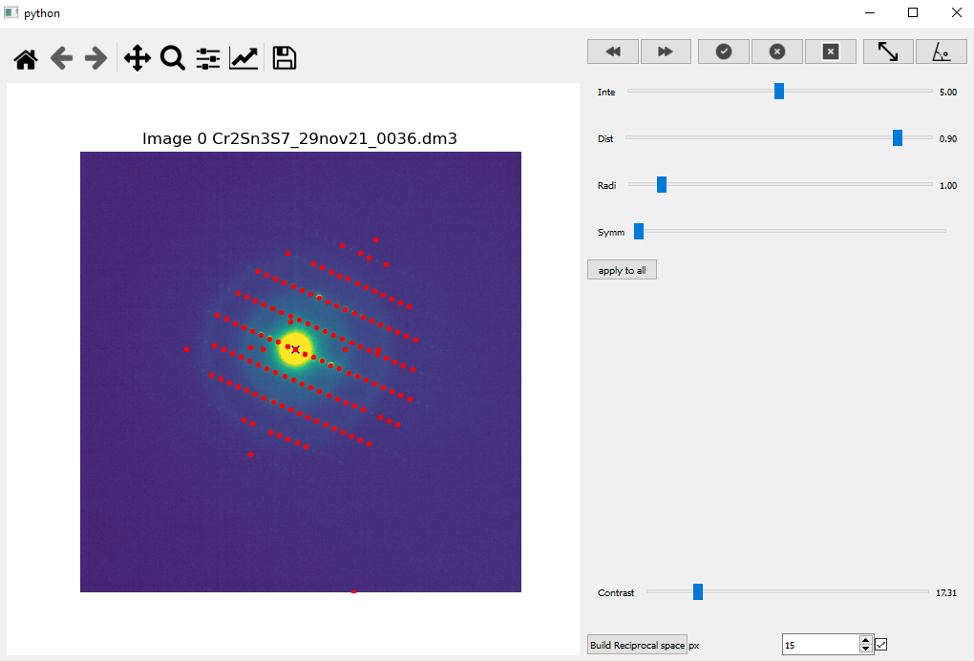
SeqIm PLOT and find peaks
Cr2Sn3S7.plot()
Change
Image
Peaks
tool
Measurement
tool
Image Zoom
Find peak parameter
Creation of Ewald Peaks

Slide 6
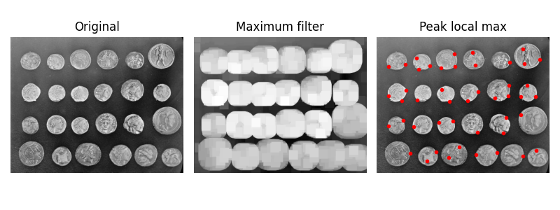
SeqIm PLOT find peaks
Cr2Sn3S7.find_peaks()
The algorithm for peaks finding is based on maximum filter.
The intensity of each pixel is replaced by the maximum intensity present in a square around the pixel
The pixels that have not changed intensity are local maxima
The peaks are filtered for minimum intensity and distance from the center
Optionally are filtered by inversion center. (0 pixel tolerance mean no symmetry)
Minimal intensity (% of maximum)
Distance from the center
Size of the square in filtering (% of size of maximum)
define as close could be the peaks

Slide 7
SeqIm PLOT and Creating Ewald Peaks object
Cr2Sn3S7.D3_peaks ()
Change
Image
Peaks
tool
Measurement
tool
Image Zoom
Find peak parameter
Creation of Ewald Peaks

Slide 8
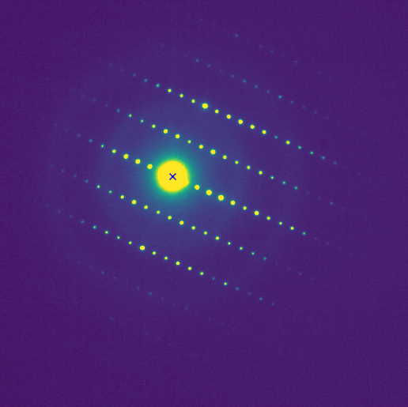
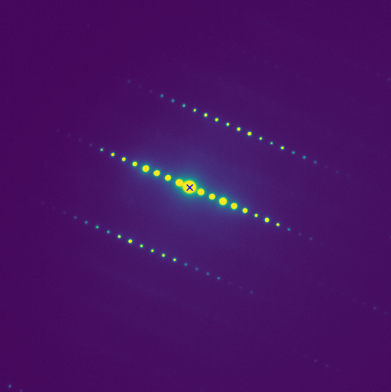
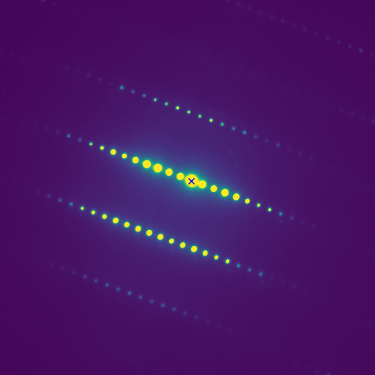
SeqIm PLOT and Creating Ewald Peaks object
Cr2Sn3S7.D3_peaks()
The algorithm to transform a series of 2D peaks in a 3D set.
Identification of the rotation axis
The peaks are translate to align all images to the same center
Only peaks present in all images in a tolerance are conserved
The peaks are filtered by a ransac linear fit (same pixel tolerance)
For each image the remain peaks are fit by a line
Corrections(fist image is considered the reference)
Each image is rotate to align the fitted lines
Optionally image are optimized for scale and translation.
The peaks are rotate along the refined axis of the magnitude
and order calculated from peaks
Do it
Pixel tolerance
Cr2Sn3S7.EwP
Scale images

Slide 9
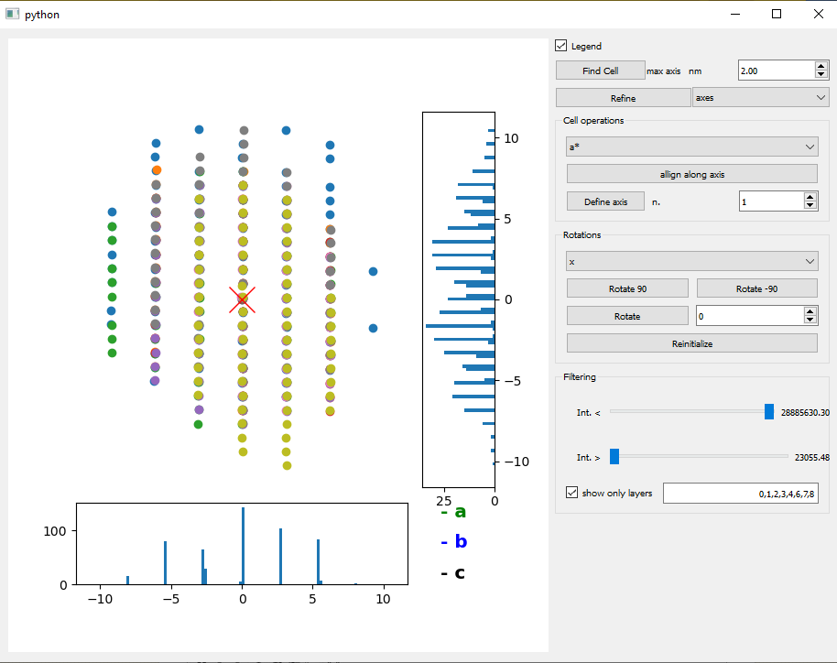
EwaldPeaks
Cr2Sn3S7.EwP.plot()
Auto find cell and refine
Manual find cell
Controlled rotation
3D peaks projection
Peaks filtering
Projection along x and y axes

Slide 10
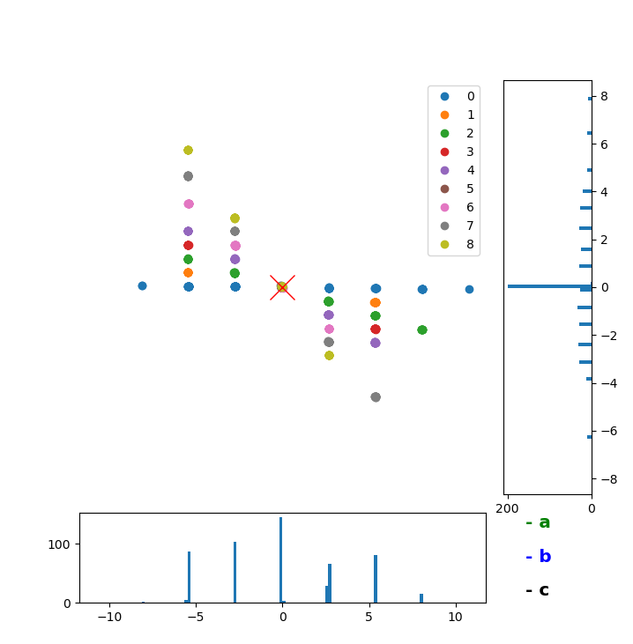
EwaldPeaks PLOT
Cr2Sn3S7.EwP.plot()
Each plane presents a different color, clicking on legend show the legend
Left click and drag for rotation
Ctrl + left click and drag constrain rotation around the z axis
Right click perform zoom
Projection along x and y axes
Higher and more isolated peaks
Better is the alignment

Slide 11
EwaldPeaks
Cr2Sn3S7.EwP.plot()
Auto find cell and refine
Manual find cell
Controlled rotation
3D peaks projection
Peaks filtering
Projection along x and y axes

Slide 12

EwaldPeaks indexing and refine
Maximum cell length
Cr2Sn3S7.EwP.find_cell()
The find cell algorithm is based on the research the largest vectors indexing the peaks. More in detail:
1) For each set of peaks associated to one image the couple of the two smallest vector able to index the higher number of peaks is maintained.
2) All the couple of vector are combined in order to find the smaller vectors that could index the most of all the peaks.
3) The most important parameter is the maximum length of the cell.
4) The find cell algorithm presents very loose requirement
Cr2Sn3S7.EwP.refine_axes() Refine cell as triclinic
Cr2Sn3S7.EwP.refine_angles() Refine goniometer angles
Cr2Sn3S7.EwP.refine_axang() Refine gonio angles and cell
The refines commands pass following several step:
Only the peaks indexed with a maximum tolerance of 10% (variable on the shell command) are selected.
The reciprocal cell components are optimized in order to minimize the sum of the residuals indexing for the selected peaks
The optimized cell is used to try to re-index all the peaks
Reciprocal cell component are stored in object.EwP.axes
Reals space cell is stored in stored in object.EwP.cell

Slide 13
EwaldPeaks
Cr2Sn3S7.EwP.plot()
Auto find cell and refine
Manual find cell
Controlled rotation
3D peaks projection
Peaks filtering
Projection along x and y axes

Slide 14
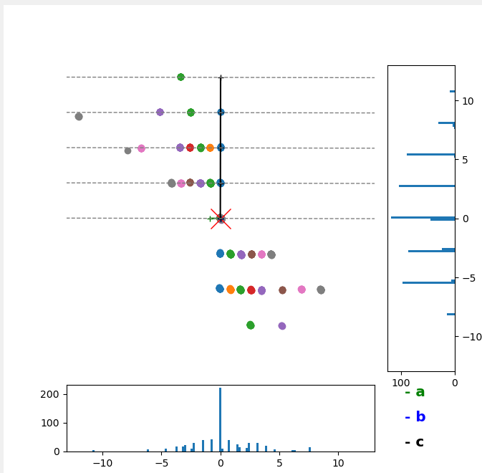
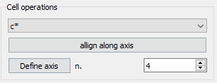
EwaldPeaks manual indexing and allignement
It is possible also to manually indexing the cell drawing the reciprocal cell parameters. In such case the parameter is drawn on the xy plane with z value =0.
In this contest is very important align at best the peaks i.e. sharp projection on the sides

Slide 15
EwaldPeaks
Cr2Sn3S7.EwP.plot()
Auto find cell and refine
Manual find cell
Controlled rotation
3D peaks projection
Peaks filtering
Projection along x and y axes

Slide 16
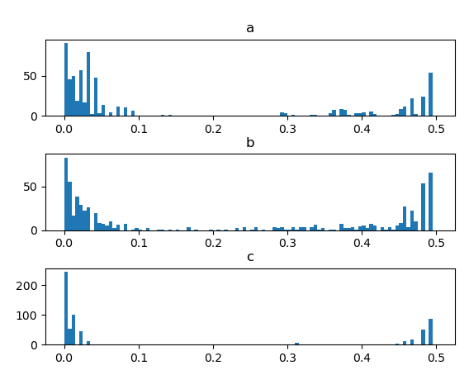
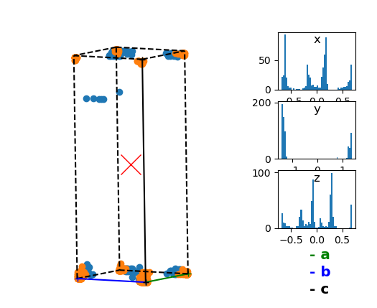
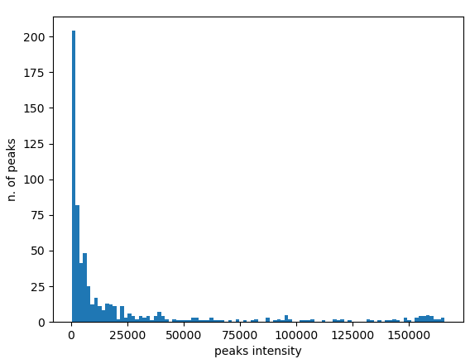
EwaldPeaks reduced cell
Cr2Sn3S7.EwP. plot_proj_int()
Cr2Sn3S7.EwP.plot_reduce()
Useful to check missing peaks and possible incommensurate modulation
Cr2Sn3S7.EwP. plot_int()

Slide 17
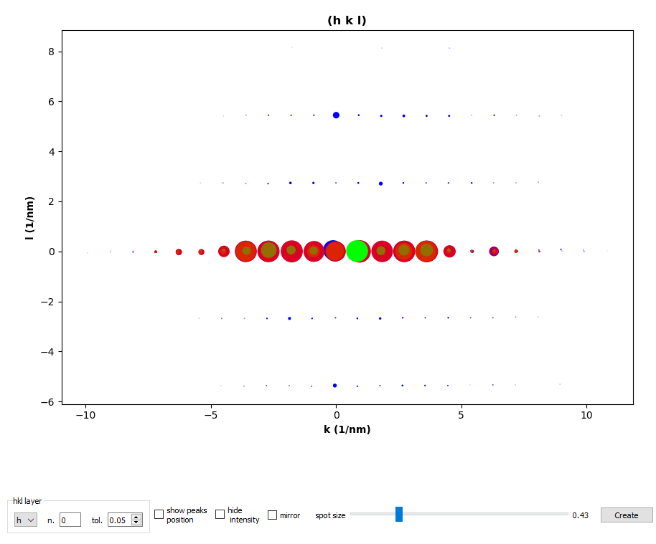
EwaldPeaks create layer
Cr2Sn3S7.EwP.create_layer()
Allows to plot a cut perpendicular to a reciprocal
space axes

Slide 18
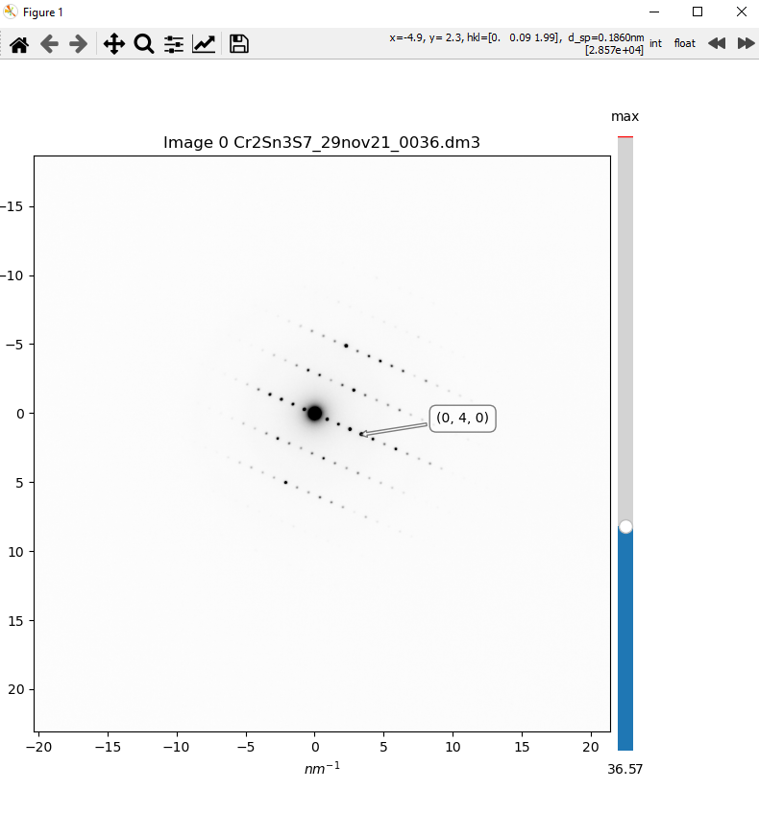
SeqIm Plot Calibrated images
Cr2Sn3S7.plot_cal()
Plotting of the used images calibrated
Possible to identifies the present peaks as integer or float

