Slide 2
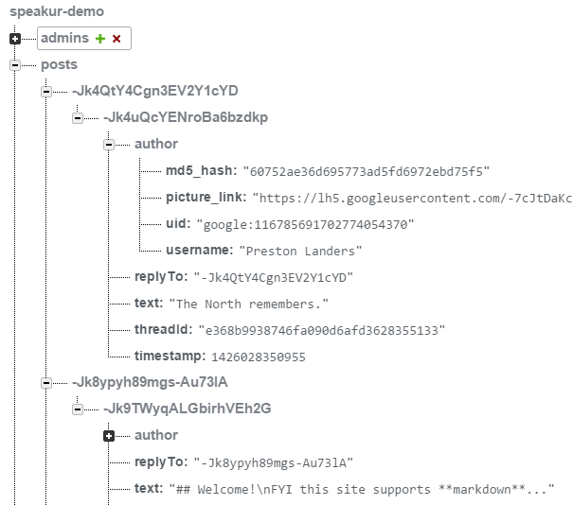
Table name
}
Parent ID
Key Structure
Post ID
Parent ID (again)
post text

Slide 3
<speaker-discussion> (top level component)
<speaker-profile> (user settings)
<speaker-thread-view> (contains entire thread)
<speaker-i18next> (translation helper)
<speaker-compose>
<speaker-post-set> (top level reply set)
<header class="thread-header">
<textarea>
<speaker-post
id="post-1">
<speaker-post
id="post-2">
standard HTML
<speaker-post-set> (replies to post 2)
custom element
...
Legend

