Slide 2
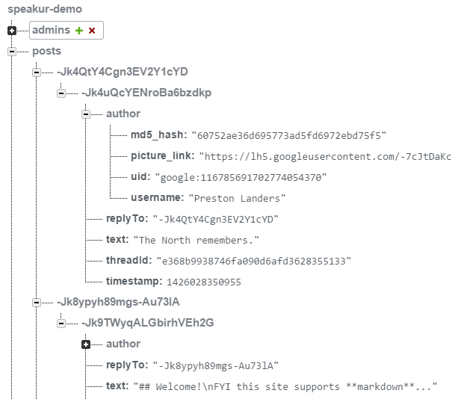
Table name
}
Parent ID
Key Structure
Post ID
Parent ID (again)
post text

