Slide 2
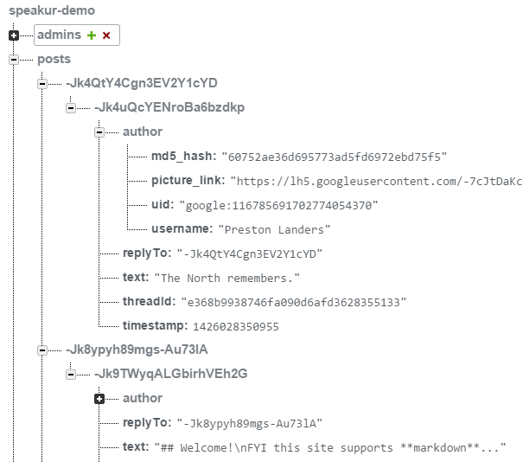
Table name
}
Parent ID
Key Structure
Post ID
Parent ID (again)
post text

Slide 3
<speaker-discussion>
<speaker-profile>
<speaker-thread-view>
<speaker-i18next>
<speaker-compose>
<speaker-post-set> (top level reply set)
<header class="thread-header">
<textarea>
<speaker-post
id="post-1">
<speaker-post
id="post-2">
standard HTML
<speaker-post-set> (replies)
custom element
...
Legend

