Slide 1
Chapter 13: Exploring the Tools of GAN Performance Evaluation
Week 7: (03/04/2022)
Team Lead: Durant Fullington
GANS DIS Spring 2022

Slide 2
Recap: Last Week
The last two weeks the topics have been:
GAN Failure Modes
GAN Evaluation Metrics
GAN Failure Modes:
1. Mode Collapse:
Generator specific failure
Characterized by the inability of the generator to produce a diverse set of output images from the latent space
Identified by output containing repeating patterns of identical images or a cyclic pattern present within the training loss of the generator
2. Convergence Failure
Total GAN model failure
Characterized by the inability of the GAN model to find a balance between the discriminator and the generator
Identified by output images appearing as noise (low quality) and through evaluating the generator/discriminator loss.
Discriminator Loss goes to quickly to zero and the generator loss gradually increases throughout training
There are over 24 different metrics listed as potential methods of evaluating the performance of the GAN model
From these different metrics, Inception Score and the Frechet Inception Distance are the two most popular

Slide 3
Objective
Chapter 12: How to Implement the Inception Score
What is the Inception Score(IS)
How to Calculate the IS
Quick Application of Code
Chapter 13: How to Implement the Fréchet Inception Distance
What is the Fréchet Inception Distance (FID)
How to Calculate the FID
Quick Application of Code
In addition, we will also discuss how we can use some of the 24 different metrics previously discussed
The Inception Score and the Frechet Inception Distance are the two most widely used metrics, therefore these will be the starting point for our discussion

Slide 4
What is the Inception Score
The inception score (IS) is an objective metric used for evaluating the quality of generated images.
This methodology was specifically developed and implemented on the synthetic images generated from GANs.
Why was it Developed?
Traditionally, GANS were really only able to be evaluated subjectively by providing a human review of generated images.
This of course led to increased risk of variation and bias in the evaluation of GAN performance.
The inception score was developed to remove the problems associated with subjective human evaluation. This provides a objective scoring that correlates with the traditional human subjective scoring.

Slide 5
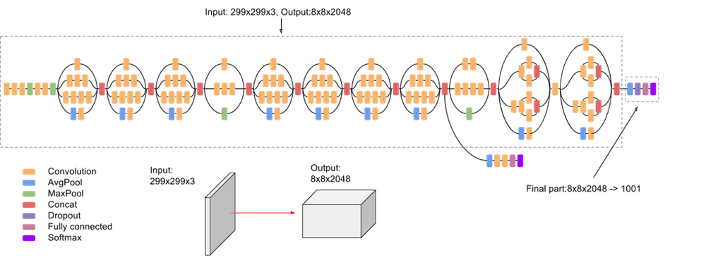
What is the Inception Score
The IS is derived from the use of an external classification model to evaluate generated images
This model is known as an Inception model, as it takes images as input and returns a probability distribution
In particular, the Inception V3 model developed by Christian Szegedy, et al. in their 2015 paper: Rethinking the Inception Architecture for Computer Vision.

Slide 6
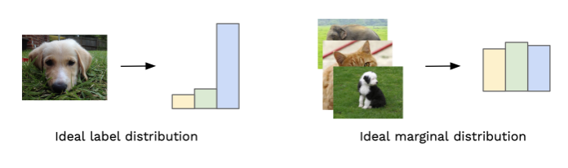
How Does the Inception Score Work?
There are two main properties at the center of IS:
Image Quality, do the images look real (do they distinctly look like something)?
Image Diversity, do the images have variety?
What is the output from the IS?
The Inception Score provides a value where the lowest score is a 1 and the highest score is equal to number classes in the dataset
The higher the score, the better the performance of the Generative Model
By comparing the label distribution and Marginal label distribution, we can develop the IS score
For each generated image we want to achieve a distribution of class labels like the “Ideal Label Distribution”
While we simultaneously want the collection of images to have diversity or the “Ideal Marginal Distribution”

Slide 7

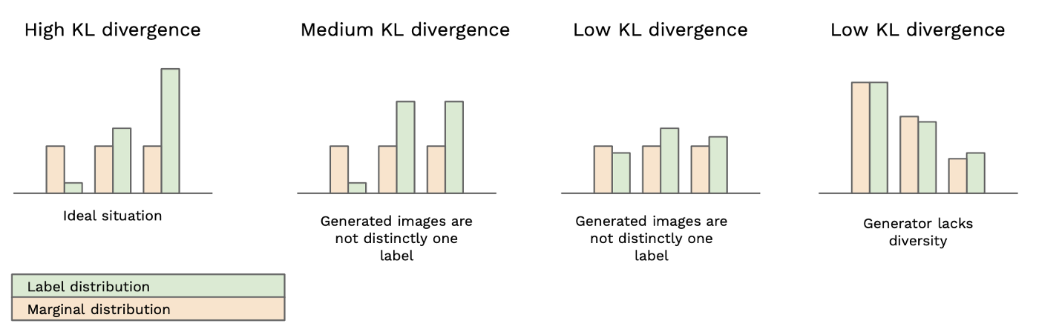

How to Calculate the Inception Score
To produce the IS, we leverage the statistics formula called the Kullback-Leibler (KL) divergence
The KL divergence is a measure of how similar/different two probability distributions are.
The equation in the end is the conditional probability minus the probability of that class.
Note:
log probabilities are easier and faster for computers to compute.
$$p\left(y | x\right)=Conditional probability of each image$$
$$p\left(y\right)=Probability for images in the group$$

Slide 8
Limitations of the Inception Score
The Inception Score is effective, but not perfect
There are a few limitations to the IS:
The score is limited to what can be captured by the inception model
This is characteristic of any external classifier used for this purpose…
2. The Inception V3 model is pre-trained for 1,000 classes
We do not need all of the information learned about objects not contained in our dataset
3. The Inception V3 Model also requires relatively small images (300x300) that must by symmetric (Square)
For GANS that do not have control over the class of object generated, it is hard to get an even number of
samples with a good distribution

Slide 9
What is the Fréchet Inception Distance
The Fréchet Inception Distance (FID) is another metric developed to evaluate the performance of GAN models
It was developed as an improvement over the inception score and calculates the distance between feature vectors of real data and generated data.
The previous method, IS, does not capture how the synthetic (generated) images compare to the original images
The goal in developing the FID score was to evaluate synthetic images based on the statistics of a collection of synthetic images compared to the statistics of a collection of real images from the target domain.

Slide 10
How Does the Fréchet Inception Distance Work?
Like the inception score, the FID score uses the inception v3 model.
This is focused on the coding layer of the model (the last pooling layer prior to the output classification of images)
This layer is used to capture computer-vision-specific features of an input image.
These activations are calculated for a collection of real and generated images.
They are summarized as a multivariate Gaussian by calculating the mean and covariance of the images.
The distance between these two distributions (real and fake) is then calculated using the Frechet distance
(also called the Wasserstein-2 distance.)

Slide 11
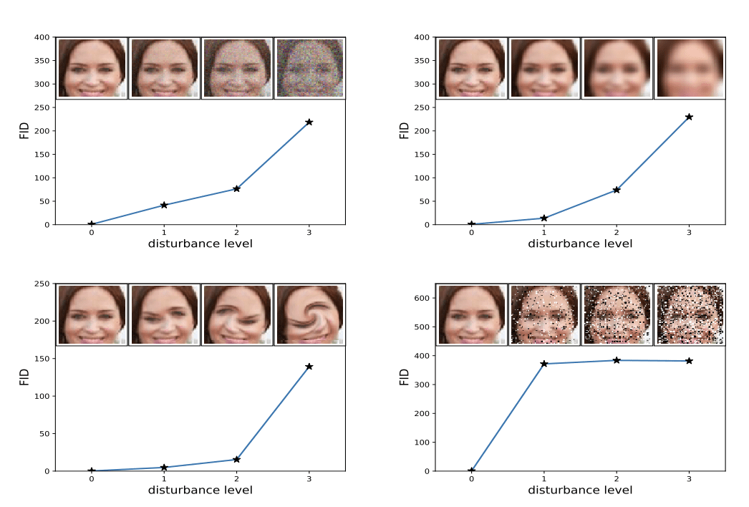
How Does the Fréchet Inception Distance Work?
A lower FID score indicates better-quality images
A higher FID score indicates a lower-quality image (and the relationship may be linear)

Slide 12
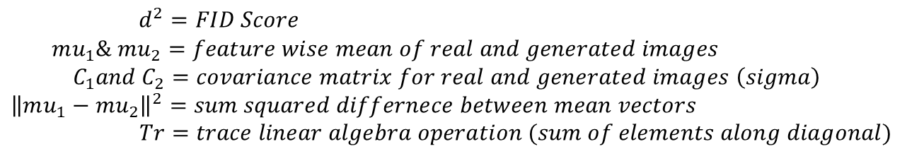
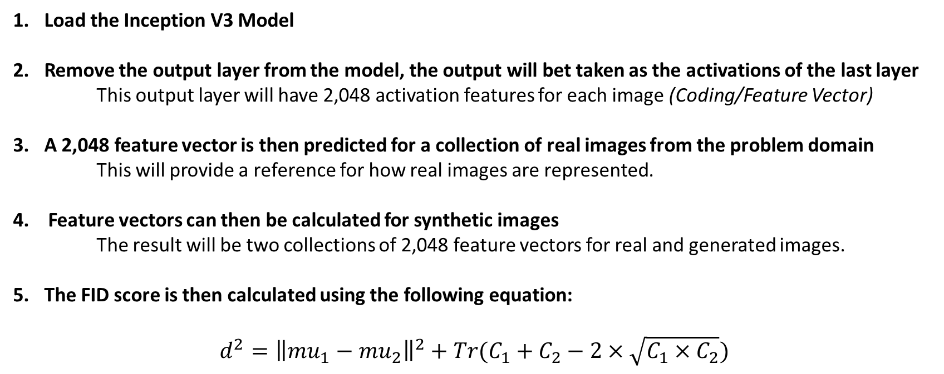
How to calculate Fréchet Inception Distance?
Load the Inception V3 Model
Remove the output layer from the model, the output will bet taken as the activations of the last layer
This output layer will have 2,048 activation features for each image (Coding/Feature Vector)
A 2,048 feature vector is then predicted for a collection of real images from the problem domain This will provide a reference for how real images are represented.
4. Feature vectors can then be calculated for synthetic images
The result will be two collections of 2,048 feature vectors for real and generated images.
The FID score is then calculated using the following equation:
$$d^{2}={\left\|mu_{1}−mu_{2}\right\|}^{2}+Tr(C_{1}+C_{2}−2×\sqrt{C_{1}×C_{2}})$$
$d^{2}=FID Score$
$$mu_{1}\& mu_{2}=feature wise mean of real and generated images$$
$${ C}_{1}and C_{2}=covariance matrix for real and generated images \left(sigma\right)$$
$${\left\|mu_{1}−mu_{2}\right\|}^{2}=sum squared differnece between mean vectors$$
$$Tr=trace linear algebra operation (sum of elements along diagonal)$$

Slide 13
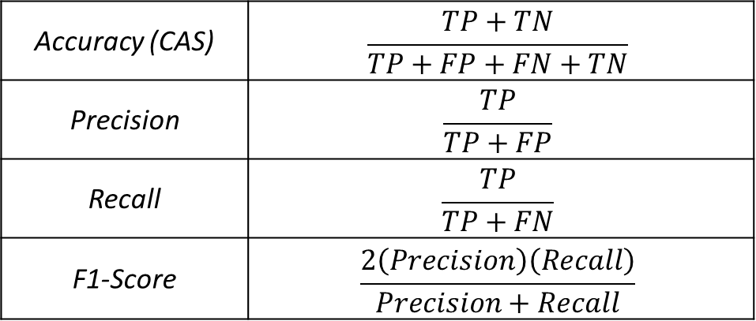
Classification Metrics
For GANS that allows us to control the output class label:
Conditional GANS (cGANS)
Auxiliary Classifier GANS (AC-GANS)
These GANS allow the user to specify the output class label of the generated images, giving us more control over the GAN.
From here, a simple and intuitive way to evaluate the quality of the output images is through traditional classification metrics:
The IS and FID are also useful for these types of GANs
Accuracy (CAS) | $$\frac{TP+TN}{TP+FP+FN+TN}$$
Precision | $$\frac{TP}{TP+FP}$$
Recall | $$\frac{TP}{TP+FN}$$
F1-Score | $$\frac{2\left(Precision\right)\left(Recall\right)}{Precision+Recall}$$

Slide 14
Other Metrics to consider
One of the biggest evaluation criteria is the output image QUALITY from the GAN model
Other metrics outside of the FID and IS include:
Peak-Signal-to-Noise Ratio (Evaluating the level of Noise in the generated images)
Sharpness Difference (Evaluating the sharpness of generated images, i.e. looking for distortions)
Reconstruction Errors (Evaluating the capabilities of GANs to reconstruct original images)
There are also Metrics for evaluating the output distribution to verify DIVERSITY in the output images.
Other metrics outside of IS and FID include:
Density and Coverage Metrics: These results are used as replacements or additions to the traditional classification metrics as they improve the ability to further evaluate the diversity of the images generated
Geometry Score: This incorporates a topological approach to evaluating the difference between the characteristics of the original and generated datasets. This score does not require the use of an auxiliary classifier
Generative Adversarial Metric (GAM): Basically an adversarial metric that leverages coemption between GAN models to improve the GAN performance

Slide 15
Questions?
Next week we will wrap up the discussion on general GANs by evaluating the loss functions
After that we want to discuss Conditional GANs in detail, and leave the remaining weeks open to summarize the remaining types of GAN models and discuss research potentials

