Slide 1
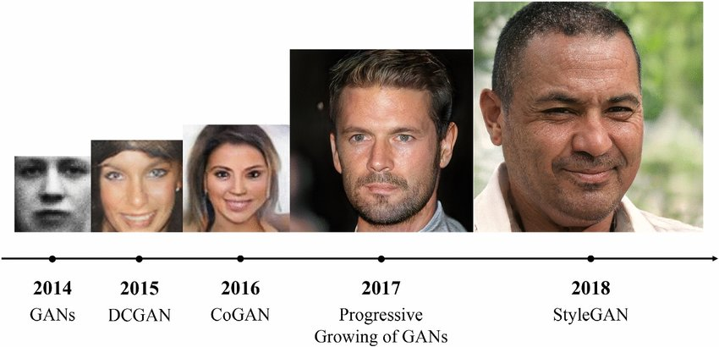
Introduction to GANS
Week 1: (01/28/2022)
Week Lead: Durant Fullington
GANS DIS Spring 2022

Slide 2
Meeting Overview
Chapter 1: Introduction to GANS
What are Generator Models?
Unsupervised v. Supervised Learning
Discriminative Modeling v. Generative Modeling
What are GANs?
GANs: Generator Model, Discriminator Model, Combination
CNN’s Role in GANs
Conditional GANs
Why GANs?
Chapter 2: Keras Refresher
Keras Model Life Cycle
Keras Functional Network Structures
Standard Network Examples

Slide 3
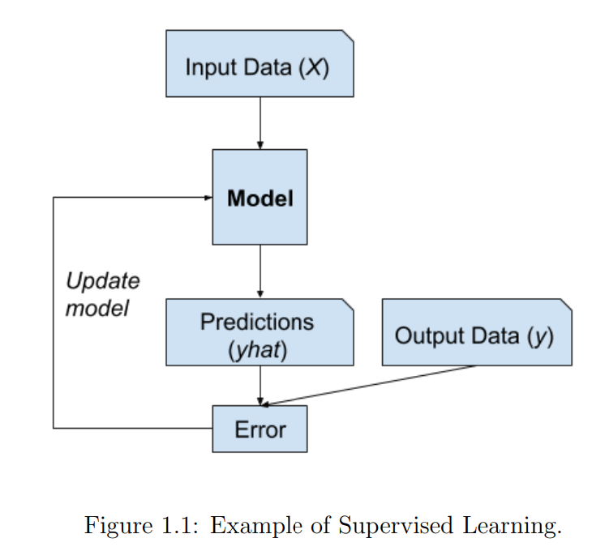
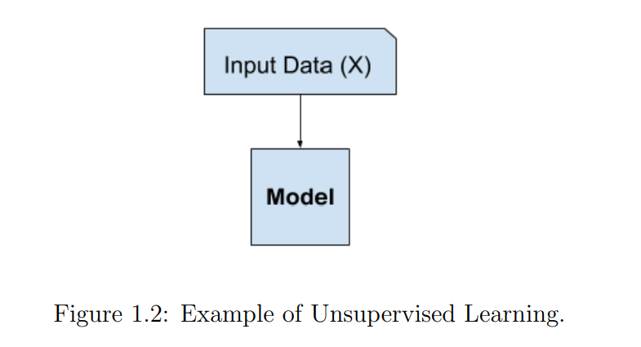
What are Generative Models?
Supervised Learning
Unsupervised Learning
Traditional Form of Machine Learning where there is an input (X) and a known output (y) for each sample
Unsupervised models are given no correction values (y), only an input (X). These models learn by identifying patterns in the input (X)
Classification, Regression
Clustering, Generative Modeling

Slide 4
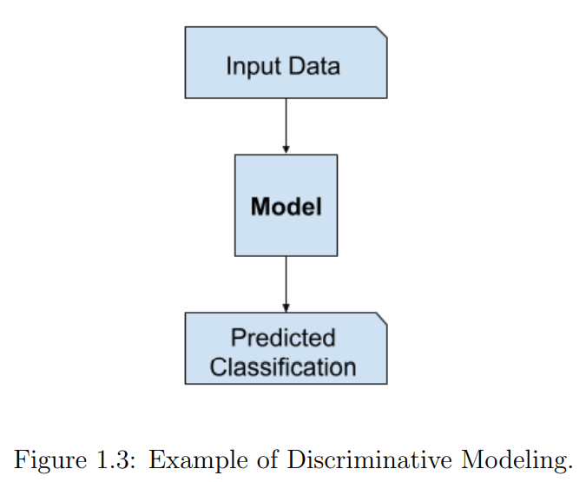
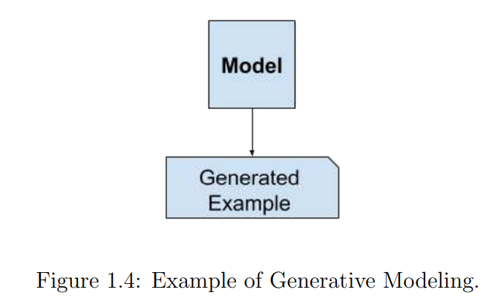
What are Generative Models?
Discriminative Modeling
Generative Modeling
Discriminative modeling is equivalent to classification. The model must decide which class a test sample belongs to.
Generative Modeling is not used for predicting a class but is used for generating new samples within the input data distribution.
Examples:
Naïve Bayes
LDA
Deep Learning*

Slide 5
What are GANS?
GANS = Generative Adversarial Networks
GANS are a deep-learning-based generative model, more specifically they are an architecture for training deep generative models.
They provide a clever way of training a generative model by framing the problem as a supervised learning problem with two sub-models….
GANS contain two main sub-models:
Generator: a generator model for generating new examples
Discriminator: a discriminator model for classifying whether generated examples are:
real (from the domain) or fake (generated by the generator model).

Slide 6
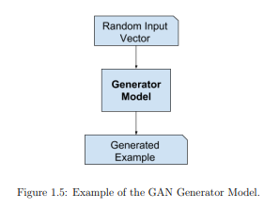
What are GANS: Generators
Generator Model:
The Generator Model takes a fixed-length random vector as input and generates a sample output
Basically, the generator develops synthetic images based from a latent space that is descriptive of the latent variables that are present in the real image dataset domain
The generator to applies meaning to points within the latent space, and then be used to generate different output examples.
After training and finalizing the GAN, the generator is kept and used to generate new samples.

Slide 7
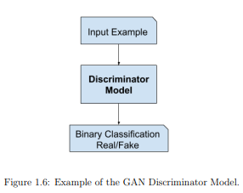
What are GANS: Discriminators
Discriminator Model:
The Discriminator model takes a sample from the problem domain as input(this can be either real or synthetically generated)
Predicts the binary class label: (Real or Fake)
After Training the entire GAN model, we generally discard the discriminator

Slide 8
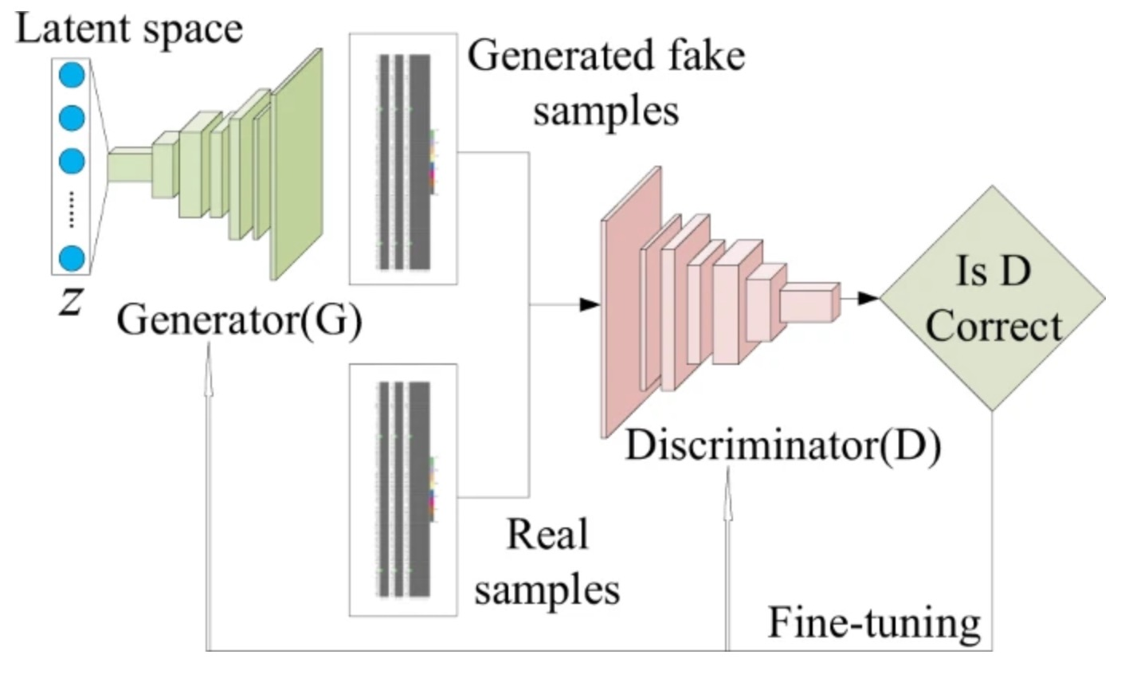
What are GANS: The Big Picture
Together, the goal is for the generator to defeat the Discriminator by creating images that cannot be distinguished from the real images
The two models are competing against each other.
They are adversarial in the game theory sense
(playing a zero-sum game.)
When the discriminator correctly identifies samples,
The Discriminator is rewarded
The generator is penalized with large updates to model parameters.
When the generator fools the discriminator
The Generator is rewarded.
The discriminator is penalized and its model parameters are updated

Slide 9
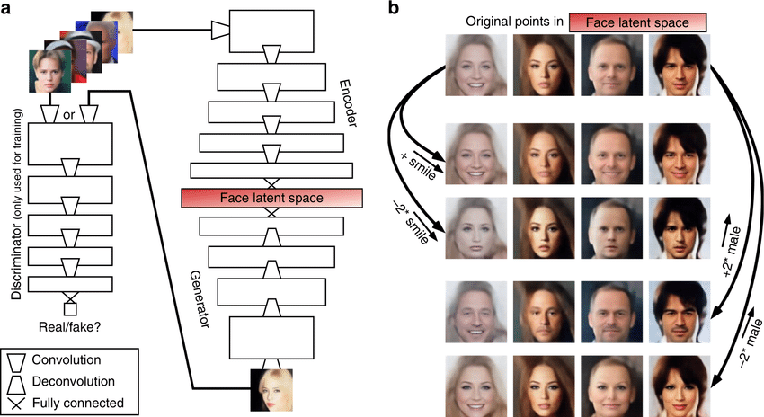

Slide 10
What are GANS: GANS and CNNs
GANS and CNNs
Typically, GANS are used with image data and leverage CNNs for their Discriminator and Generator Models, for two reasons:
The latent space, the input to the generator, provides a compressed representation of the set of images used to train the model.
It also means that the generator generates new images, providing an output that can be easily viewed and assessed by developers or users of the model.
These benefits are one of the main reasons that CNNs are leveraged for GANS

Slide 11
What are GAN: Conditional GANs
Conditional GANS
Conditional GANS are an important extension of GANS, used for conditionally generating an output.
For the Generator, images are generated from the latent space representing the original image space, but are also combined with an additional input (conditional).
Additional input could be:
Class Value
Digits
GANS can even be conditioned with additional image input
For the Discriminator, it also receives an additional input, generally a class label so that the discriminator is more aware of the images generated, in turn, better updating the Generator Model.

Slide 12
Why GANS?
Generative Modeling is a direct result of the boost in utilization of Data Augmentation
Data Augmentation:
Computer Vision Technique
Yields better performing Models (Inc. Model Skill and Regularization)
Reduces Generalization Error
Data Augmentation creates new, but probable examples from the input image data. However these techniques were primitive (Rotating, cropping, flipping, etc)
Generative Modeling (GANS specifically) provide a more sophisticated, domain specific technique for generating new samples for more training for modeling.
To name a few advancements:
Image Super-Resolution
Model High-Dimensional Data
Creating Art
Handle Missing Data
Image-to-Image Translation
Multi-plausible Outputs

Slide 13
Keras Modeling Life Cycle
Define Network
Fit Network
Evaluate Network
Compile Network
Make Predictions

Slide 14
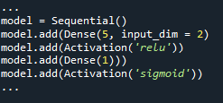
Keras Modeling Life Cycle
Defining Networks:
Neural Networks are defined in Keras as a sequence of Layers….
The container for these layers is the Sequential Class, first create an instance of this class and then you can add your layers in the order they are to be connected.
Think of the Network as a Pipeline, where raw inputs go into the bottom, and predictions come out of the top….
Defining a Model includes defining the Architecture:
Number of Layers
Neurons in each layer
Activation functions used
This example builds a simple MLP Model:
2 inputs into the first layer
5 neurons in the first layer
Added ReLu Activation Function
Single neuron output layer
Sigmoid Activation Function on output

Slide 15
Keras Modeling Life Cycle
2. Compiling Networks:
Compiling Networks is and Efficiency step in the process…
Compiling transforms the sequence of layers previously defined, into a highly efficient series of matrix transforms in a format intended to be executed on your GPU or CPU.
Compiling is always required.
Parameters to be specified:
Optimization algorithm for Training Network
Loss Function
Optionally you can specify Metrics for evaluation
In addition to pre-defined optimizers, you can define your own

Slide 16
Keras Modeling Life Cycle
Models can be saved, exported and imported to use later after training
3. Fitting Networks:
Fitting a model is defined as adapting the model weights in response to a training dataset…
The training data must be specified as:
X, matrix of input patterns
y, corresponding output labels
The network is trained using the backpropagation algorithm
The network is optimized according to the optimization algorithm and loss function specified when compiling the model
For training, the model is trained for a specified number of epochs.
Each epoch is sub-partitioned into batches, the number of patterns that the model is exposed to before updating the weights.
The history object will return a report for performance of the model during training, including the loss and optionally specified metrics

Slide 17


Keras Modeling Life Cycle
4. Evaluating Networks:
After training the network, the network will be validated using a secondary dataset that was not used during the training process for the model…
This test data will be evaluated with the specified loss function and any of the optionally specified metrics.
5. Making Predictions:
After evaluating the test performance of the model, you can use it to make predictions on new data
Simple Predict() command

Slide 18


Keras Functional Models
Defining Input:
Unlike Sequential, the input must have its own layer in the model
This layer must take the shape input of a tuple that describes the dimensionality of the input data
Connecting Layers:
Layers are connected pair-wise
This is done by specifying where the input is coming from
Creating the Model:
After connecting the layers, you have to define the model
This is accomplished with the Keras Model Class, which only requires and input and an output to be defined

Slide 19
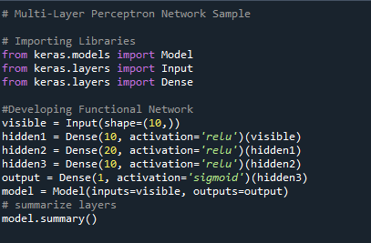
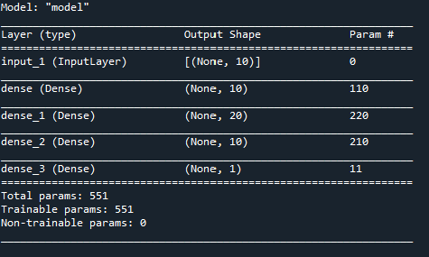
Keras Standard Networks: MLP

Slide 20
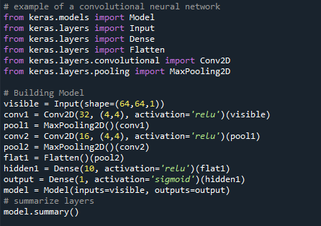
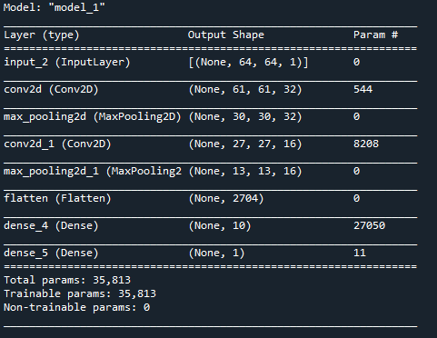
Keras Standard Networks: CNN

Slide 21
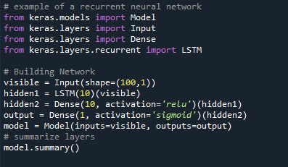
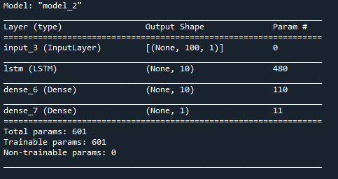
Keras Standard Networks: RNN

Slide 22
Questions?
1/28/2022:
What are we? What makes us different the CS or CSE ?
WHO. ARE. WE.
Understand the technical aspects and understand the big picture
Make some slides for QCRE project and explain how its going
Move meeting room to 350

