Slide 1
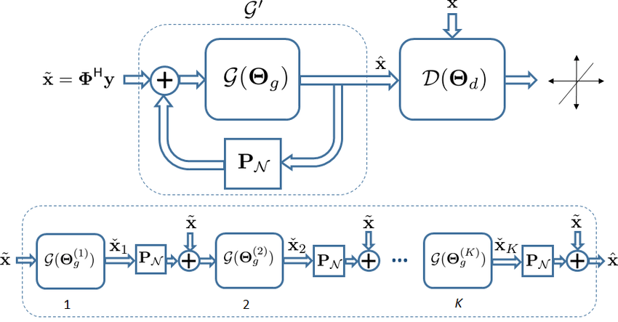
Recurrent GANs Model
Week 11: (4/01/2022) Team Lead: Preston Robertson
Notes:
Introduce ourself, what we do and the department

Slide 2
Recap: GANs Evaluation
2
Update: This topic is not covered in the book. This topic is very new, and little to almost no research has been done into this topic.
*This is due to the difficulty of implementing both models separately. Recap: GANs Loss Functions, least squared and Wasserstein are two of the most popular loss functions for GANs as one implements more of a gradient.
Notes:
Ask them to tell us in their own words what AM
History

Slide 3
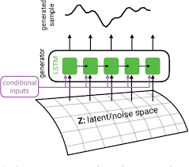
Overview:
3
Objective: Learn recurrent GANs and how to apply them to our research.
Overview:
Recurrent Neural Networks
2D Recurrent GANs
Literature Review
Language Generation with Recurrent Generative Adversarial Networks without Pre-training
Real-valued (Medical) Time Series Generation with Recurrent Condition GANs
Recurrent GANs Password Cracker For IoT Password Security Enhancement
3D Recurrent GANs
Novel Idea
What’s Next
Notes:
Ask them to tell us in their own words what AM
History

Slide 4
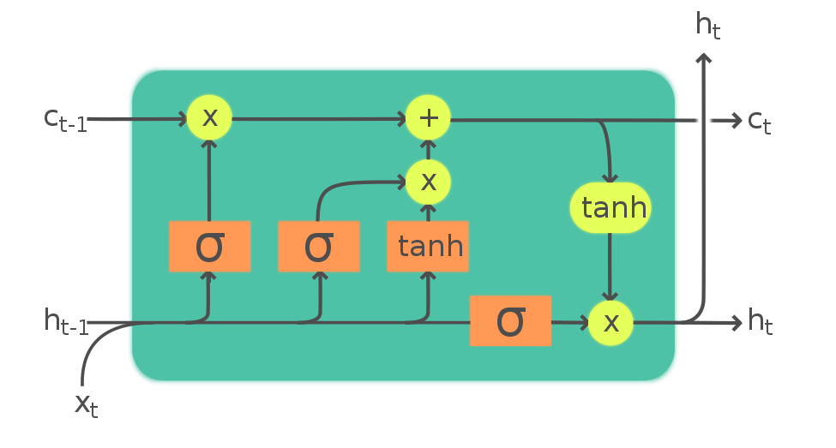
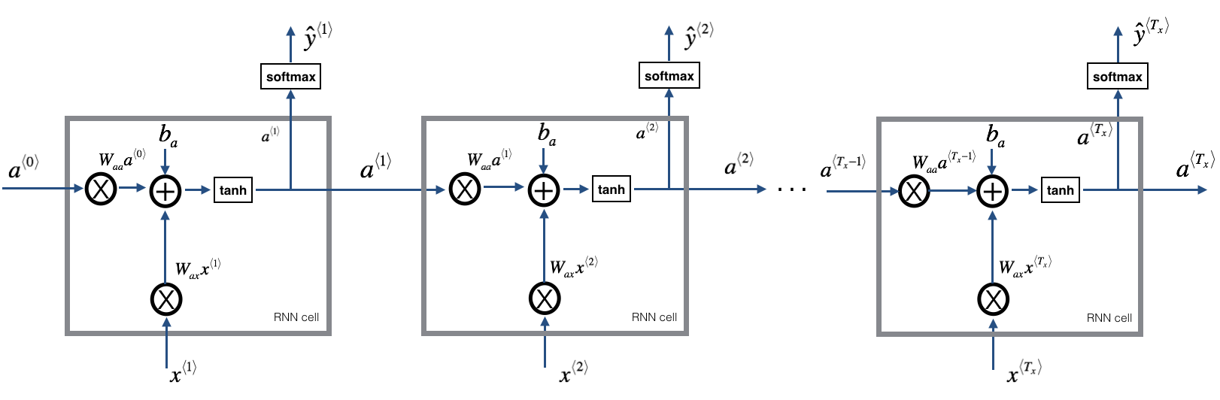
Recurrent Neural Networks
4
Why: A neural network that works with time-series data.
Basics: The recurrent neural network (RNN) uses the output from the previous node to make current decisions.
How: The process goes through a forget gate, input gate, and an output gate.
Modern: New research uses more improved models such as the LSTM to allow for better and less saturated memory or the GRU for simpler data sets to be less computationally expensive.
Notes:
Ask them to tell us in their own words what AM
History

Slide 5
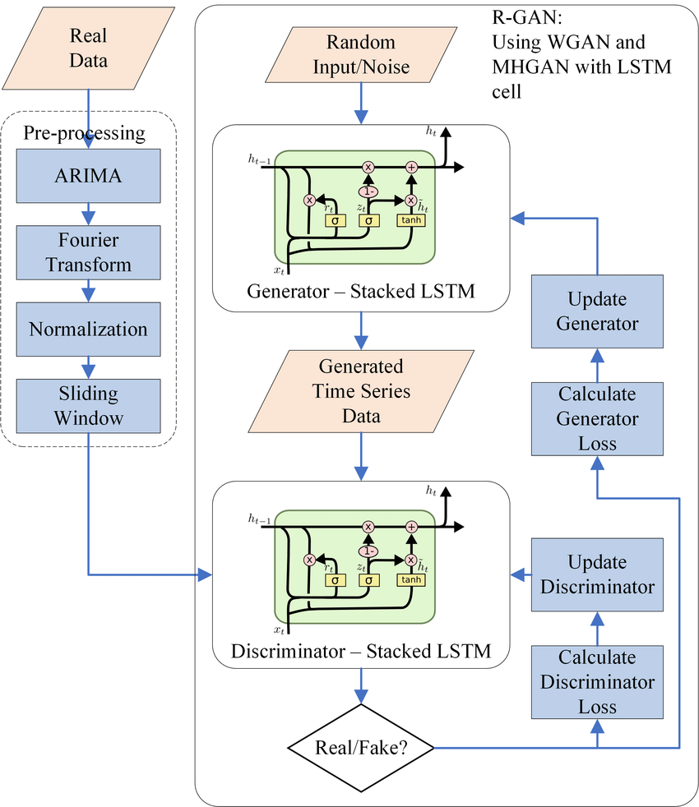
2D Recurrent GANs
5
2D Data type: This data type basically encompasses all that is not image datasets.
Objective: Create missing data from time-series based datasets.
New Architecture: The important take-away before the literature review is that the architecture of the 2D recurrent GANs is very new and little research has been done into this topic.
*The reason why is the lack of use of recurrent neural network architecture in relevant data science/engineering fields.
Notes:
Ask them to tell us in their own words what AM
History

Slide 6
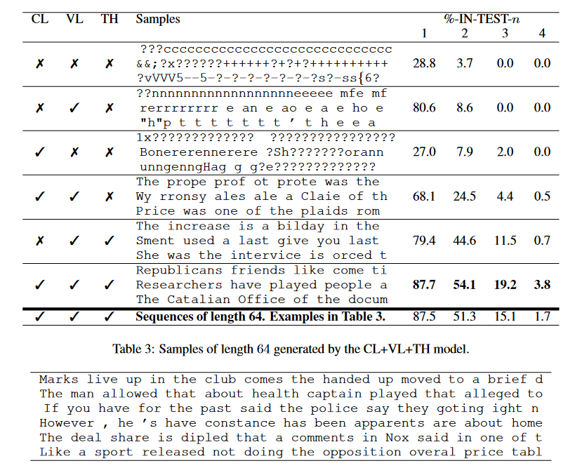
Literature: Language Generation with Recurrent Generative Adversarial Networks without Pre-training
6
Objective:
Set up a baseline analysis of the capabilities of modern recurrent GANs in language generation.
Method:
Generating random sentences with the tested model and two previously created recurrent GANs and testing the results.
Set-up:
N/A
Conclusion:
Modern recurrent GANs has proven very effective and is now effective at creating several lines of sentences.
Discussion:
The results are very interesting, and by reading the best statement made, it is possible to see the room for improvement. These results were also made from zero input values into the recurrent GANs meaning that these sentences were purely generated from the latent space. There are several improvements the paper could also consider, such as using a better RNN model than the GRU. Overall, this is not an important topic of research and was made to demonstrate the capabilities of recurrent GANs.
Notes:
Ask them to tell us in their own words what AM
History

Slide 7
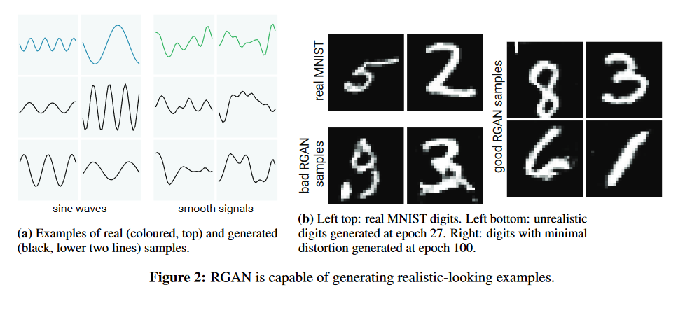
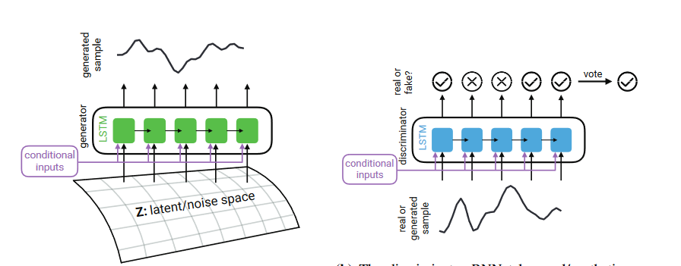
Literature: Real-valued (Medical) Time Series Generation with Recurrent Condition GANs
6
Objective:
Create a working recurrent GANs and recurrent conditional GANs (RCGANs) architecture with new GANs evaluation function for the purpose of data generation.
Method:
Implementing the new loss function to run the RGANs and RCGANs on functions, the MNIST dataset, and ICU medical dataset.
Set-up:
N/A
Conclusion:
The researchers generated good MNIST data; however, the ICU dataset had 95%-99% undistinguishable generated datapoints (based on class of warning).
Discussion:
This shows the effectiveness of recurrent GANs models when generating time-series based datasets. The math in the paper is relatively easy to follow and the Maximum Mean Discrepancy seems to be a reason for the results. This will be used in the idea mentioned later. The process by which the images were made, can be used to make images into a video.
Notes:
Ask them to tell us in their own words what AM
History

Slide 8
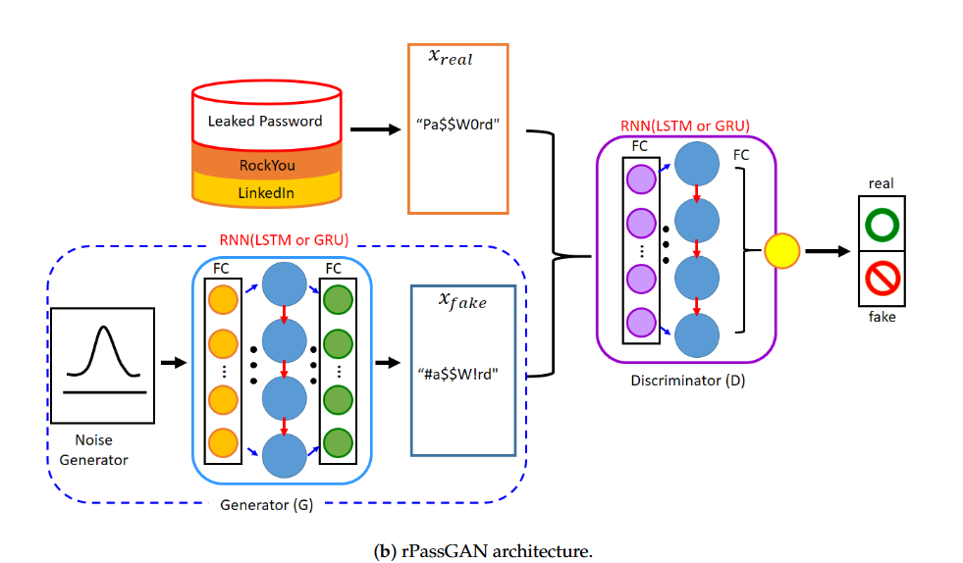
Literature: Recurrent GANs Password Cracker For IoT Password Security Enhancement
6
Objective:
Generate a recurrent GANs for cracking passwords. Re-make the tools used by hackers today.
Method:
Use RGANs to develop a better dictionary-based password cracking method. The dataset will actual leaked passwords. Multiple models will different hyper parameters will be compared.
Set-up:
N/A
Conclusion:
This research has proven most effective when cracking passwords. With a success rate of up to 4%.
Discussion:
This paper was chosen since it is the most cited paper for RGANs at around 40 citations when last checked. It does not re-invent the wheel and will not be very helpful to my idea since I do not work in security. However, this paper was still left in since I know Dr. Tian’s lab works with security and wanted to show the application in that field as well.
Notes:
Ask them to tell us in their own words what AM
History

Slide 9
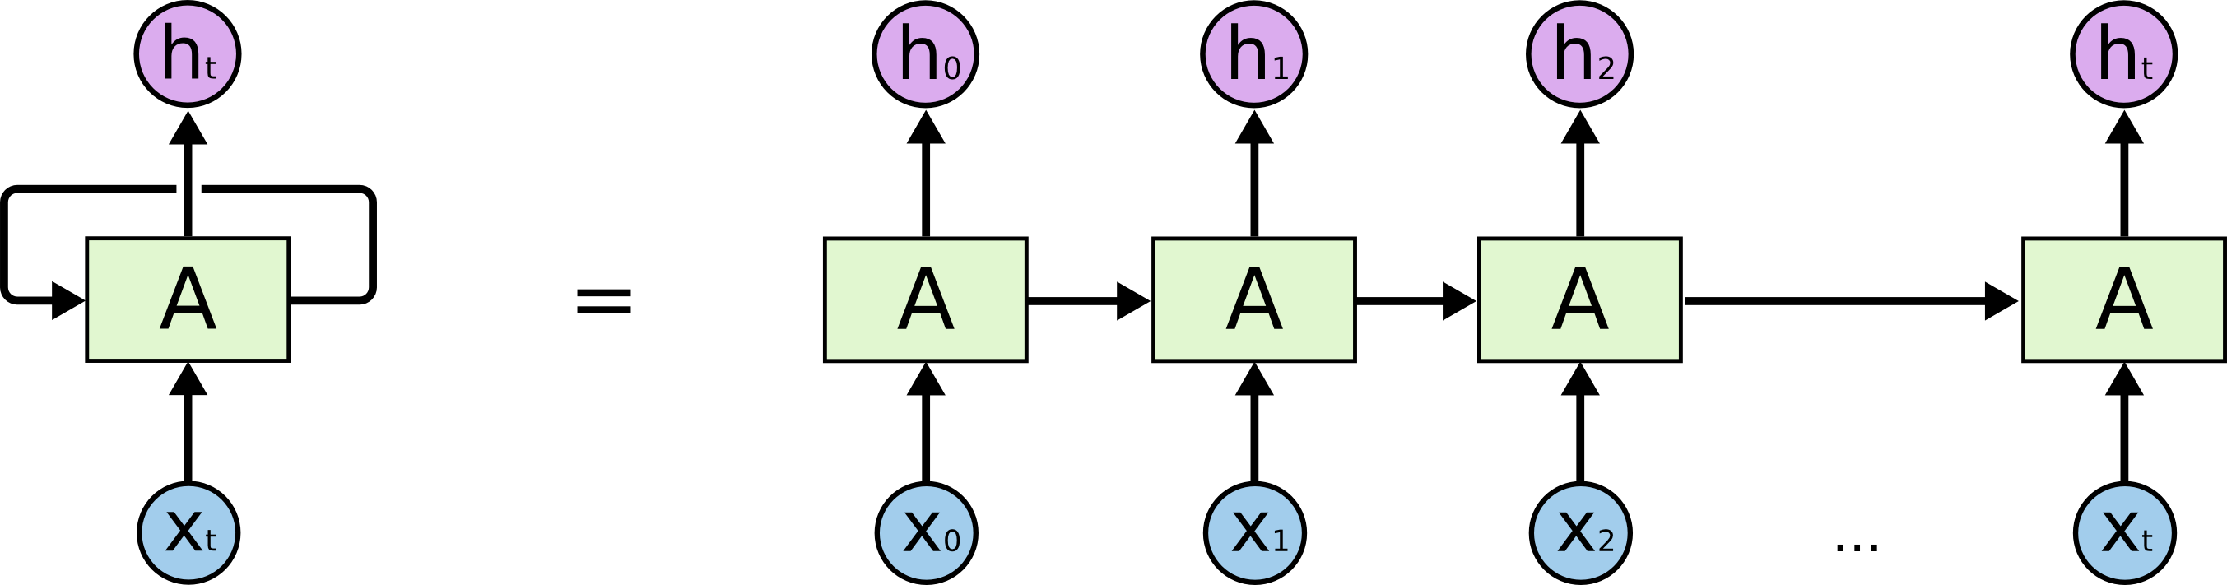
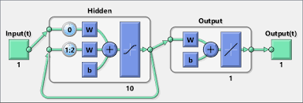
3D Recurrent GANs
7
No Available 3D GANs: This is due to the concept of recurrent GANs being so new, and 2D recurrent GANs are not even that developed.
Applying Knowledge: The book goes over every detail needed to make 2D GANs into 3D GANs, applying this knowledge to recurrent GANs should be easy.
Nature of Recurrent Models: Turning the GANs portion of the models should be easy, but due to the nature of recurrent models. There will need to be adjustments made. VGANs do exist; however, make entire videos from scratch and do not work as intended for the novel idea.
*Since the recurrent neural network model only produces a single output. Proposed Solution: Recurrent neural network fed into a cGANs model that produces images based on the result of the recurrent model.
Notes:
Ask them to tell us in their own words what AM
History

Slide 10
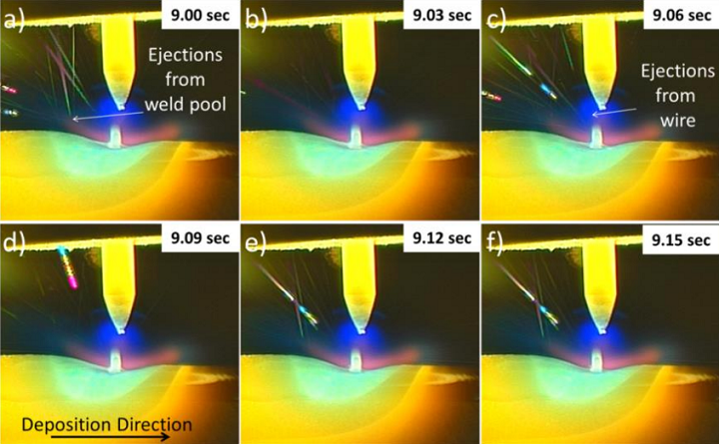
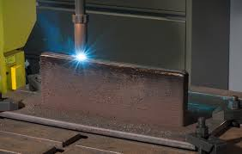
Novel Idea: Theory
8
Theory: Use recurrent GANs to recreate lost data from visual/thermal sensing methods. Reason: The main issue of using visual/thermal sensing methods is its loss of data due to the light source from the heat of AM. How: Using the video, and previous data points from the latent space. Create a GANs architecture to create a conditional image that matches the missing data.
*Used in post-processing and not in-situ
Notes:
Ask them to tell us in their own words what AM
History

Slide 11
What’s Next
9
Next Week: Just a recurrent GANs will not be good enough, since images will need to be conditionalized through cGANs.
*This is Durant’s topic next week.
Notes:
Ask them to tell us in their own words what AM
History

Slide 12
Questions?
Notes:
Ask them to tell us in their own words what AM
History

Slide 13
References
Objective:
…
Method:
…
Set-up:
…
Conclusion:
…
Discussion:
…
Notes:
Ask them to tell us in their own words what AM
History

