Slide 1
How to implement GAN training Algorithm + Hacks
Week 3: (02/11/2022)
Week Lead: Preston Robertson
GANS DIS Spring 2022

Slide 2
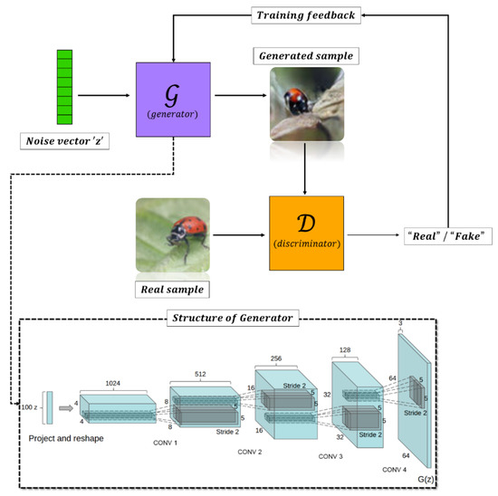
Review:
GANS use an adversarial model framework
The Generator and Discriminator try to outperform each other
Keras library utilized for compiling our models (Good application and customizable library)
Upsampling: Opposite of down sampling action that occurs in traditional CNN
Points within latent space are upsampled to form the fake image, through the generator
Convolutional2DTranspose
Efficient method for increasing the size of the image while simultaneously learning information
Latent Space
Generation Process for GANs

Slide 3
Objective:
Implement and understand how to optimize and train a GANs model
Chapter 4: How to Implement GAN Training Algorithm
Understanding the GAN Loss Function
How to train GAN Models in Practice
Chapter 5: How to Implement GAN Hacks to Stabilize Model
Challenge of Training of GANs
Deep Convolutional GANs
Soumith Chintala’s GAN Hacks

Slide 4
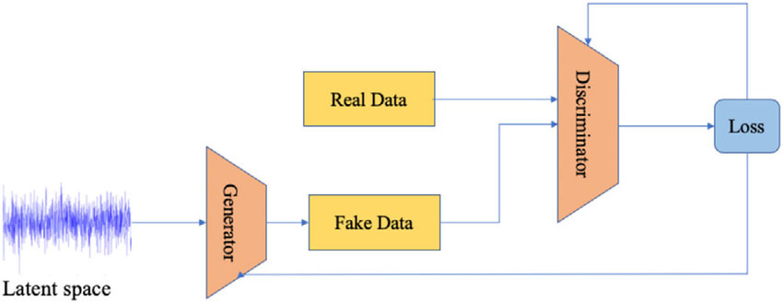
How to Implement the GAN Training Algorithm
GAN training involves training both the discriminator model and the generator model in tandem.
This is done through stochastic gradient descent.
The process of mapping the loss/cost function and finding the lowest loss to optimize the model.
Steps:
First the discriminator model trains on the training images.
The generator model trains on the training data and produces images.
The discriminator model then trains on the fake images.
With every iteration the discriminator model trains twice.

Slide 5


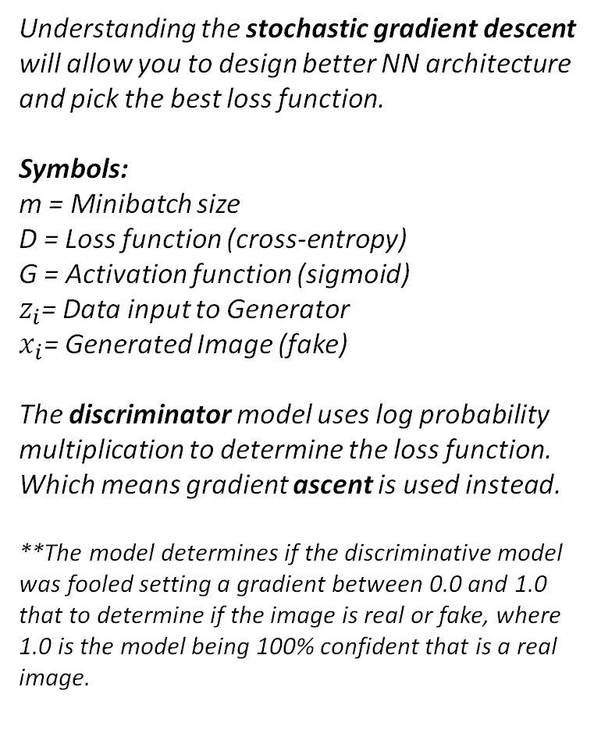
Understanding the GAN Loss Function
Understanding the stochastic gradient descent will allow you to design better NN architecture and pick the best loss function.
Symbols:
m = Minibatch size
D = Loss function (cross-entropy)
G = Activation function (sigmoid)
$z_{i}$= Data input to Generator
$x_{i}$= Generated Image (fake)
The discriminator model uses log probability multiplication to determine the loss function. Which means gradient ascent is used instead.
**The model determines if the discriminative model was fooled setting a gradient between 0.0 and 1.0 that to determine if the image is real or fake, where 1.0 is the model being 100% confident that is a real image.
Generative Model:
Did the generative model successfully fool the discriminator model.
Discriminator Model:
Was the model fooled by the generative model (gradient/non-binary)
What the model learned from the real data

Slide 6
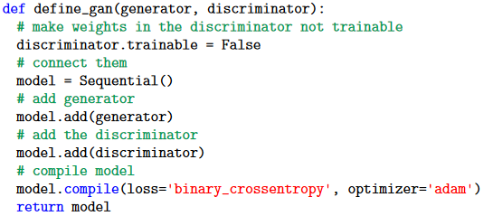
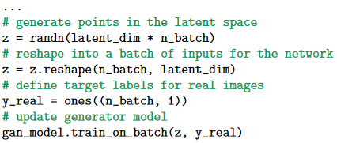
How to Train GAN Models in Practice
Application of the model is relatively simple since keras does most of the behind the scene work
Steps:
Make a composite GAN model
Then create labels and plug-ins for the real and fake images.

Slide 7
How to implement GAN Hacks to stabilize model
Week 3: (02/11/2022)
Team Lead: Preston Robertson
GANS DIS Spring 2022

Slide 8
Challenge of Training GANs
Why:
The models are trained by competing with one another. Meaning that the improvement of one model leads to loss of performance in another.
The Game:
Think of a game of table tennis. If player A improves too fast where player B can no longer compete, then both players will no longer improve due to the lack of competition.
This property makes training GANs very unstable, and our goal is to find the equilibrium that allows for both models to improve.
Sources for Methods:
1. Alec Radford, et al’s 2015 paper that introduced the DCGAN architecture.
2. Soumith Chintala’s 2016 presentation and associated GAN Hacks list

Slide 9
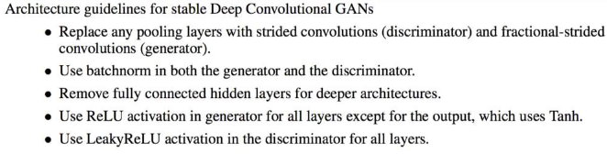
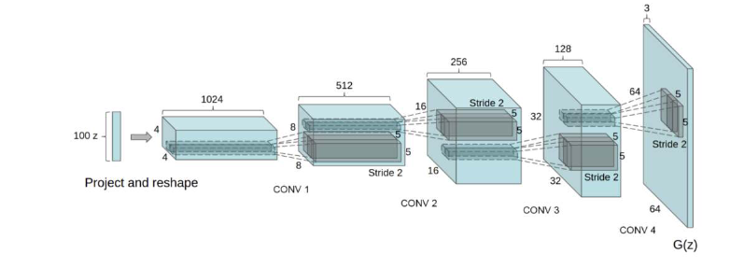
Deep Convolutional GANs (DCGANs)
This model was developed to be a good starting point for all GANs and can be adjusted per dataset.
This paper did extensive tests and found the list to right to be the best starting GANs for most datasets.
Chapter 5.4 goes through all the specifics.
The main idea is adding a convolutional layer.
This layer is normally used as a pseudo feature engineering step for images. However, in this case it keeps the model from “winning” over the other model by reducing the importance of a singular pixel.

Slide 10
Deep Convolutional GANs (DCGANs)
Parameters and layers | Description | Advantages
Downsampling using strided convolutional | Changing the stride of convolutional layers from (1,1) to (2,2) to remove the need to down sample with Pooling layers. | Stride convolutional layers retain more information than pooling layers at the cost of being more computationally expensive.
Upsample using strided convolutional | Stride of (2,2) to up sample the image to the dimensions desired. | Same as above.
Using leaky relu | A different form of the popular activation function, relu. Adds a negative component. | The negative component greatly enhances performance due to the nature of the discriminator’s output.
Batch normalization | Standardizes the activations from a prior layer to have a zero mean and unit variance. | Stabilizes the training process.
Gaussian weight | Initialize all weights using a zero-centered Gaussian distribution with a standard deviation of 0.02. | Allows neurons to learn different features while training.
Adam stocatic gradient descent | Learning rate of 0.0002 and momentum value of 0.5. | Gradient-based optimization of stochastic objective functions that computes individual adaptive learning rates for different parameters.

Slide 11
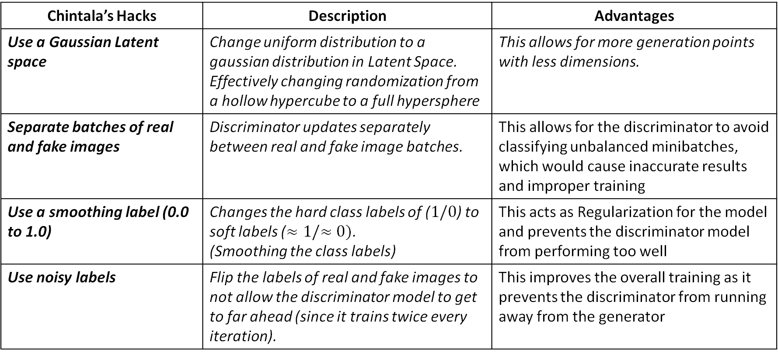
Soumith Chintala’s GAN Hacks
Chintala’s Hacks | Description | Advantages
Use a Gaussian Latent space | Change uniform distribution to a gaussian distribution in Latent Space. Effectively changing randomization from a hollow hypercube to a full hypersphere | This allows for more generation points with less dimensions.
Separate batches of real and fake images | Discriminator updates separately between real and fake image batches. | This allows for the discriminator to avoid classifying unbalanced minibatches, which would cause inaccurate results and improper training
Use a smoothing label (0.0 to 1.0) | Changes the hard class labels of ($1/0$) to soft labels ($≈1/≈0)$. (Smoothing the class labels) | This acts as Regularization for the model and prevents the discriminator model from performing too well
Use noisy labels | Flip the labels of real and fake images to not allow the discriminator model to get to far ahead (since it trains twice every iteration). | This improves the overall training as it prevents the discriminator from running away from the generator

Slide 12
Questions
Add Text Here…

Slide 13
Slide Topic Here
Add Text Here…
Add Images to the slides as needed (More Visual = Better Reception)
Duplicate this Slide for others in the presentation to stay consistent

Slide 14
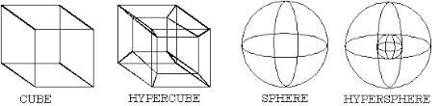
Soumith Chintala’s GAN Hacks
This is another paper full of recommendations.
Recommendations:
Use a Gaussian Latent space
Rec. 1 changes the uniform distribution to a gaussian distribution effectively changing randomization from a hollow hypercube to a full hyper sphere. This allows for more generation points with less dimensions.
Separate batches of real and fake images
Rec. 2 allows for the model to update separately between real and fake images. (Let’s say we have 9 real images and 1 fake, then the model is likely to catch the fake; however, if the batch has 5 real images and 5 fake then model is unlikely allowing for randomness).
Use a smoothing label (0.0 to 1.0)
Rec. 3 changes the hard labels of 1 and 0 to slight variations (such as 1.03) to represent the real/fake images. This stabilizes the model since the outputs will punish the wrong model less
Acts as a form of Regularization.
Use noisy labels
Rec. 4 flips the labels of real and fake images to not allow the discriminator model to get to far ahead (since it trains twice every iteration). The theory is the same as the theory behind adding errors to normal data to improve testing scores.

Slide 15
Gaussian Latent Space
Select point from the latent space with a uniform distribution.
Negative: Less samples data points needed effectively train gans.
Select points from the latent space with a gaussian distribution.
Gans more accurate because you are randomizing dataset. More variations and samples.

