Slide 1
How to Upsample with Convolutional Neural Networks
Week 2: (02/04/2022)
Week Lead: Christian Zamiela
GANS DIS Spring 2022

Slide 2
Meeting Overview
Chapter 3: Upsampling with GANS
Need for Upsampling in GANs
Recap of CNN’s for classification
Recap of Generative Modeling
How to Use the Upsampling Layer
Max pooling vs Upsampling layer
Keras Example
Simple Generator Model with Upsampling2D
How to Use the Transpose Convolutional Layer
Convolutional Operations
Simple Generator Model with Transpose Convolutional Layer

Slide 3
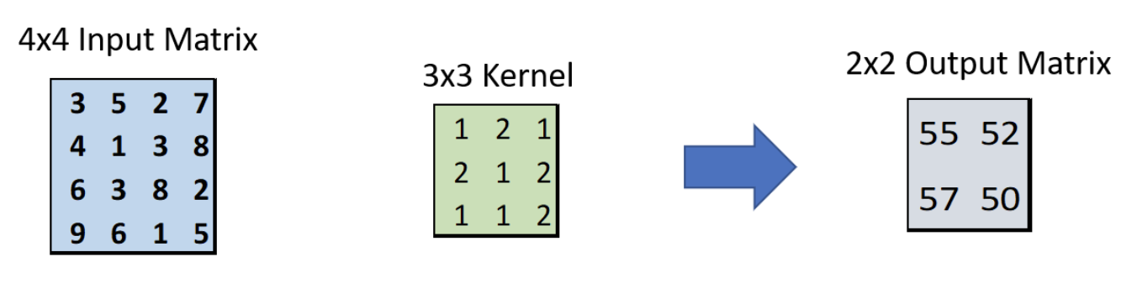

Need for Upsampling: Recap of CNN’s
Convolutional Operations
Latent Space

Slide 4
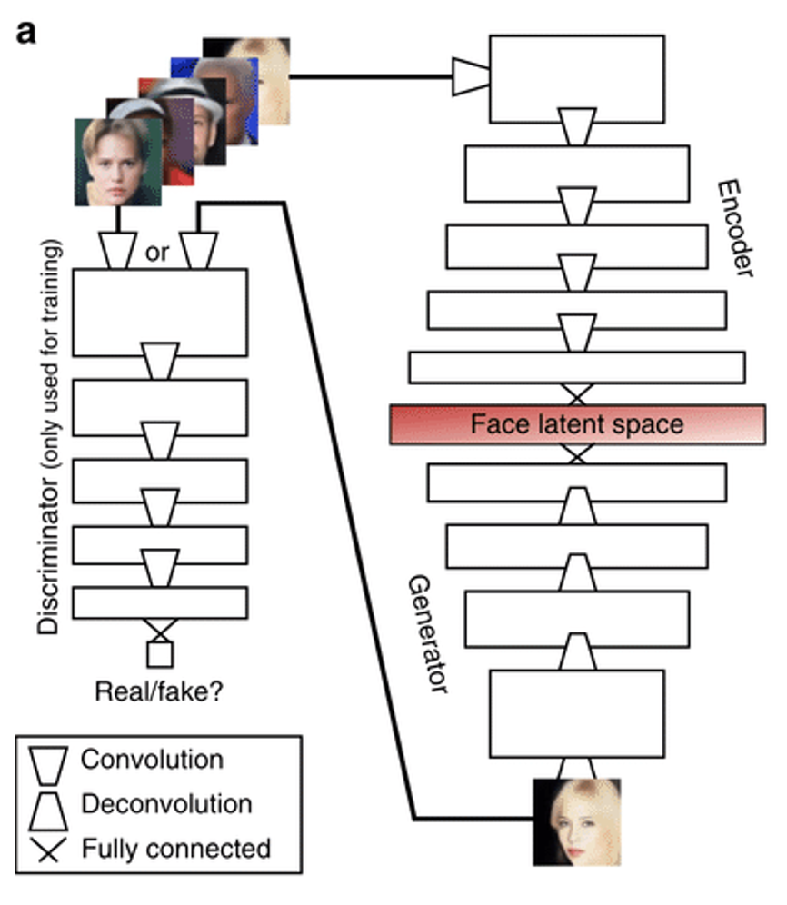
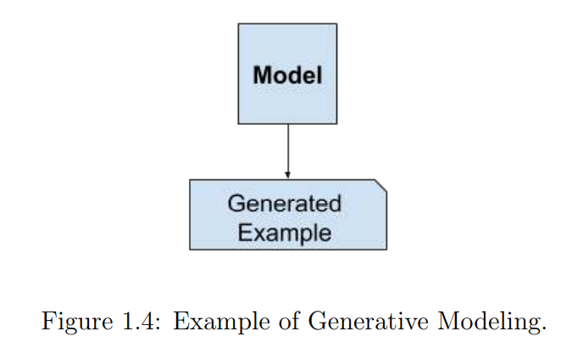
Recap of Generative Modeling
Generative Modeling
How generative modeling works
The generator works by taking a random point from the latent space as input and outputting a complete image, in a one-shot manner.
Generative Modeling is not used for predicting a class but is used for generating new samples within the input data distribution.
Upsampling with CNN’s

Slide 5
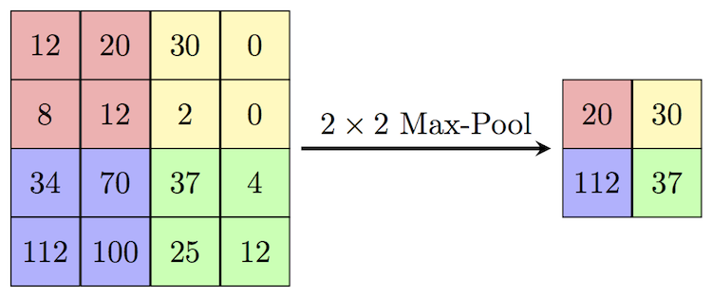
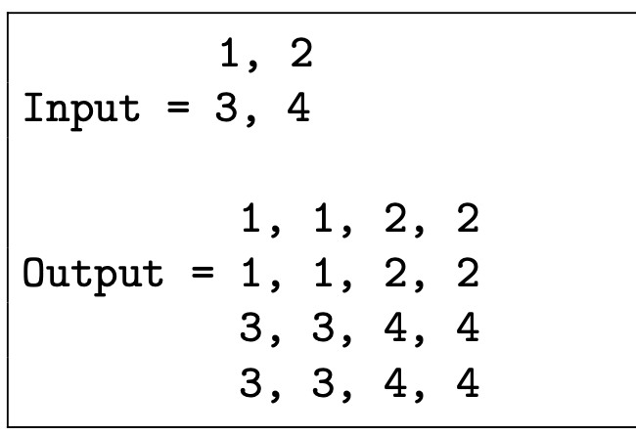
How to Use the Upsampling Layer
The upsampling layer is the opposite of a max pooling layer.
It works by repeating the rows and columns of the input.
By default, the upsampling layer will double each image. The Size hyperparameter can manipulate the dimensions of output. Example: size=(2,3) doubles width and triples length.
The interpolation hyperparameters are ‘nearest’ (default) or ‘bilinear’.
Upsampling layer is a simple method, but I does NOT preform any learning. There is no parameter training with upsampling layer
Max pooling layer
Upsampling layer

Slide 6
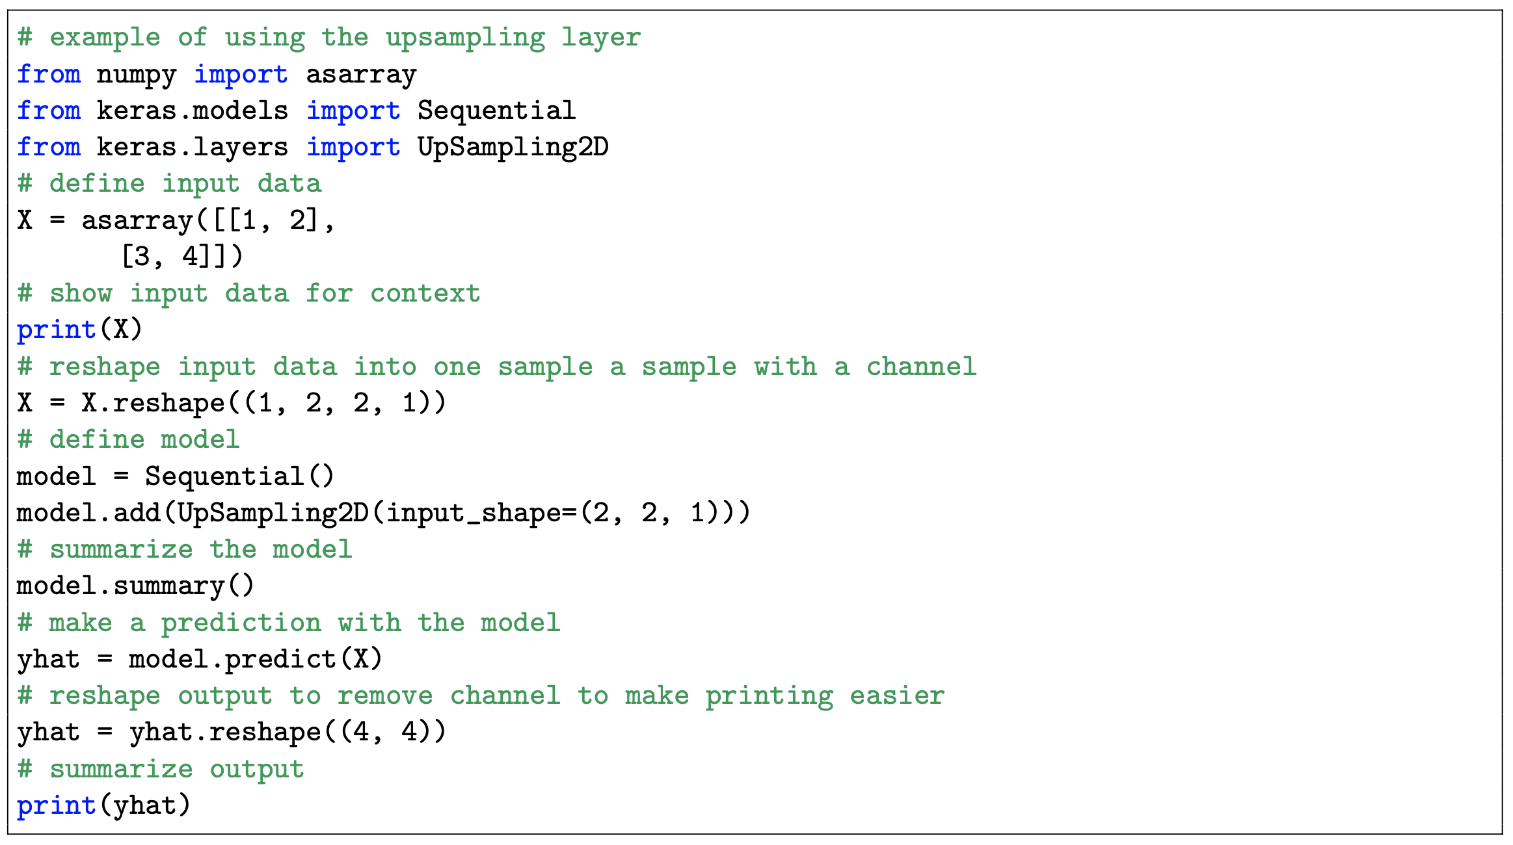
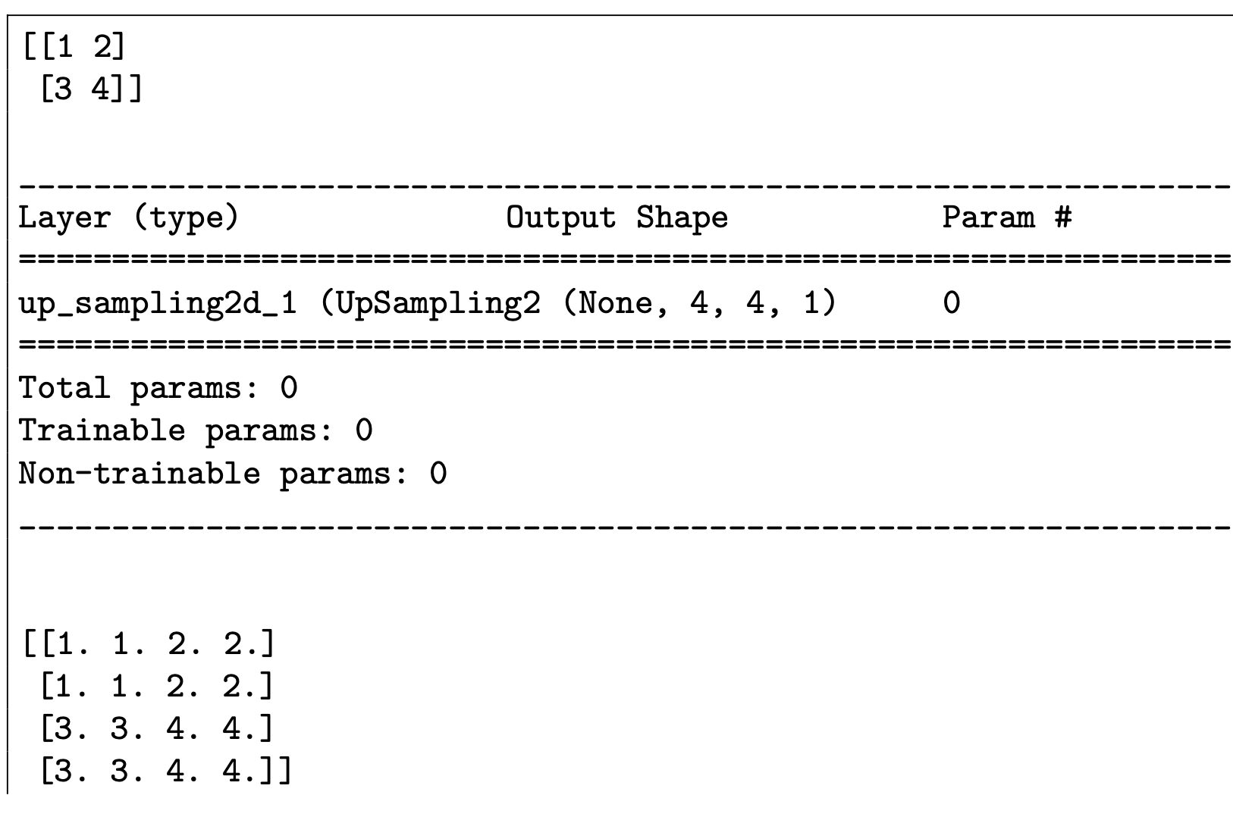
Keras Example: Upsampling2D
Python Code
Output

Slide 7
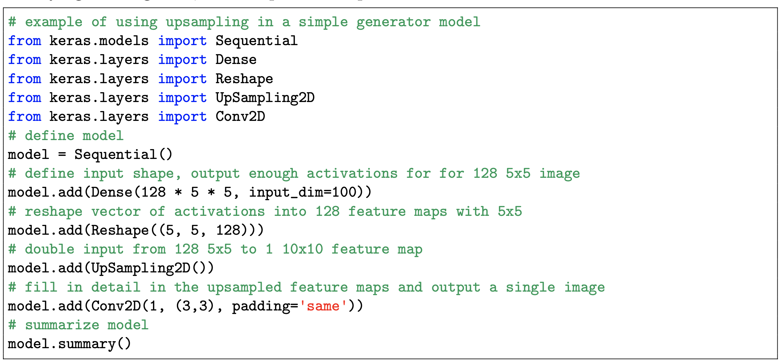
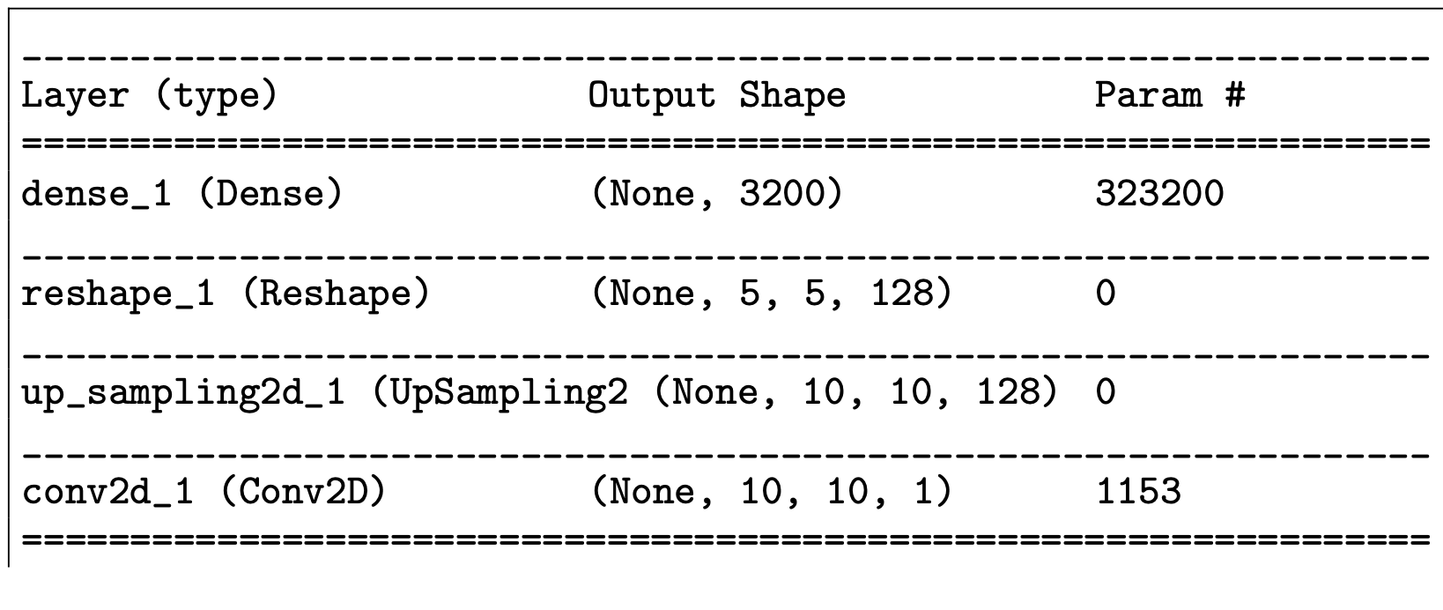
Simple Generator Model with UpSampling2D
To be useful in a GAN, each UpSampling2D layer must be followed by a Conv2D layer that will learn to interpret the doubled input and be trained to translate it into meaningful detail.
Code
Output

Slide 8
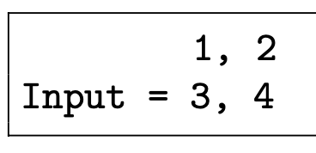
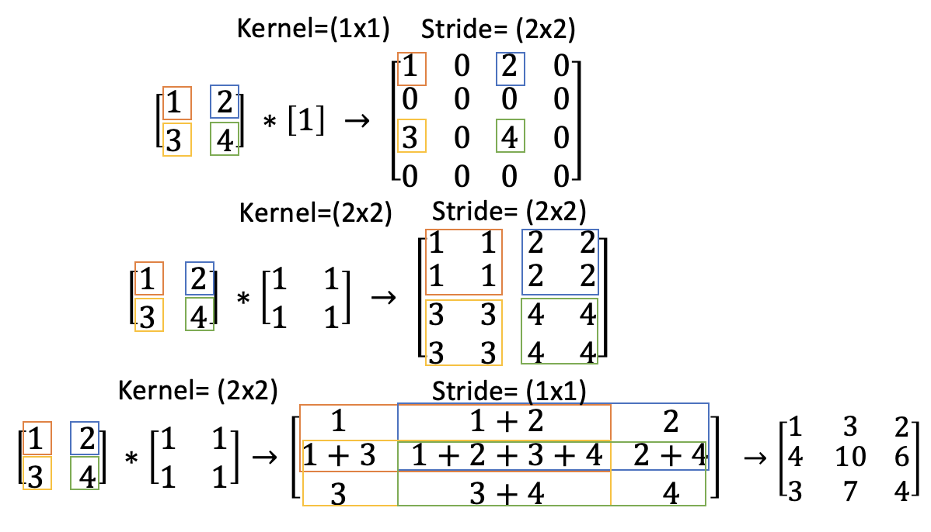
How to Use the Transpose Convolutional Layer
Input
The transpose convolutional layer and the upsampling layer both performs the upsample operation and interprets the input data to fill in the detail while it is upsampling.
The transpose convolutional layer is more complex layer that combines upsample2D and conv2D.
The transpose convolutional layer has a trainable convolutional kernel.
The transpose convolutional layer preforms an inverse convolutional operation.
Output

Slide 9
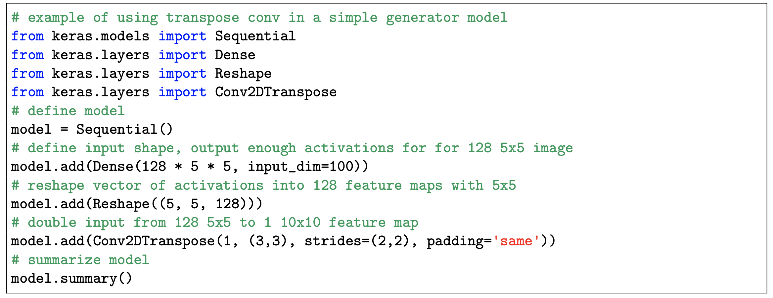
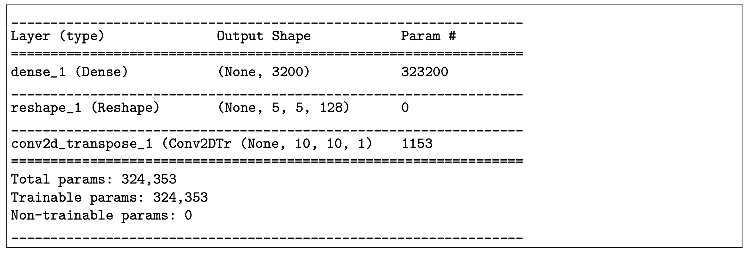
Simple Generator Model With the UpSampling2D
Code
Output

Slide 10
Questions?
2/04/2022:

Slide 11
Questions?
1/28/2022:
What are we? What makes us different the CS or CSE ?
WHO. ARE. WE.
Develop Knowledge
Solve Challenges with the tools we have and if we don’t have a tool, make one

Slide 12

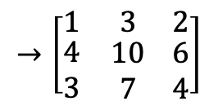
Kernel=(1x1)
Stride= (2x2)
$$\left[\begin{matrix}1 & 2 \\ 3 & 4\end{matrix}\right] ∗\left[1\right] → \left[\begin{matrix}1 & 0 \\ \begin{aligned}0 \\ 3 \\ 0\end{aligned} & \begin{aligned}0 \\ 0 \\ 0\end{aligned}\end{matrix} \begin{matrix}2 & 0 \\ \begin{aligned}0 \\ 4 \\ 0\end{aligned} & \begin{aligned}0 \\ 0 \\ 0\end{aligned}\end{matrix}\right]$$
$$\left[\begin{matrix}1 & 2 \\ 3 & 4\end{matrix}\right] ∗\left[\begin{matrix}1 & 1 \\ 1 & 1\end{matrix}\right] → \left[\begin{matrix}1 & 1 \\ \begin{aligned}1 \\ 3 \\ 3\end{aligned} & \begin{aligned}1 \\ 3 \\ 3\end{aligned}\end{matrix} \begin{matrix}2 & 2 \\ \begin{aligned}2 \\ 4 \\ 4\end{aligned} & \begin{aligned}2 \\ 4 \\ 4\end{aligned}\end{matrix}\right]$$
$$\left[\begin{matrix}1 & 2 \\ 3 & 4\end{matrix}\right] ∗\left[\begin{matrix}1 & 1 \\ 1 & 1\end{matrix}\right]→\left[\begin{matrix}1 & 1+2 \\ \begin{aligned}1+3 \\ 3\end{aligned} & \begin{aligned}1+2+3+4 \\ 3+4\end{aligned}\end{matrix} \begin{matrix}2 \\ \begin{aligned}2+4 \\ 4\end{aligned}\end{matrix}\right]$$
Kernel=(2x2)
Stride= (2x2)
Kernel= (2x2)
Stride= (1x1)
$$→\left[\begin{matrix}1 & 3 \\ \begin{aligned}4 \\ 3\end{aligned} & \begin{aligned}10 \\ 7\end{aligned}\end{matrix} \begin{matrix}2 \\ \begin{aligned}6 \\ 4\end{aligned}\end{matrix}\right]$$

