Slide 1

SpinOff
Dustin, Isaac, Preston, Karb, and Baoying

Slide 2
Overview
-Overview
The different test cases
Demo mode
-Demo
-Code
-Q & A

Slide 3
Demo ..

Slide 4
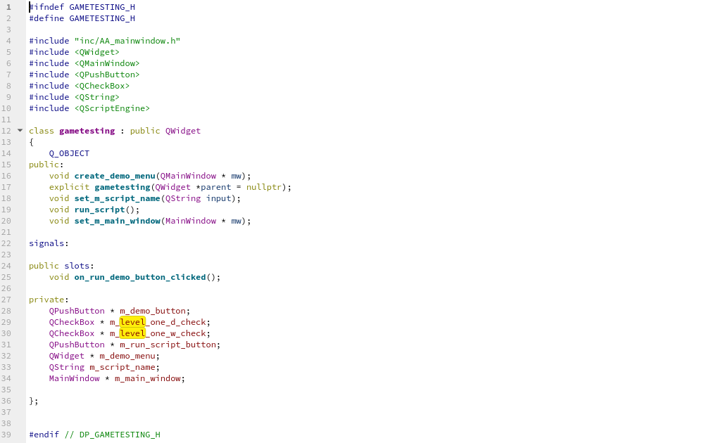
Code

Slide 5
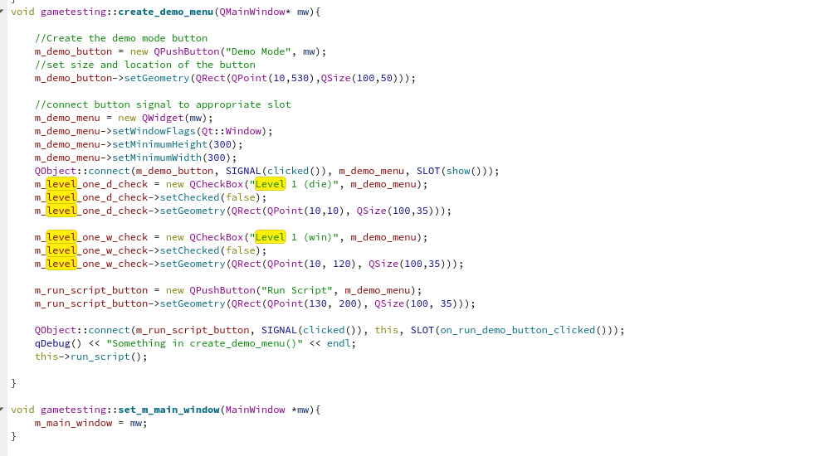
Code (continued)

Slide 6
Q & A

