Slide 1
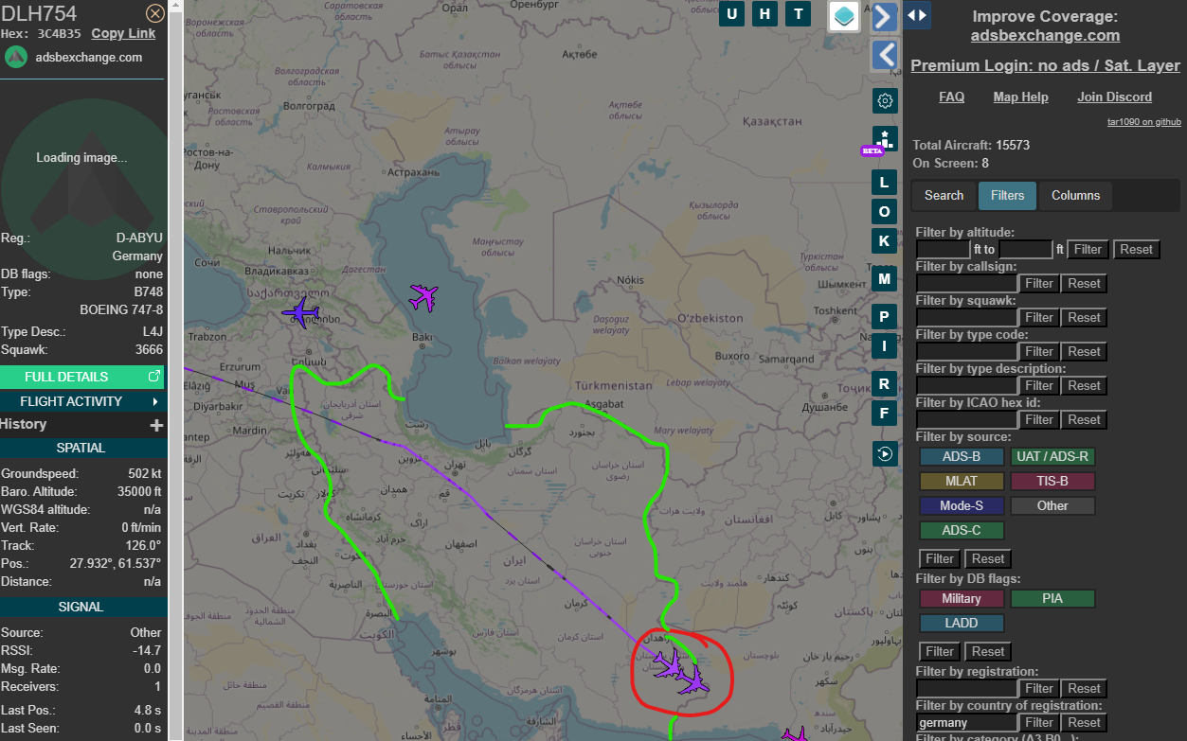
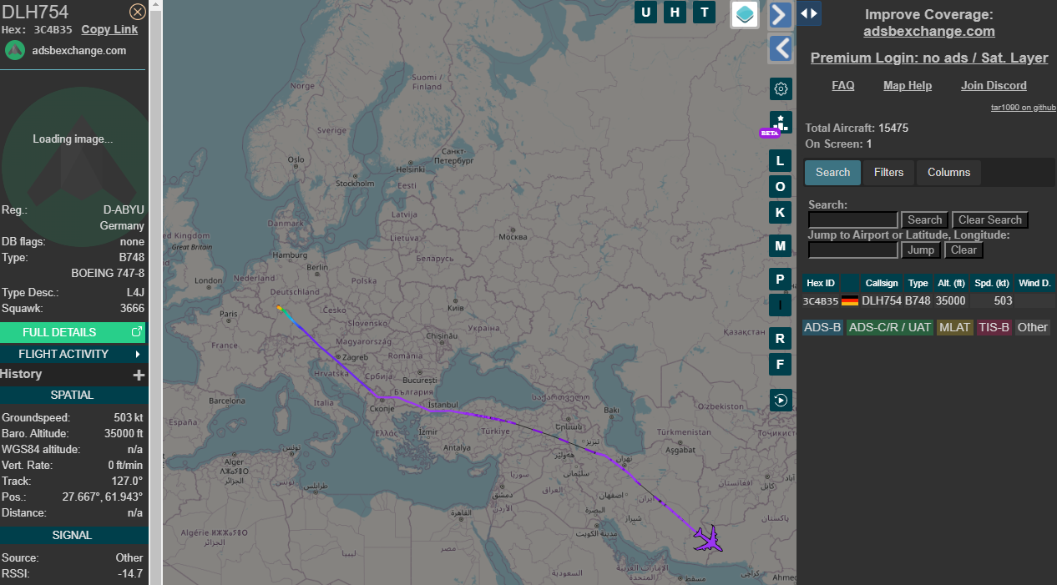

Narrative – Person of Interest Capture
Source: ADS-B Exchange, Flight DLH754 (https://globe.adsbexchange.com/?icao=3c4b35) 1429 EST 2 July 2024
Flight from Frankfurt Germany to Singapore.
Passenger of Interest outspoken against & refugee from Iranian Govt living in Germany.
Can the Iranian regime force the plane to land while over their airspace?

Slide 2
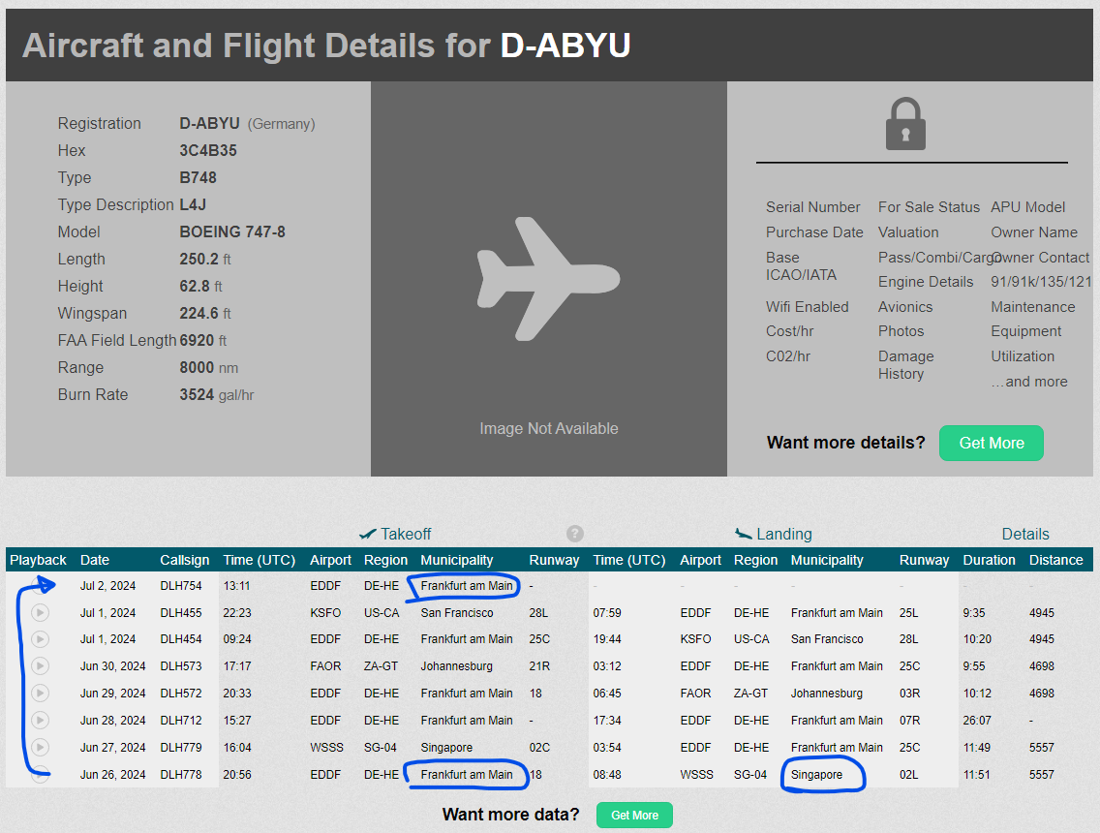
Narrative – Person of Interest Capture
Source: ADS-B Exchange, Flight DLH754 (https://globe.adsbexchange.com/?icao=3c4b35) 1429 EST 2 July 2024

Slide 3
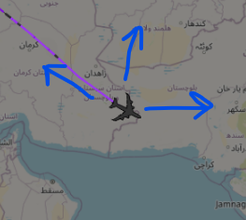

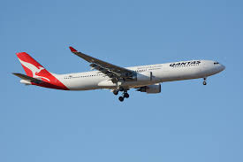
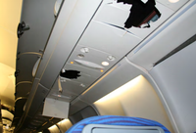
Attack Path – Nothing complicated
Force an emergency landing
Pseudocode Idea:
if(lat, long in Friendly Airspace):
for x in range(2):
sleep(15 min)
send(AoA=-70 deg word)
(emulates Qantas Flight 72 – causing piolets to declare mayday and do an emergency landing)
Agents waiting at airport apprehend Person of Interest for being critical of their government
ADIRU

