Slide 1

Project Title - SEASONAL AGRICULTURE PERFORMANCE ANALYSIS
Major Project
Student Name: PRETHIP R
College Name: Hindusthan College Of Arts and Science
AICTE STU ID : STU6982ba026d94e1770174978

Slide 2

PROBLEM STATEMENT
Agricultural performance changes across seasons because of environmental conditions, farming practices, resource availability and market conditions.
This project analyzes the agricultural dataset to identify seasonal differences, trends, relationships and variations in agricultural performance.

Slide 3
Project Objectives
Explore and understand the agricultural dataset.
Clean and prepare the data for analysis.
Compare agricultural performance across seasons.
Identify seasonal patterns and trends.
Study relationships between conditions and outcomes.
Develop evidence-based conclusions and recommendations.

Slide 4
Project Description
The project analyzes agricultural activities across different seasons, crops and geographical areas.
Key areas include crop yield, production, revenue, cost, profit, water usage, environmental conditions and disease/pest risk.
Python-based data cleaning, statistical analysis and visualization are used to generate meaningful insights.

Slide 5

WHO ARE THE END USERS?
Farmers
Agricultural Planners
Agricultural Researchers
Government Departments
Agricultural Organizations
Data Analysts

Slide 6

Technology Used
Python
Jupyter Notebook
Pandas
NumPy
Matplotlib
Seaborn

Slide 7
DATA ANALYSIS WORKFLOW
Dataset Loading → Data Exploration → Data Cleaning → Exploratory Data Analysis → Seasonal Analysis → Crop/Regional Analysis → Correlation Analysis → Visualization → Findings → Recommendations

Slide 8
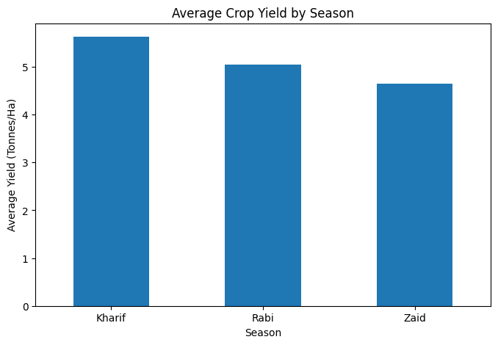
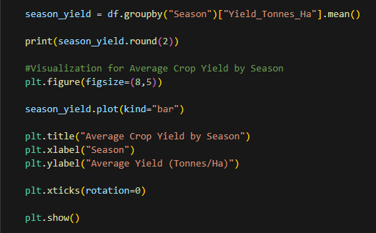
RESULTS – Seasonal Yield
Key insight: Kharif recorded the highest average yield in the analyzed dataset.

Slide 9
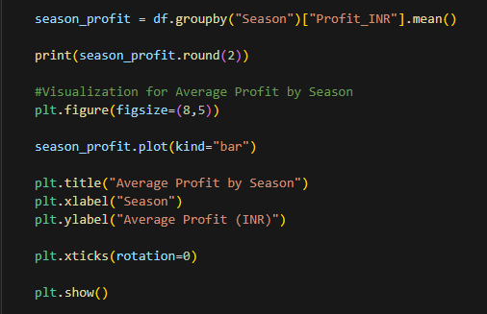
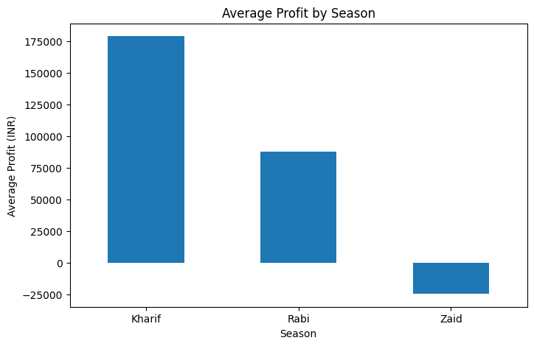
RESULTS – Seasonal Profit
Key insight: Kharif showed the strongest average profitability, while Zaid showed negative average profit.

Slide 10
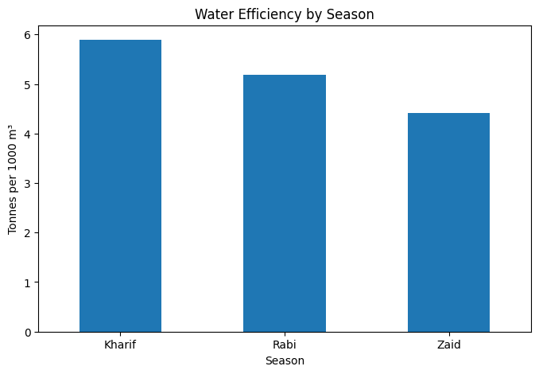
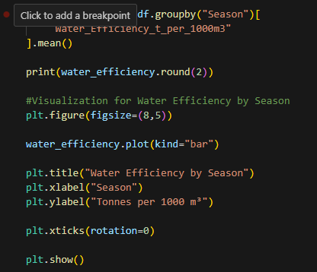
RESULTS – Water Efficiency
Key insight: Water-use efficiency varies by season and should be considered in agricultural planning.

Slide 11
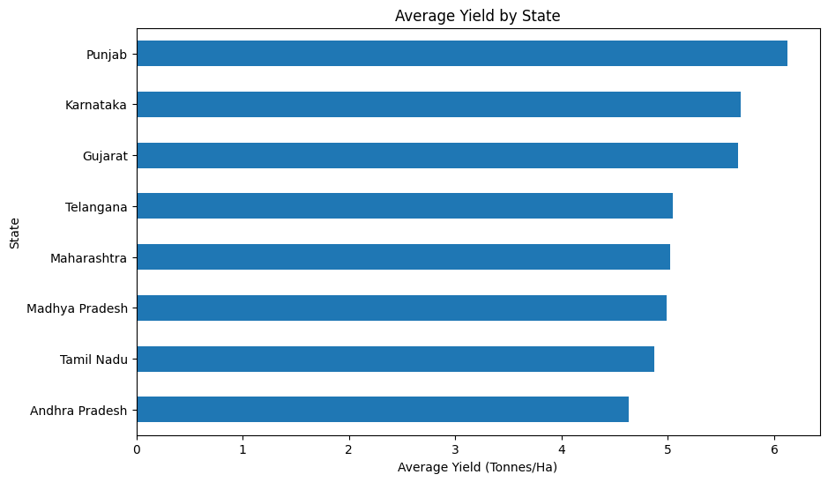
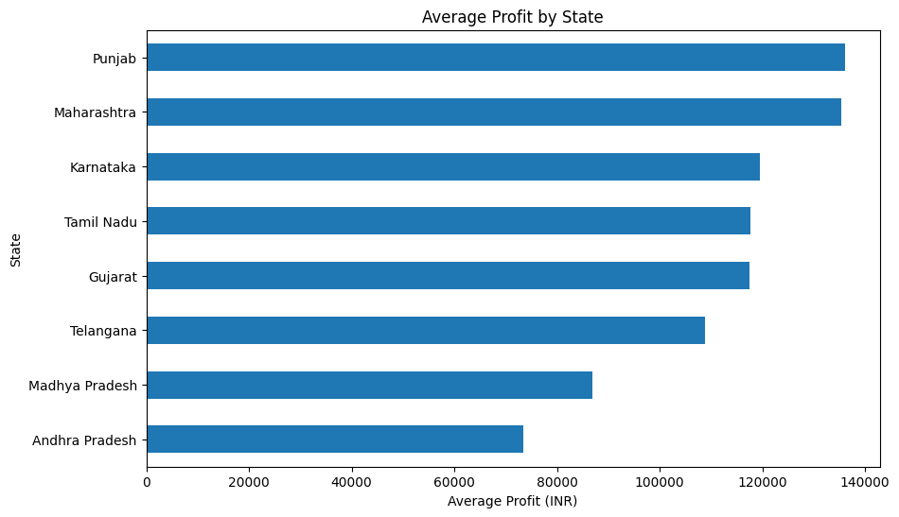
RESULTS – Crop and Season Comparison
Key insight: Punjab showed the highest average yield and profitability in the dataset.

Slide 12
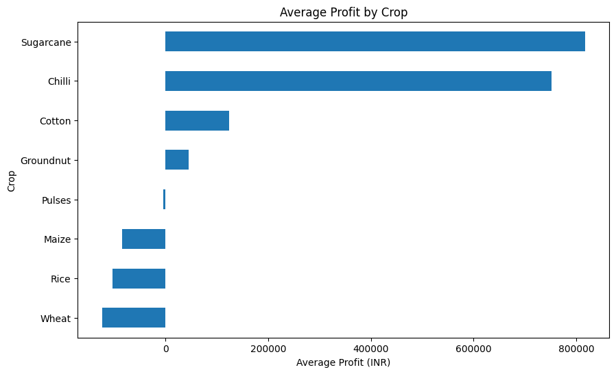
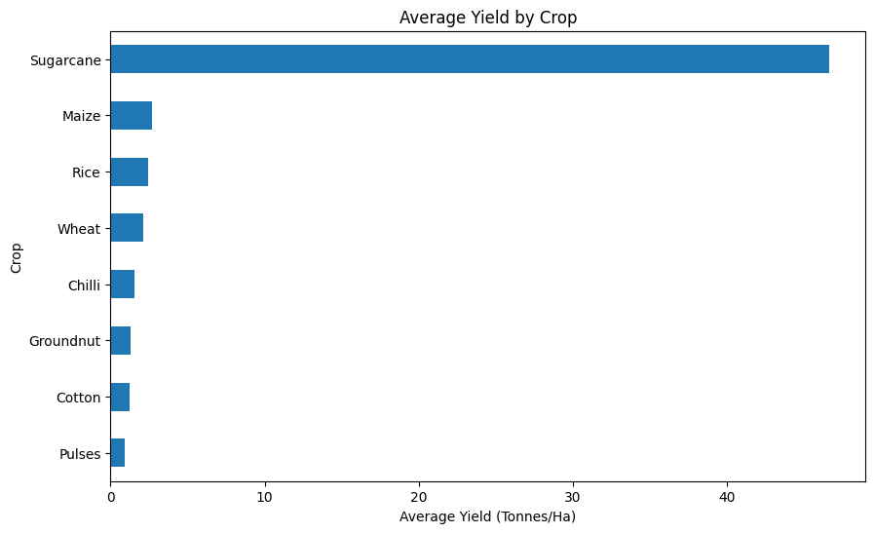
RESULTS – Crop Performance Analysis
Key insight: Sugarcane showed the highest average yield and profitability in the dataset.

Slide 13
Future scope
Real-time agricultural monitoring dashboard.
Weather forecast integration.
Machine-learning-based yield prediction.
Disease and pest risk prediction.
Crop recommendation system.
Market-price analysis.
Satellite, soil and remote-sensing data integration.

Slide 14
Conclusion
Seasonal analysis provides useful insights into agricultural yield, profitability, resource usage and environmental conditions.
The findings can help stakeholders understand seasonal patterns and make more informed agricultural planning decisions.

Slide 15
GitHub Link
https://github.com/PrethipR/Seasonal-Agriculture-Performance-Analysis

Slide 16

VOIS Course completion certificate - Course name- Data Visualization

Slide 17
Thank you
.
.

