Slide 1
Mutual Fund Analytics
Capstone Project
Prethivraj GS | Computer Science Engineering | Anna University
Bluestock Fintech – Data Analyst Internship

Slide 2
Problem Statement & Objectives
Problem Statement
Indian mutual fund investors lack unified analytics tools for performance & risk evaluation
Fragmented datasets across fund houses make comparison and decision-making difficult
No single platform combines live NAV, historical returns, and risk metrics end-to-end
Project Objectives
Ingest, validate, and profile 10 mutual fund CSV datasets alongside live NAV via MFAPI
Calculate performance metrics: CAGR, Sharpe Ratio, Alpha, Beta, Maximum Drawdown
Perform risk analytics: VaR, CVaR, volatility, and fund-level risk segmentation
Build interactive Power BI dashboard covering executive overview, performance & risk
Bluestock Fintech | Mutual Fund Analytics Capstone | Prethivraj GS | Anna University

Slide 3
Data Sources
10 CSV Datasets
Live Data Source
fund_master.csv – Fund metadata & category
scheme_details.csv – Scheme-level attributes
nav_history.csv – Historical NAV time series
aum_data.csv – Assets under management
returns_data.csv – Computed return series
risk_metrics.csv, expense_ratio.csv
portfolio_holdings.csv, benchmark_data.csv, sip_data.csv
MFAPI (api.mfapi.in) – live NAV feed
Funds tracked: SBI Bluechip, ICICI Bluechip, Nippon Large Cap, Axis Bluechip, Kotak Bluechip
Stored under data/raw/live_nav/ as CSVs
SQLite database for structured storage & querying
Data quality: missing values, duplicates, AMFI code & type validations
Bluestock Fintech | Mutual Fund Analytics Capstone | Prethivraj GS | Anna University

Slide 4
Project Architecture
Data Layer
data/raw → data/processed → data/db (SQLite)
Ingestion Layer
data_ingestion.py | live_nav_fetch.py (MFAPI REST calls)
Analytics Layer
notebooks/ – EDA, Performance, Risk, Cohort & Portfolio
SQL Layer
sql/ – schema definitions, analytical queries
Reporting Layer
Power BI dashboard | reports/ (PDFs, PNGs, CSVs)
Bluestock Fintech | Mutual Fund Analytics Capstone | Prethivraj GS | Anna University

Slide 5
EDA Highlights – Part 1
Fund Universe & Category Analysis
Dataset spans Equity, Debt, Hybrid, and Solution-Oriented fund categories across major AMCs
SBI, ICICI Prudential, Axis, Kotak, and Nippon are the most represented fund houses by scheme count
NAV history reveals consistent upward trend in bluechip equity funds over 5-year horizon
AUM analysis shows top 5 fund houses control the majority of total assets under management
Expense Ratio & SIP Data
Direct plans exhibit significantly lower expense ratios compared to regular plans across all categories
SIP data highlights monthly investment continuity and average SIP ticket size by fund category
Equity funds attract higher SIP volumes; Debt funds preferred for lump-sum investments
Bluestock Fintech | Mutual Fund Analytics Capstone | Prethivraj GS | Anna University

Slide 6
EDA Highlights – Part 2
NAV Trend & Return Distribution
Live NAV time series for 5 bluechip funds plotted: SBI, ICICI, Axis, Kotak, Nippon Large Cap
Rolling 1-year returns show high variance during 2020 market correction; recovery by 2021
Return distribution analysis reveals equity funds are positively skewed over 3–5 year windows
Portfolio Holdings & Benchmark Comparison
Top sector exposures: Financial Services, IT, Consumer Goods, and Energy across equity funds
Benchmark comparison (Nifty 50, Sensex) shows select funds generating consistent alpha
Correlation heatmap across fund NAVs reveals high co-movement within the same category
Bluestock Fintech | Mutual Fund Analytics Capstone | Prethivraj GS | Anna University

Slide 7
Performance Metrics
CAGR
Sharpe Ratio
Compound Annual Growth Rate – annualized return over the investment period
Risk-adjusted return; excess return per unit of total volatility
Sortino Ratio
Alpha / Beta
Downside-risk-adjusted return; penalizes only negative volatility
Alpha = excess return over benchmark; Beta = market sensitivity
Max Drawdown
Annualized Vol.
Peak-to-trough percentage decline; measures worst-case capital loss
Standard deviation of daily returns scaled to annual frequency
Bluestock Fintech | Mutual Fund Analytics Capstone | Prethivraj GS | Anna University

Slide 8
Risk Metrics
Quantitative Risk Framework
Value at Risk (VaR) – estimated maximum loss at 95% confidence level over a holding period
Conditional VaR (CVaR / Expected Shortfall) – average loss beyond the VaR threshold
Volatility-based risk segmentation classifies funds into Low, Moderate, and High risk tiers
Beta analysis measures each fund's sensitivity to Nifty 50 / Sensex benchmark movements
Maximum Drawdown and Calmar Ratio used to assess downside protection and recovery speed
Cohort analysis tracks investor retention and SIP continuity across fund categories
Outputs
var_cvar_reports.csv | fund_scorecard.csv | alpha_beta.csv | sector_hhi.csv
Bluestock Fintech | Mutual Fund Analytics Capstone | Prethivraj GS | Anna University

Slide 9
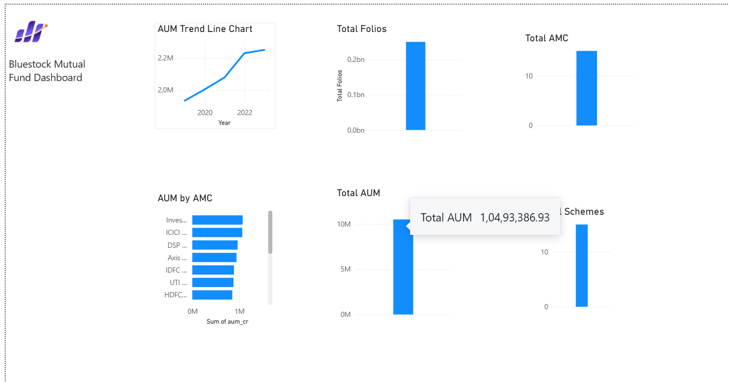
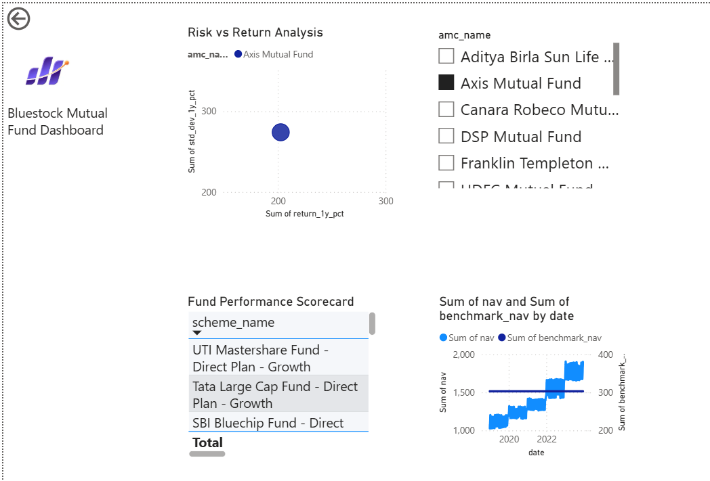
Dashboard – Executive Overview & Fund Performance
Bluestock Fintech | Mutual Fund Analytics Capstone | Prethivraj GS | Anna University

Slide 10
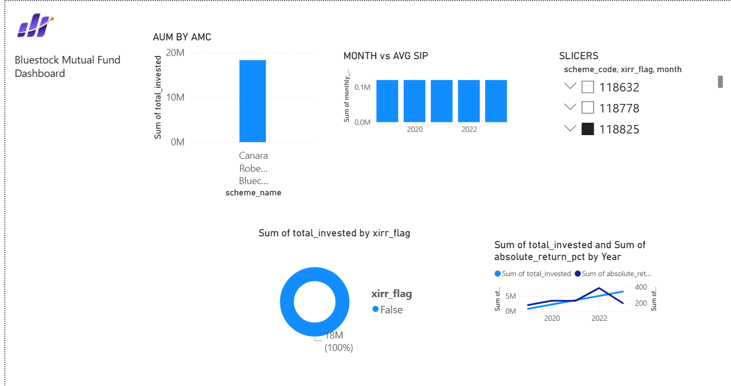
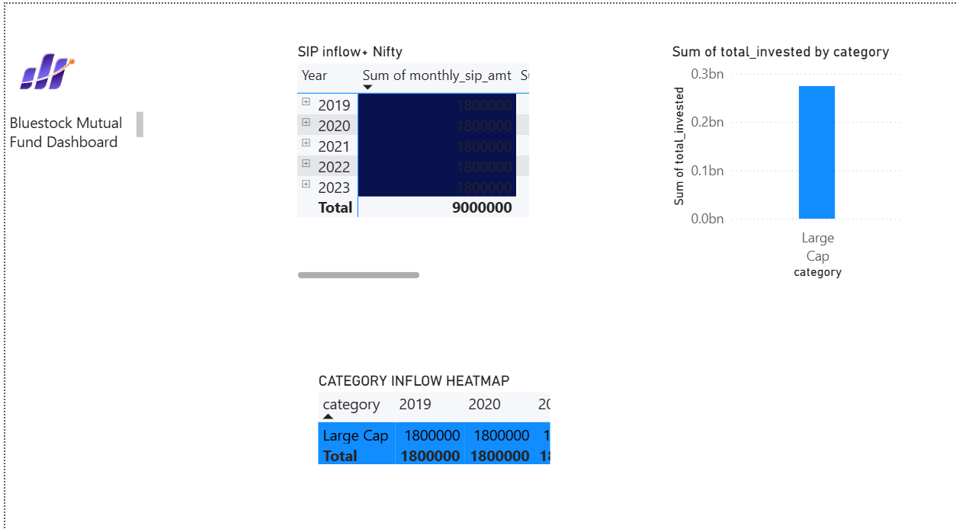
Dashboard – Risk Analytics & Investment Recommendations
Bluestock Fintech | Mutual Fund Analytics Capstone | Prethivraj GS | Anna University

Slide 11
Key Findings
Performance
Risk
SBI and ICICI Bluechip funds consistently outperform their Nifty 50 benchmark on a risk-adjusted basis
Axis Bluechip shows the highest Sharpe Ratio, indicating superior return per unit of risk
Direct plan funds deliver 0.5–1% higher CAGR over regular plans due to lower expense ratios
VaR analysis shows large-cap equity funds carry moderate daily tail risk (~2–3% at 95% CI)
Debt funds exhibit near-zero Beta and minimal drawdown, confirming low-risk positioning
High SIP continuity in equity funds signals strong long-term investor confidence
End-to-end pipeline: raw CSV ingestion → live NAV ETL → SQL storage → analytics notebooks → Power BI dashboard
Bluestock Fintech | Mutual Fund Analytics Capstone | Prethivraj GS | Anna University

Slide 12
Thank You
Prethivraj GS
Computer Science Engineering | Anna University
Bluestock Fintech – Data Analyst Internship
github.com/PrethivrajGS/bluestock_mf_capstone

