Slide 1


TEAM NAME: The Codevengers
TEAM LEAD: Saharsh Vadlakonda
MEMBER 1: Pratik Boda
MEMBER 2: Sahiti Edupuganti
COLLEGE : CBIT

Slide 2
PROBLEM STATEMENT
LIFESTYLE AND ENVIRONMENT:
In this category, participants should work on ideas and projects that enhance lifestyles while considering the environment. This can include sustainable solutions, eco-friendly innovations, or initiatives that improve the overall quality of life.
OVERVIEW:
Minimizing food wastage by redistributing excess food from F&Bs to charities.
APP NAME:
NourishNeighbours

Slide 3
MOTIVATION:
Quality of Life: Addressing hunger and food insecurity improves the basic standard of living.
Environmental Impact: Reducing food wastage contributes to sustainability by decreasing the need for additional waste disposal facilities.
Food waste is a massive issue globally, with up to 40% of food wasted while people go hungry.
As we know, our world is battling high food wastage, widespread hunger and extensive food insecurity. These are all problems that directly affect the basic quality of life. Moreover, higher food wastage also means that we would need to build more waste disposal facilities, which leads to an unnecessary increase energy consumption.
However, by distributing these food leftovers to people who are unable to afford food on their own, we can alleviate their standard of living. So the value of this product is the possibility of solving all the mentioned problems, without even increasing the food output.

Slide 4
KEY FEATURES
User Authentication: Secure access for F&Bs and charities.
Main Page: Centralized hub for food donation and request management.
Donation Matches: Intelligent algorithm for matching F&B donations with charity needs.
Charities: User-friendly interface for charities to manage donation requests.
Restaurants: Simple donation form for F&Bs to list excess food items.
Donation Form/Inbox: Streamlined process for donation creation and management.

Slide 5
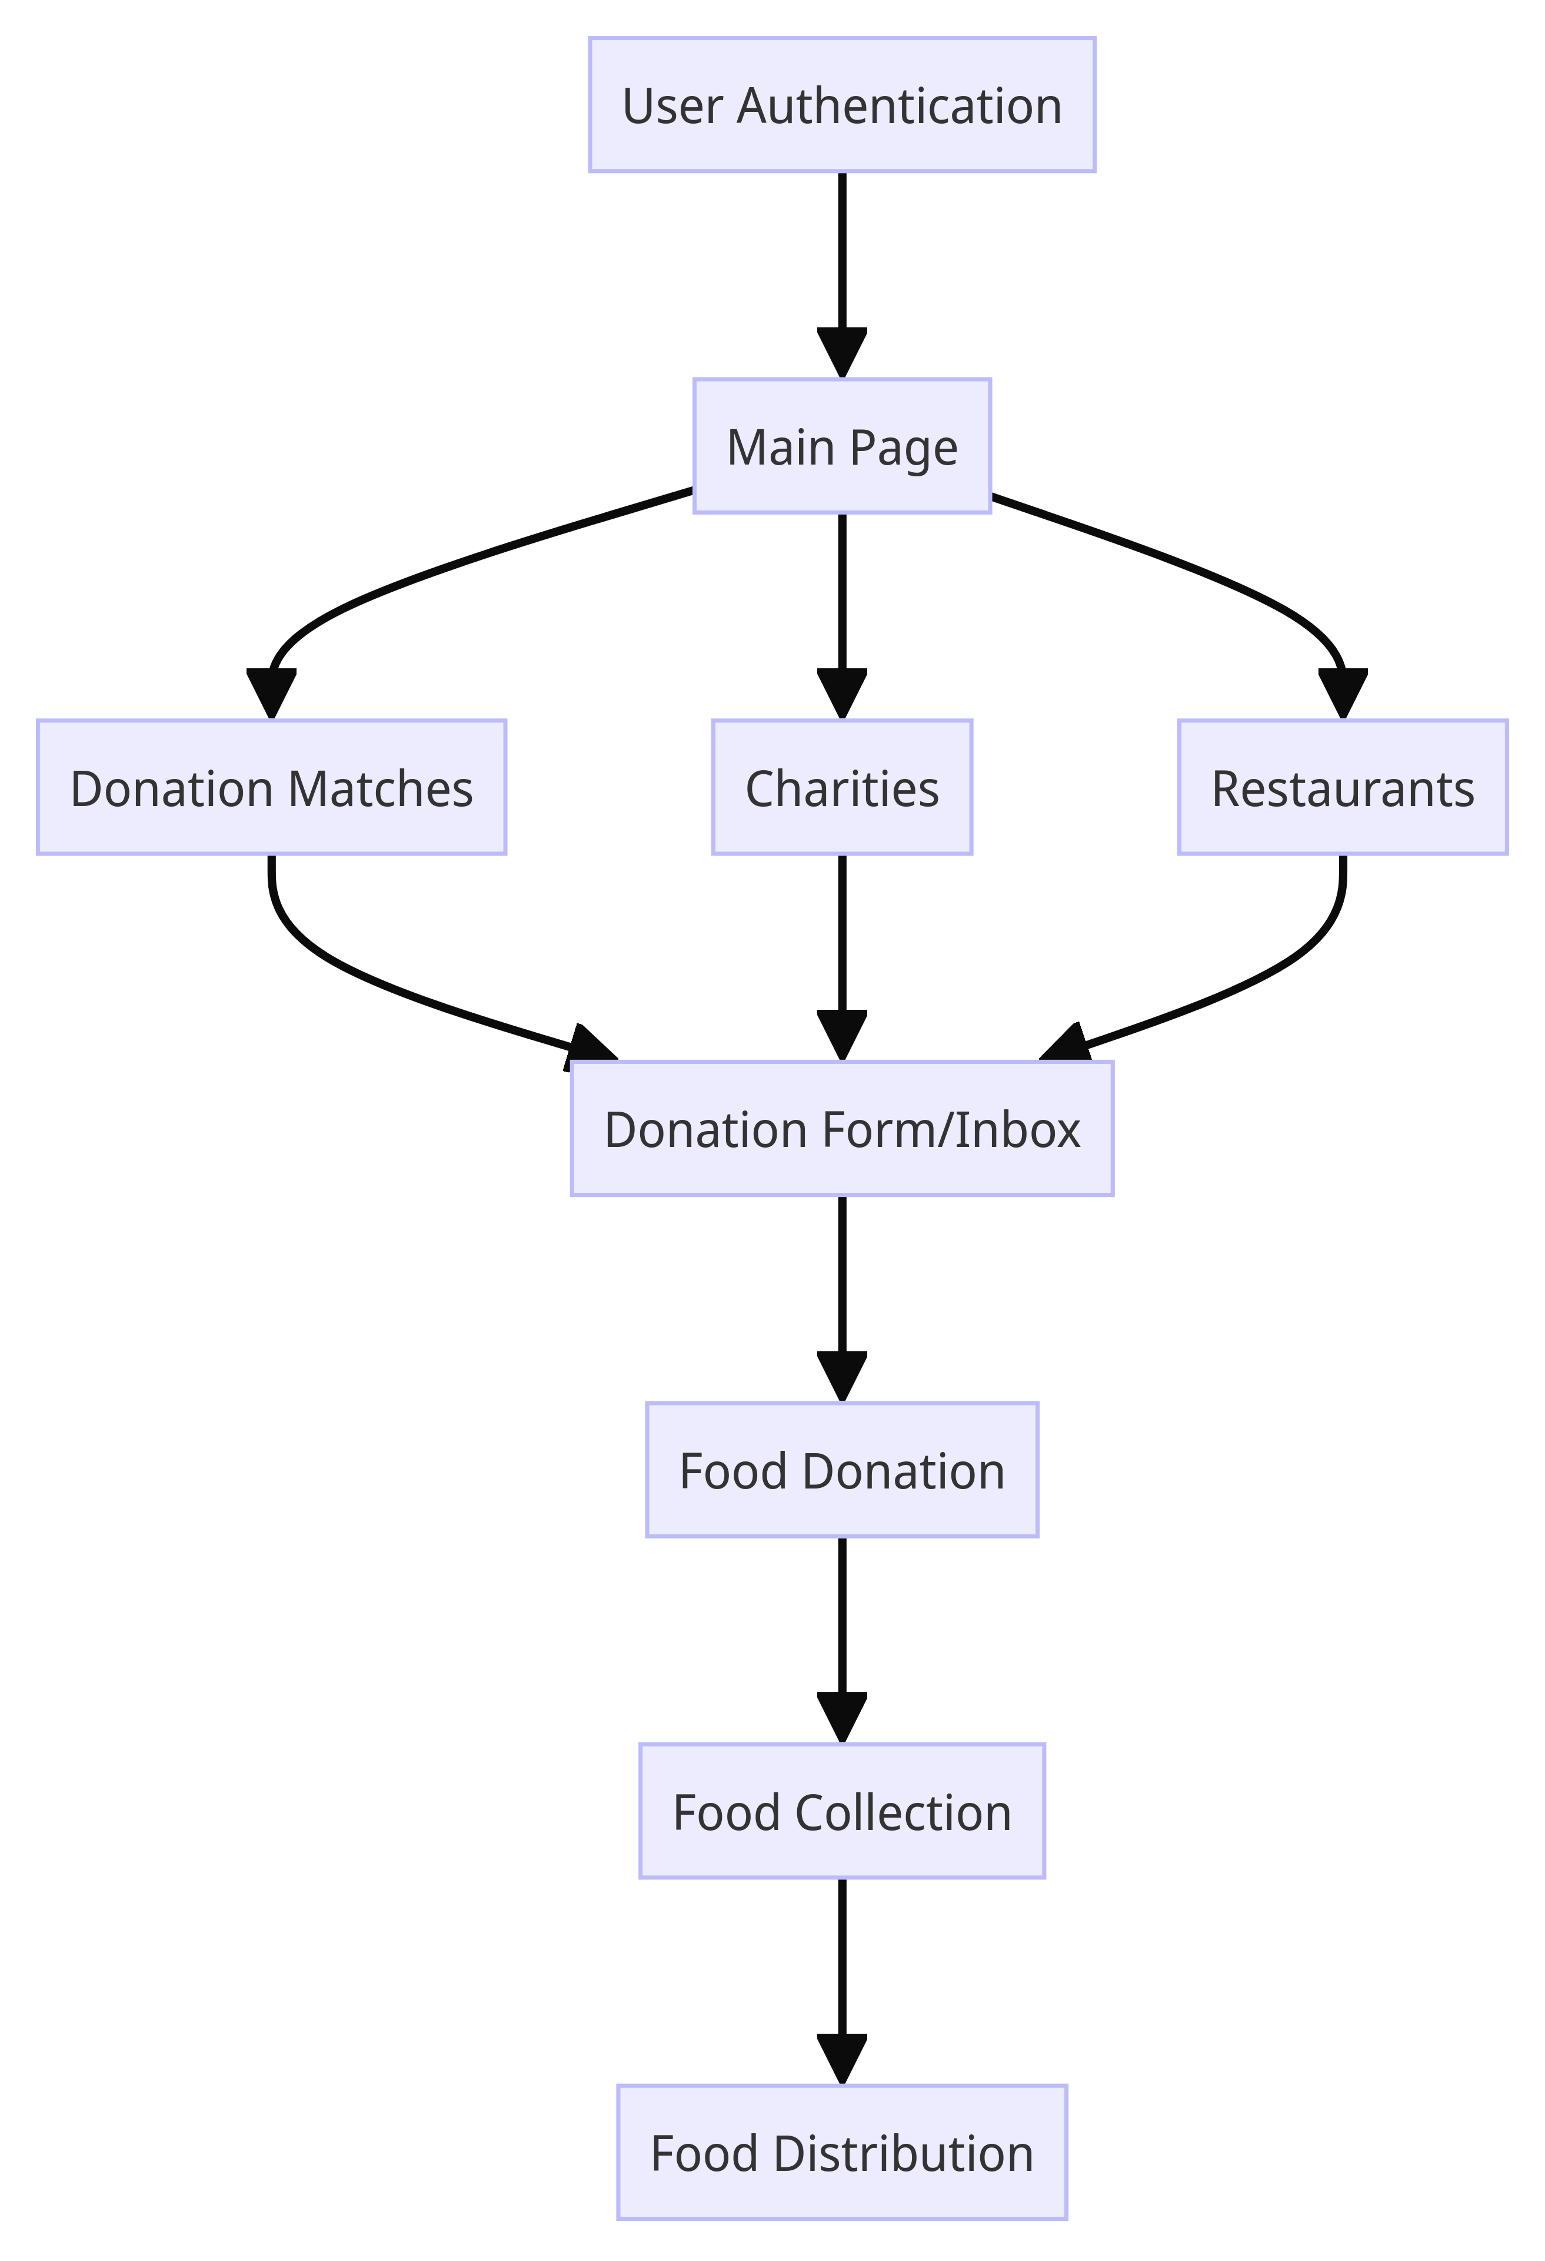
Future Enhancements
Real-time Tracking: Implement a real-time tracking system for donated food.
User Ratings: Introduce a rating system to build trust and accountability within the community.
Expand to Other Regions: Scale the platform to address food insecurity on a global scale.
TECH STACK
Html
CSS
Javascript
Google Cloud Platform (GCP)
Google Cloud SDK (gcloud)
React
Python
SQLite

Slide 6
ADDITIONAL FEATURES:
Route Optimization: Travelling Salesman For Shortest Path.
Nutritional Analysis - Providing nutritional information for donated food to help charities match items to dietary needs and restrictions of recipients.
Adding points, badges, and leaderboards to incentivize usage and engage users. F&Bs and charities can compete on donations provided and food redistributed.
CONCLUSION:
NourishLink. isn't just a platform; it's a movement towards a more sustainable and compassionate world. Join us in making a real impact on food wastage and hunger.
It is Effective solution to improving lifestyles and the environment

Slide 7
THANK YOU

