Slide 1
In-Line Quality Inspection Strategy
± 5 µm
vs
90 s
CASE STUDY & SEMINAR · AUTOMATION IN MANUFACTURING
Comparative analysis of Coordinate Measuring Machines against non-contact vision and laser inspection, for an automated engine cylinder-block line
Target COs: CO-1, CO-5 SDG 9 — Industry, Innovation & Infrastructure SDG 4 — Quality Education
Notes:
Good morning. The question put to the plant is a choice between a CMM and a non-contact vision system for inspecting engine cylinder blocks. I will argue that the choice as posed is a false alternative, and that the arithmetic of the line settles it.

Slide 2
The problem: inspection has become the bottleneck
Automated cylinder-block line · blocks are currently carried off the line for offline dimensional checking
90 s
800
25 min
2.0 %
line takt time
blocks per day
(two shifts)
to inspect one block
on a CMM
present scrap
and rework rate
Two consequences
Inspection is the throughput bottleneck — the line waits on the inspection room.
Far more damaging: the DETECTION LAG. With sampling only, a drifting bore diameter is found long after a batch of blocks has already been machined to the wrong size.
Scrap is therefore not a measurement problem but a feedback-speed problem.
Notes:
The real cost is not the inspection labour. It is that a process drift is discovered sixteen blocks too late.

Slide 3
What this seminar covers
Three analyses, then a recommendation
Tactile CMM
1
Structural configurations · drive control · probe systems · accuracy tests, laser-interferometric calibration and error compensation
Non-contact inspection
2
3-D laser line scanners · CCD/CMOS machine vision · comparison across range, speed, accuracy, repeatability, reflectivity and environment
Decision
3
Weighted trade-off matrix · throughput arithmetic · economics · final engineering recommendation
Notes:
I will take the two technologies in turn, compare them on the parameters that matter, and then let the throughput arithmetic decide the architecture.

Slide 4
Four structural configurations
Which structure suits which part — the trade-off between accuracy, stiffness, access and part size
Moving bridge
Fixed bridge
Bridge travels over a fixed granite table
Bridge fixed, the TABLE moves
+ Best accuracy-to-cost; part mass does not enter the dynamics
– Bridge yaw if single-driven
+ Highest accuracy — the metrology frame never moves
– Moving table limits part weight
Cantilever
Gantry / Horizontal arm
Probe on an arm from one side
Self-supporting frame / horizontal quill
+ Open on three sides — easy robot loading; small footprint
– Arm deflects with extension
+ Very large volumes; part craned in; good access to vertical faces
– Lower accuracy per metre; arm droop
Heavy parts (a 38 kg block) → moving bridge. Light parts → cantilever. Very large parts → gantry.
Notes:
For a 38 kg cylinder block the moving bridge is the answer: the part stays still, so its mass never enters the servo dynamics.

Slide 5
Drive control and probe system
Both selections are forced by the need to run unattended inside a production cell
Drive control
Probe system
Manual (free-floating)
Touch-trigger
operator pushes the carriages — repeatability depends on the operator. Rejected.
3–5 points per second. Sizes and positions only. Main error is pre-travel variation — the trigger force changes with approach direction.
Motorised / joystick
consistent approach speed, but still operator-paced. Teaching only.
Continuous scanning
Hundreds to thousands of points per second. Measures FORM — roundness, cylindricity, profile. SELECTED.
Direct Computer Control
a part program drives the probe — repeatable, unattended, line-triggerable, and the only option that can scan. SELECTED.
Cylinder bores need cylindricity — and that cannot be certified from a handful of discrete points.
Notes:
DCC and a scanning probe are not preferences here; the application forces both.

Slide 6
Accuracy, calibration and traceability
A CMM is itself a measuring instrument — it must be calibrated and periodically reverified
3
6
9
3
21
linear positioning
(scale) errors
straightness
errors
angular errors
(pitch, yaw, roll)
squareness errors
between axis pairs
rigid-body error
components in total
How they are measured
Compensation and acceptance
Laser interferometry — linear positioning directly; pitch and yaw with angular optics; straightness with Wollaston optics
Roll by electronic level or autocollimator
Squareness by granite square, ball plate or ball bar
Air temperature, pressure and humidity fed in to correct the refractive index
The 21 components are loaded as a CAA volumetric compensation map — every point corrected in real time, improving volumetric accuracy 3–10×
ISO 10360-2 (IS 15250): length error E₀,MPE and repeatability R₀
ISO 10360-5: probing form error P on a calibrated sphere
ISO 10360-4: scanning probing error THP
Notes:
The key practical point: the quoted accuracy is only valid inside the thermal window, which is exactly why this CMM must be near-line in a climate-controlled room, not on the open floor.

Slide 7
Two non-contact technologies
Both trade absolute accuracy for speed and coverage
3-D laser line scanner
CCD / CMOS machine vision
A laser line is projected on the part and imaged by a camera at a known angle; triangulation gives 3-D coordinates.
A telecentric lens images the feature, usually back-lit in silhouette; sub-pixel edge detection locates the edge.
10 000 – 600 000 points per second — a whole block in 2–5 min
Full-field point cloud → colour deviation map against CAD
20–50 µm per point; 10–30 µm for a fitted feature
Accepted to VDI/VDE 2634, not ISO 10360
Weak on shiny, dark or translucent surfaces — dropout and noise
Sub-second per view — a full station fits inside a 90 s takt
50 mm field on a 5 MP sensor ≈ 20 µm per pixel; ~10–30 µm real accuracy
Telecentric optics are essential — constant magnification with height
Global-shutter CMOS specified; a rolling shutter distorts a moving part
Two-dimensional, line of sight — blind bores are unreachable
Notes:
Note the traceability gap: laser scanners are accepted to VDI/VDE 2634, which is not the standard a customer will cite.

Slide 8
Head to head on the parameters that matter
Parameter | Tactile CMM | 3-D laser scanner | CCD / CMOS vision
Speed per block | 25 min | 2 – 5 min | 45 s
Accuracy | 1.9 + L/300 µm | 20 – 50 µm | 10 – 30 µm
Repeatability | 0.5 – 2 µm | 5 – 20 µm | 2 – 10 µm
Surface reflectivity | Not affected | Highly sensitive | Moderately sensitive
Coolant mist and dust | Part must be clean | Beam scatter, dropout | Needs sealed, purged optics
Vibration | Most sensitive | Tolerant | Most tolerant
Blind / internal features | Reaches them | Line of sight only | Line of sight only
GD&T capability | Full | Form and profile | Limited, 2-D
Traceability standard | ISO 10360 / IS 15250 | VDI/VDE 2634 | Gauge R&R only
In-line capability | Near-line at best | Feasible on a robot | Excellent
Notes:
No single column wins. The CMM owns accuracy and traceability; vision owns speed and in-line capability.

Slide 9
The arithmetic that settles it
A 1 500 s inspection cannot live inside a 90 s takt
1 500 s
÷ 90 s
17
6 %
full GD&T inspection
on the CMM
line takt time
CMMs needed for
100 % inspection
sampling one CMM
can actually achieve
In-line vision + laser: 45 s < 90 s takt → 100 % of blocks gauged, every one
Seventeen CMMs is not an engineering proposal. A CMM can therefore only ever sample — and sampling one block in seventeen means a drift is found, on average, sixteen blocks too late. That is the very failure the plant is trying to eliminate.
Notes:
This single calculation decides the architecture. Everything else is detail.

Slide 10
Weighted trade-off matrix
Seven criteria, weighted for this plant's problem — scores out of 5
Criteria and weights
25 %
Cycle time and throughput
20 %
Accuracy on the CTQ features
15 %
GD&T and datum capability
15 %
In-line integration
10 %
Robustness to mist, dust, vibration
10 %
Capital and operating cost
5 %
SPC / MES data integration
Notes:
The hybrid scores 4.60. It wins because it is the only option that is strong on both of the top two weighted criteria.

Slide 11
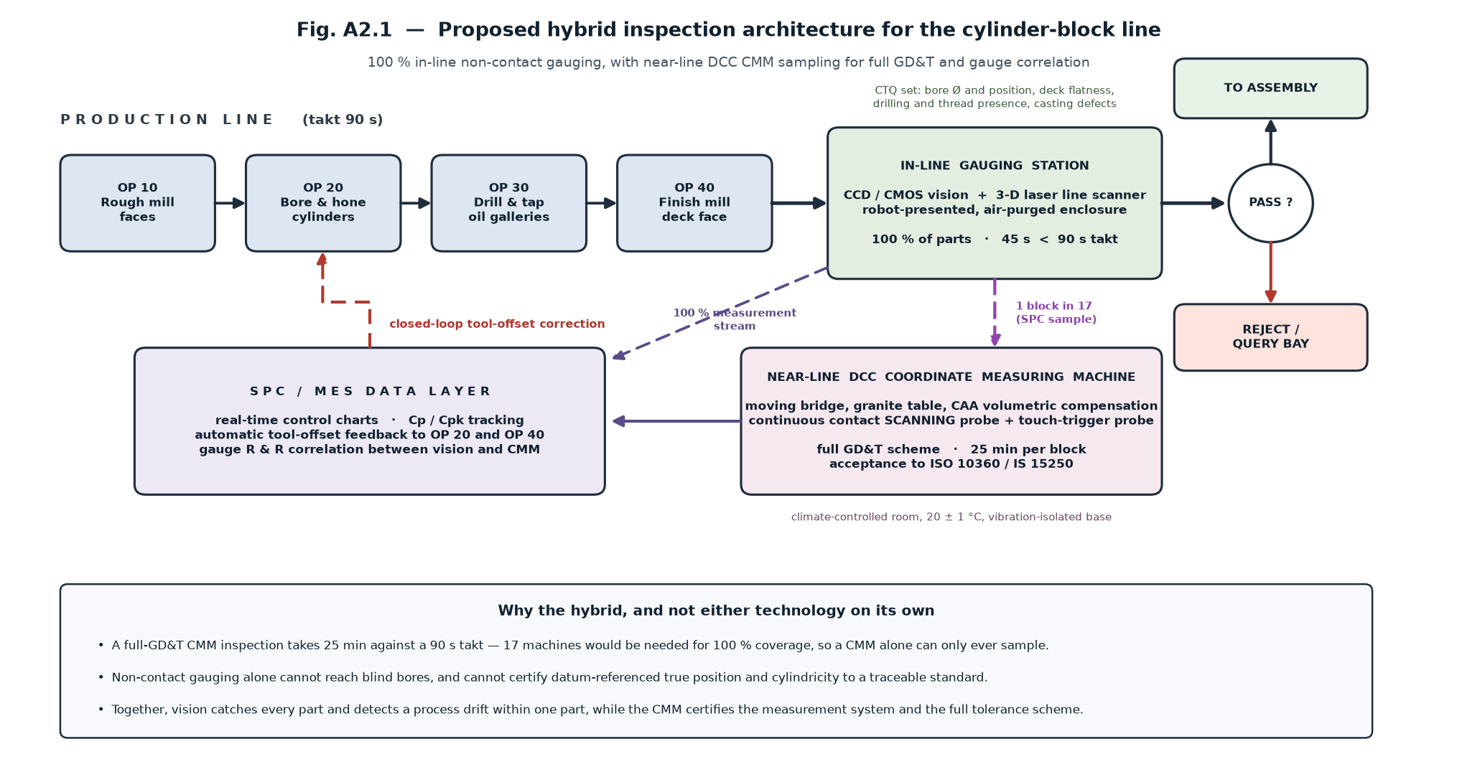
Recommendation: a hybrid architecture
100 % in-line non-contact gauging, backed by a near-line DCC scanning CMM sampling 1 block in 17
In-line station
Near-line CMM
Closed loop
100 % · 45 s · bore Ø and position, deck flatness, drilling and thread presence
1 in 17 · 25 min · full GD&T to ISO 10360, and the reference for gauge R&R
tool offsets fed back to OP 20 and OP 40 — a drift corrected within one part
Notes:
Neither technology alone is sufficient. Together they are complementary: vision gives coverage, the CMM gives traceability and acts as the reference instrument.

Slide 12
The business case, and what to do next
₹ 1.35 cr
₹ 1.30 cr
≈ 1.0 yr
annual saving from cutting
scrap 2.0 % → 0.5 %
total capital
(vision ₹45 L + CMM ₹85 L)
simple payback
Illustrative figures — the structure of the case is what matters: the saving is driven by the scrap improvement and is an order of magnitude larger than the difference in capital between the options.
Two conditions for success
Correlate the gauges formally — quarterly gauge R&R between the in-line station and the CMM, with in-line control limits guard-banded inside the drawing tolerance by the measured uncertainty.
Protect the optics — a sealed, filtered, positive-pressure enclosure with an air knife. Most in-line vision installations that fail, fail for this reason, not for want of resolution.
Thank you — questions welcome
Notes:
To close: the choice as posed was a false alternative. The throughput arithmetic rules out a CMM as a 100 % instrument, and line-of-sight physics rules out vision as a complete substitute. The hybrid scores 4.60 out of 5 and pays back in about a year.

