Slide 1


INTRODUCTION
Company Name:
NEXTHIKES IT SOLUTIONS
Project Name:
SCIENTIFIC CALCULATOR USING PUTHON AND TKINTER
Presented By:
PREYANSHI PANCHOLI

Slide 2
Project Overview
Created a Graphical Scientific Calculator using python
Includes basic arithmetic and advanced functions
Trigonometric (sin, cos , tan)
Logarithmic (log, exp )
Constants (π ,e)
Factorial, square root, percentage
Memory operations (MC , <R , M+, M-)
UNIQUENESS:
Memory functionality
Clear button with standout design (red, color)
Keyboard bindings for smooth user experience

Slide 3
Libraries and GUI
• CUSTOM THEMES:
Button color styles for improved UI/UX
3
• MESSAGE BOX:
Prepared for error handling, though not used in final version
2
• Tkinter:
For GUI design.
MATH:
For advanced mathematical operations
1

Slide 4

Challenges Faced
• Challenge: Managing complex math operations and errors
Solution: used TRY-EXCEPT to handle evaluation and invalid inputs
•Challenge: GUI alignment and layout
Solutions: used grid layout with dynamic row/column weights
Challenge: Keyboard input handling
Solution: Added key bindings for smoother usability
Challenge: Implementing memory functions
Solutions: Added variables to store, retrieve and modify memory

Slide 5
References
• Python official documentation.
(https://docs.python.org)
• Tkinter GUI examples on Github
Stake Overflow for troubleshooting errors
• Math module reference.
(https://docs.python.org/3/library/math.html)
• TutorialsPoint / GeeksforGeeks (tkinter tutorials)

Slide 6
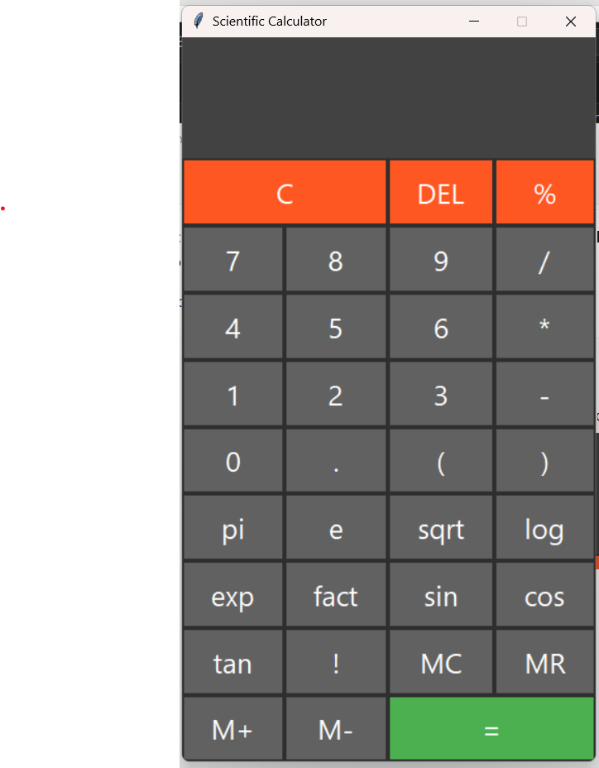

Slide 7
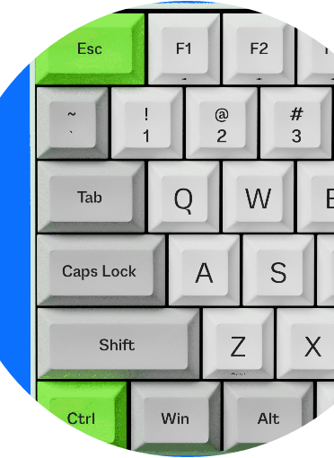
Thank You
Thank you for your attention!

