Slide 1
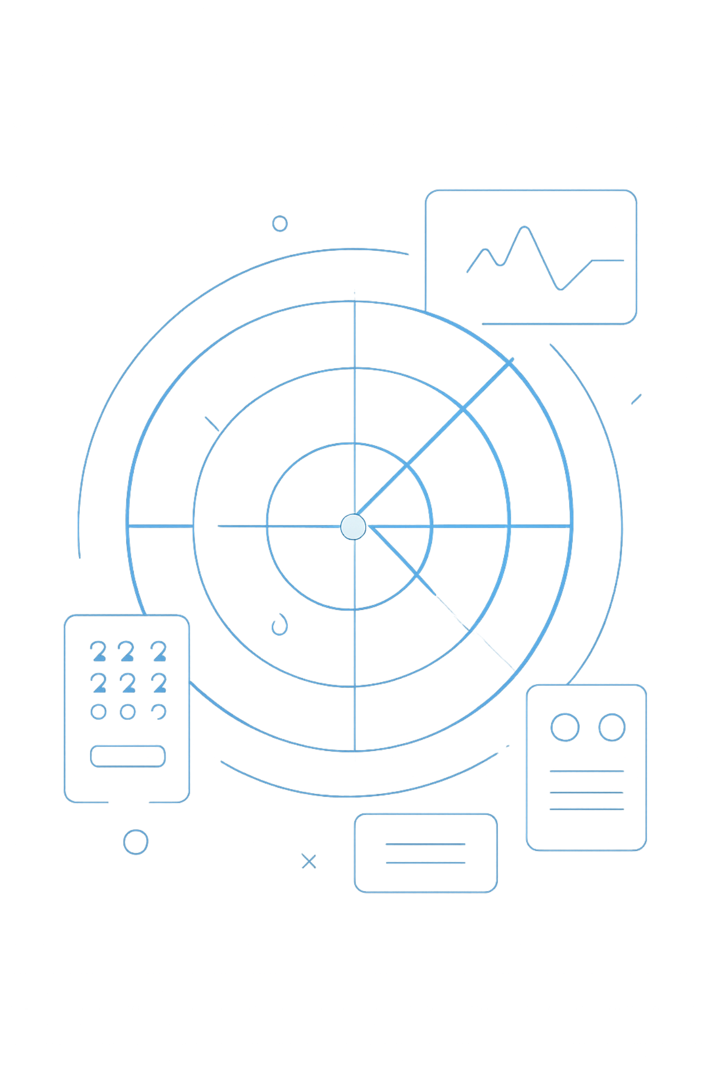
Threat Intelligence: Smart Security for Your Network
Introducing ClearSignal AI — the system that cuts through the noise and finds real cyber threats before it's too late.

Slide 2


The Problem: Alert Fatigue
10,000+
Security alerts every single day — too many for any human to read
Mostly False Alarms
Like a bird triggering a motion sensor — harmless, but the alarm still goes off
Real Attacks Get Missed
Analysts are exhausted and distracted — dangerous threats slip right through
This is called "Alert Fatigue" — and it's one of the biggest problems in cybersecurity today.

Slide 3

What is a Cyber Attack?
A hacker tries to break into a company's computer network — to steal data, shut down systems, or cause serious damage.
Attacks happen constantly, around the clock
Most are blocked automatically by basic defenses
The real danger: we can't easily tell a fake alarm from a real attack

Slide 4

Why Current Systems Fail
Every suspicious activity triggers an alert — even completely harmless ones. Here's what analysts actually see:
🔔 Employee logs in from a new location
🔔 Routine system backup runs overnight
🔔 Real hacker stealing passwords
Flagged as suspicious → Alert sent
Flagged as suspicious → Alert sent
Flagged as suspicious → Alert sent
All three look identical. Analysts can't tell which one is actually dangerous.

Slide 5




Our Solution: ClearSignal AI
Filters False Alarms
Automatically ignores the noise so analysts don't have to
Identifies Real Threats
Shows only the 3–5 alerts that actually matter
Writes the Report
Delivers a clear summary straight to the security commander

Slide 6

How ClearSignal Works: Step 1 — Filter
What gets filtered out?
Employee logging in at a normal time
Routine nightly backups
Standard software updates
Incoming Alerts
Suspicious Alerts
ClearSignal Filter
What moves forward?
Anything that doesn't match normal, everyday behavior gets flagged and passed to Step 2 for a closer look.

Slide 7



How ClearSignal Works: Step 2 — Analyze
Act Like a Detective
Check the Database
Name the Attacker
Example: 500 failed logins = "Brute Force Attack" → likely from hacker group Red Dragon
ClearSignal looks at suspicious alerts and asks: "Have I seen this before?"
It compares the alert against a library of known hacker methods and attack patterns

Slide 8

How ClearSignal Works: Step 3 — Report
Once a real threat is confirmed, ClearSignal writes a simple, clear summary — no technical jargon, just the facts.
🚨 ALERT: Brute Force Attack detected on Server A.
Hacker group: Red Dragon.
Status: Blocked.
The report goes directly to the security commander
The boss sees exactly what happened and what to do next
No guesswork. No delay. Immediate action.

Slide 9
The Impact: Before vs. After ClearSignal
❌ Before ClearSignal
✅ After ClearSignal
Analysts face 10,000 alerts every day
Real attacks get lost in the noise
Response time: hours
Damage already done before anyone notices
Analysts see only 3–5 real alerts
Every real attack is caught
Response time: minutes
Attacks stopped before any damage is done
10,000
5
~90%
Alerts Before
Alerts After
Faster Response
Overwhelming — impossible to manage manually
Only what truly matters reaches the analyst
From hours of delay to minutes of action

Slide 10

Why This Matters
Cyber attacks are not just a tech problem — they affect real people and real money.
Millions Lost Every Year
Companies lose enormous amounts of money to cyber attacks that could have been stopped
Your Data at Risk
A single breach can expose the personal information of thousands of customers
ClearSignal Changes the Game
Security teams can finally focus on what actually matters — stopping real threats before they cause harm

