Slide 1
Internship type- IDP Company Name- Brainly beam
Conatct Person- Sagar Sir Contact Number- 9033237336
Precious
Property
G U I D E D
B Y : -
B Y - A K S H A T
S H A H
( I U 1 9 4 1 2 3 0 1 4 5 )
A S | S | T . P | R | O | F . H | I | R | E | N | V | M | E | R | C S E | - C
 |  |  |  |  |  |  |  |  |  |  |  |  |  | 8 T H | S E | M

Slide 2
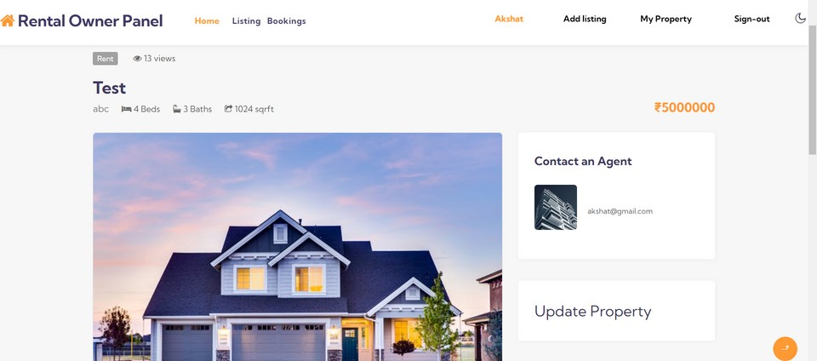


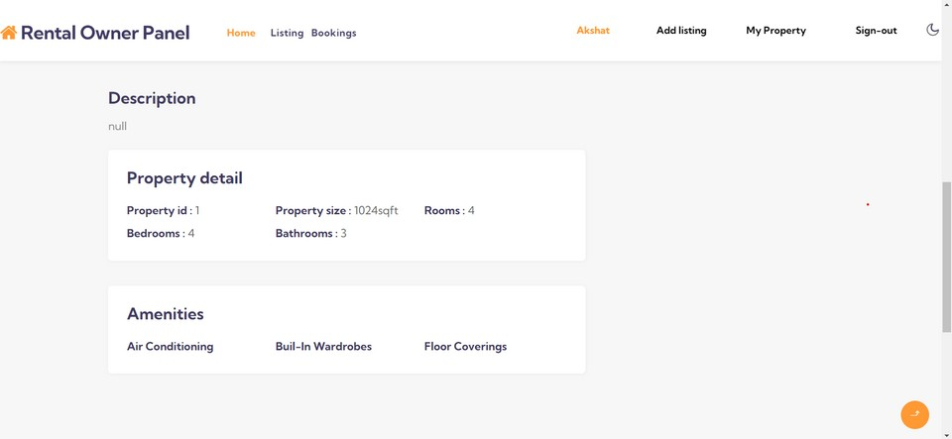



Property Page
Heading
The heading of the property with basic info is placed .
Views
Total how many times the users have visited this property .
Update
The information including the name and the description can be updated by the owner.
Description
All the information which was filled in the listing form will be shown.

Slide 3
USER'S HOME PAGE
In this page user will be able to search the property and the normal listing will be according to the ratings of the users .

Slide 4

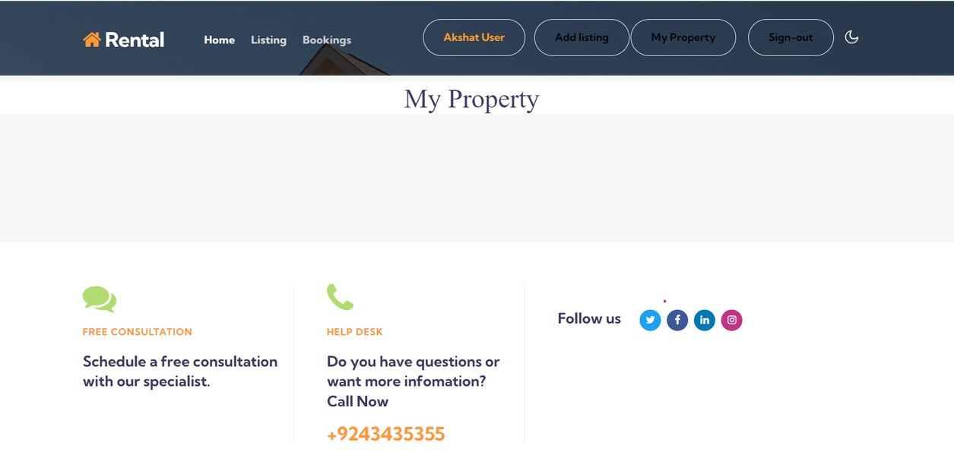

PROPERTY PAGE
If the user wants to sell any property then that user has to add it from add listing option and after that the property will be visible in this page.

Slide 5

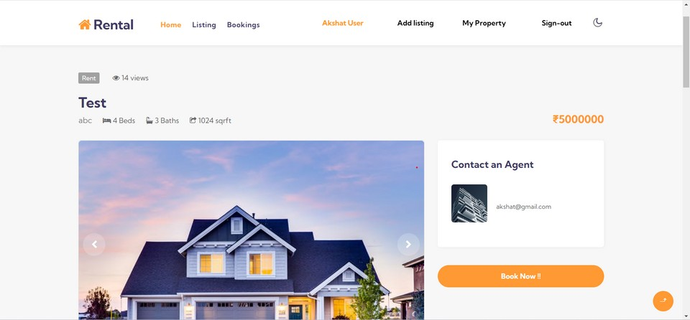


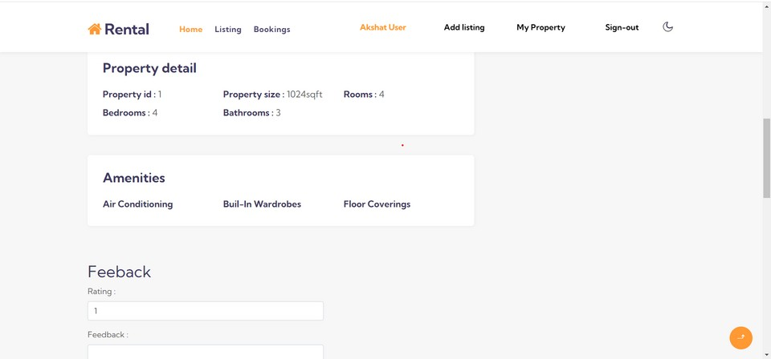

BUYING PAGE
From this page the user will be able to send the request for booking to the owner and also will be able to give feedback and ratings.

Slide 6






Thank You

