Slide 1
Internship type- IDP Company Name- Brainly beam
Conatct Person- Sagar Sir Contact Number- 9033237336
Precious
Property
G U I D E D
B Y : -
B Y - A K S H A T
S H A H
( I U 1 9 4 1 2 3 0 1 4 5 )
A S | S | T . P | R | O | F . H | I | R | E | N | V | M | E | R | C S E | - C
 |  |  |  |  |  |  |  |  |  |  |  |  |  | 8 T H | S E | M

Slide 2

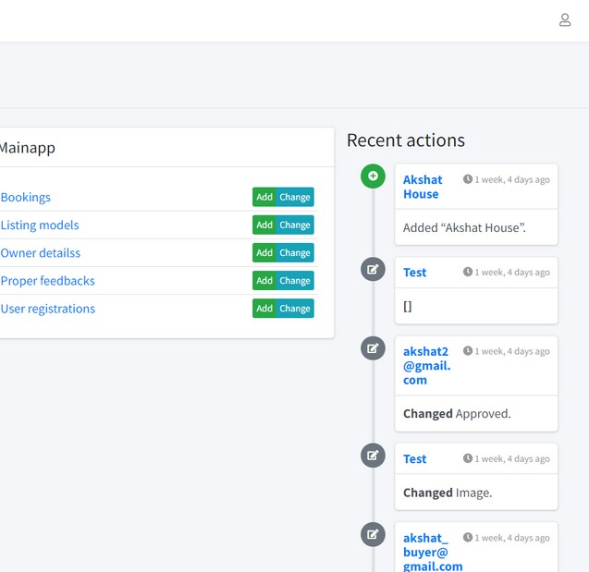
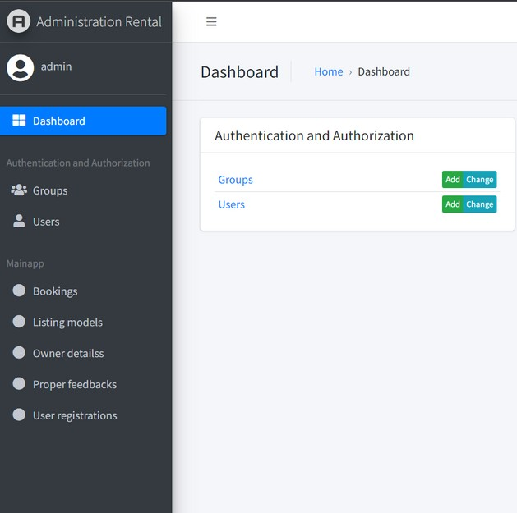




MODELS
Bookings
In this model all the bookings which are requested will be placed.
LIST I NG MODEL
In this model all the properties which are added by the owner/broker will be present here.
OWNER DETAILS
In this model the signup details of the owner will be present .
PROPER FEEDBACK
In this model the Feedbacks given by the users to the property listed will be present here .
USER REGISTRATIONS
In this model the signup details of the users will be present .

Slide 3
ADD LISTING
Through the add listing option the owners can add the property for rent or sell on the main dashboard.

Slide 4

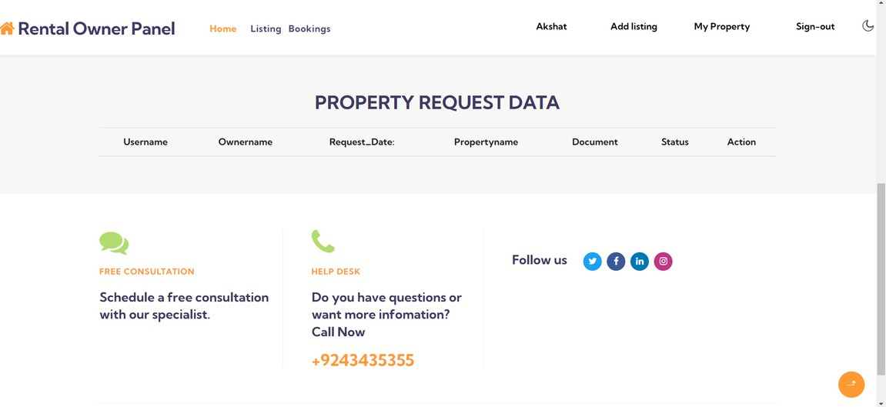


Bookings page
The properties which are interested by the user will be shown on this page
.

Slide 5




FILTERS
Appartment Type
Price
Price From
Price To

Slide 6




Thank You

