Slide 1
BCSE497J • PROJECT I • REVIEW II
URBAN GROWTH SIGNALS
Urban Expansion &
Ghost-Growth Detection
A Multi-Signal Framework for Urban Intelligence
VARANASI • INDIA
2010 → 2024
BUILT-UP
NIGHT LIGHT
EXPANSION
REMOTE SENSING × SPATIAL INTELLIGENCE
TEAM
PROJECT GUIDE
Mayank 23BCE1753
Mohammad Owais 23BCE1746
Achal Pramod Tripathi 23BCE1734
Dr. Joshan

Slide 2
The Core Problem in One Number
Table (summary)
Core Gap
Big Metric
Built-up area grew 2.3× faster than population (2010–2020)
Built-up surface: +23.8% (72.48 → 89.73 km²)
Population: +10.3% (4.17M → 4.60M)
Land consumption outpaces housing demand; no municipal record of occupancy for new built land.

Slide 3
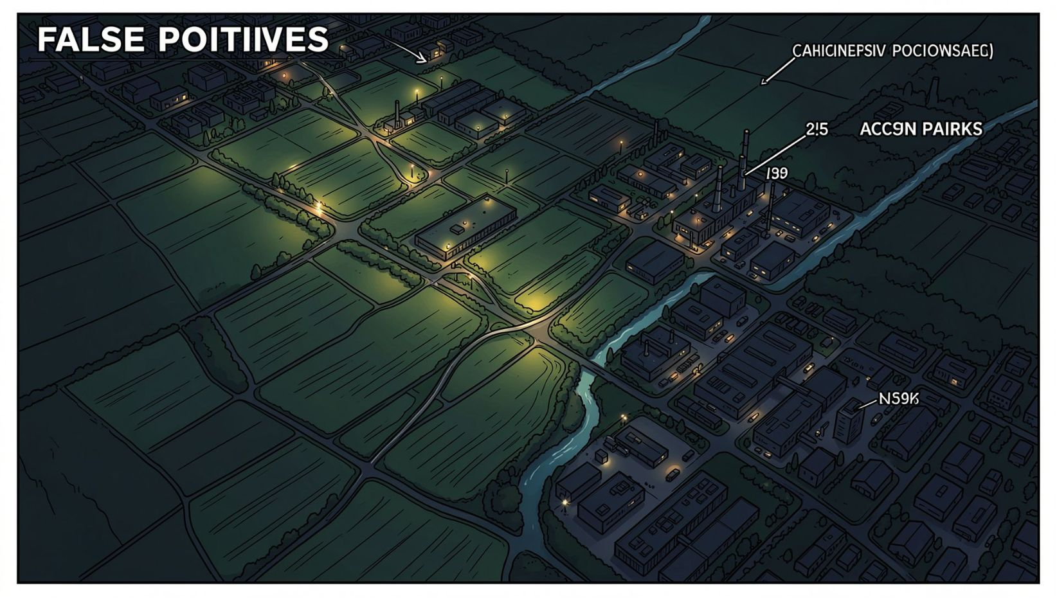
Problem Definition & Detection Challenges
1
2
Failure Mode — Low Nighttime Lights
Failure Mode — Low Population Density
False positives: agriculture, unlit industry — low radiance ≠ vacancy.
False positives: warehouses, commercial zones; density metrics misclassify function.
Requirement: Learn local dynamic norms; flag deviations; separate stalled zones from mid-occupation growth.

Slide 4
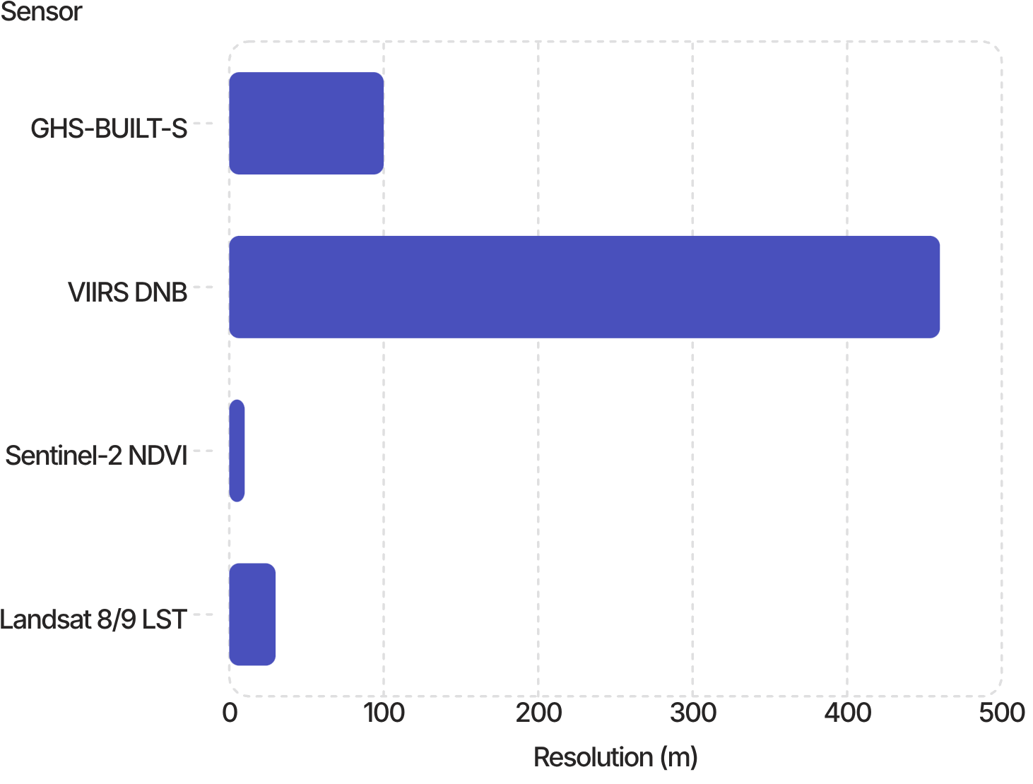
Sensor Domain & Resolution Limits
Data sources: GHS-BUILT-S (100 m), VIIRS DNB (~460 m), OSM POIs (vector), Sentinel-2 NDVI (10 m), Landsat 8/9 LST (30 m).
Critical limit: VIIRS ~460 m → valid inferences at neighborhood scale (≥500 m reporting). Not reliable at building scale.

Slide 5
Objectives & Scope
O1–O4
O5–O8
O1 Expansion quantification · O2 Typology classification · O3 Multi-signal index · O4 Ghost growth detection
O5 Green-cover loss attribution · O6 SUHI vulnerability · O7 Validated expansion model · O8 Interactive dashboard
Out of scope:
Scope: 1,206 km² AOI; analysis 100 m; reporting grid 500 m (4,765 cells).
Completed: All 8 objectives.
Building-level occupancy
Manual ground surveys
Causal socioeconomic attribution

Slide 6

Literature Review: Selection & Categorization
Set A — VIIRS Cross-Sensor
Zheng (2019); Li (2020); Zhao (2020); Chen Z. (2021); Nechaev (2021 Residual U-Net)
Ronneberger (2015); Nechaev (2021); Sirko (2021); Shojaei (2022); Wang (2022); Gui (2025)

Slide 7

Finding 1 — Accuracy is a Function of Scale
National 0.964
Province 0.874
City 0.747
Pixel 0.617

Slide 8
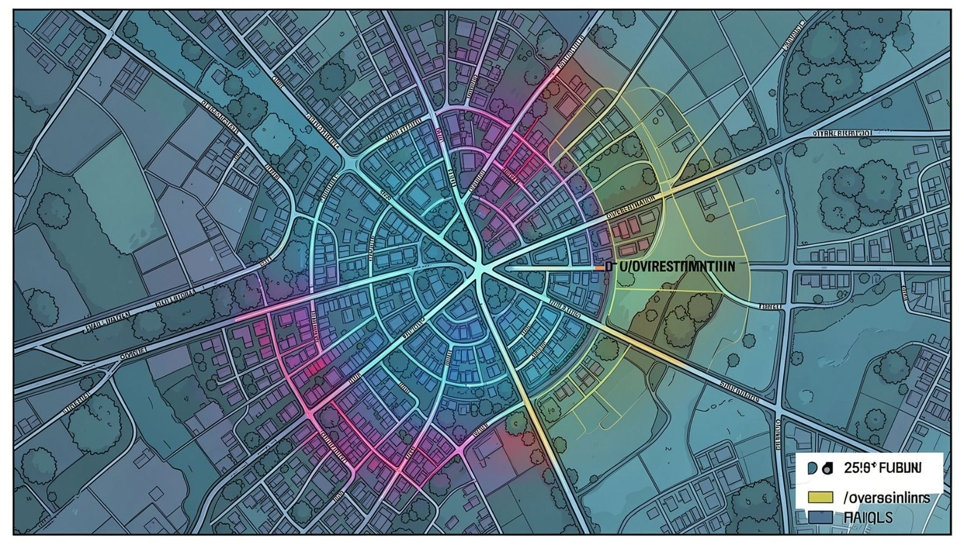
Finding 2 — Error Concentrates at the Fringe
1
2
Chen et al. 2024
ChenVNL
Underestimates fringe radiance → misses low-luminance outskirts.
Overestimates core radiance; underestimates peri-urban. Bias concentrated at edge-of-city.
Design decision: Use observed VIIRS (VNL V2, 2012–) only. Avoid harmonized synthetic series for fringe detection.

Slide 9
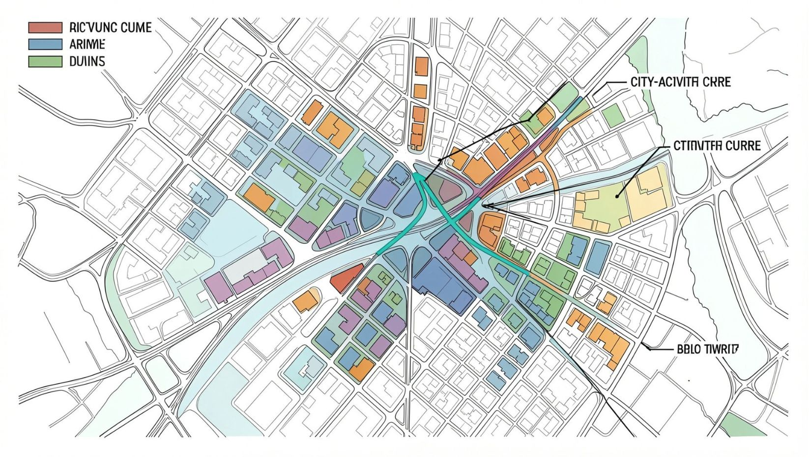
Finding 3 & Research Gap
U‑Net tradeoff
High automation cost (labels, GPUs) with marginal accuracy gain vs. Cellular Automata (Wang 2022).
Gap
Current methods use fixed global thresholds. Missing: City-specific activity curves + spatial form classification to detect stalled vs. emerging growth.

Slide 10
Dual-Path System Architecture
Paths:
Data acquisition: GHSL, OSM, WorldPop; Earth Engine: VIIRS, Sentinel-2, Landsat
Analysis (100 m, UTM 44N): built-up change, NTL trend, vegetation loss, thermal SUHI, ghost classifier
Zonal aggregation: 100 m → 500 m reporting grid (4,765 cells)
Interface: Streamlit 5-tab dashboard (explore, map, cell report, timeseries, export)

Slide 11
Presentation Roadmap
Objectives
Data & Processing
Methodology
Results
Detect, classify, and model peri‑urban expansion; quantify ghost‑growth.
Multi-source raster & vector fusion; reprojection & density-preserving transforms.
Composite indices, typology learning, constrained CA prediction.
Built extent, form decomposition, SUHI, activity trends, validation.
Risks & Ethics
Data lineage, mitigations, attribution, anonymization.

Slide 12
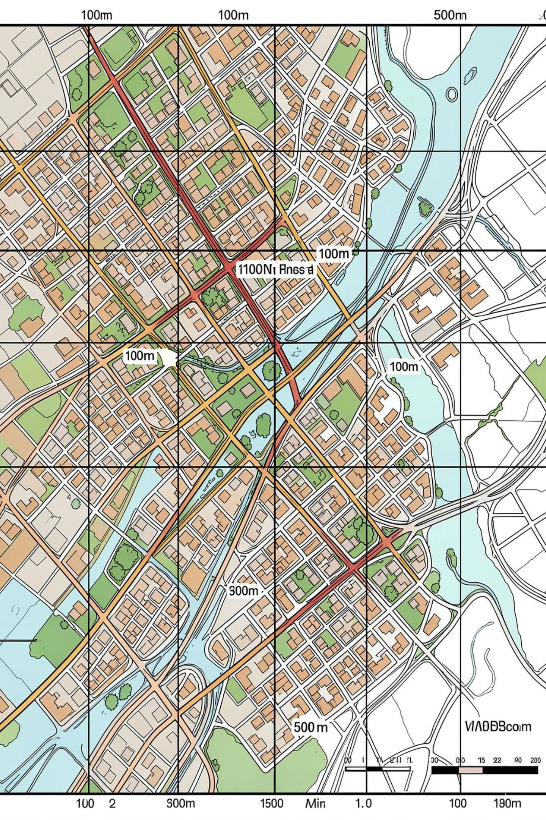

Data Strategy — Dual Grid Approach
Two spatial grains optimized for distinct tasks:
100 m grid — change detection & spatial form accuracy; preserves patch structure for leapfrog/infill classification.
500 m grid — reporting, population/area aggregates, computationally efficient for time-series summaries and public dissemination.
Use 100 m for algorithmic detection; aggregate to 500 m for policy reporting and density maps.

Slide 13
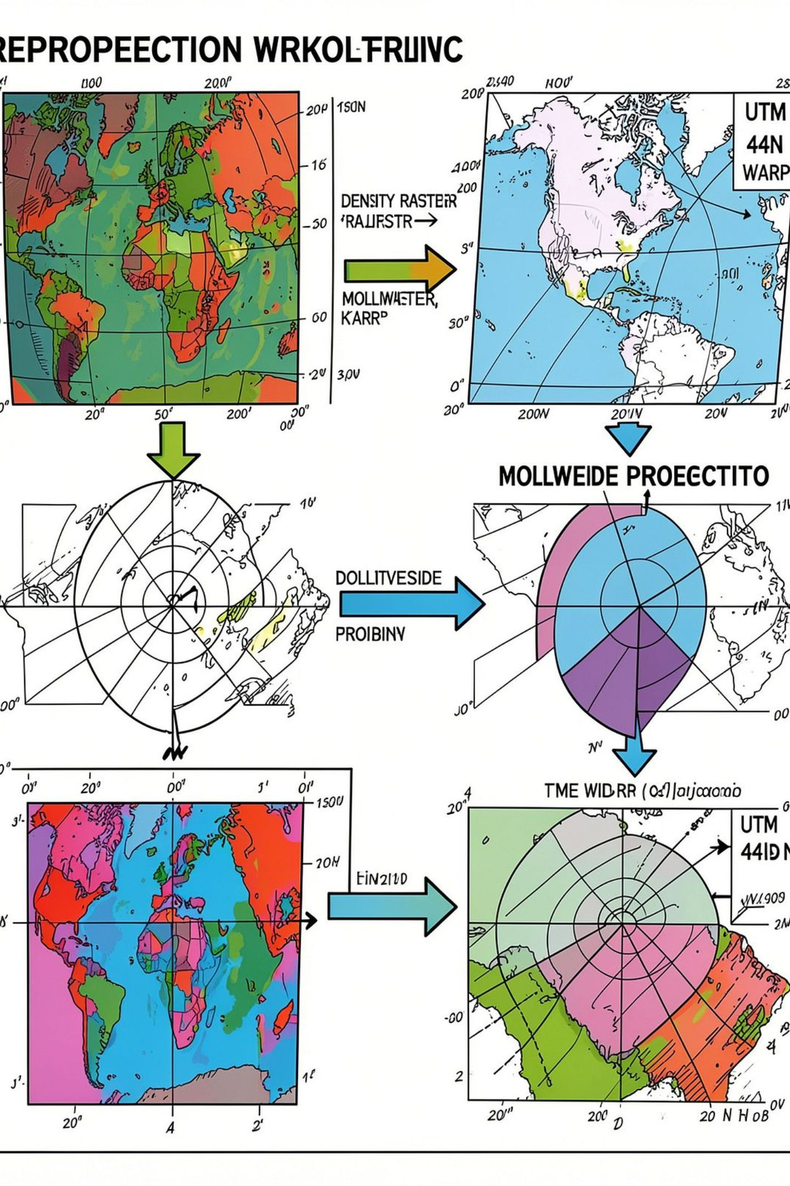
Density‑Preserving Reprojection Pipeline
Problem: direct reprojection of extensive metrics (m², population) biases area-dependent statistics.
01
02
Convert to densities
Mollweide normalize
Compute per-cell density (e.g., population/km², built fraction) on native grid.
Aggregate spatial totals on equal-area projection for inter-epoch comparability.
03
Warp → UTM 44N
Reproject density rasters to analysis CRS with conservative resampling (mass‑conserving bilinear).

Slide 14
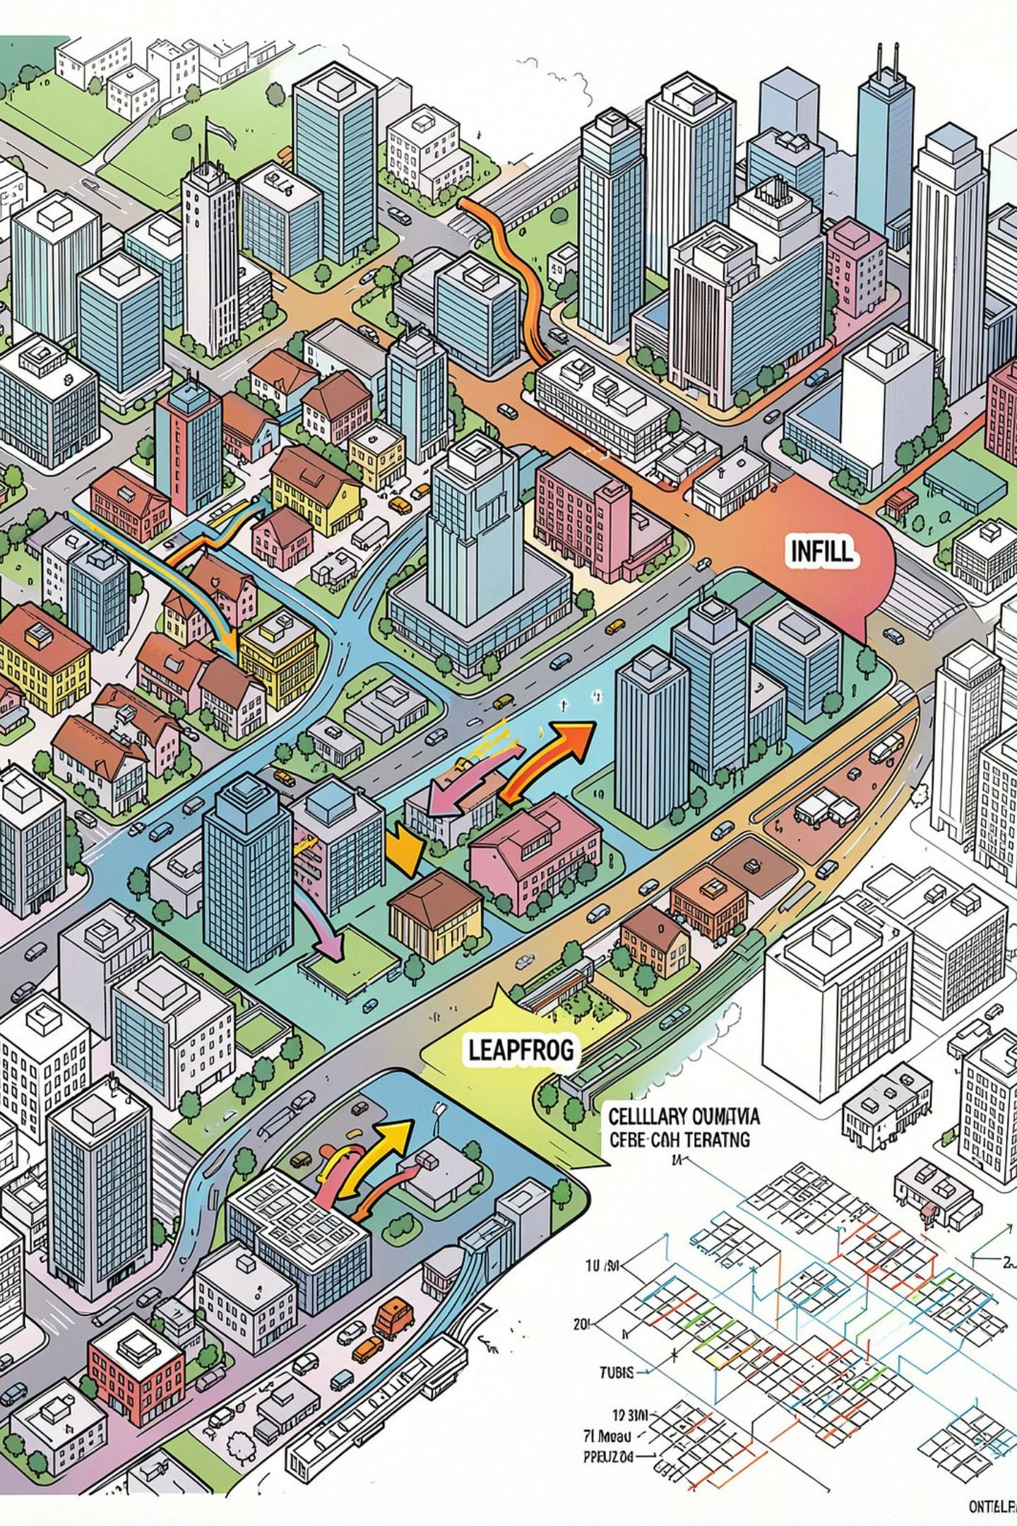
Spatial Expansion Classification — Landscape Expansion Index
New urban cells classified by neighbourhood context and contiguity:
Infill: new cell surrounded by built neighbors (compact growth).
Edge: contiguous addition extending existing patches (incremental sprawl).
Leapfrog: isolated new patches beyond a defined buffer — service cost proxy.
Classification computed at 100 m; reported aggregated statistics on 500 m grid.

Slide 15

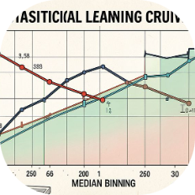
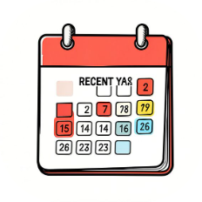

Ghost‑Growth Detection — Core Methodology
Step 1 — Composite Activity Index
Step 2 — Local Norm Learning
Step 3 — Residual & Recency Screen
Step 4 — Six‑Class Typology
Binned median curve derived from Varanasi 2010–2019 to establish internal activity baseline by cell-age and size.
Index = 0.45·VIIRS + 0.35·OSM POIs + 0.20·GriddedPop, normalized per built area (density‑weighted).
Flag cells with negative residuals vs. baseline and require post‑2010 share to pass temporal filter.
ghost_growth, emerging, healthy_growth, established_active, declining, undeveloped — assigned via residual thresholds and trend direction.

Slide 16
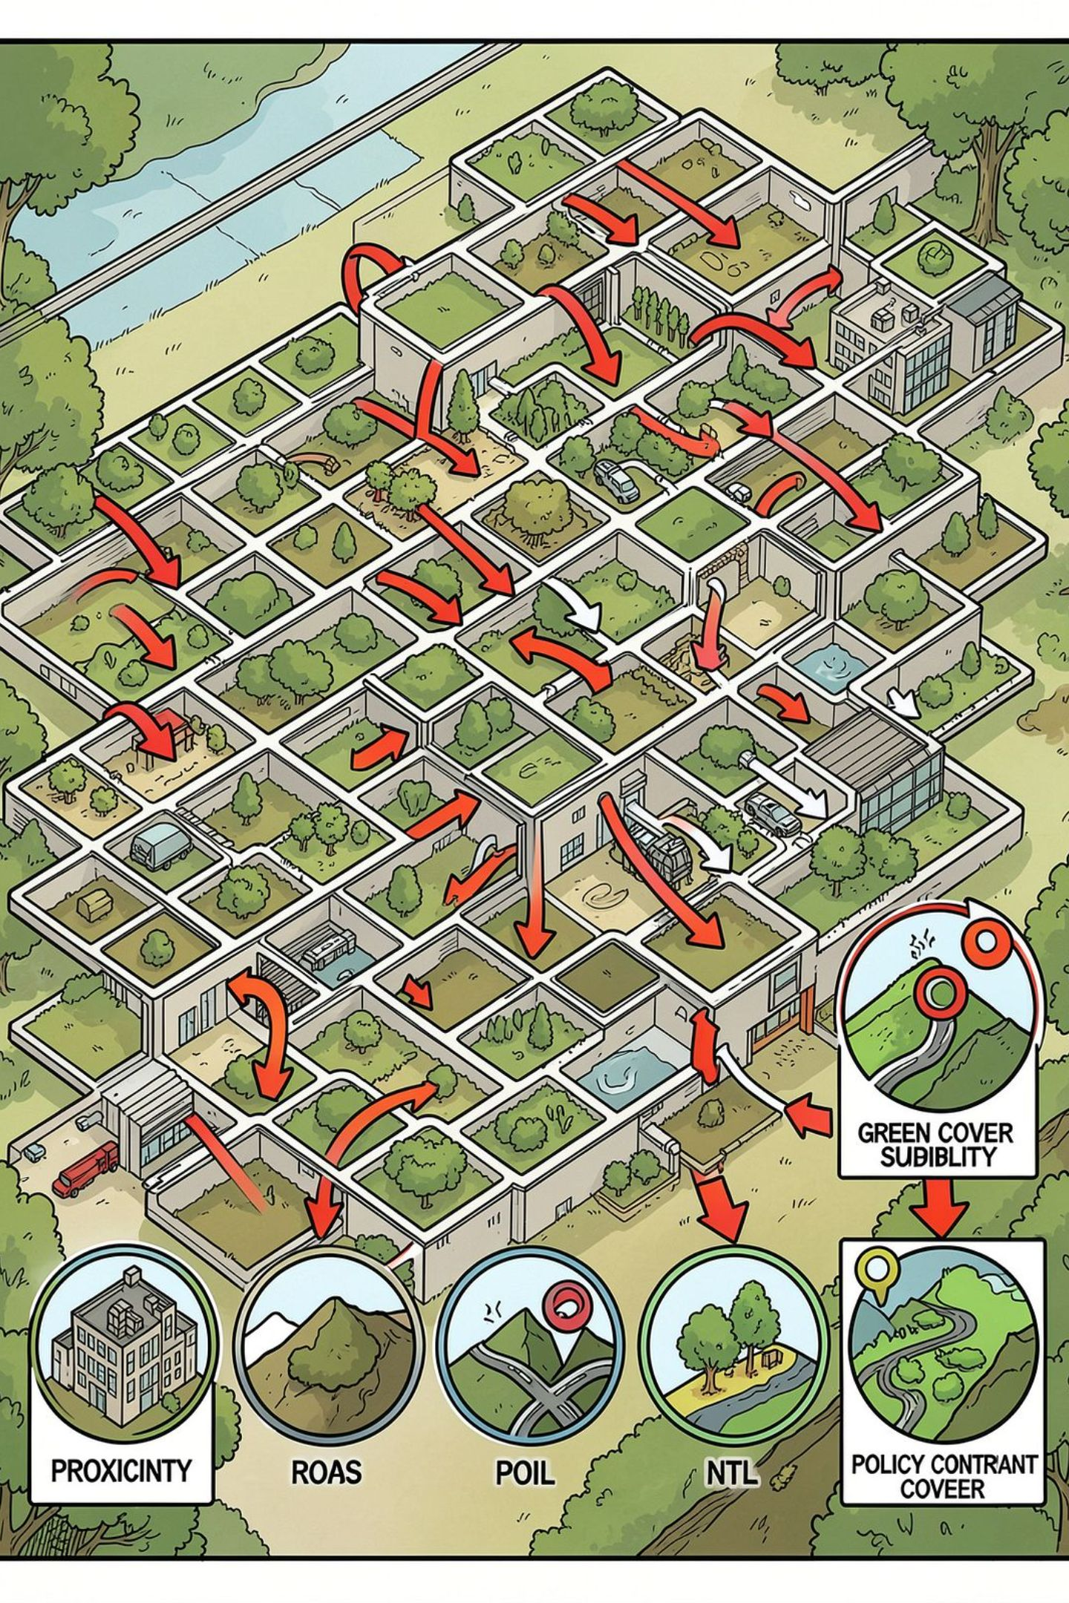
Predictive Expansion Model — Framework
Hybrid model combining logistic suitability with spatially constrained Cellular Automata (CA):
Suitability: logistic regression (multivariate) producing per‑cell probability from seven drivers.
CA: constrained growth rules enforcing contiguity, road‑access bias, and exclusion masks.
Drivers (7): distance to roads, built fraction, slope, NTL change, POI density, green cover, zoning/exclusion mask.

Slide 17
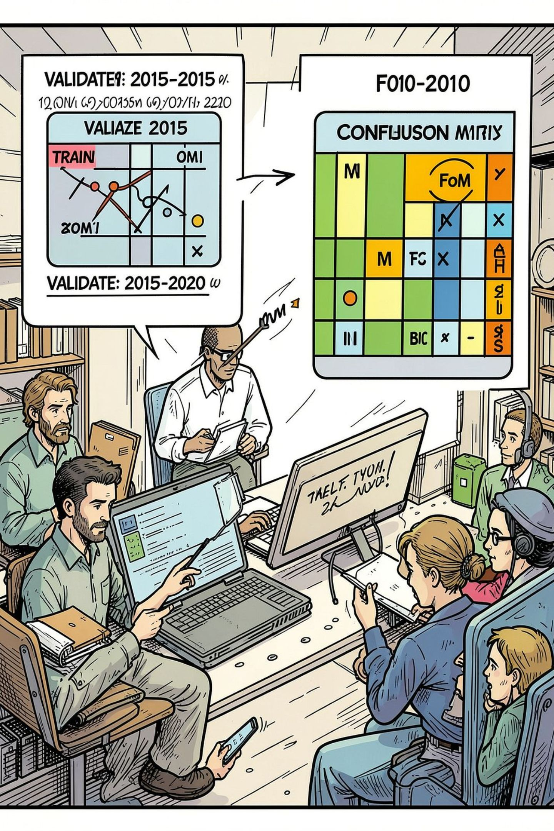
Validation Discipline & Metrics
Temporal hold‑out validation to avoid spatial leakage:
Train: observed transitions 2010 → 2015.
Validate: predict transitions 2015 → 2020 on held‑out data.
Primary evaluation: Figure of Merit (FoM) — chosen because overall accuracy dominated by stable background (null baseline = 98.91%). Other metrics: AUC, Cohen's κ reported for completeness.

Slide 18
Results — Aggregate Urban Change (2010 → 2020)
Metric
2010
2020 (Δ%)
Built‑up surface (km²)
72.48
89.73 (+23.8%)
Urban extent (km²)
128.43
154.39 (+1.40%/yr)
Population (M)
4.17
4.60 (+10.3%)
Key point: Land expansion ≈ 2.3× relative to population growth → spatial inefficiency and servicing cost implications.

Slide 19
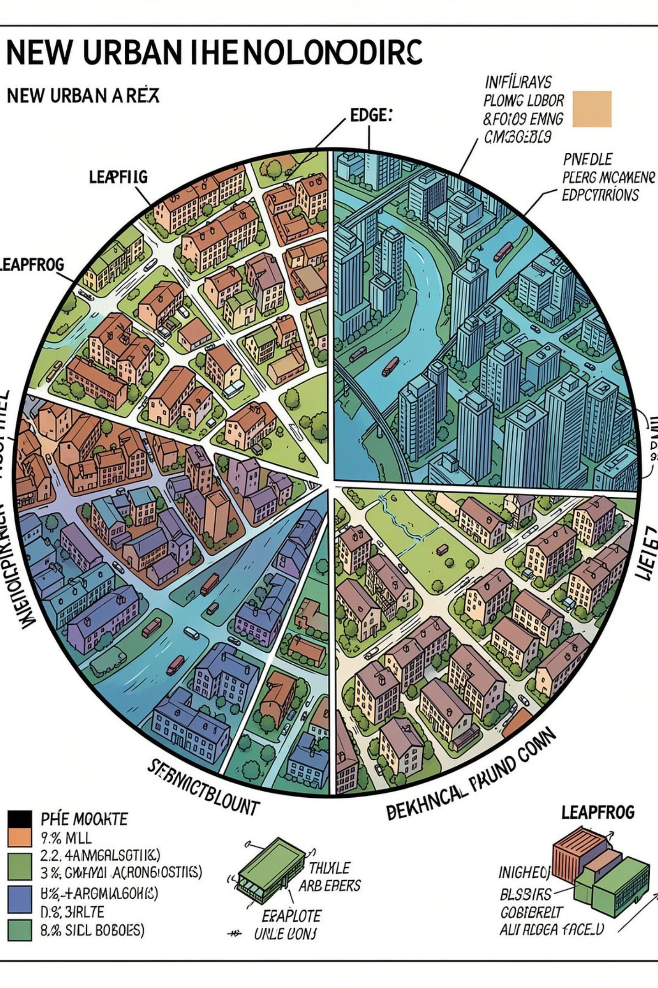
Results — Urban Form Decomposition (13.45 km² New)
Infill
0.95 km² — 7.1%
Edge
5.94 km² — 44.2%
Leapfrog
6.56 km² — 48.8%
Insight: ~49% of new area is detached (leapfrog) — major cost-to-serve and infrastructure risk.

Slide 20
Limitations & Phase 3 Roadmap
Explicit Limitations
Phase 3 Roadmap
Screening tool (not census)
Peripheral OSM sparsity
Sensor resolution constraints
Ground validation of 15 zones
90-ward Census reporting
Open Buildings temporal height analysis
Master plan overlay

