Slide 1
Satellite-Based Urban Growth and
Economic Activity Intelligence System
Review 3 - Implementation and Results - Varanasi, Uttar Pradesh
Mayank 23BCE1753 Achal Pramod Tripathi 23BCE1734 Mohammad Owais 23BCE1746
Guide: Joshan BCSE497J Project I - SCOPE - Fall 2026-27
Panel review, 16 September 2026

Slide 2
What changed since Review 2
Three things, in order of importance
1. We fixed what was wrong
An audit of our own code found 15 defects. The pipeline used GHSL's 2025 epoch - a projection, not an observation - as the current year, so every 2010-2025 figure was measured against a forecast. Every number is now recomputed on the observed epochs 2010, 2015 and 2020.
2. We tested the results against independent data
Six built-up datasets, a second temperature sensor, a hold-out test of the ghost-growth classes, and Indian records: Census of India 2001 and 2011, the 2013 Economic Census, and district GDP from the Government of Uttar Pradesh.
3. We finished the prediction module
Logistic regression and random forest, trained on 2010-2015, scored on a held-out 2015-2020, compared on a TOC curve; the better one projects growth 5 and 10 years ahead.
Corrections log: docs/REVIEW3_REPORT.md section 6 - every before and after number.

Slide 3
Implementation status
What runs today, and how to check it
Module | Status | Run it with
Data acquisition - GHSL, OpenStreetMap, 13 Earth Engine layers | Done | prefetch.py, export_review3_layers.py
Indian datasets - census, economic census, UP district GDP | New | fetch_indian_data.py
Analysis pipeline - built-up, activity, green cover, heat, typology | Done | python -m urbanintel.pipeline
Growth models - logistic regression, random forest, +5 / +10 years | Extended | run_growth_model.py
Validation - hold-out test, cross-checks, census, economy | New | validate_*.py, cross_checks.py
Results pack - 14 figures, 23 zone cards, one results file | New | make_figures.py, make_zone_cards.py
Dashboard - seven tabs, including Validation | Updated | run_dashboard.bat
City search; ground labels for flagged zones | Review 4 | -
41 / 41
unit tests pass; 16 added for Review 3
run_review3.bat
one command: tests, pipeline, models, validation, figures
review3_results.json
every number in this deck, machine-readable

Slide 4
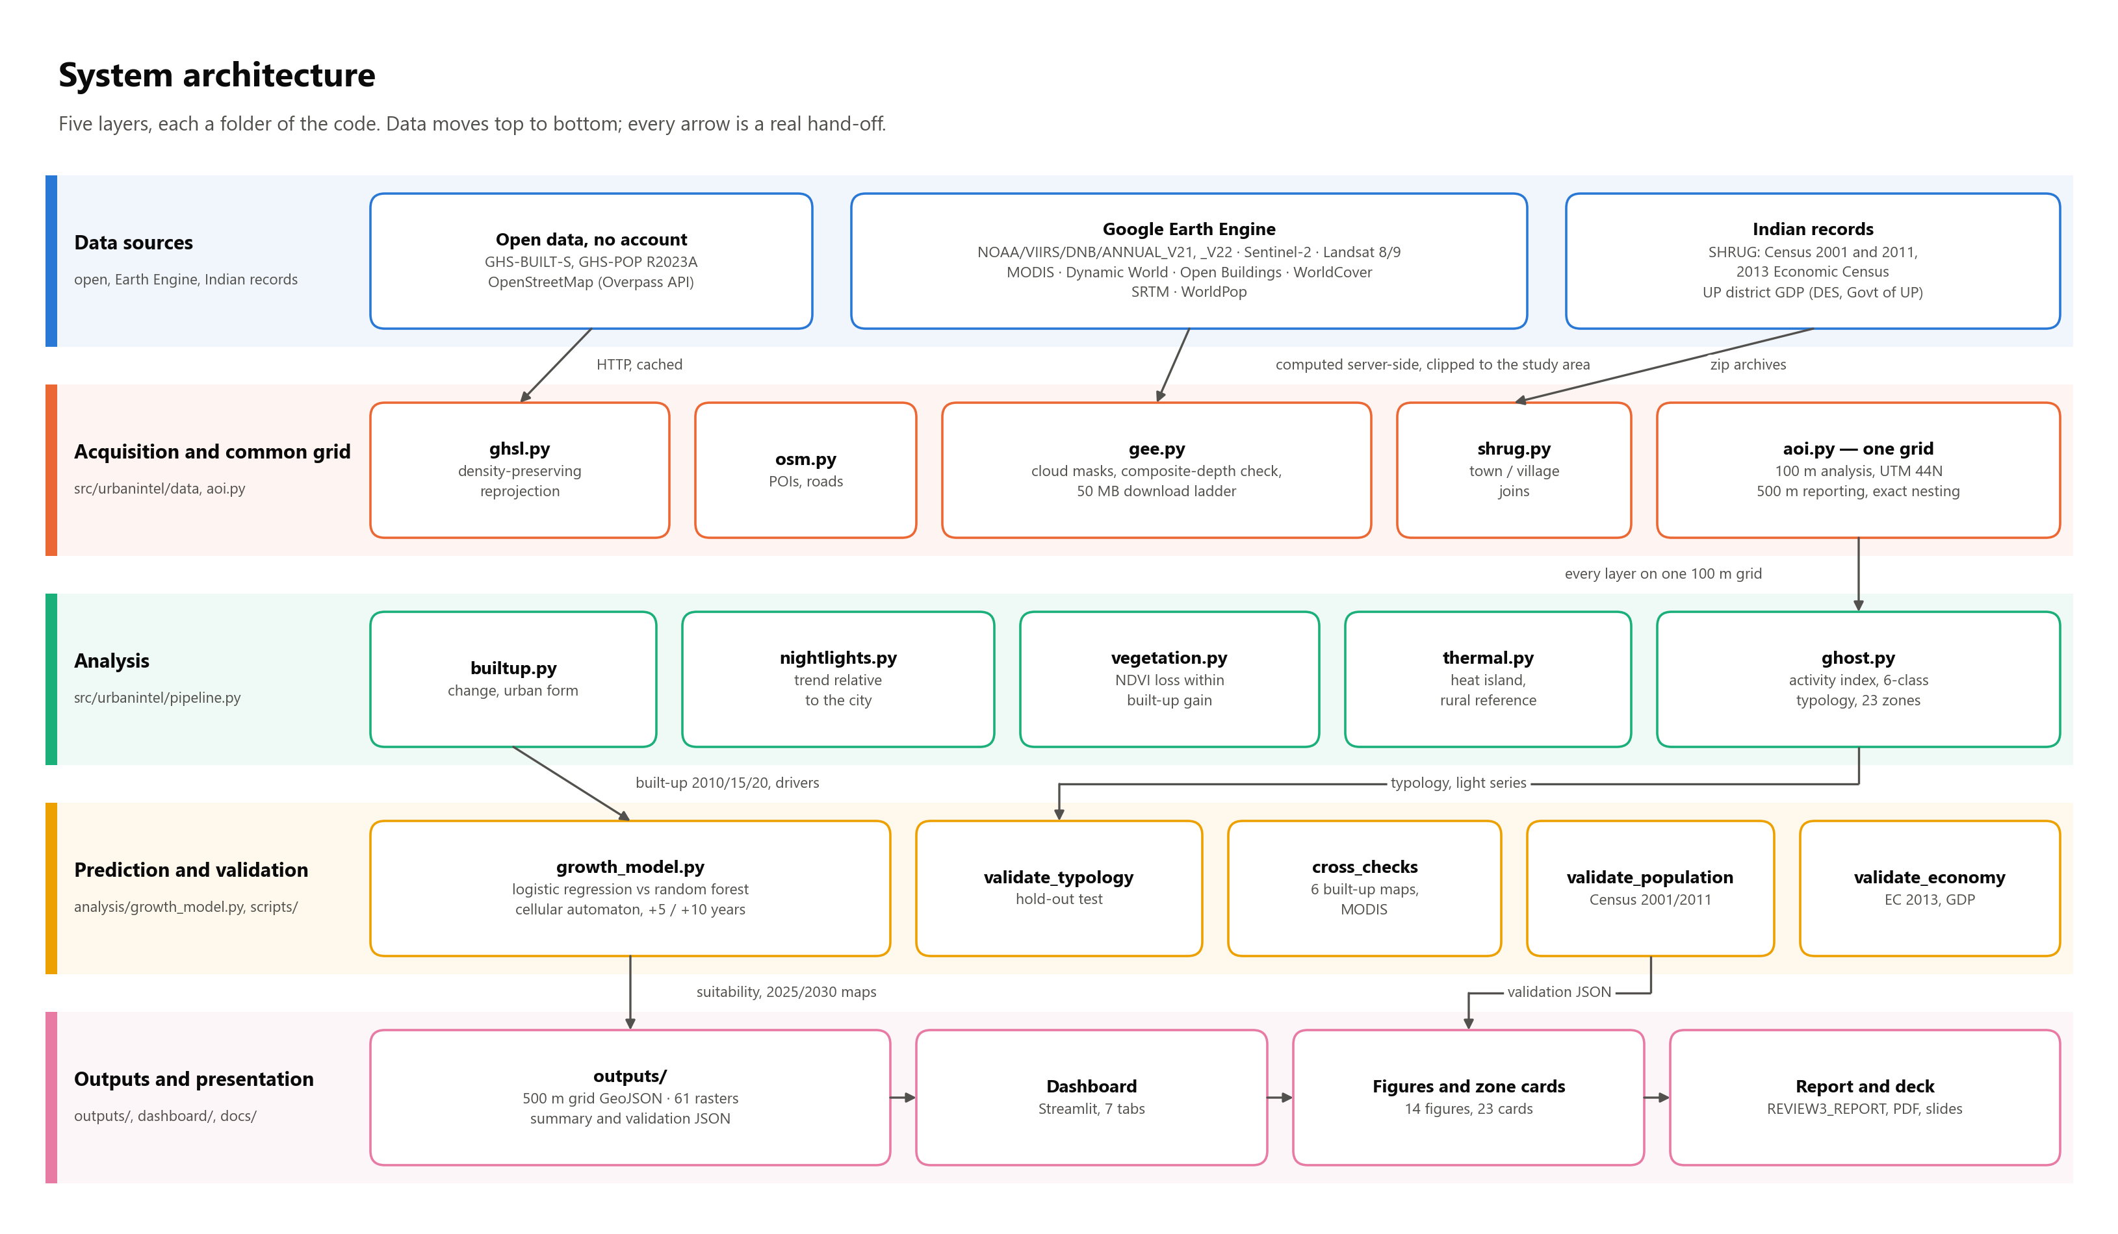
System architecture
Five layers, each a folder of the code
Data flow stage by stage: docs/diagrams/A2_pipeline_dataflow.png. All 15 diagrams are explained in docs/DIAGRAMS.md.

Slide 5
Datasets
Official identifiers; the Indian records are new this review
Satellite and griddedGHS-BUILT-S / GHS-POP R2023A built-up surface and population, 100 m, 2010-2020
NOAA/VIIRS/DNB/ANNUAL_V21 + V22 night-time light 2013-2024, activity proxy
COPERNICUS/S2_SR_HARMONIZED NDVI, NDBI, true colour
LANDSAT/LC08 + LC09 C02 T1_L2 land surface temperature, band ST_B10
MODIS/061/MOD11A2 independent temperature check
GOOGLE/DYNAMICWORLD/V1 water mask, built-up gain
open-buildings-temporal/v1 do flagged cells contain buildings?
ESA/WorldCover/v200 independent built-up map
USGS/SRTMGL1_003 terrain slope
WorldPop/GP/100m/pop independent population
Indian records (new)Census of India 2011 and 2001 population of 71 districts of Uttar Pradesh and 11,624 towns and villages, through SHRUG
Economic Census 2013, MoSPI non-farm jobs per town and village, through SHRUG
SHRUG boundaries town, village and district polygons - so a satellite value can be compared with a census count for the same place
District Domestic Product Directorate of Economics and Statistics, Government of Uttar Pradesh, 2020-21 and 2021-22
Downloaded by scripts/fetch_indian_data.py; the source, size and SHA-256 of every file is recorded in data/raw/india/MANIFEST.json.
SHRUG is CC BY-NC-SA 4.0; cited as Asher, Lunt, Matsuura and Novosad (2021).

Slide 6
Technical accuracy: what the audit found
The headline defect, and what it changed
GHS-BUILT-S R2023A publishes epochs to 2030, but only 1975-2020 are observed. 2025 and 2030 are the GHSL model's own projections.
Our pipeline used 2025 as the current year, so Review 2's growth figures were measured against a forecast. The configuration now refuses a projected epoch, and a unit test locks that behaviour.
Figure | Review 2 (against the 2025 projection) | Review 3 (observed 2010-2020)
New built-up surface | +23.47 km2 | +17.25 km2
Urban extent growth | 1.40 % per year | 1.86 % per year
Leapfrog share of new urban land | 48.8 % | 44.3 %
Mean urban heat-island intensity | +1.10 C, warm cells only | -1.66 C, urban cells
Green cover lost to built-up | 0.05 km2, mismatched years | 0.67 km2, same years
Growth model AUC | 0.9901, training data | 0.910 / 0.834, held out
Low-activity new development filling up | 95 % | 74 %
All 15 defects, with evidence and before/after values: report section 6.

Slide 7
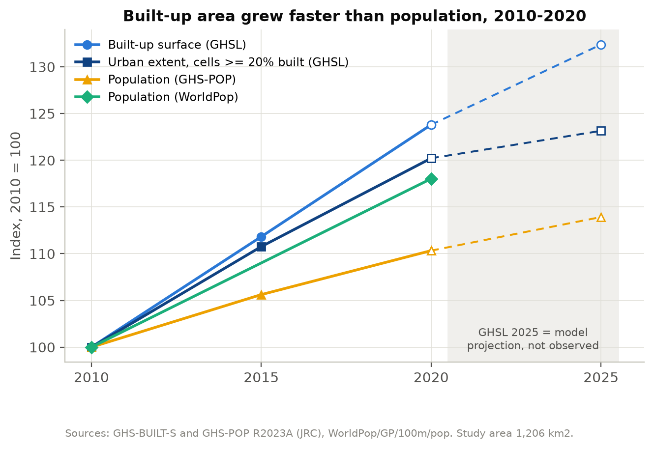
Urban growth, 2010-2020
Observed epochs only
+17.25 km2
built-up surface, 72.48 to 89.73 km2
1.86 %/yr
urban extent, compound
44.3 %
of new urban land is leapfrog - detached from the city
1.3x - 2.3x
faster than population, depending on the population dataset
GHSL 2025 is drawn dashed and labelled: a model projection, not a measurement.

Slide 8
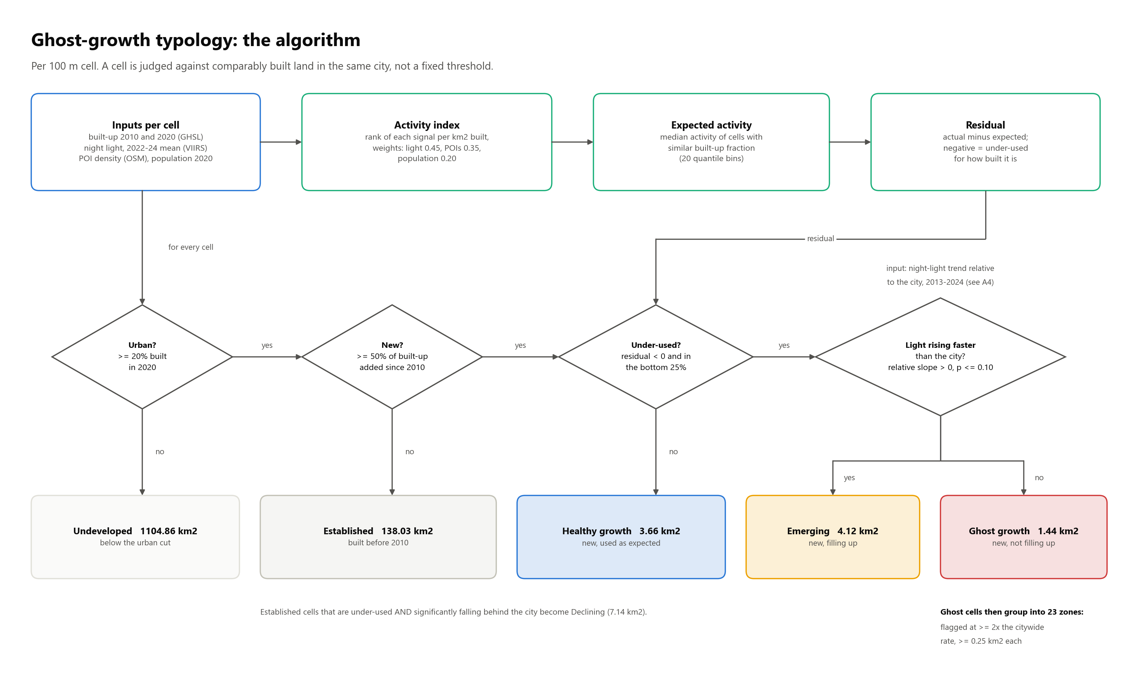
How a cell is classified
The ghost-growth typology, per 100 m cell
Why the light trend is relative to the city: docs/diagrams/A4_relative_light_trend.png.

Slide 9
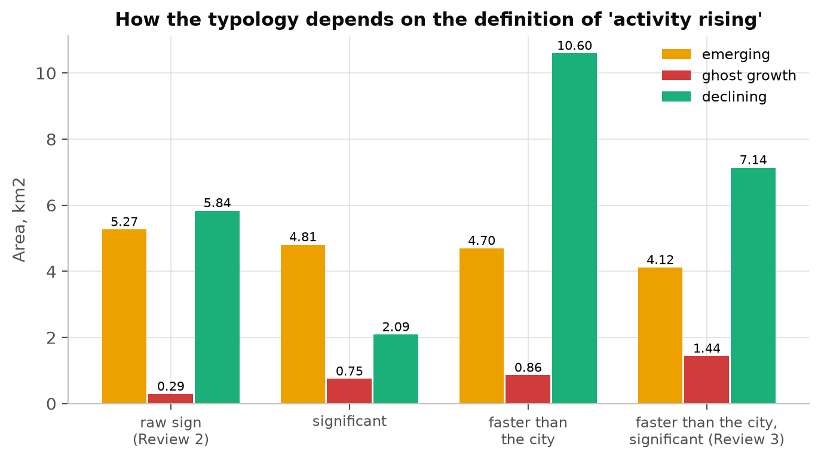
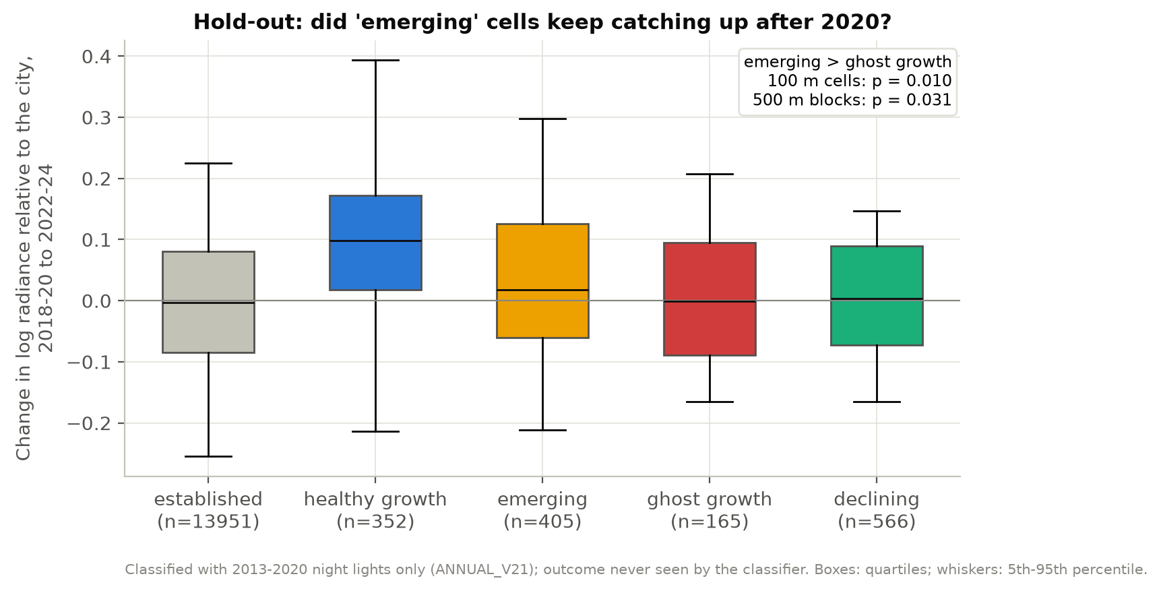
Ghost growth: is the split real?
The rule decides how the same 5.56 km2 of candidates divides
Hold-out test: classify with the 2013-2020 night lights only, then check what happened next.
Cells called emerging went on to brighten, relative to the city, more than cells called ghost growth: p = 0.010 over 100 m cells and p = 0.031 over 500 m blocks. The split carries real information - and the effect is modest: an emerging cell out-brightened a ghost cell 56% of the time. It is a screening map, not a verdict.

Slide 10
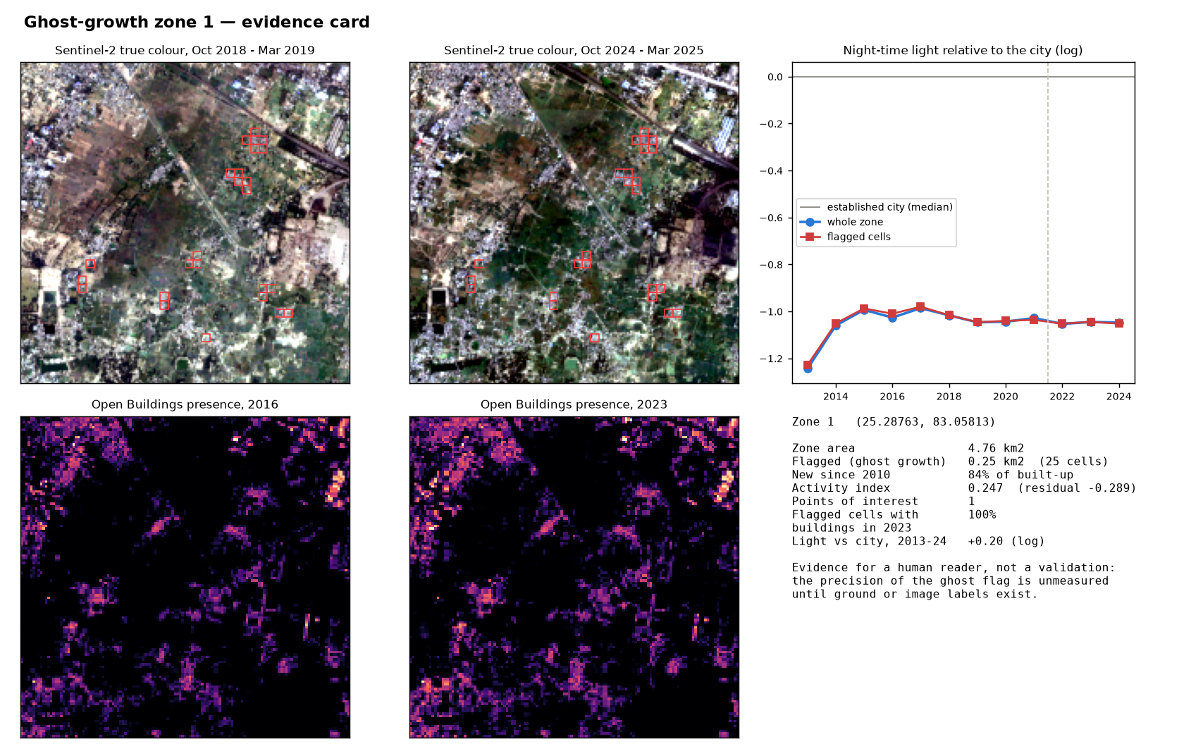
What a flagged zone actually looks like
One evidence card of 23
23
zones flagged, all peripheral
82 %
of ghost cells contain buildings in 2023 (Open Buildings)
26 of 144
ghost cells have no buildings - likely GHSL false positives
+0.32 m
building height gained 2016-2023 in ghost cells
Evidence for a reader, not a validation: precision stays unmeasured until ground or image labels exist - Review 4.

Slide 11
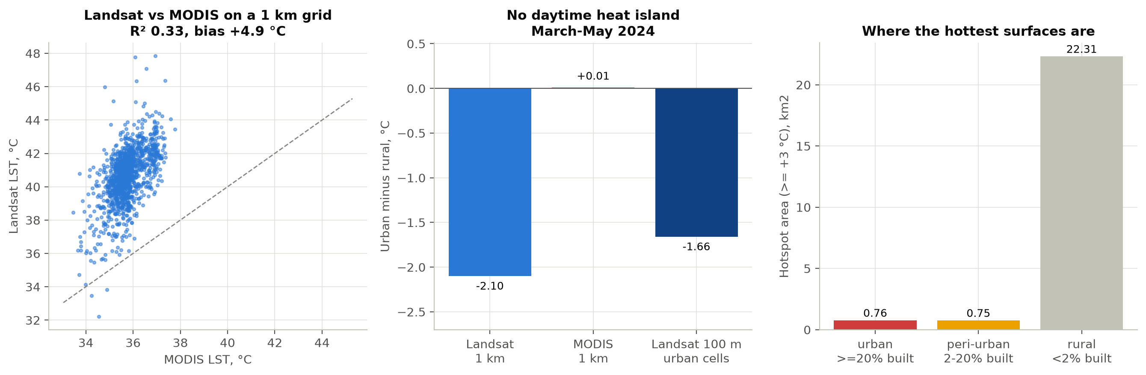
Surface heat: the result reversed
March to May, daytime
Varanasi has no daytime surface heat island in the pre-monsoon season.
Measured over urban cells, the built-up area is 1.66 C cooler than the dry, bare farmland around it, and MODIS - an independent sensor - shows no heat island either. 22.3 of the 23.8 km2 of hotspots lie on rural land. Review 2's +1.10 C was the mean over only the cells warmer than rural, which is positive by construction. Heat vulnerability, which weights heat by residents, remains the planning layer.

Slide 12
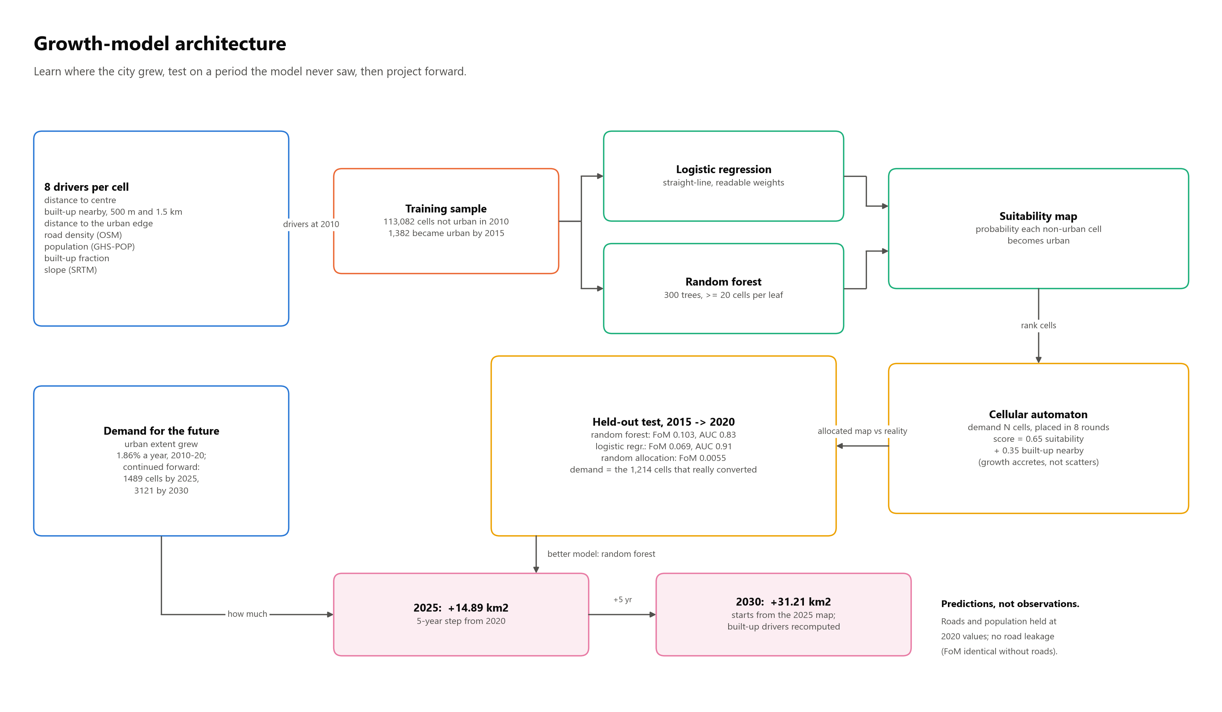
How the growth model works
Learn where the city grew, test on years it never saw, then project
Which years feed which step: docs/diagrams/A8_temporal_design.png.

Slide 13
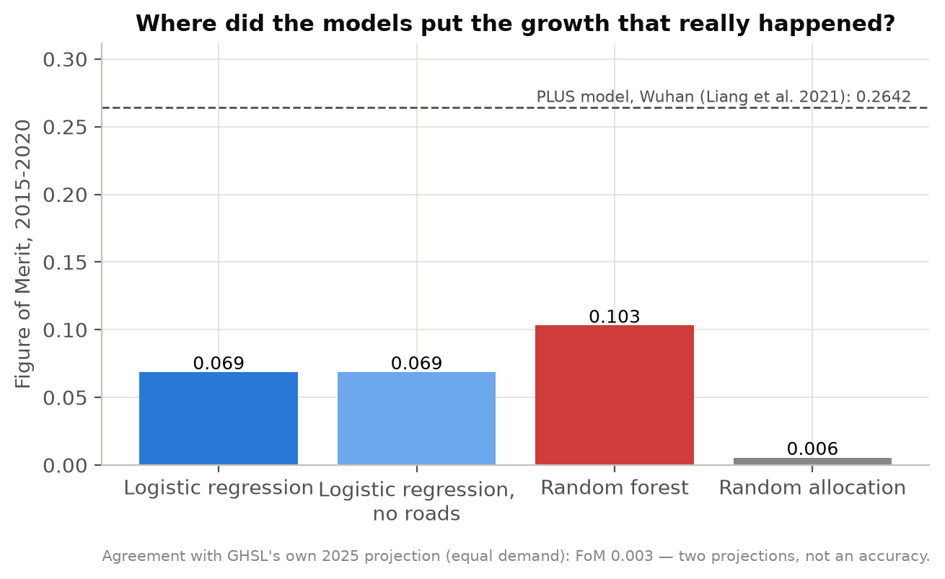
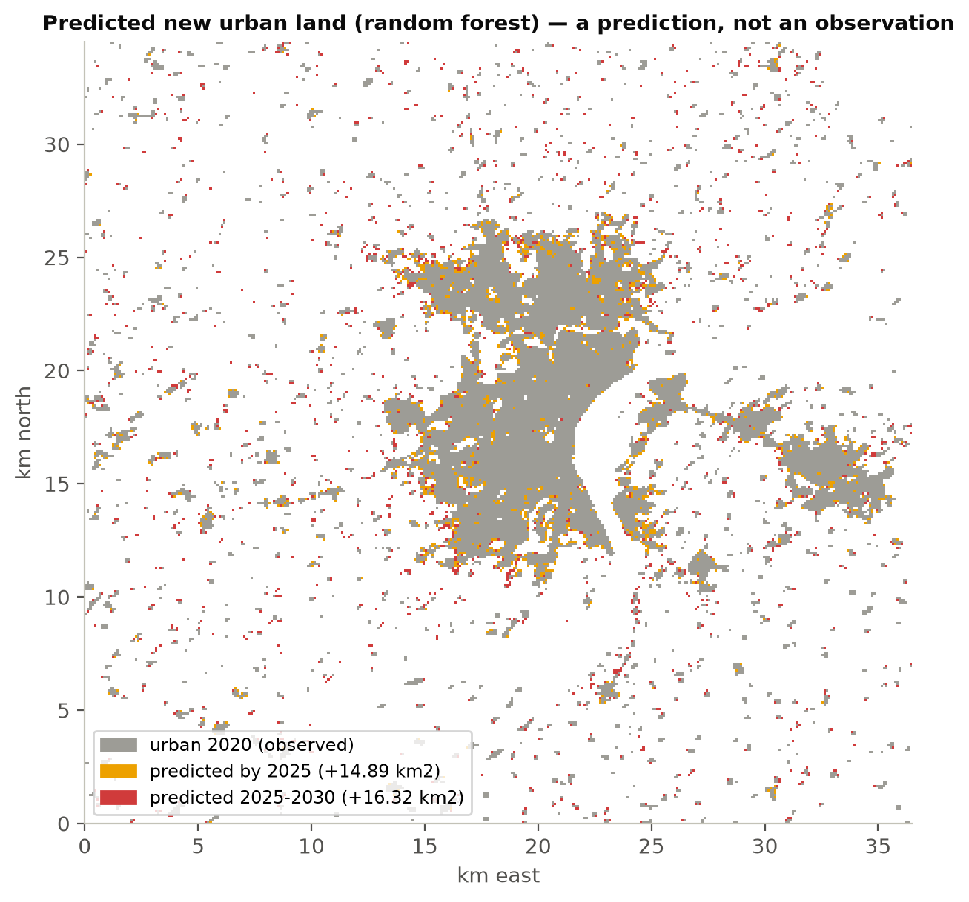
Where the city grows next
Trained 2010-2015, scored on a held-out 2015-2020
+14.89
km2 by 2025
+31.21
km2 by 2030
Model | AUC held out | Figure of Merit | x random
Random forest | 0.834 | 0.103 | 18.7x
Logistic regression | 0.910 | 0.069 | 12.5x
Random allocation | 0.500 | 0.0055 | 1x
Predictions, not observations.
The forest places growth better; the straight-line model ranks the bulk of the cells better. Removing roads changes nothing, so no later information leaks in. Published benchmark on the same measure: 0.264, for PLUS in Wuhan.

Slide 14
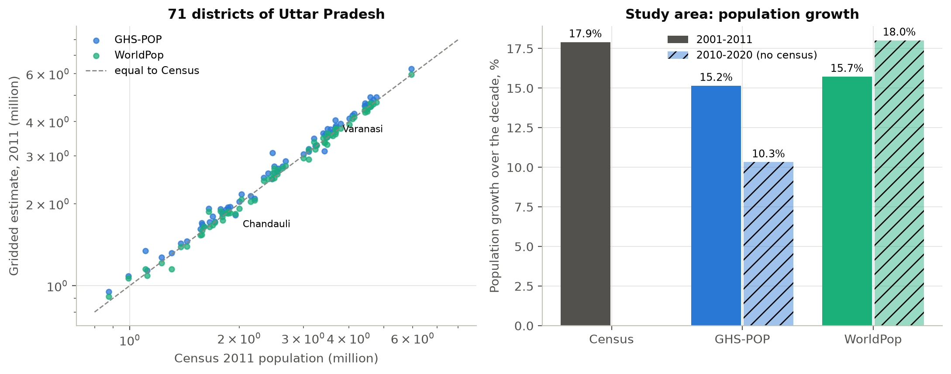
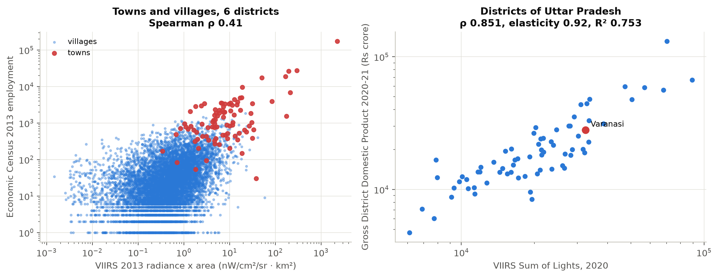
Checked against Indian records
Census of India, Economic Census, Uttar Pradesh district GDP
WorldPop is closer to the 2011 Census than GHS-POP: median district error -0.4% against +3.4%, over 71 districts.
GHS-POP puts 63% too many people inside the Municipal Corporation boundary.
So the Review 2 headline becomes a range: built-up area grew 1.3x to 2.3x faster than population.
District scale: light against UP district GDP, Spearman 0.85, R2 0.75. Varanasi sits within 5% of what its light predicts.
Village scale: light against 2013 Economic Census jobs, 0.41 - no better than population.
That is why the screen reports zones, not single cells.

Slide 15
Limitations, and what Review 4 adds
Said plainly
No ground truth for the ghost flag: how often a flagged zone is really vacant is unmeasured. The hold-out test and the building check are indirect.
VIIRS pixels are 463 m; at village scale, light mostly measures settlement size.
GHS-POP over-counts the city core; the activity index still uses it, at weight 0.20.
Heat is daytime only, and the 2013 composite has just 5 dates.
Dynamic World's built class is unreliable in this landscape: 531 km2 against GHSL's 154 km2.
The projection assumes the 2010-2020 growth rate continues.
Review 4City search type any city name; the Earth Engine route is already checked
Labels read a sample of flagged and unflagged cells off historical high-resolution imagery, and measure precision
Planning data ward-level reporting, VDA Master Plan 2031, Bhuvan land use, UP RERA cross-check
Model drop the population driver, tune the neighbourhood weight, give a range of demand scenarios
Publication a paper submission, built on the hold-out and proxy-scale findings

Slide 16
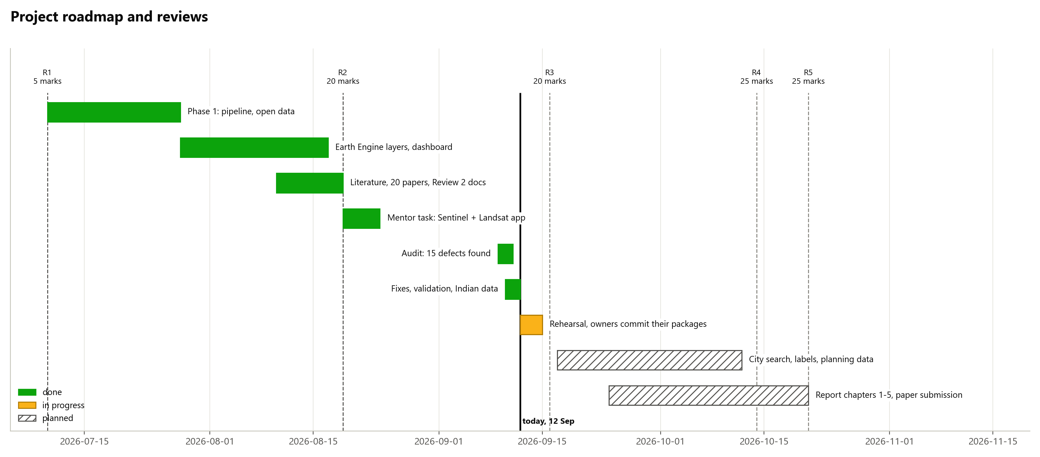
Where we are
Phases, reviews and what is left
Code size per module: docs/diagrams/P2_implementation_status.png; the one-command run: P4_run_timeline.png.

Slide 17
Everything here is reproducible
And attributable
run_review3.bat
Unit tests, pipeline, growth models, four validations, 14 figures and 23 zone cards - one command, on cached data, in a few minutes. Every number in this deck is in outputs/review3_results.json.
Stream | Work packages | Owner
A - pipeline, heat, results, dashboard | Observed epochs, heat-island fixes, zone cards, figures, dashboard, report
B - validation | Satellite cross-checks; Indian census, economic census and district GDP
C - models | Typology rule and hold-out test; logistic regression, random forest, projections
Owners are filled in CONTRIBUTIONS.md; each owner re-runs, explains and presents their own part. AI assistance is acknowledged there, as the project guidelines require.
Questions we expect: why the 2025 epoch mattered; why the heat result reversed; why the forest wins on Figure of Merit but loses on AUC; what the ghost flag can and cannot claim.

