Slide 1
Satellite-Based Urban Growth and
Economic Activity Intelligence System
Review 3 - Architecture, Methods and Results - Varanasi, Uttar Pradesh
Mayank 23BCE1753 Achal Pramod Tripathi 23BCE1734 Mohammad Owais 23BCE1746
Guide: Joshan BCSE497J Project I - SCOPE - Fall 2026-27
Panel review, 16 September 2026
Notes:
Introduce the team and say who presents which part: architecture and pipeline, the typology and the growth model, validation and results.

Slide 2
What the system answers
Three questions about Varanasi, from open satellite data
Where and how fast did the city grow?
Built-up change from 2010 to 2020, measured on a 100 m grid, and the form it took: infill, edge expansion or leapfrog.
Is the new development being used?
Night-time light, points of interest and population, compared with how much is built. New land that stays dark and empty is flagged as ghost growth.
Where will it grow next?
A growth model learns from 2010-2015, is tested on 2015-2020, and predicts new urban land for 2025 and 2030.
1,206 km²
study area around the city
100 m
analysis grid
500 m
reporting grid
2010-2020
observed built-up years
2013-2024
night-light years
Ghost growth: land that became built-up after 2010 but shows much less activity than comparable built-up land in the same city.
Notes:
The problem: Varanasi is growing, but satellite built-up maps only say that land was built, not whether anyone uses it. We combine built-up area with signals of use - night-time light as a proxy for activity, points of interest, population - to separate new development that is filling up from development that is not. The third part predicts where growth goes next.

Slide 3
What changed since Review 2
Three things, in order of importance
1. We fixed what was wrong
An audit of our own work found 15 defects. The most serious: GHSL's 2025 epoch - a projection, not an observation - was used as the current year, so every 2010-2025 figure was measured against a forecast. Every number is now recomputed on the observed epochs 2010, 2015 and 2020.
2. We tested the results against independent data
Six built-up datasets, a second temperature sensor, a hold-out test of the ghost-growth classes, and Indian records: Census of India 2001 and 2011, the 2013 Economic Census, and district GDP from the Government of Uttar Pradesh.
3. We finished the prediction module
Logistic regression and random forest, trained on 2010-2015, scored on a held-out 2015-2020; the better one predicts growth 5 and 10 years ahead.
Notes:
Lead with the correction: it is the strongest evidence of technical accuracy that we found and fixed our own mistake. Every number after this slide is on observed data only.

Slide 4
Implementation status
What works today
Component | Status | What it delivers
Data acquisition - GHSL, OpenStreetMap, 13 Earth Engine layers | Done | every layer on one 100 m grid
Indian datasets - Census, Economic Census, UP district GDP | New | independent checks from Indian records
Analysis - built-up, activity, green cover, heat, typology | Done | change maps and a six-class growth typology
Growth models - logistic regression, random forest | Extended | held-out test; 2025 and 2030 predictions
Validation - hold-out test, cross-checks, census, economy | New | six claims, each tested on independent data
Results - 14 figures, 23 zone evidence cards | New | every number regenerated in one run
Dashboard - seven views, including validation | Updated | interactive maps
City search; image labels for flagged zones | Review 4 | -
41 of 41
automated tests pass; 16 added for Review 3
about 3.5 min
one end-to-end run, tests to figures
15 of 15
audit defects fixed
Notes:
Everything above the last row runs today and can be shown live. The whole chain - tests, analysis, models, validation, figures - runs as one step in about three and a half minutes on the data already downloaded.

Slide 5
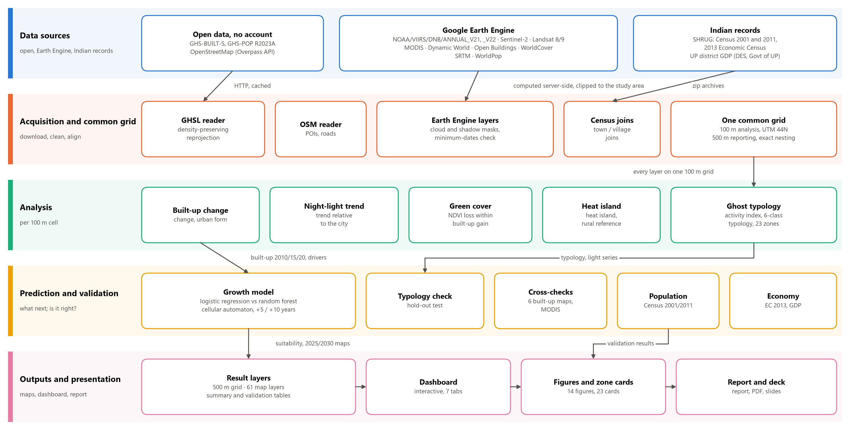
System architecture
Five layers; data moves top to bottom and every arrow is a real hand-off
Notes:
Three kinds of source: open downloads with no account (GHSL built-up and population, OpenStreetMap), Google Earth Engine (night light, Sentinel-2, Landsat, MODIS, Dynamic World, Open Buildings, WorldCover, SRTM, WorldPop) and Indian records. The second layer puts every source on one 100 m grid; the 500 m reporting grid nests exactly, 25 cells to one. Earth Engine computes on Google's servers and sends back only the clipped study area, which is why the whole system runs on a laptop.

Slide 6
Datasets
Official identifiers; the Indian records are new this review
Satellite and gridded dataset | Used for
GHS-BUILT-S R2023A, GHS-POP R2023A | built-up surface, population, 100 m
NOAA/VIIRS/DNB/ANNUAL_V21 + ANNUAL_V22 | night-time light, 2013-2024
COPERNICUS/S2_SR_HARMONIZED | NDVI, NDBI, true colour
LANDSAT/LC08/C02/T1_L2 + LANDSAT/LC09/C02/T1_L2 | land surface temperature
MODIS/061/MOD11A2 | independent temperature check
GOOGLE/DYNAMICWORLD/V1 | water mask, built-up gain
GOOGLE/Research/open-buildings-temporal/v1 | buildings in flagged cells
ESA/WorldCover/v200 | independent built-up map
USGS/SRTMGL1_003 | terrain slope
WorldPop/GP/100m/pop | independent population
Indian and other records | Used for
Census of India 2001 and 2011 | population check, 71 districts
Economic Census 2013 | non-farm jobs per town and village
SHRUG, Development Data Lab | town and village boundaries
District Domestic Product, DES, Govt of UP | district GDP 2020-21, 2021-22
OpenStreetMap | 1,999 points of interest, 38,455 roads
FAO/GAUL/2015/level2 | district boundaries
SHRUG is used under CC BY-NC-SA 4.0 and cited as Asher, Lunt, Matsuura and Novosad (2021). DES: Directorate of Economics and Statistics.
Notes:
Every dataset is named by its official identifier. Night-time light is used as an indirect indicator of activity - a proxy, not a measurement of the economy. The Indian records are used only to check our results, never as inputs.

Slide 7
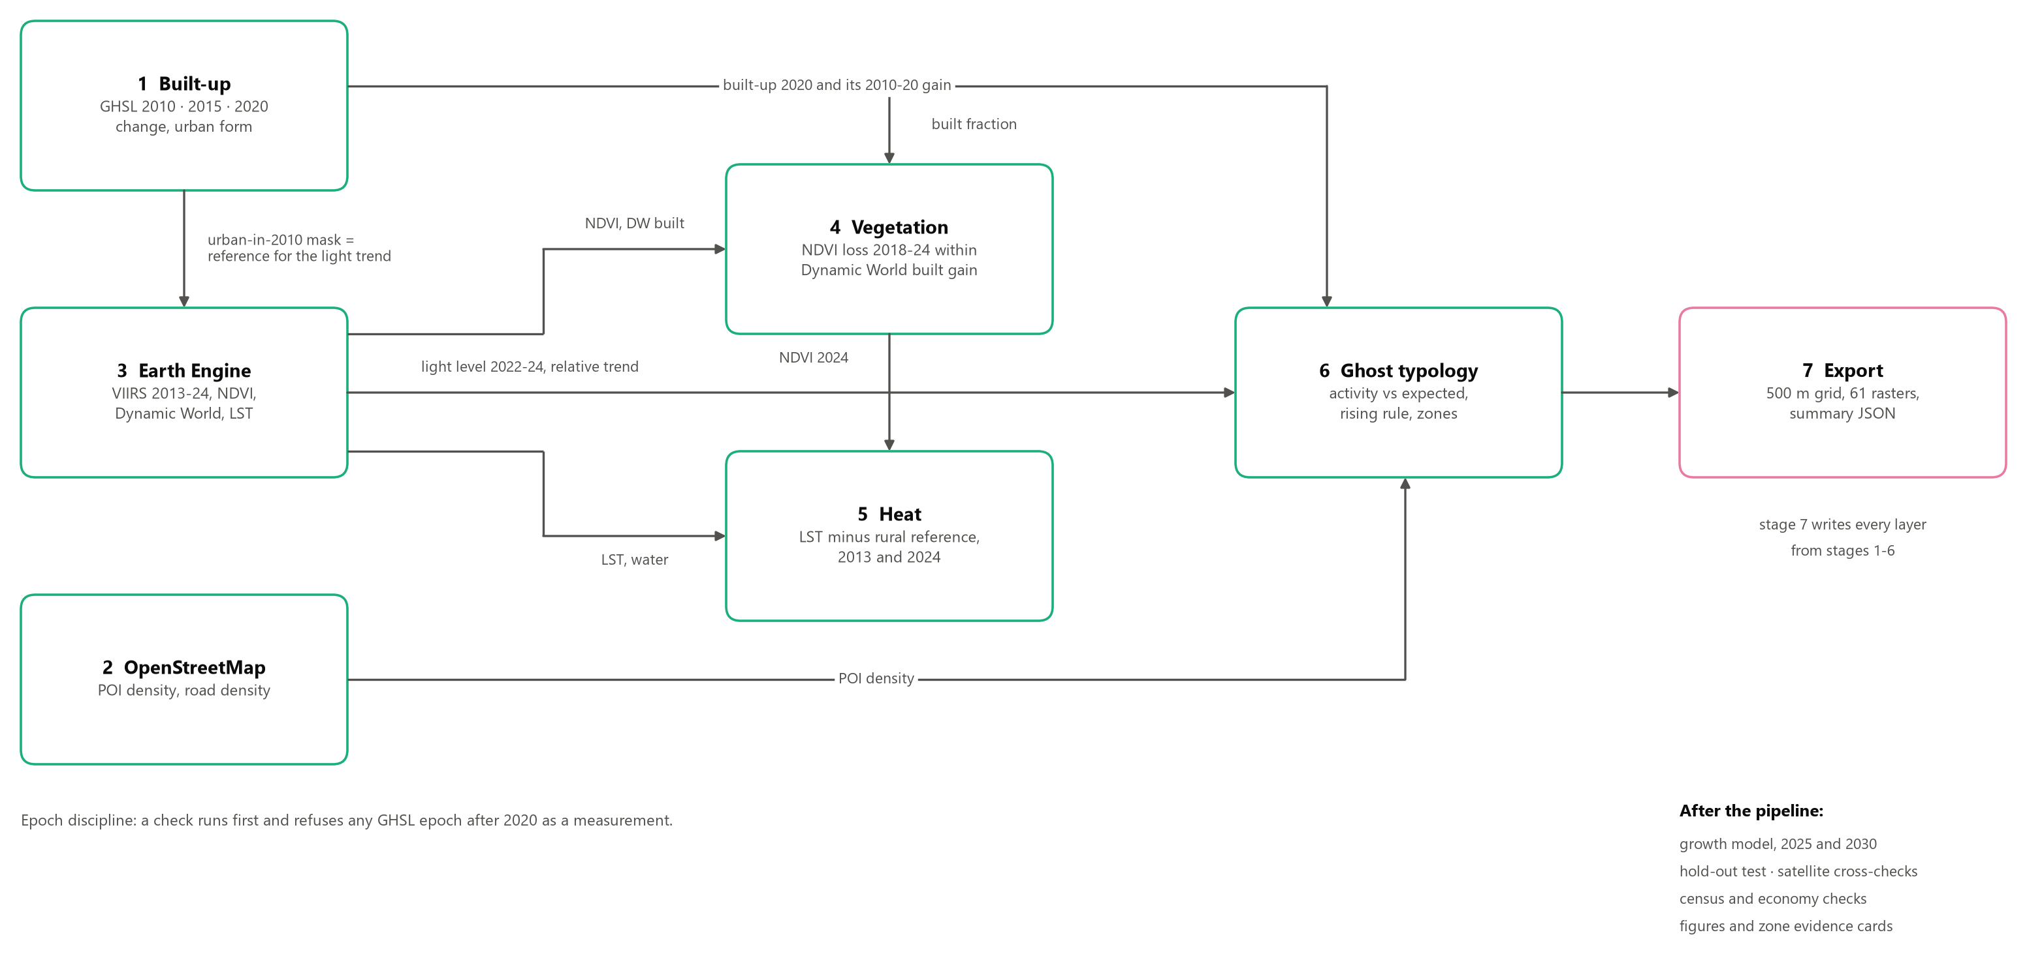
Processing flow
Seven stages; each hands a named layer to the next
Notes:
Stage 1, built-up, feeds almost everything: the 2020 built fraction for vegetation, the 2010-2020 gain for the typology, and the mask of land already urban in 2010 that defines 'the established city' for the light trend. Stage 6 is where the three signals meet. Before anything runs, a check refuses any GHSL year after 2020 as a measurement - that is the Review 2 defect, fixed in the system itself.

Slide 8
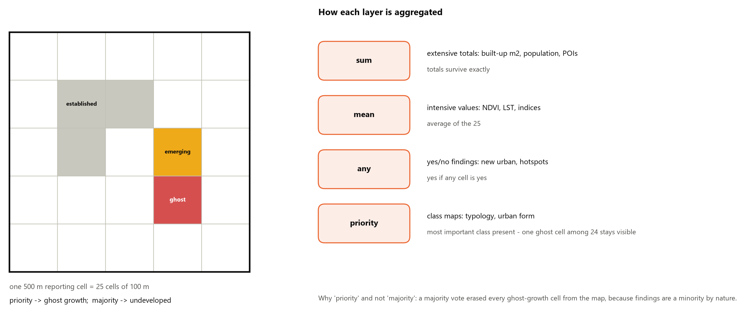
Analysis grid and aggregation
Analysis at 100 m, reporting at 500 m - the scale night-time light can support
Notes:
VIIRS pixels are about 463 m, so 500 m is the honest reporting scale for activity, while 100 m keeps built-up change sharp. Totals are summed, averages averaged, yes/no findings use 'any', class maps use 'priority'. A majority vote erased every ghost-growth cell from the map, because a finding is always a minority of its block.

Slide 9
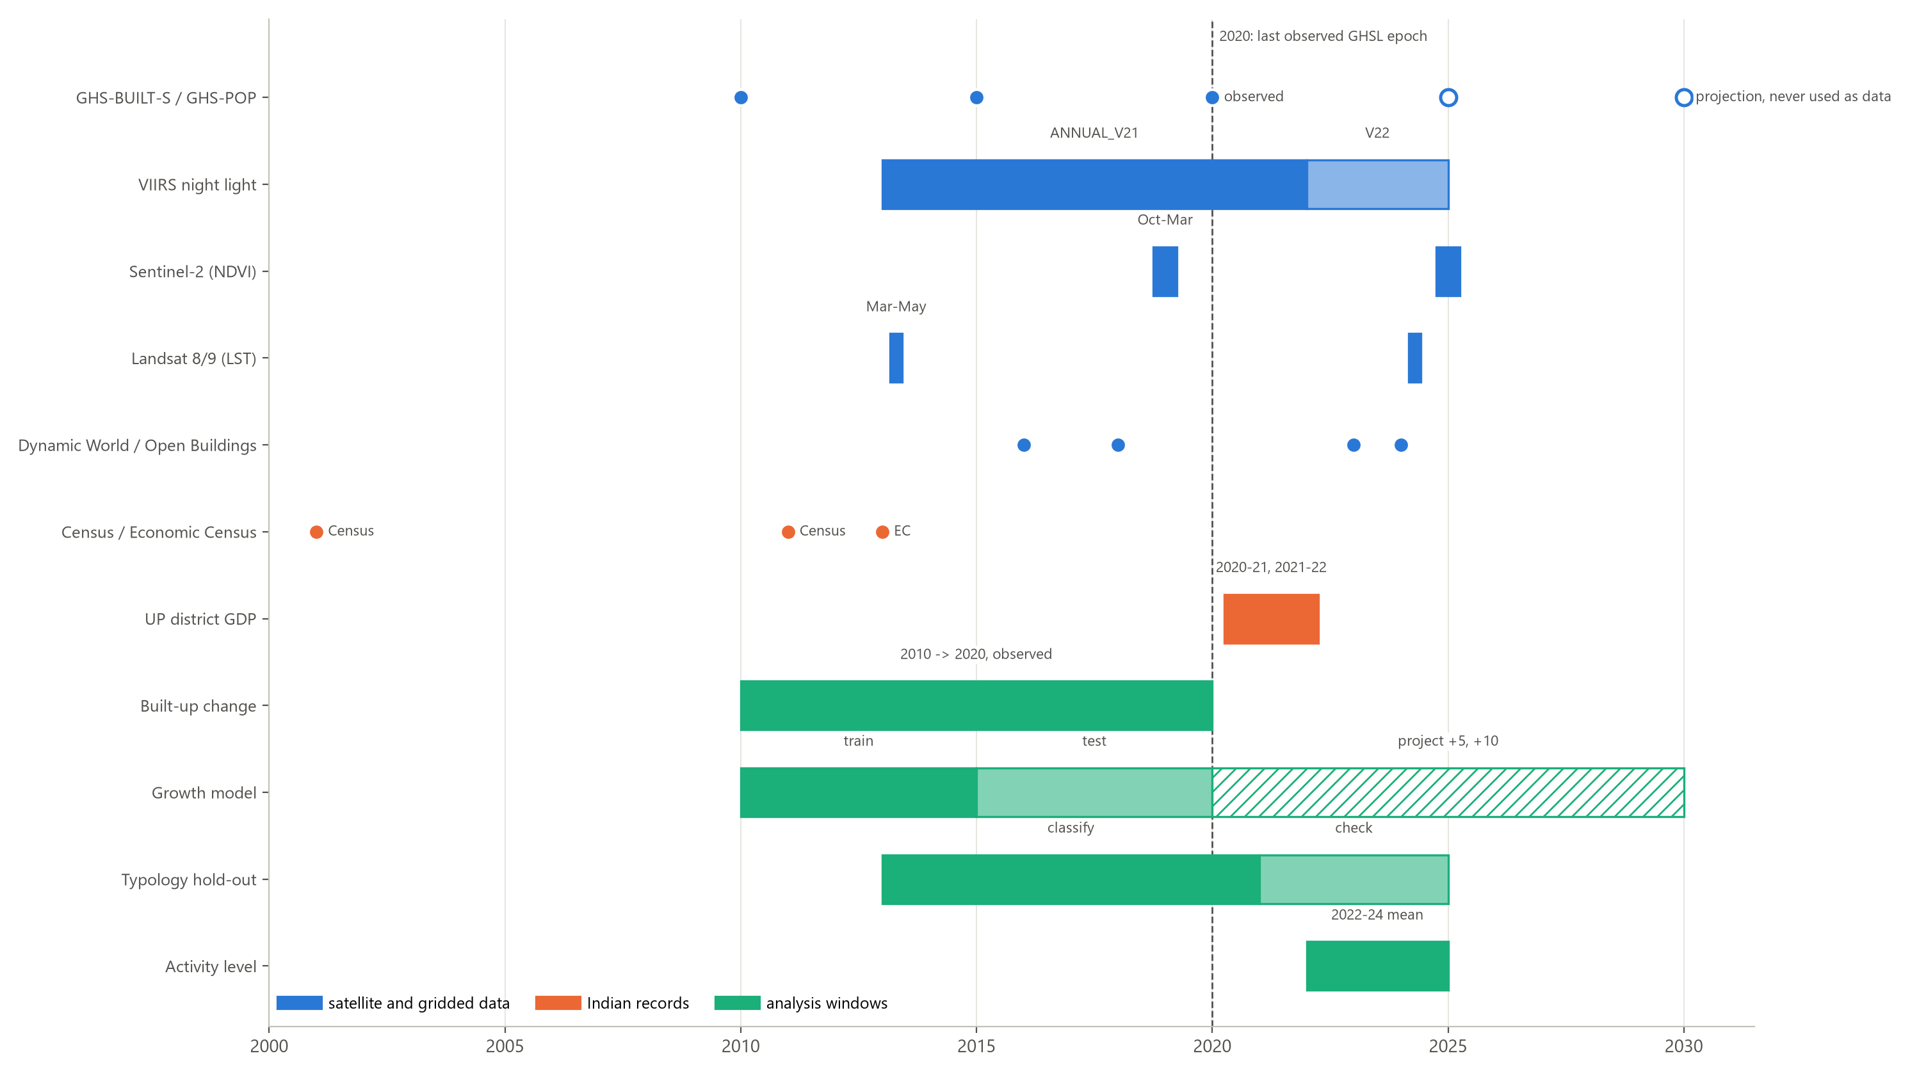
Temporal design
2020 is the last observed epoch; later years are projections or our own predictions
Notes:
Built-up change is 2010 to 2020, observed only. The growth model trains on 2010-2015 and is tested on 2015-2020; the typology classifies on 2013-2020 and is checked on 2021-2024. In both, the check uses years the method never saw. Activity uses the 2022-2024 light mean, which gives land built by 2020 two years to be occupied.

Slide 10
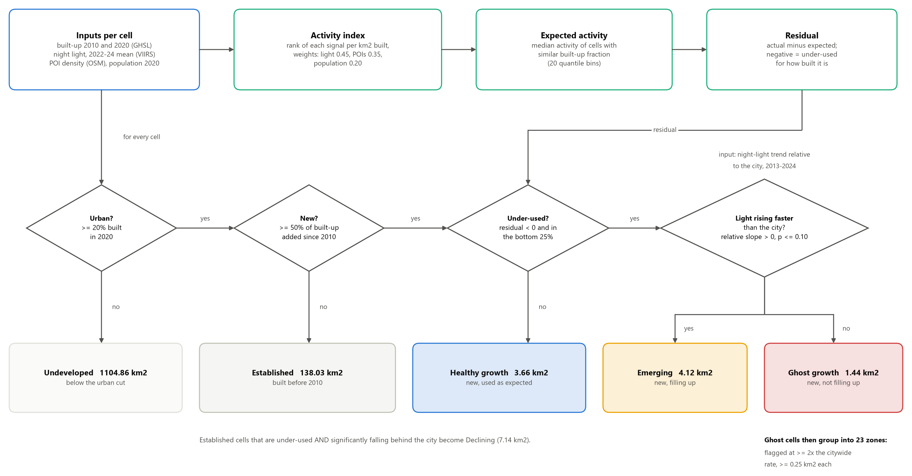
The ghost-growth algorithm
Each cell is judged against comparably built land in the same city
Notes:
The activity index ranks each signal per square kilometre built - light 0.45, points of interest 0.35, population 0.20 - so a large built-up area is not 'active' just because it is large. Expected activity is the median of cells with a similar built-up fraction. New, under-used cells then split on the light trend: emerging if it rises significantly faster than the city, otherwise ghost growth. It is a screening rule; its precision is unmeasured until image labels exist.

Slide 11
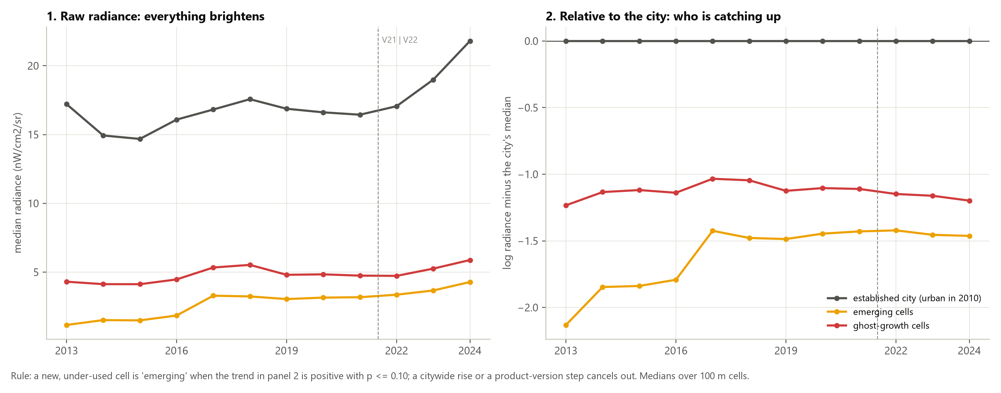
Why the light trend is relative to the city
Raw radiance rises everywhere; relative to the city, only some cells catch up
Notes:
On raw radiance, 51.4% of urban cells show a significant rise, so 'rising' on the raw sign says little - Review 2 used that rule. The 2021 to 2022 change of product version adds a step. Subtracting the established city's median cancels both, and leaves which cells are catching up.

Slide 12
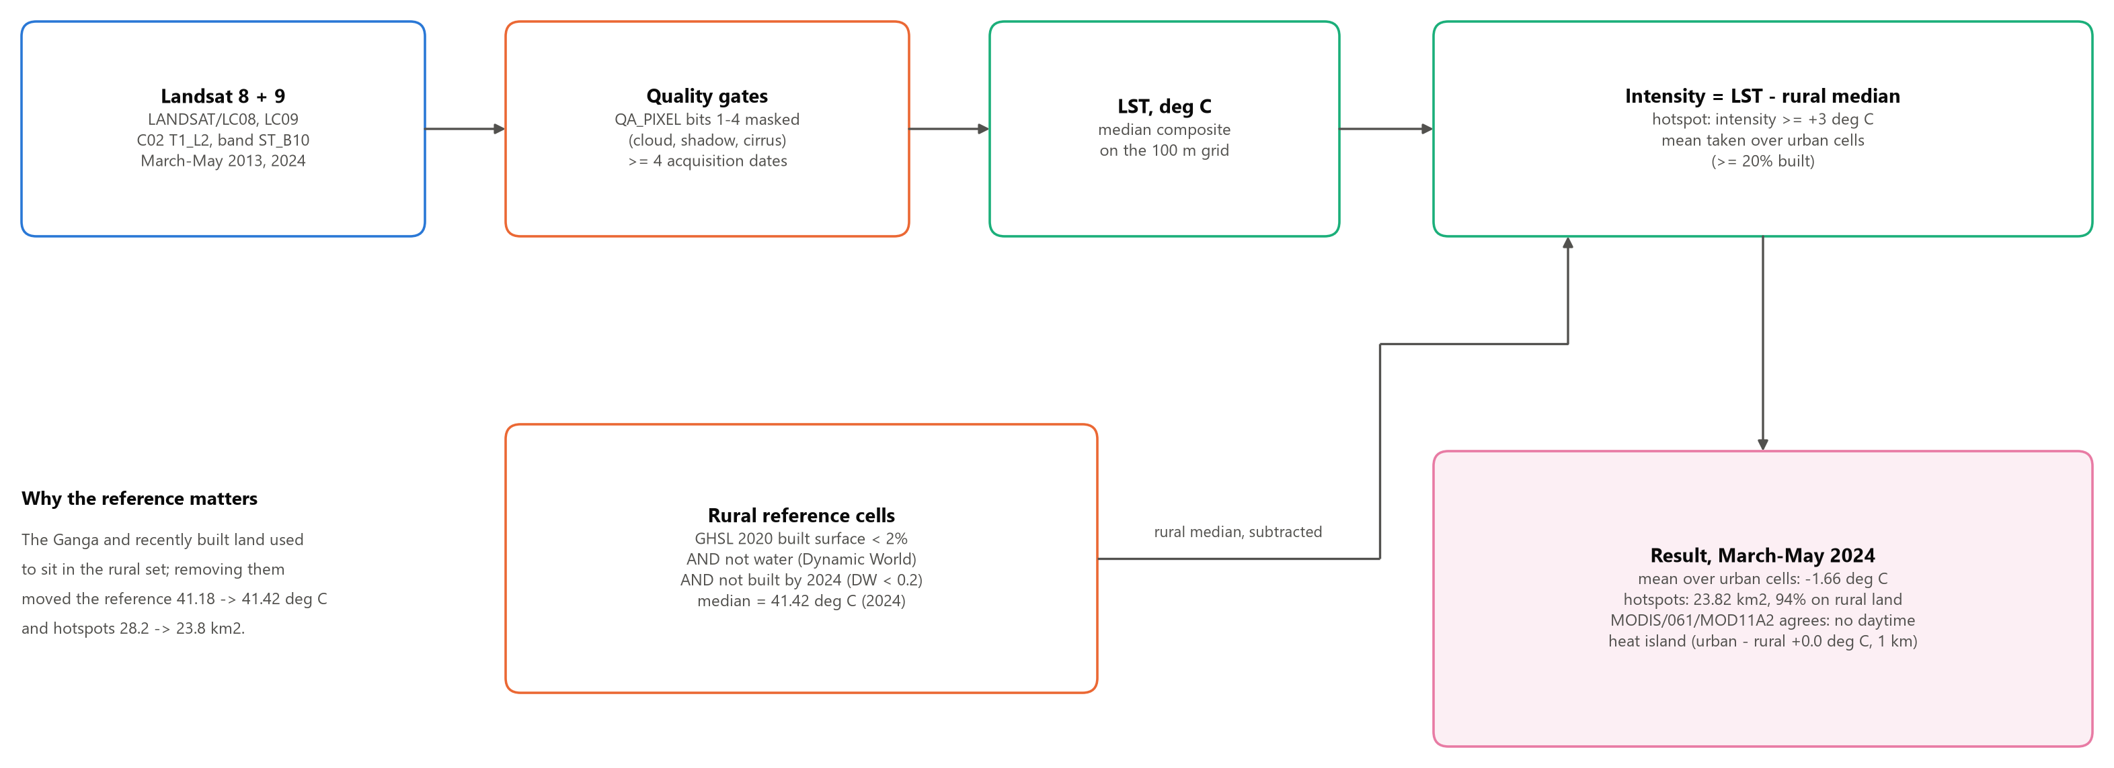
Surface heat-island method
Land surface temperature minus a rural reference from the same scene
Notes:
Cloud, shadow and cirrus are masked and every composite needs at least four dates. The rural reference now excludes the Ganga and recently built land; that moved it from 41.18 to 41.42 degrees C. The mean is taken over urban cells only.

Slide 13
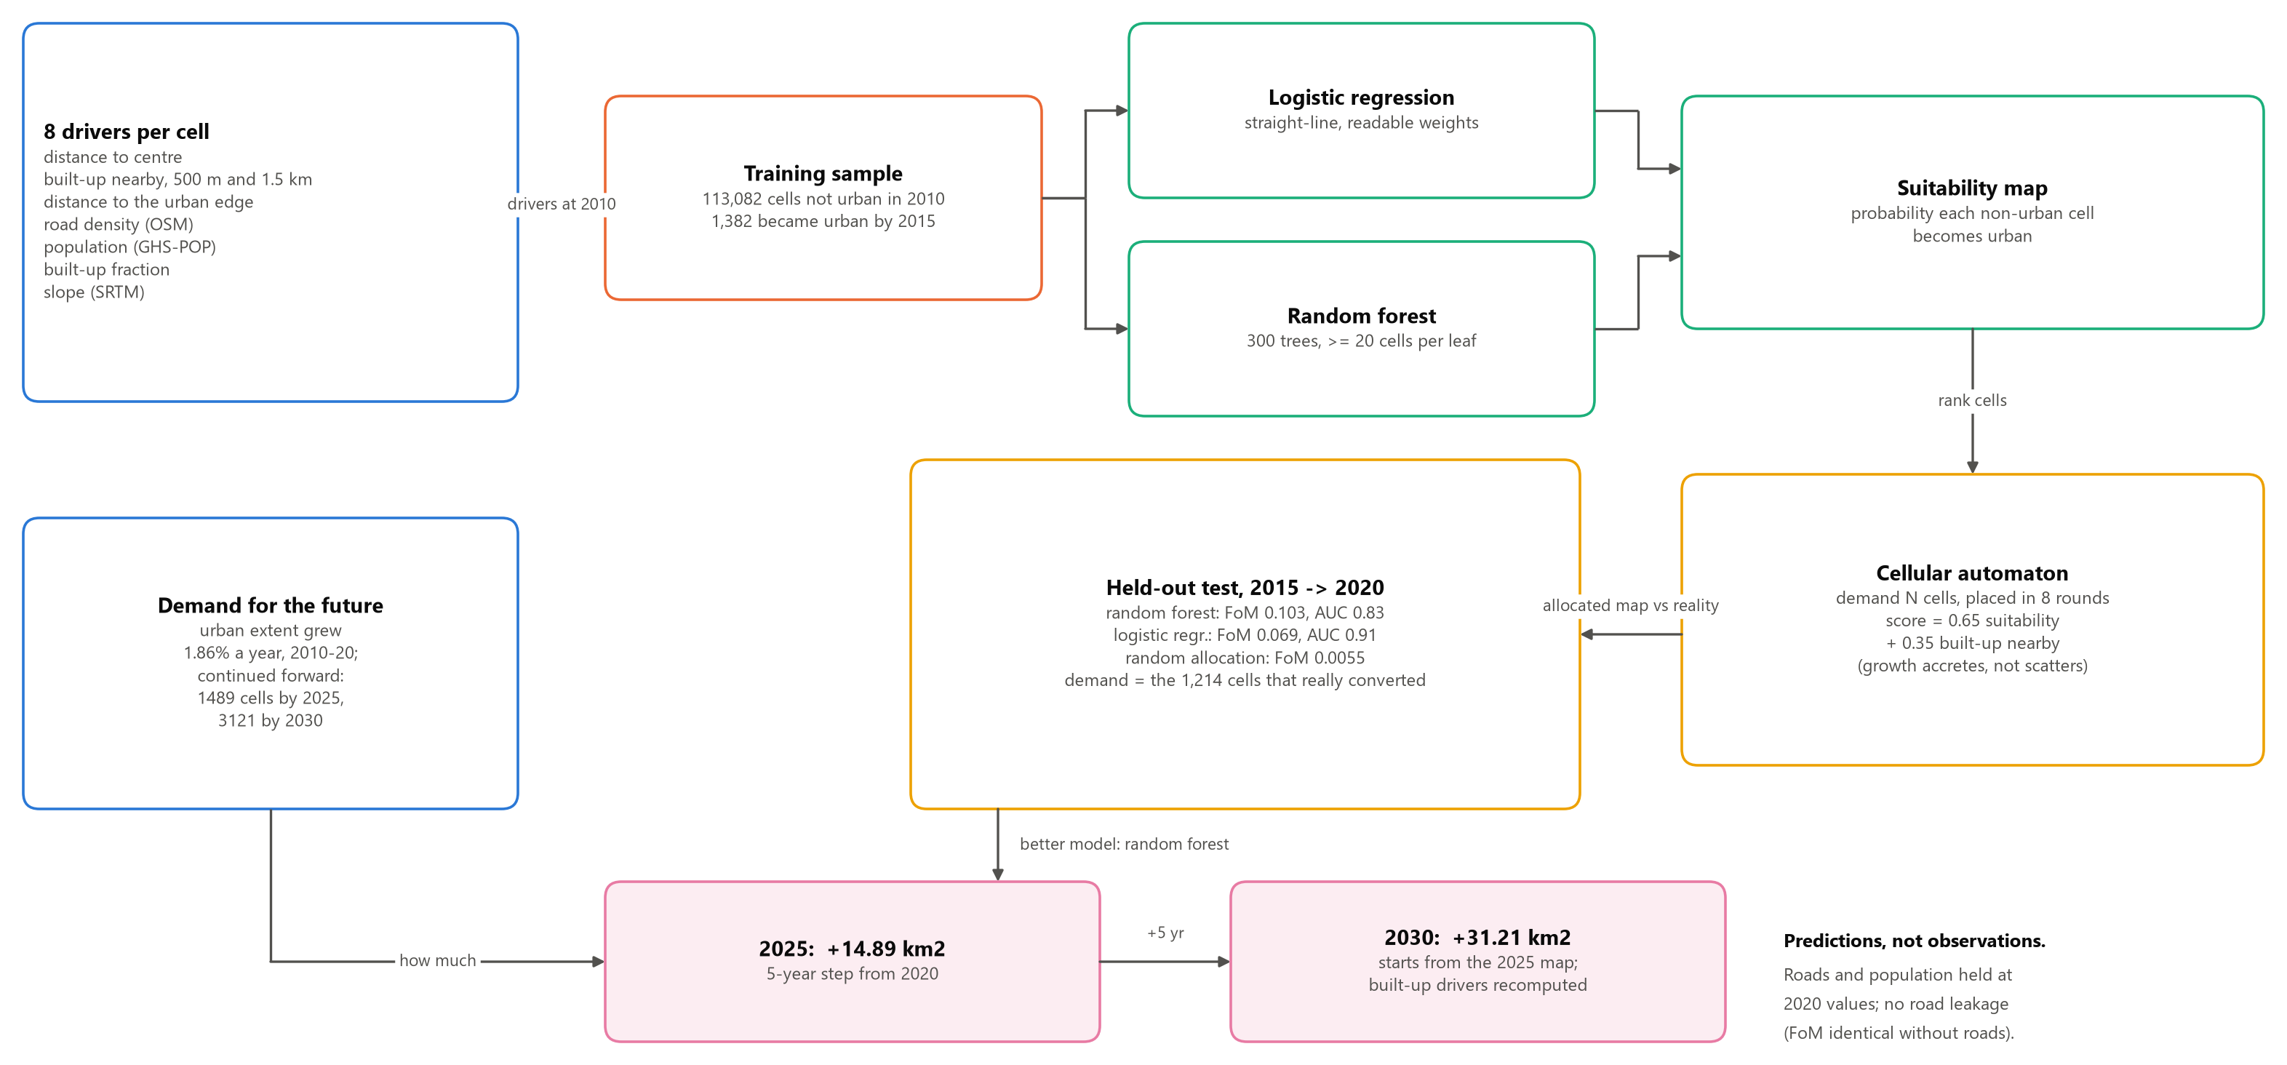
Growth-model architecture
Learn where the city grew, test on years it never saw, then predict
Notes:
Logistic regression is a straight-line model with readable weights; random forest combines 300 decision trees and captures non-linear effects. Both get the same eight drivers and the same split. A cellular automaton places the demanded number of cells, mixing suitability (0.65) with built-up nearby (0.35), so growth attaches to growth. We choose the model on Figure of Merit because it scores the placed map.

Slide 14
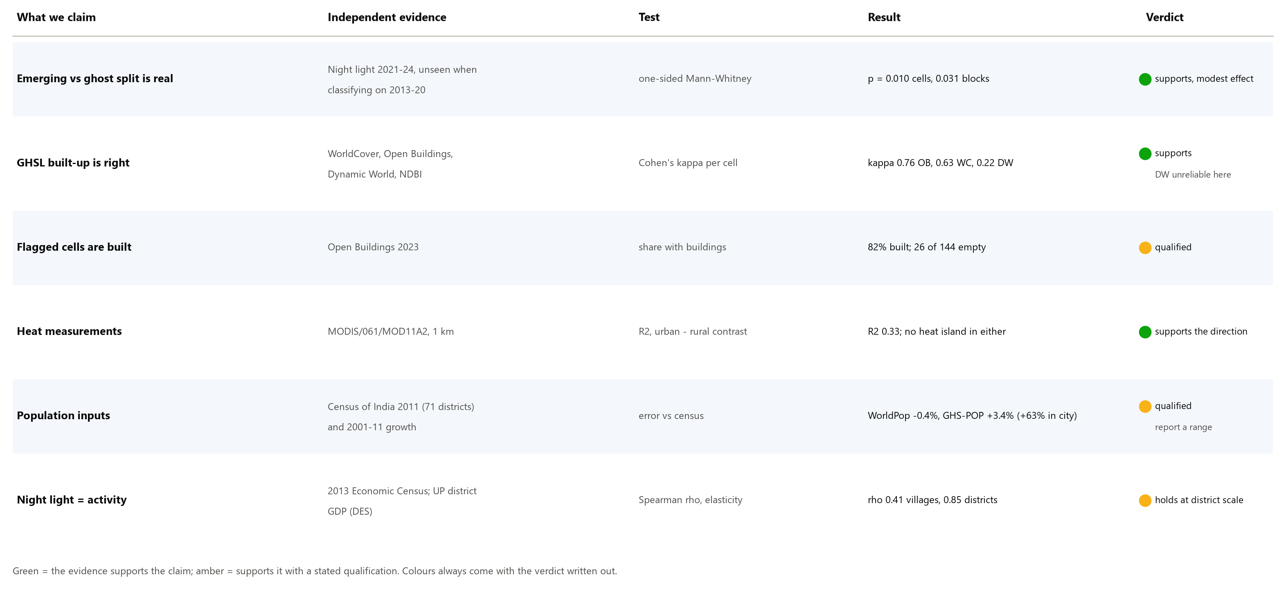
Validation framework
Every headline claim is checked against evidence the method never used
Notes:
Green means the independent evidence supports the claim; amber means it supports it with a stated qualification. No evidence here was used to build the result it checks.

Slide 15
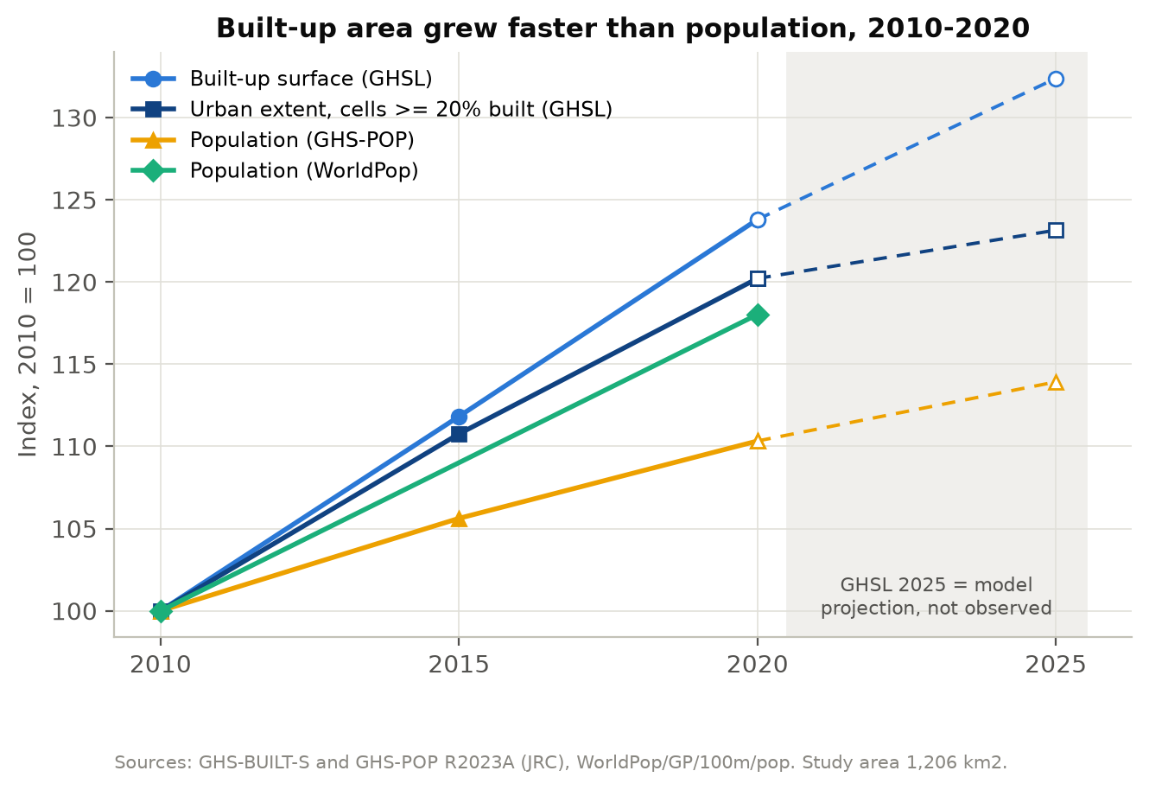
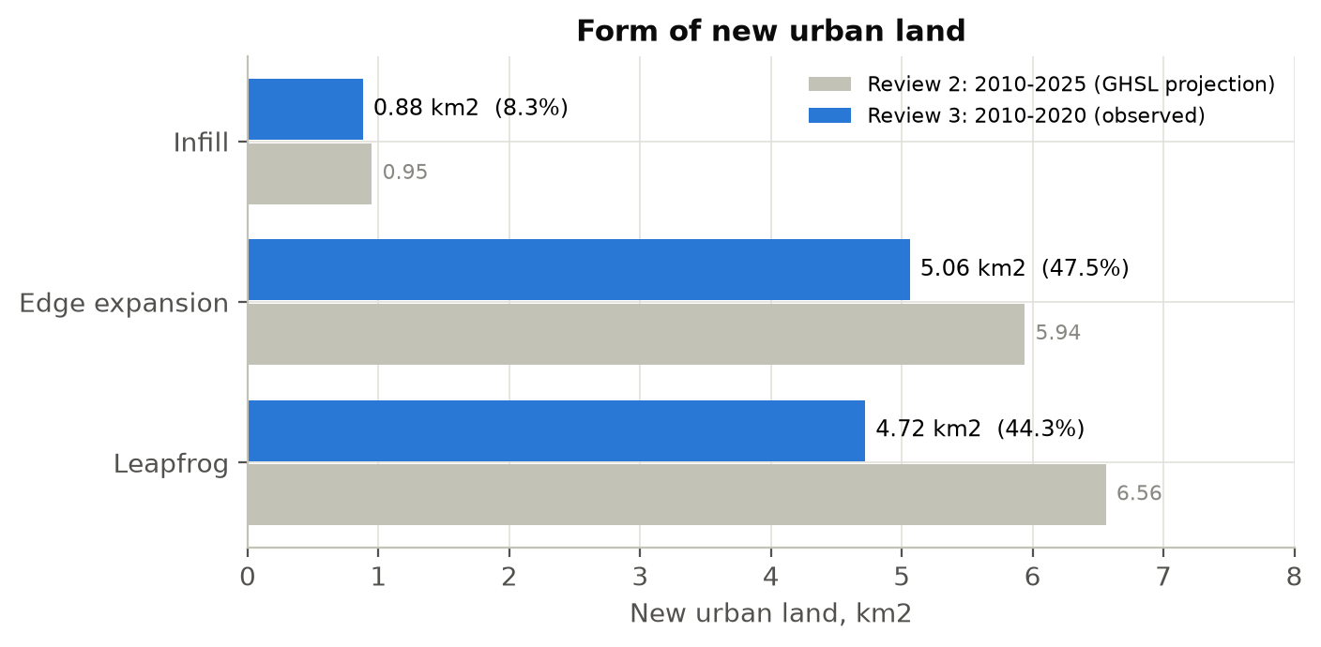
Result: urban growth, 2010-2020
Observed epochs only
+17.25 km²
built-up, 72.48 to 89.73 km²
1.86 % / yr
urban extent growth
44.3 %
of new urban land is leapfrog
1.3x - 2.3x
faster than population
Notes:
Built-up surface grew 23.8% in ten years while population grew 10 to 18% depending on the dataset, so land is consumed faster than people arrive: 1.3 to 2.3 times, reported as a range because the two population datasets disagree. Almost half the new urban land is leapfrog - detached from the existing city. The 2025 values are drawn dashed: GHSL's projection, not data.

Slide 16
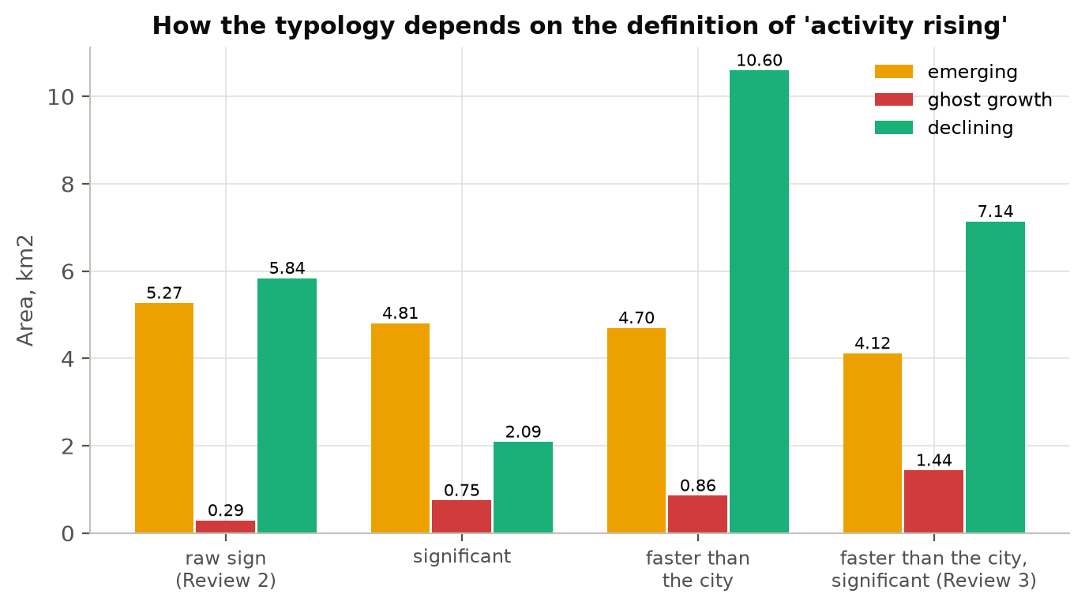
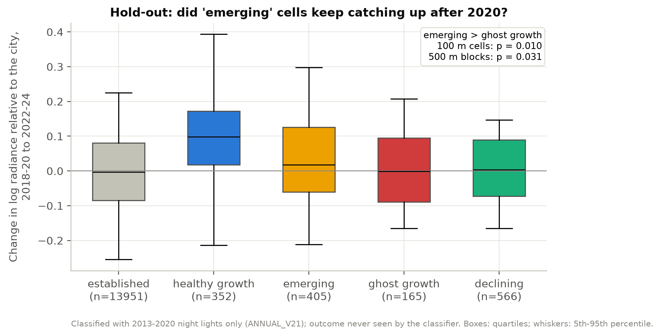
Result: is the ghost-growth split real?
Classified on 2013-2020, checked on 2021-2024 data the classifier never saw
Yes - modestly. Cells called emerging went on to brighten more than cells called ghost growth.
p = 0.010 over 100 m cells and p = 0.031 over 500 m blocks (one-sided Mann-Whitney). An emerging cell out-brightened a ghost cell 56% of the time: the split carries real information, and it is a screening map, not a verdict.
Notes:
Left: how the result depends on the definition of 'rising'. Our rule - faster than the city and significant - gives 4.12 square kilometres emerging and 1.44 ghost growth. Right: the hold-out test. The outcome was never seen by the classifier.

Slide 17
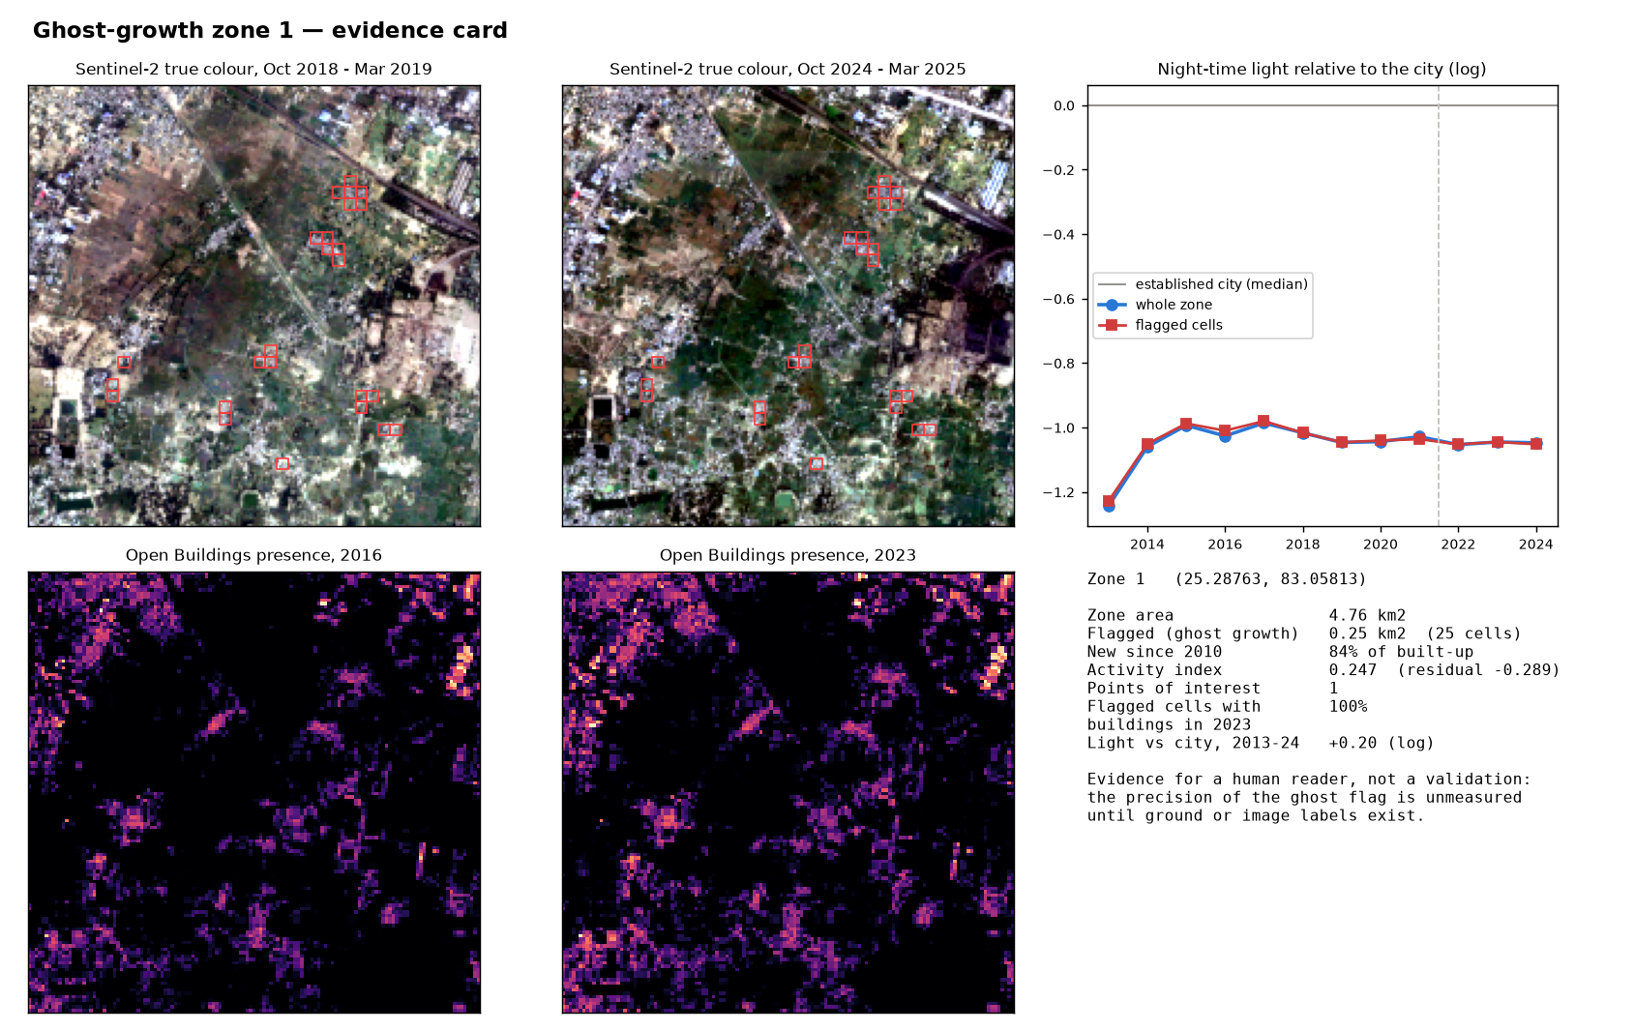
What a flagged zone looks like
One evidence card of 23
23
ghost-growth zones flagged
82 %
of ghost cells contain buildings in 2023
26 of 144
ghost cells with no buildings: likely GHSL errors
Evidence for a reader, not a validation: how often a flagged zone is really vacant stays unmeasured until image labels exist (Review 4).
Notes:
Each card shows Sentinel-2 true colour in 2018 and 2024, Open Buildings presence in 2016 and 2023, and the zone's night-light series against the city. This zone was built up, but its light has stayed flat relative to the city since 2014.

Slide 18
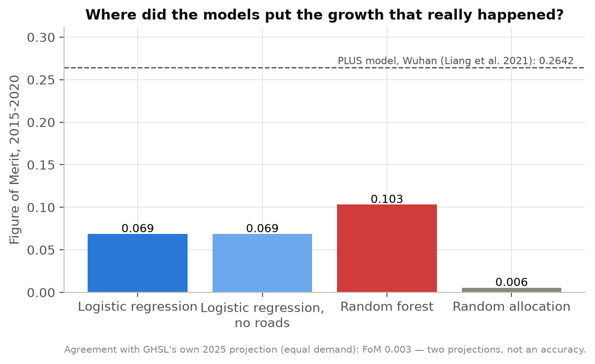
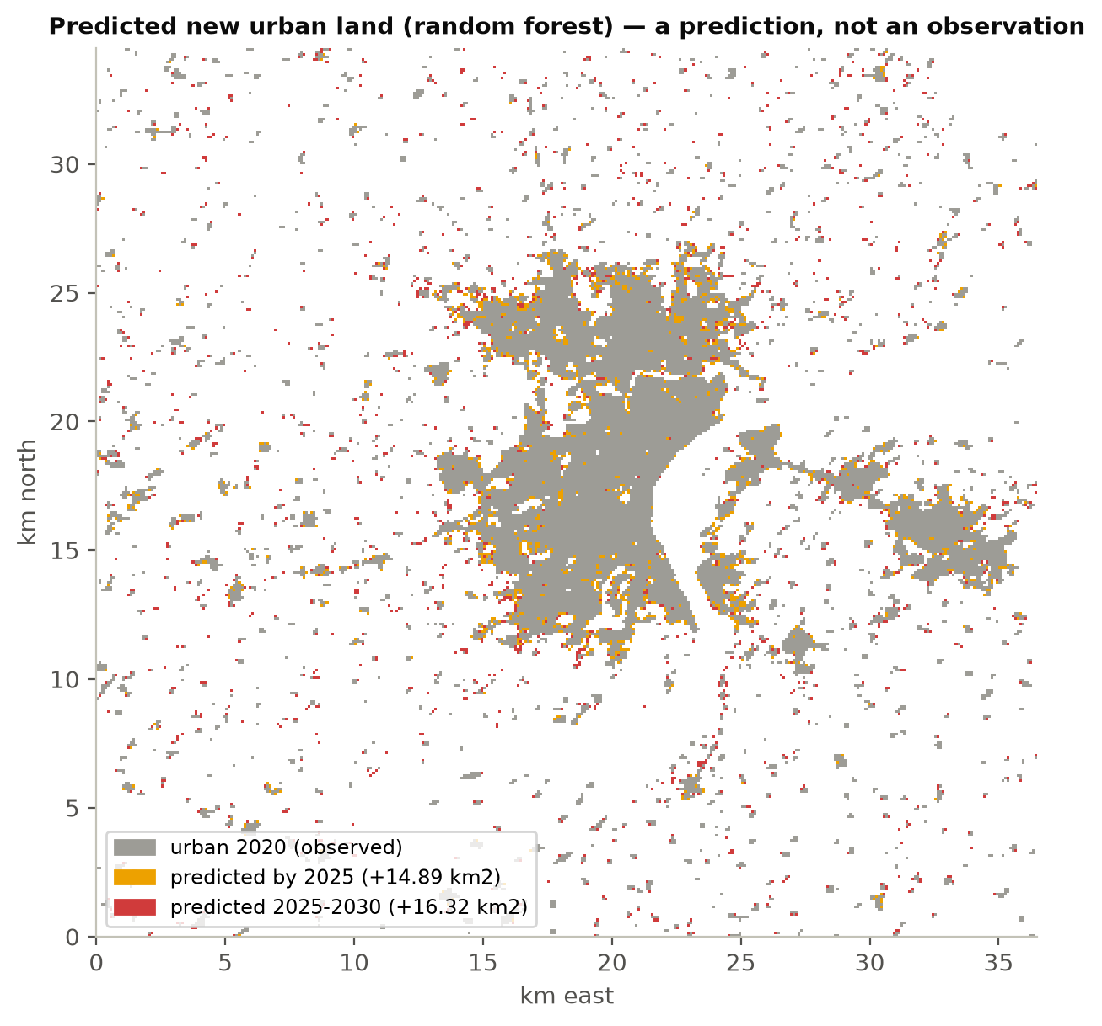
Result: where the city grows next
Trained 2010-2015, scored on a held-out 2015-2020
+14.89
km² by 2025
+31.21
km² by 2030
Model | AUC, held out | Figure of Merit | vs random
Random forest | 0.834 | 0.103 | 18.7x
Logistic regression | 0.910 | 0.069 | 12.5x
Random allocation | 0.500 | 0.0055 | 1x
Predictions, not observations.
The forest places growth better; the straight-line model ranks cells better overall. Removing roads changes nothing, so no later information leaks in. Published benchmark on the same measure: 0.264, PLUS model in Wuhan.
Notes:
Figure of Merit measures how much of the real 2015-2020 growth the placed map caught. Random forest catches 18.7 times more than random placement. AUC ranks all cells; FoM scores the map we actually publish, so we choose on FoM. The demand assumes the 2010-2020 growth rate of 1.86% a year continues.

Slide 19
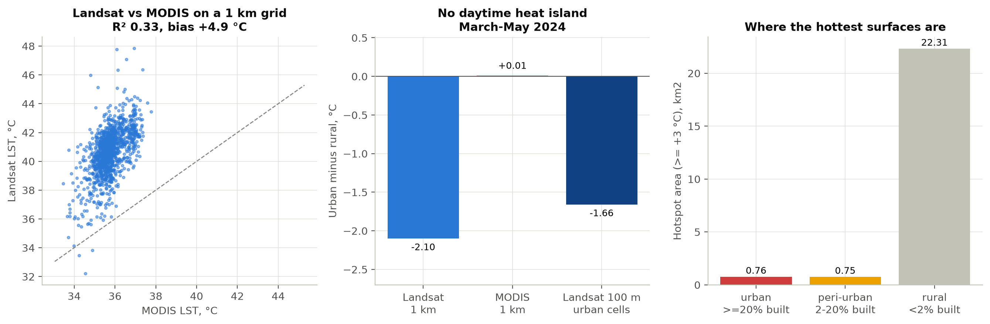
Result: surface heat
March to May, daytime
Varanasi has no daytime surface heat island in the pre-monsoon season.
Urban cells are 1.66 °C cooler than the bare farmland around them, MODIS agrees, and 22.3 of 23.8 km² of hotspots lie on rural land.
Notes:
Review 2 reported +1.10 degrees because it averaged only the cells warmer than rural - positive by construction. Dry, bare fields heat faster than the city by day before the monsoon; this pattern is reported for Indian cities in the literature (Shastri et al. 2017). Heat vulnerability, which weights heat by residents, remains the planning layer.

Slide 20
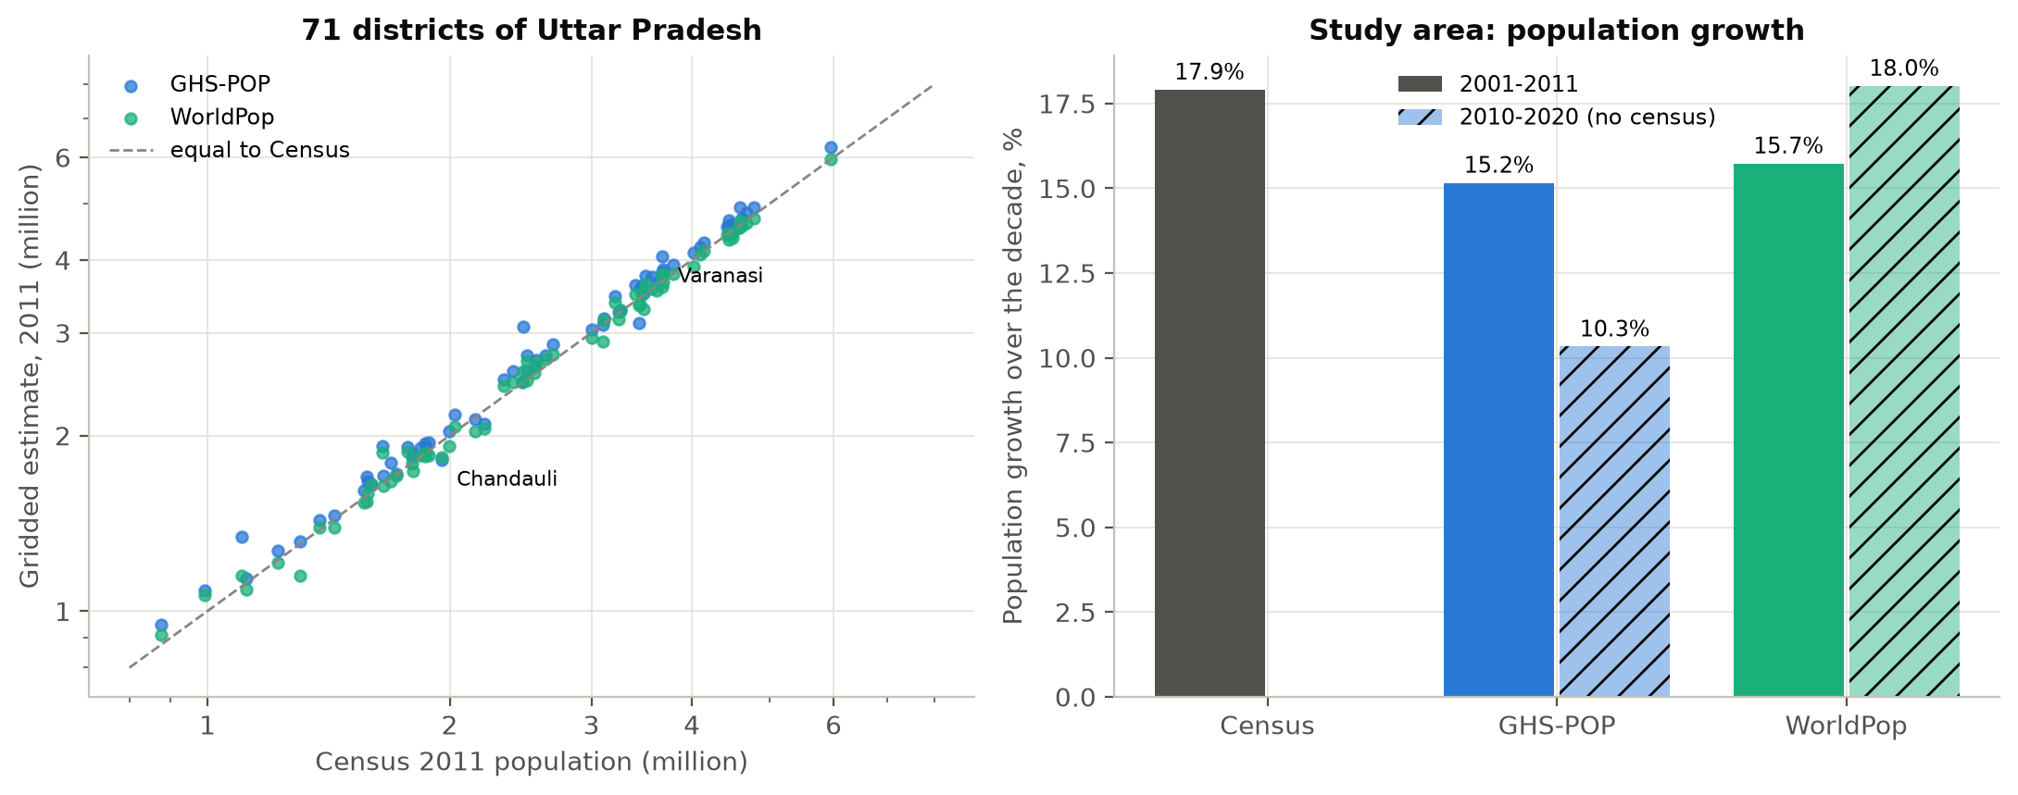
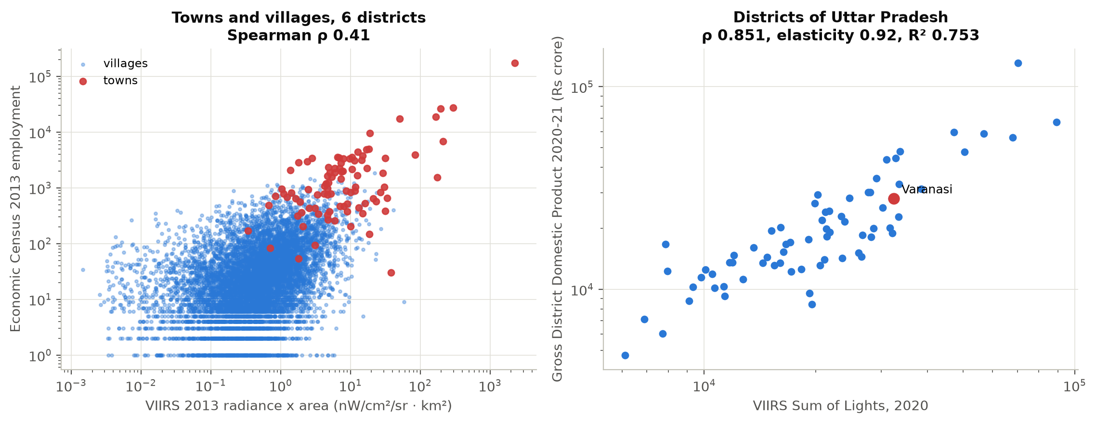
Checked against Indian records
Census of India, Economic Census, Uttar Pradesh district GDP
Population
WorldPop is closer to the 2011 Census than GHS-POP: median district error -0.4% against +3.4%, over 71 districts.
GHS-POP puts 63% too many people inside the city boundary.
So growth is reported as a range: built-up grew 1.3x to 2.3x faster than population.
Night-time light as an activity proxy
District scale: light against UP district GDP, Spearman 0.85, R² 0.75.
Village scale: light against 2013 Economic Census jobs, 0.41 - no better than population.
That is why the screen reports zones, not single cells.
Notes:
These are the Indian sources the panel asked about. They are used only as checks. The district result matches Henderson et al. (2012): light tracks economic output well at district scale.

Slide 21
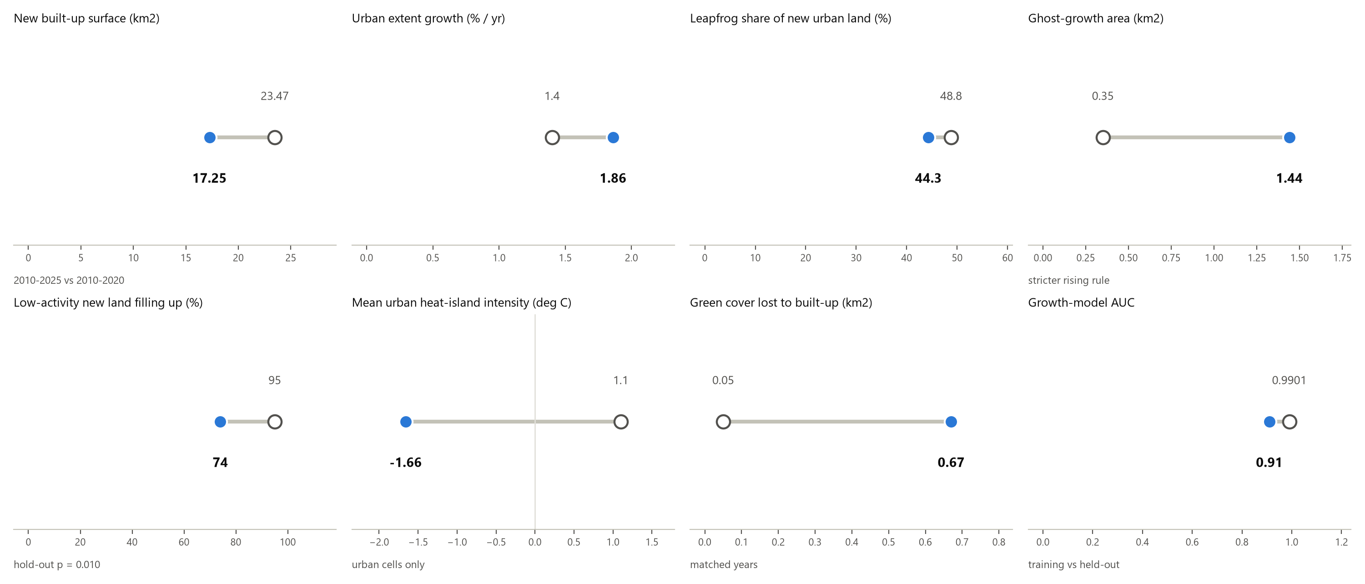
What the audit changed
Eight numbers, Review 2 (hollow) against Review 3 (filled)
Notes:
New built-up surface fell from 23.47 to 17.25 square kilometres because Review 2 counted GHSL's 2025 projection as data. Heat intensity changed sign once the mean was taken over urban cells and water left the rural reference. AUC fell from 0.99 to 0.91 because 0.99 was measured on the training data.

Slide 22
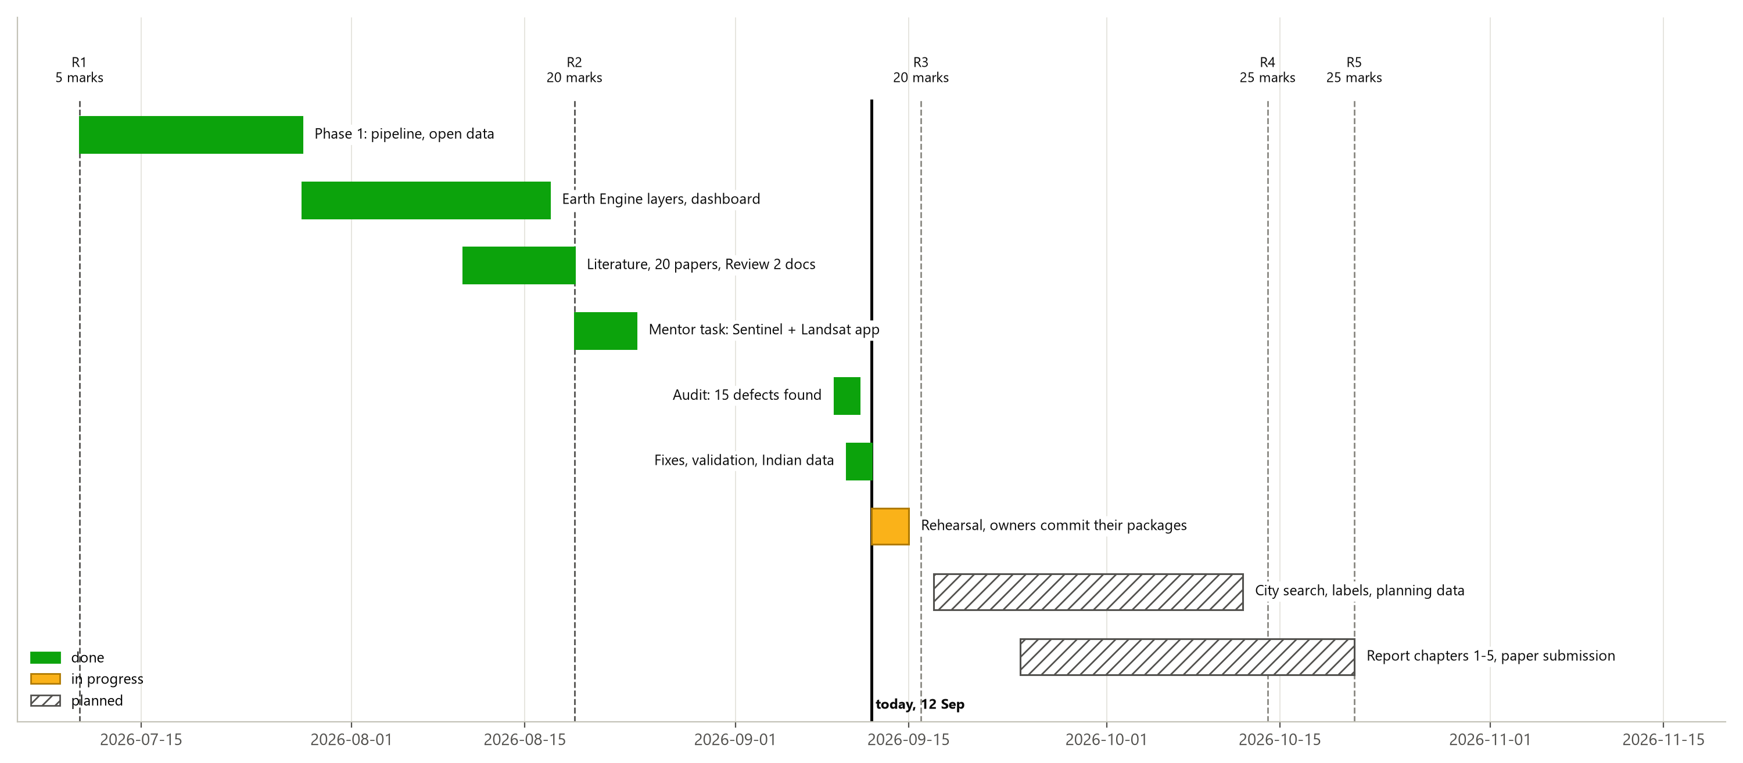
Where we are
Six phases done; Review 4 adds city search, image labels and planning data
Notes:
Everything left of the 'today' line is done. The hatched bars are planned, not claimed.

Slide 23
Limitations, and what Review 4 adds
Said plainly
What we cannot claim yet
No ground truth for the ghost flag: how often a flagged zone is really vacant is unmeasured. The hold-out test and the building check are indirect.
VIIRS pixels are 463 m; at village scale, light mostly measures settlement size.
GHS-POP over-counts the city core; the activity index still uses it, at weight 0.20.
Heat is daytime only, and the 2013 composite has just 5 dates.
The prediction assumes the 2010-2020 growth rate continues.
Review 4
City search type any city name and run the same analysis
Image labels read a sample of flagged and unflagged cells off historical high-resolution imagery, and measure precision
Planning data ward-level reporting, VDA Master Plan 2031, Bhuvan land use
Model tune the neighbourhood weight; a range of demand scenarios
Publication a paper built on the hold-out and proxy-scale findings
Notes:
Say the limitations before the panel does. The main one is that the ghost flag has no ground truth yet; Review 4 measures its precision with image labels.

Slide 24
Three things to take away
Varanasi's built-up surface grew 23.8% in 2010-2020, 1.3x to 2.3x faster than its population, and 44% of new urban land is leapfrog.
Most low-activity new development is filling up; 1.44 km² in 23 zones is not - and that split holds up on data the method never saw.
A random forest places future growth best: +14.89 km² by 2025 and +31.21 km² by 2030 - predictions, not observations.
Notes:
Questions to expect: why the 2025 epoch mattered; why the heat result reversed; why the forest wins on Figure of Merit but loses on AUC; what the ghost flag can and cannot claim.

