Slide 1
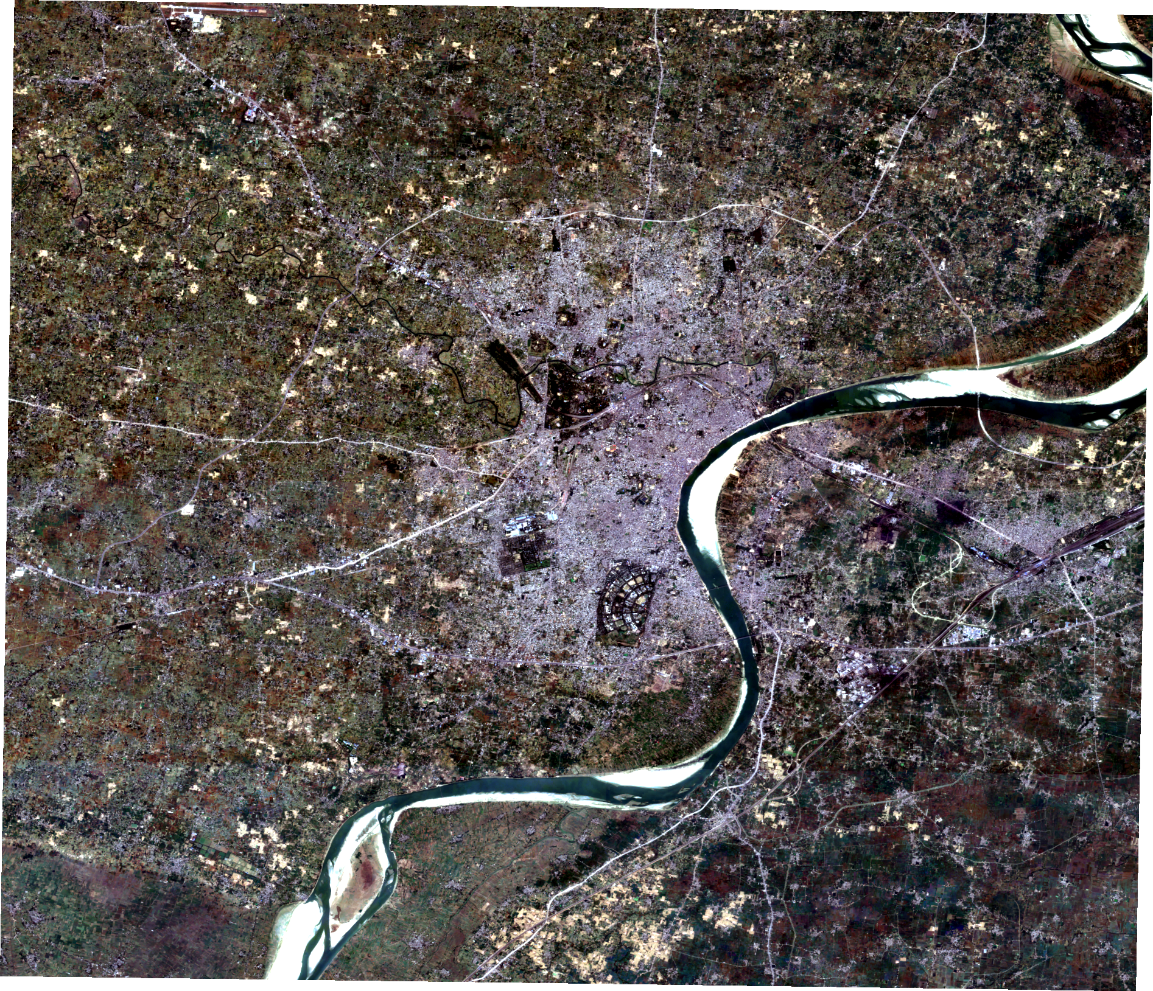
Satellite-Based Urban Growth and
Economic Activity Intelligence System
Detecting built-but-inactive development from open satellite data
Case study: Varanasi, Uttar Pradesh
Team
Mohammad Owais — 23BCE1746
Achal Pramod Tripathi — 23BCE1734
Mayank —23BCE1753
Guide: Dr. Joshan · BCSE497J Project I
School of Computer Science and Engineering · Fall 2026–27

Slide 2
Literature Review · 1 of 3
Nighttime light as a proxy for human activity — 20 papers reviewed, 19 from 2020 onward
A global annual simulated VIIRS nighttime light dataset from 1992 to 2023
An extended time series (2000–2018) of global NPP-VIIRS-like nighttime light data
Chen, X. et al. · 2024 · Scientific Data
Chen, Z. et al. · 2021 · Earth System Science Data
Method U-Net convolutional network reframed as image super-resolution, using Landsat NDVI as a second input.
Result R² 0.617 per pixel rising to 0.964 per country. Error concentrates at the urban fringe.
Method Auto-encoder neural network combined with a vegetation index to break sensor saturation.
Result R² 0.87 per pixel, 0.95 per city, validated on 150,000 random pixels.
Cross-Sensor Nighttime Lights Image Calibration with Residual U-Net
A Prolonged Artificial Nighttime-light Dataset of China (1984–2020)
Nechaev, D. et al. · 2021 · Remote Sensing
Zhang, L. et al. · 2024 · Scientific Data
Method Residual U-Net converting the newer sensor back to match the older one — the easy direction.
Result R² 0.94–0.99. Confirms the reverse direction is what is genuinely hard.
Method Convolutional Long Short-Term Memory network, learning how light changes over time.
Result RMSE 0.73, R² 0.95. Scores higher because it never crosses between two sensors.

Slide 3
Literature Review · 2 of 3
Measuring built-up extent, and inferring whether it is used
Using Landsat and nighttime lights for supervised pixel-based image classification
Continental-Scale Building Detection from High Resolution Satellite Imagery
Goldblatt, R. et al. · 2018 · Remote Sensing of Environment
Sirko, W. et al. · 2021 · Google Research
Method Nighttime light used to label training data automatically, avoiding hand-drawn training areas.
Result 80.8% balanced accuracy for India. The methodological ancestor of this project.
Method U-Net on 50 cm imagery, trained on 100,000 images with 1.75 million labelled buildings.
Result 516 million footprints. Deeper encoders gave no gain — technique beat architecture.
Dynamic World, Near real-time global 10 m land use land cover mapping
Inferring ghost cities on the globe in newly developed urban areas
Brown, C. F. et al. · 2022 · Scientific Data
Zhang, Y., Tu, T. & Long, Y. · 2024 · Cities
Method Deep learning on Sentinel-2, publishing a class probability rather than one fixed label.
Result First near-real-time global land cover. Supplies the water mask our heat layer needs.
Method Urban vitality from road density, points of interest and population, across 8,841 cities.
Result New areas show only 7.69% of the vitality of old ones; worst 5% called ghost cities.

Slide 4
Literature Review · 3 of 3
Predicting expansion, measuring its consequences — and the gap we found
Understanding the drivers of sustainable land expansion using the PLUS model
An efficient built-up land expansion model using a modified U-Net
Liang, X. et al. · 2021 · Computers, Environment and Urban Systems
Shojaei, H. et al. · 2022 · International Journal of Digital Earth
Method Random forest to find drivers, then a cellular automaton growing realistic patches.
Result Figure of Merit 0.2642.
Method Modified U-Net labelling every pixel built-up or not, from slope and distance drivers.
Result AUC 0.87 against 0.82 for random forest — a 0.05 gain, at the cost of a GPU.
Spatio-temporal analysis of urban expansion using Google Earth Engine
Google Earth Engine Open-Source Code for Landsat Land Surface Temperature
Zhang, A. et al. · 2025 · Scientific Reports
Ermida, S. L. et al. · 2020 · Remote Sensing
Method Random forest in Earth Engine, then a cellular automaton with a neural network, to 2030.
Result Accuracy above 92%. The closest recent precedent for our whole workflow.
Method Open code computing land surface temperature from Landsat entirely inside Earth Engine.
Result RMSE 1.0–1.3 K against ground sensors. The reference method behind our heat layer.
The gap: no study learns the activity level normal for a given level of development within a city, then uses it to separate development that has stalled from development still filling up.
.

Slide 5
Methodology
Six steps, each a separate testable module
1
Find the city
A city name is turned into coordinates, and a circle around that point becomes the study area.
A city has no single official boundary available everywhere, and municipal limits usually exclude the fastest-growing fringe — which is exactly where our findings are.
2
Download the data
GHSL and OpenStreetMap come straight over HTTP; the satellite layers come through Google Earth Engine.
Earth Engine clips each layer on its own servers, so a few megabytes arrive instead of whole scenes. The GHSL path needs no account, so the system always returns a result.
3
Put it on one grid
Every dataset is reprojected onto a single 100 m grid in UTM zone 44N, and reported at 500 m.
Built-up area and population are extensive quantities, so they are converted to density before reprojection and rescaled after — otherwise the totals would not survive the warp.
4
Compute indicators
Built-up change, vegetation loss, surface temperature, night-light trend, and shop and road density.
Each is normalised per unit of built-up area, because raw values otherwise measure how large a place is rather than how intensively it is used.
5
Train the model
Logistic Regression learns which cells became built-up, from seven drivers; a cellular automaton places the growth.
The automaton makes each cell look at its neighbours, so predicted development appears in connected patches rather than scattered single cells — which is how cities actually grow.
6
Predict and display
Future demand is extrapolated from the city's own past growth rate, then allocated to the most suitable cells.
The +5 and +10 year maps are a prediction, not a measurement — they show where growth is likely if current trends continue, and the dashboard says so.

Slide 6
Workflow
Seven pipeline stages, run in order
1. builtup
GHS-BUILT-S
GHS-POP
2. osm
OpenStreetMap
Overpass API
3. gee
VIIRS · Sentinel-2
Landsat · Dynamic World
4. vegetation
Green cover
change
5. thermal
Heat island
intensity
6. ghost
Activity index
+ typology
7. export
500 m grid
+ summary
A failed stage does not stop the run
Public data sources rate-limit and time out, and Earth Engine needs an account. Any stage that cannot run records why, and the pipeline continues. The reason appears in the output and on the dashboard, so a missing layer is always visible rather than silently read as zero.
Prediction runs separately
Build seven drivers → train on an early period → test on a later unseen period → compare against random → project +5 and +10 years → allocate with a cellular automaton so growth appears in connected patches.

Slide 7
System Architecture
Four layers · data flows upward
PRESENTATION
Interactive map
Growth typology
Ghost zones
Environment
Grid export
Two paths, on purpose
Most projects of this kind stall at “first, get an Earth Engine account”. Splitting the sources means the core result exists before anyone logs in.
ANALYSIS
builtup.py
nightlights.py
vegetation.py
Never downloads —
so it is testable offline
thermal.py
ghost.py
growth_model.py
Layers only talk downward
Acquisition never analyses; analysis never downloads. That is why the analysis can be tested on synthetic data with no network — the suite runs in seconds.
ACQUISITION
OPEN PATH — no account
EARTH ENGINE PATH — one login
GHS-BUILT-S
VIIRS nighttime lights
GHS-POP
Sentinel-2
Landsat 8 / 9
A new city is a new file
Nothing below the configuration layer is hard-coded. Pointing the system at another city changes a centre point and a radius, not a line of code.
OpenStreetMap
Dynamic World
Open Buildings
CONFIGURATION
config/varanasi.yaml — city, area, grid, epochs, thresholds, sources

Slide 8
Datasets Acquired
Official identifiers, exactly as published
Official dataset
Provider
Res.
Imagery dates
Gives us
GHS-BUILT-S R2023A
EC Joint Research Centre
100 m
2020 epoch
Built-up surface
GHS-POP R2023A
EC Joint Research Centre
100 m
2020 epoch
Population
NOAA/VIIRS/DNB/ANNUAL_V21 / _V22
NOAA
463 m
2013–2024
Nighttime lights
COPERNICUS/S2_SR_HARMONIZED
ESA / Copernicus
10 m
Oct 2024 – Mar 2025
True colour, NDVI, NDBI
LANDSAT/LC08 & LC09/C02/T1_L2
USGS
30 m
Mar – May 2024
Land surface temperature
GOOGLE/DYNAMICWORLD/V1
Google
10 m
Oct 2024 – Mar 2025
Land cover
GOOGLE/Research/open-buildings-temporal/v1
Google
4 m
2023
Building height
OpenStreetMap · Overpass API
OSM contributors
vector
Current
Shops, offices, roads

Slide 9
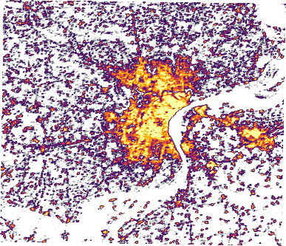
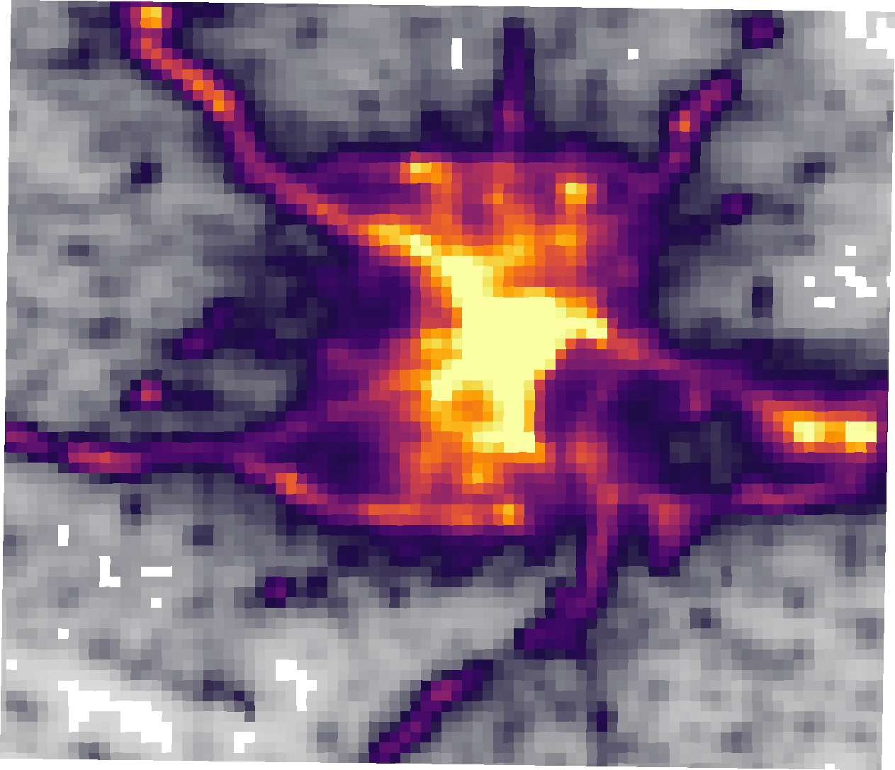
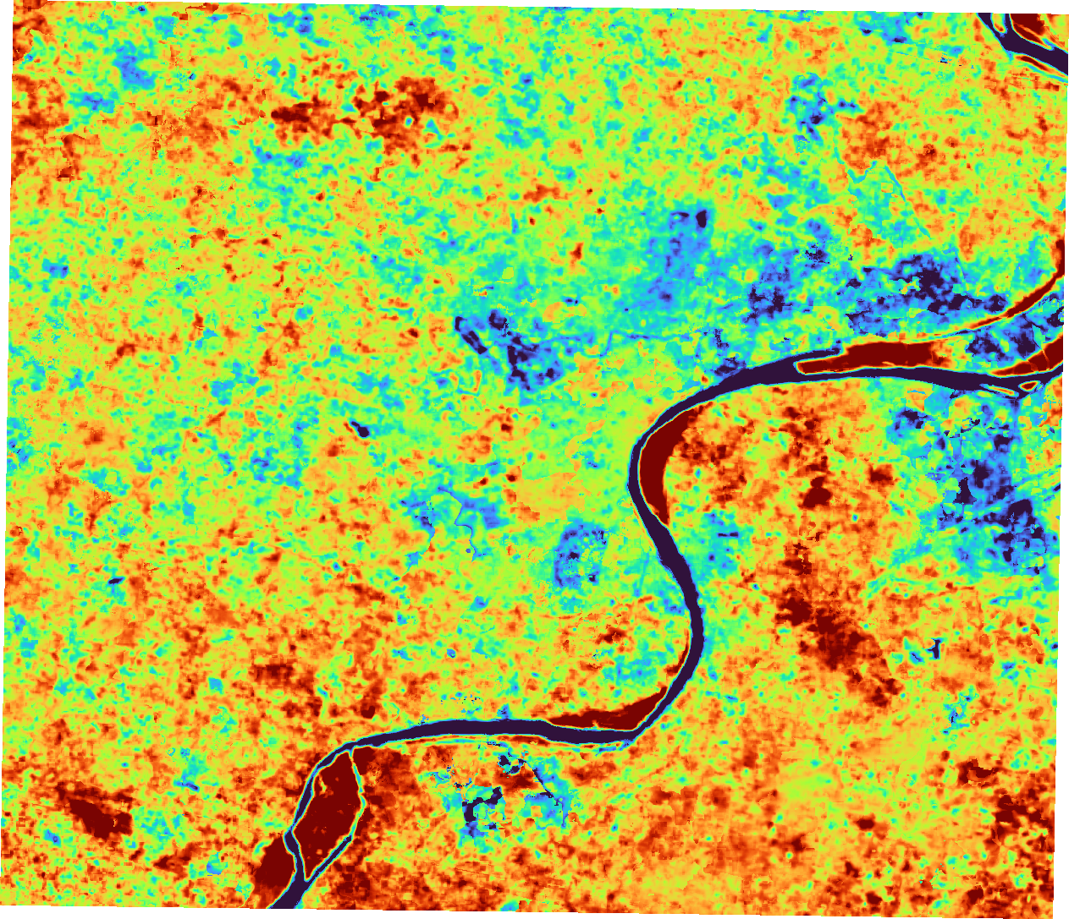
The Complete Pipeline
Real output at every stage — nothing here is a sample image
1 · Satellite image
Sentinel-2 true colour
2 · Built-up surface
GHS-BUILT-S, 2020
3 · Activity
VIIRS nighttime lights
4 · Heat island
Landsat surface temperature
→ combined into one activity index → compared against the level normal for that much development in this city → six-class growth typology:
active areas, healthy growth, emerging areas, declining areas, ghost growth, and undeveloped areas.

Slide 10
Conclusion
What the system delivers, and what it does not claim
Key findings for VaranasiBuilt-up +23.8% against population +10.3%, 2010–2020
2.3× more land consumed per resident
48.8% leapfrog new development detached from the city
0.35 km² stalled across 15 zones, all peripheral
Contribution
The activity level expected of a place is learned from the city's own data rather than set as a fixed threshold, so the method transfers to any city unchanged. Development that has stalled is separated from development still filling up — a distinction that accounts for 95% of what would otherwise be reported as a problem.
Screening, not a census — the smallest reliable unit is a neighbourhood
No ground validation yet; that is the first Phase 3 task
Figure of Merit 0.0679 carries real signal but is not parcel-accurate
Ground validation of the 15 flagged zones
Ward-level reporting on Census 2011 boundaries
City search box replacing the configuration file
Master-plan overlay: planned versus actual development

