Slide 1
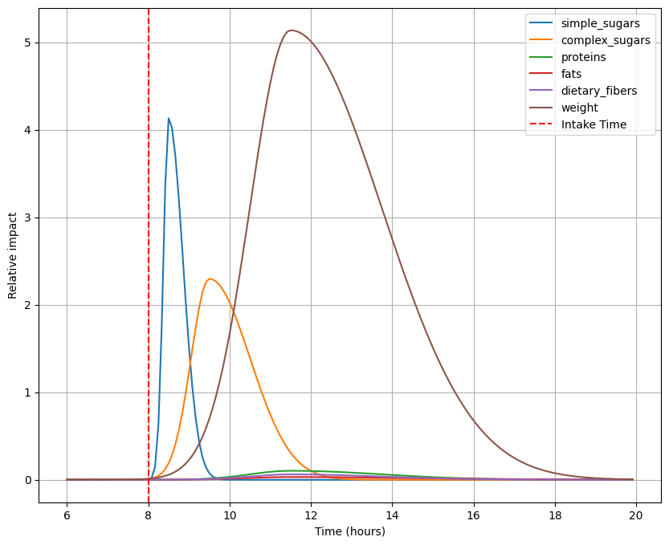
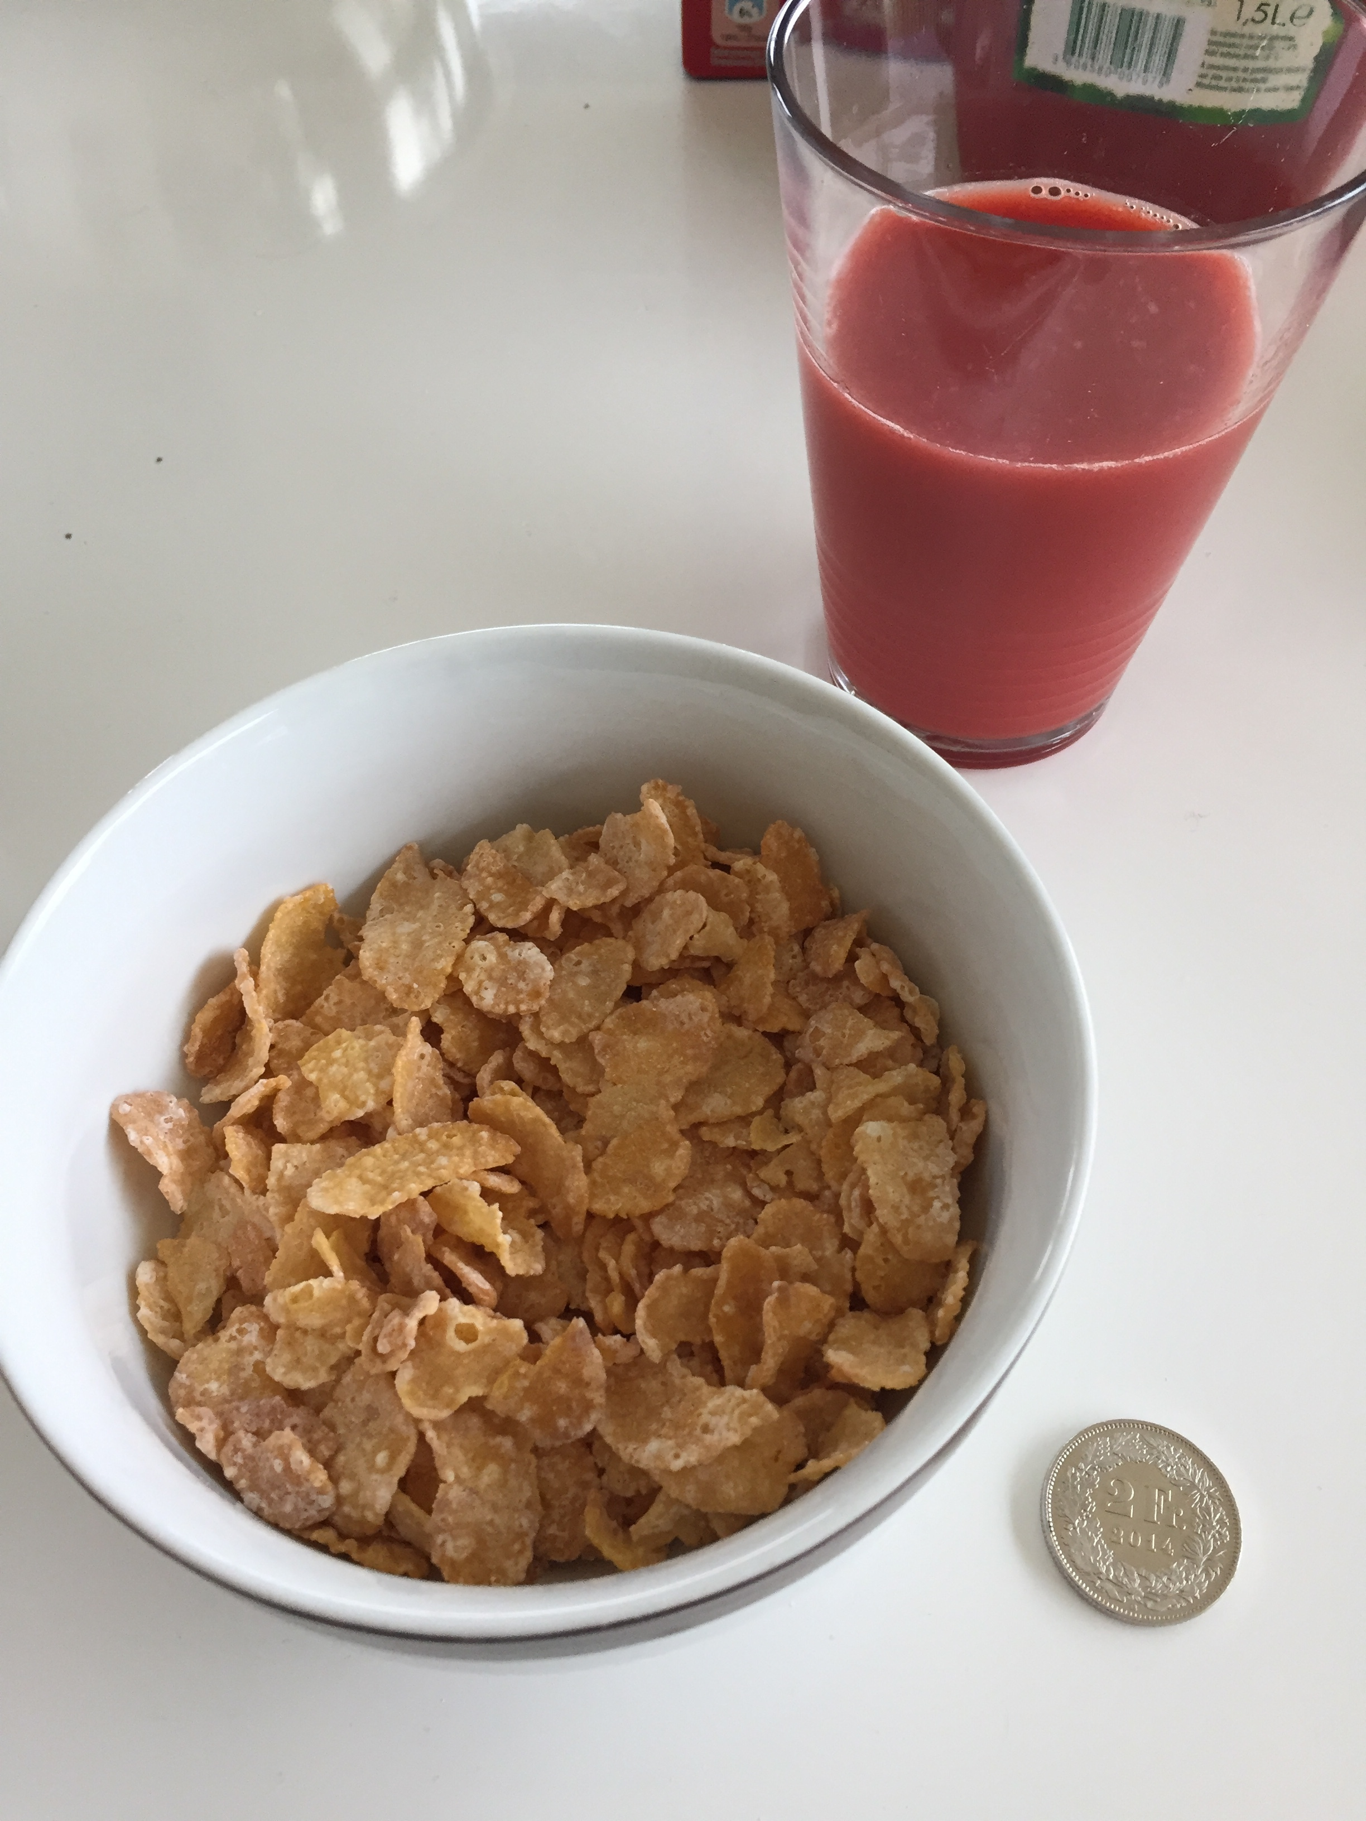
Large Language models for glucose forecasting and investigating patient metabolism
Estimation of macronutrients in meal images via LLM

Slide 2
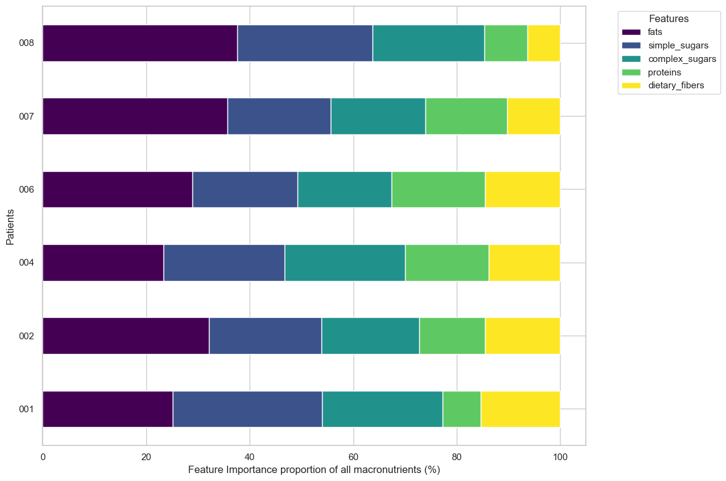
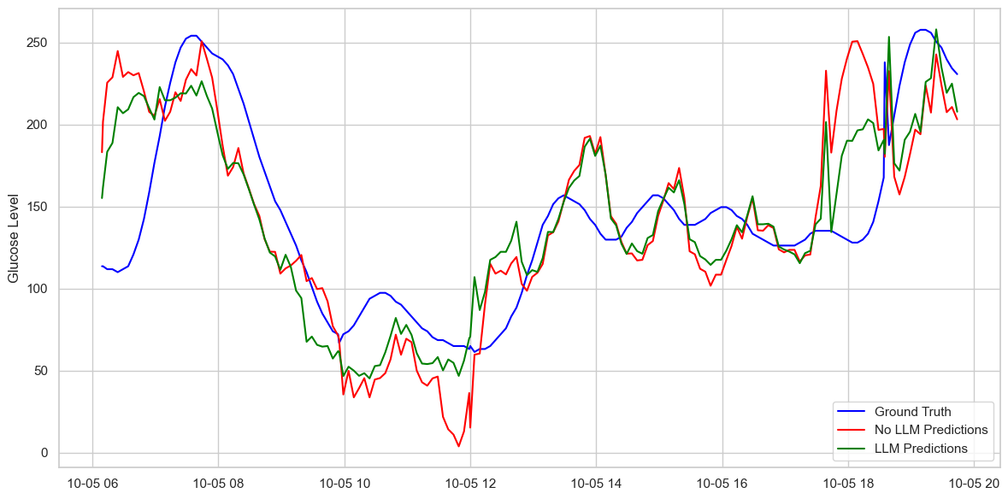
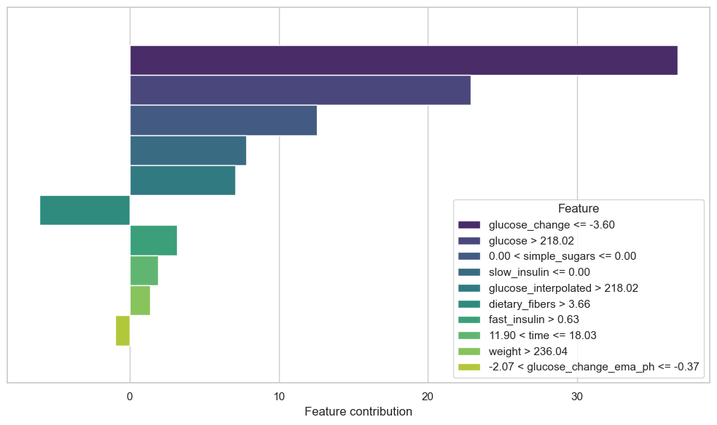
Advantages of incorporating meal macronutrient features
Improved glucose forecasting performance
Uncover individual patient metabolism
Investigating causes for hyper- and hypoglycemic events

