Slide 1




INTEL PRODUCTS
SENTIMENT ANALYSIS FROM ONLINE REVIEW
By -
Prity Mishra b222036@iiit-bh.ac.in
Dakh Katiyar b222018@iiit-bh.ac.in

Slide 2

Phase 1: Scraping
Source: Amazon and Flipkart reviews
Information Extracted: Review title, review body, ratings, date
Filtering: Latest reviews for better analysis
Output: Generated CSV files for each product

Slide 3
Phase 2: Sentiment Analysis
Preprocessing: Filtering and cleaning reviews
Tool Used: Vader (Valence Aware Dictionary and sEntiment Reasoner)
Reasons for Using Vader:
Pretrained model
Widely used in the industry
Easy to apply
High accuracy
Analyzes emojis effectively
Classification: Reviews categorized into positive, negative, competitive, and expectation segments

Slide 4
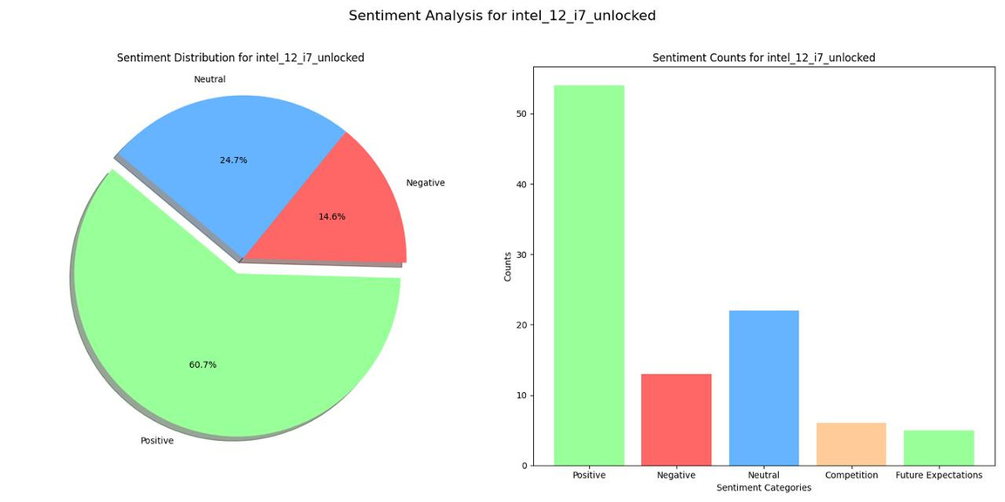
Phase 3: Plotting
Visual Graphs:
Pie Chart: Illustrates overall user sentiment (positive, negative, neutral)
Bar Graph: Displays numerical data for positive, negative, competitive, and expectation categories
Conclusion:
Competitive Edge: Highlights product strengths compared to competitors
User Expectations: Provides insights into user expectations and desired product improvements

Slide 5




Wardiere Inc.
Home
Service
About Us
Contact
Search . . . .
Contributions
Prity Mishra
Responsible for web scraping and organizing documents.
Managed the GitHub repository to ensure seamless collaboration and version control.
Co-contributed to the project documentation, ensuring clarity and comprehensiveness.
Daksh Katiyar
Conducted data analysis and generated visualizations.
Co-contributed to the project documentation, ensuring clarity and comprehensiveness.
Concluded the analyzed data.

Slide 6
THANK YOU

