Slide 1
Diwali Sales Analysis
Using Python

Slide 2
Objective:
This project is all about how to analyze the Diwali Sales Database. Examining the dataset with Python and to share the summary through which it helps to improve customers experience by analyzing sales data and to increase revenue.
Tools And Technologies Used:
Python, Data Cleaning, Data Preprocessing, Data Manipulation, Data Analysis, Data Visualization, NumPy, Pandas, Matplotlib, Seaborn, EDA

Slide 3
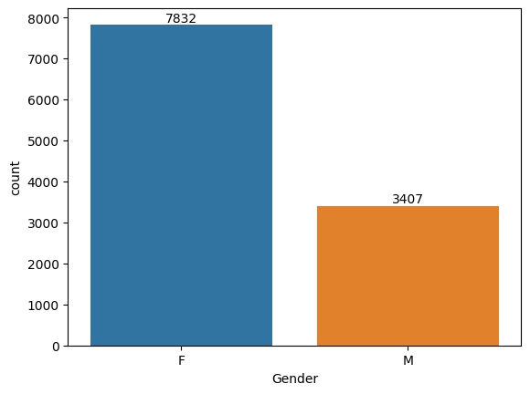
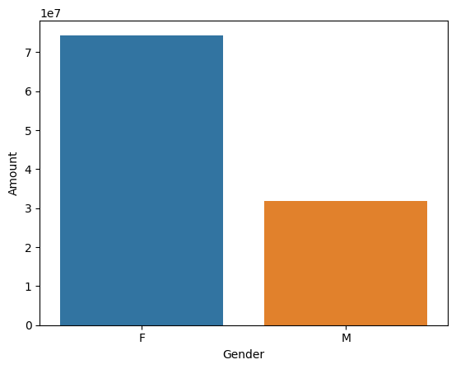
Exploratory Data Analysis:
Gender
From above graphs we can see that most of the buyers are females and even the purchasing power of females are greater than men.

Slide 4
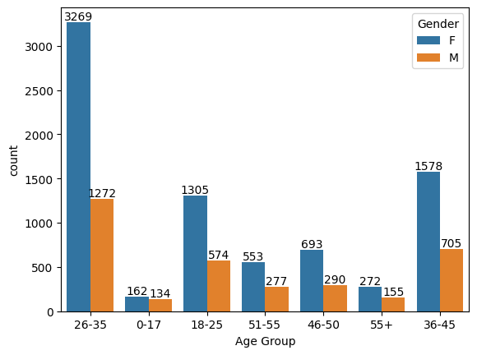
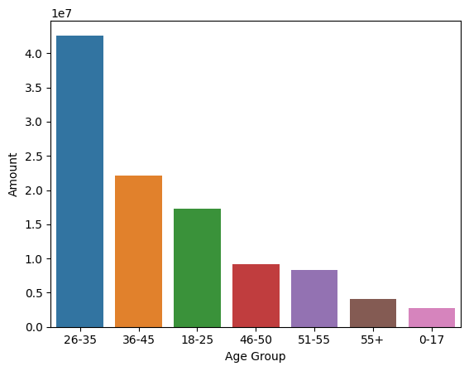
Age
From above graphs we can see that most of the buyers are of age group between 26-35 years female.

Slide 5
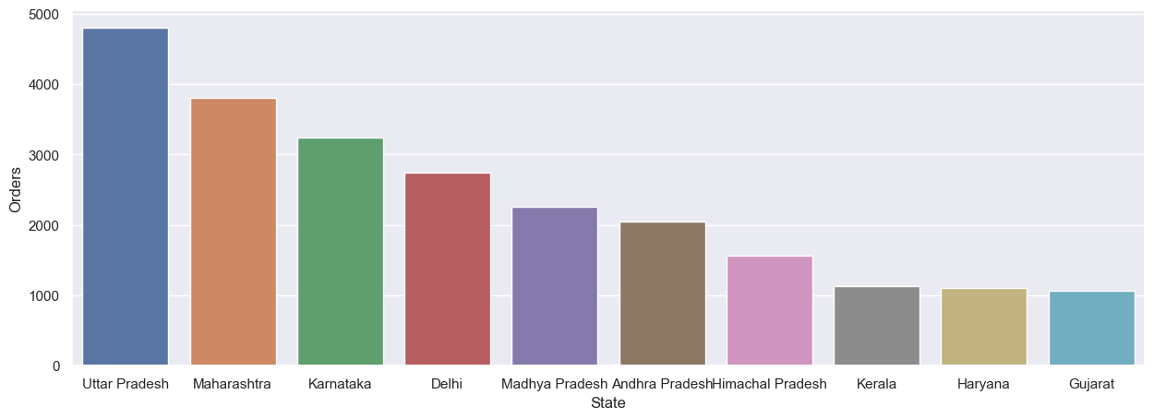
State

Slide 6
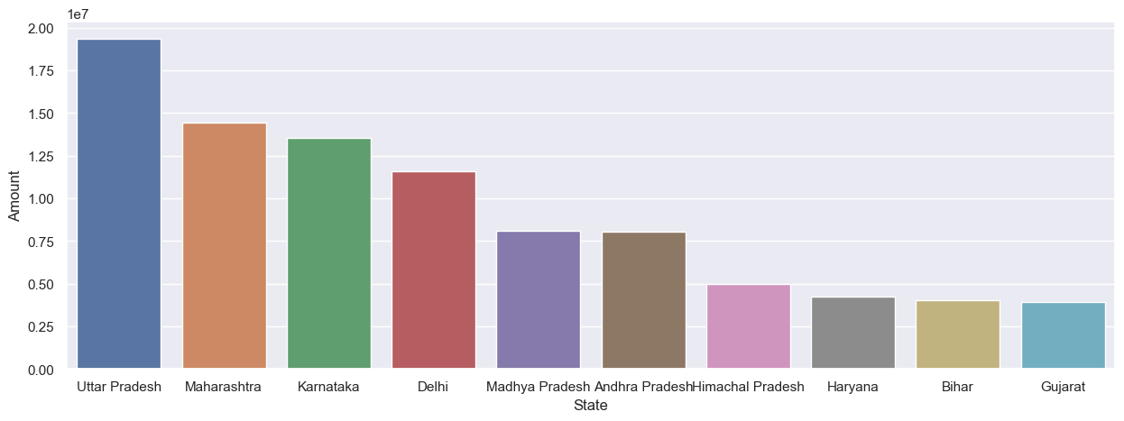
From above graphs we can see that most of the orders & total sales/amount are from Uttar Pradesh, Maharashtra and Karnataka respectively

Slide 7
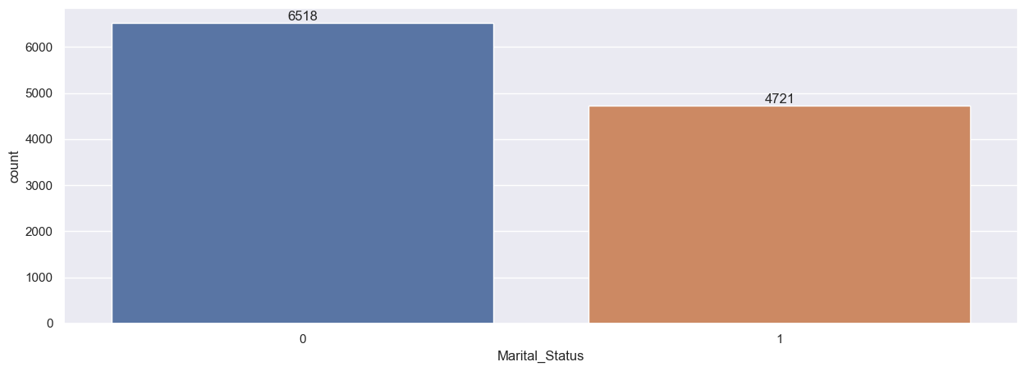
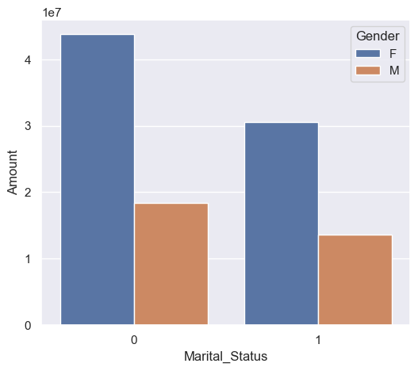
Marital Status
From above graphs we can see that most of the buyers are married (women) and they have high purchasing power

Slide 8
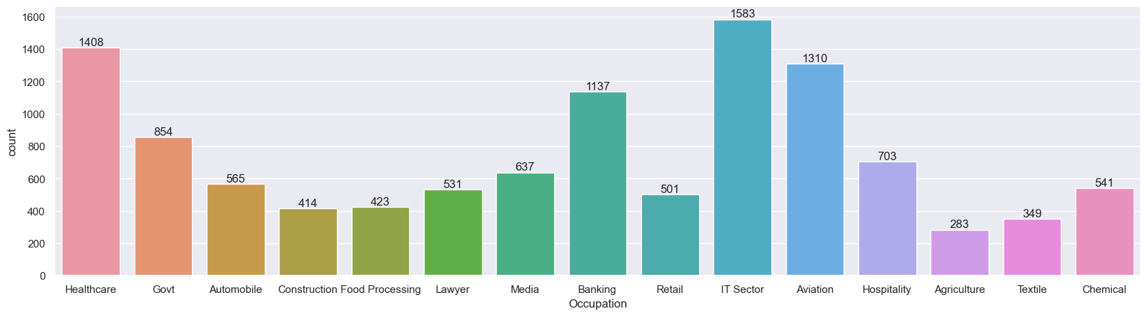
Occupation

Slide 9
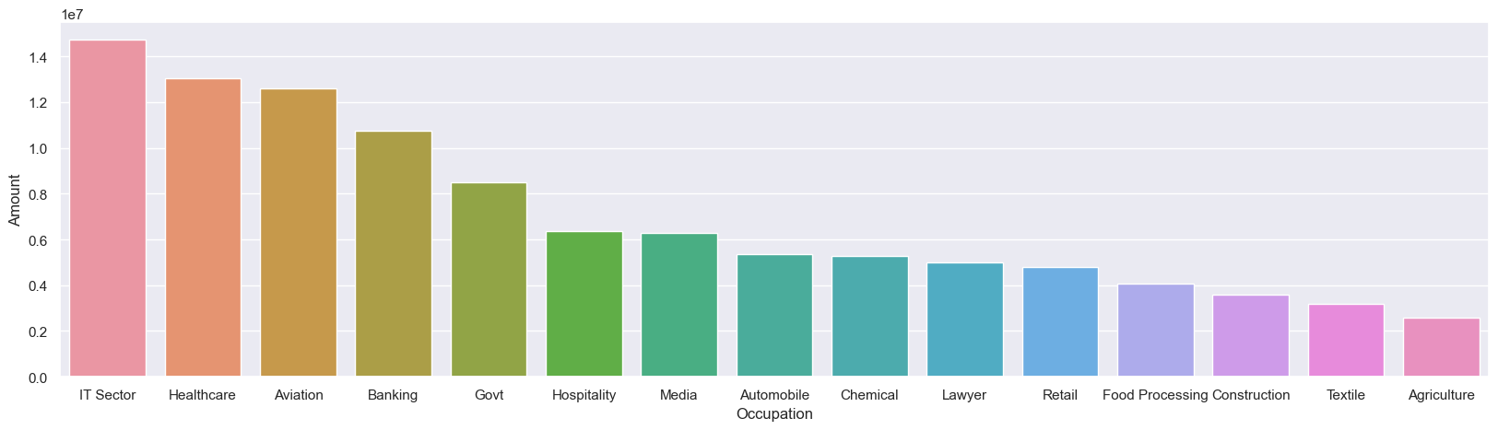
From above graphs we can see that most of the buyers are working in IT, Healthcare and Aviation sector.

Slide 10
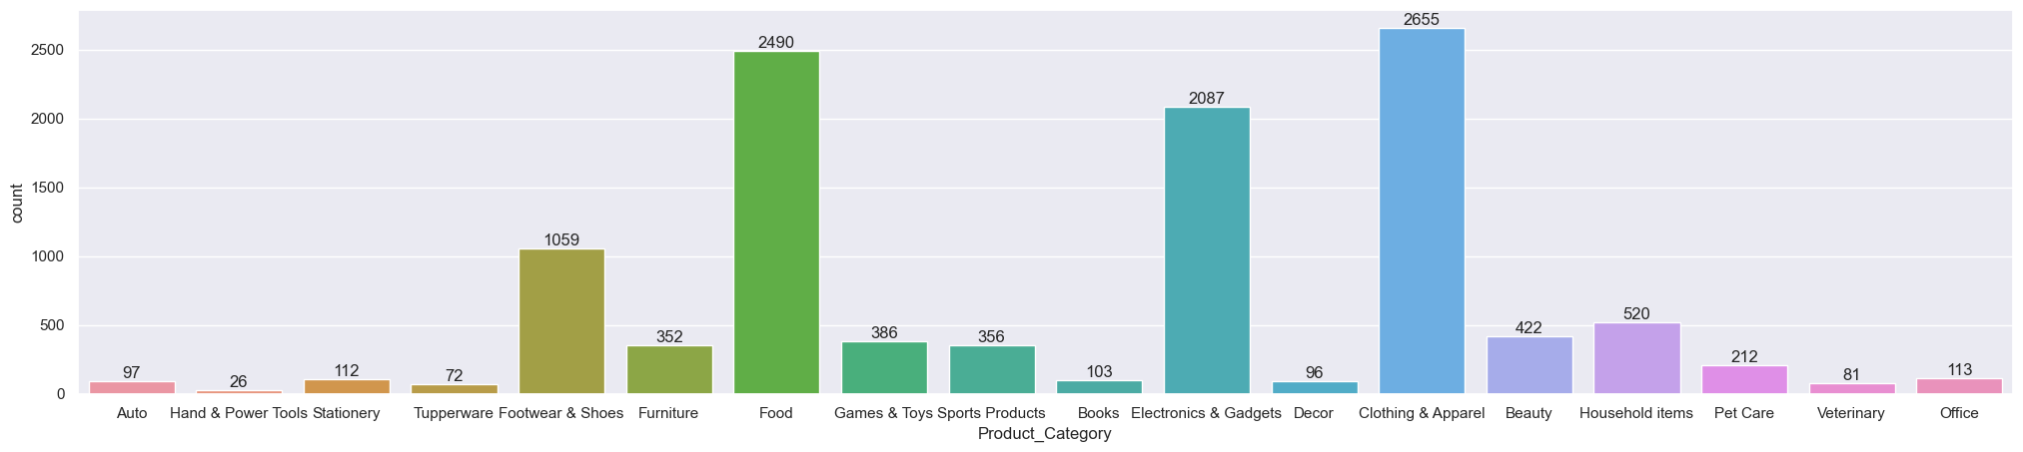
Product Category

Slide 11
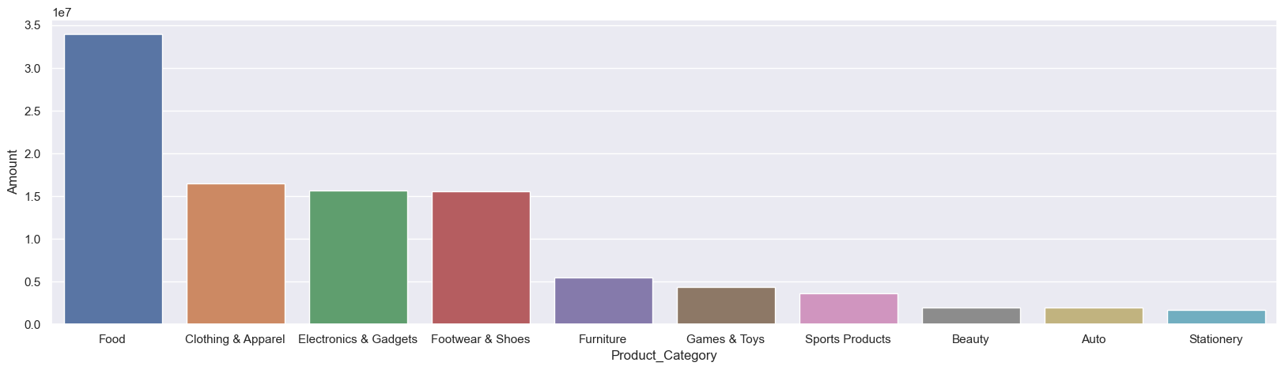
From above graphs we can see that most of the buyers purchases the product category of Food, Clothing, Electronic Gadgets.

Slide 12
Project Leanings:
Performed data cleaning and manipulation.
Performed exploratory data analysis using Pandas, Matplotlib and seaborn libraries.
Improved customer experience by identifying potential customers across different states, occupation, gender and age group.
Improved sales by identifying most selling product categories and products, which can help to plan inventory and hence meet the demands.

Slide 13
Conclusion:
Married women age group 26-35 years from UP, Maharashtra and Karnataka working in IT, Healthcare and Aviation are more likely to buy products from Food, Clothing and Electronics category.

