Slide 1
Home Expense & Retirement Calculator
Name: Priyanka Gnanasekaran
Class: CS 521 - Fall 1
Date:10/19/2020

Slide 2
Scope:
Savings calculation from Income / Expense
Retirement calculation
Retirement report saved to a file

Slide 3
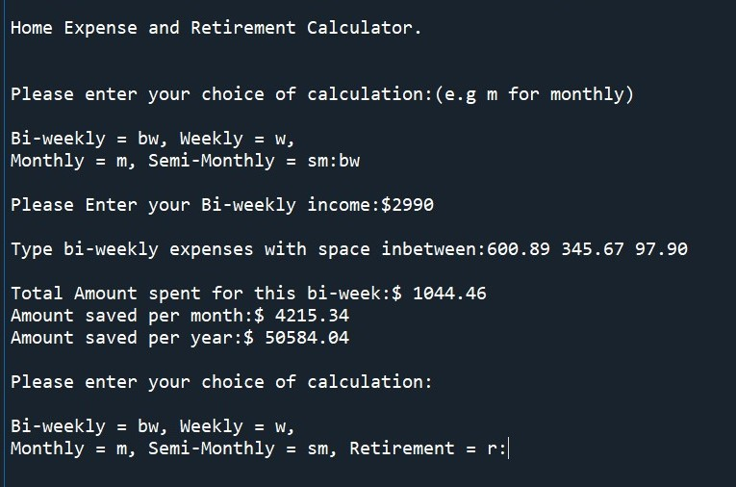
Savings Calculations:
Calculates based on four forms of paychecks
  Weekly
  Bi-Weekly
  Semi-Monthly
  Monthly
Retirement

Slide 4
Calculates
  Spent amount
  Amount saved per Month
  Amount saved per Year

Slide 5
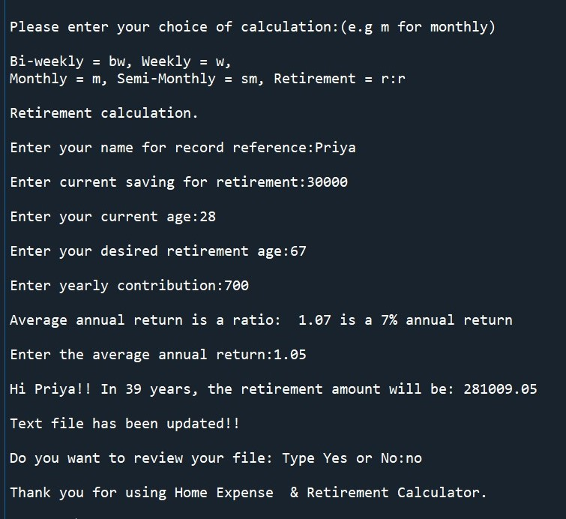
Retirement Calculations:
Calculate retirement amount with
  Name
  Current savings
  Current age
  Desired retirement age
  Average Annual Return
  Yearly contribution
Calculated data is saved in a file

Slide 6
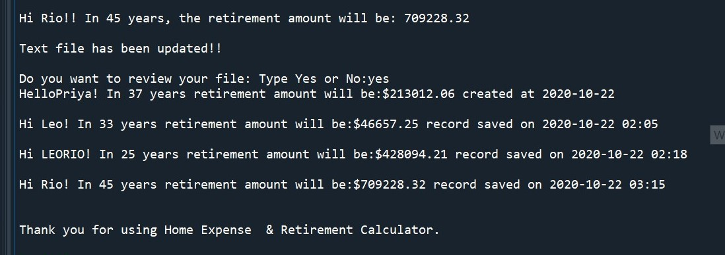
Text File Update:
Name, date and time is written to a file
Data gets appended in the file

Slide 7
Entire Output Displayed:

Slide 8
