Slide 1
GOLD PRICE PREDICTION
NAAN MUDHALVAN
GENERATIVE AI FOR ENGINEERING (E2324)
PRIYADARSHINI.S (2021503036) DEPARTMENT OF COMPUTER TECHNOLOGY
MADRAS INSTITUTE OF TECHNOLOGY

Slide 2
OUTLINE :
Introduction
Problem Statement
Objective
Software Requirements
Proposed Work
Result
Conclusion
References

Slide 3
Introduction:
The gold prediction dataset contains historical gold price data along with other relevant features.
After loading and preprocessing the data, including converting the date column to datetime format, the correlation between features and the target variable (gold price) is calculated and visualized using a heatmap. The dataset is then split into training and testing sets, and a Random Forest Regressor model is trained on the training set.
The model's performance is evaluated using the R-squared error metric on both the training and testing sets. Finally, the actual and predicted gold prices are plotted to visualize the model's predictions.

Slide 4
Problem Statement:
The problem is to develop a machine learning model that can predict the price of gold (GLD) based on historical data and other relevant features.
The goal is to create a model that accurately forecasts the future price of gold, which is crucial for investors, traders, and financial analysts to make informed decisions.
By analyzing past trends and patterns in the gold market, the model aims to provide valuable insights into potential future price movements. It seeks to leverage machine learning algorithms to build a predictive model that can assist stakeholders in the gold market in making strategic decisions.

Slide 5
Objectives
The objective of this project is to build a reliable machine learning model that can accurately predict the price of gold (GLD).
By analyzing historical data and relevant features, the model aims to forecast future gold prices, providing valuable insights for investors, traders, and financial analysts.
The goal is to create a tool that can help stakeholders in the gold market make informed decisions, improve their trading strategies, and potentially maximize their returns. Additionally, the project aims to demonstrate the application of machine learning in financial forecasting and enhance understanding of the factors influencing gold prices.

Slide 6
SOFTWARE REQUIREMENTS:
Language Used: Python
Tool : Jupyter notebook
Libraries used:
Numpy
pandas
matplotlib
seaborn
scikit-learn

Slide 7
Proposed solution:
Data collection and loading
Split train and test data
Model training
Model evaluation
Visualize actual vs predicted values

Slide 8
Data Collection and Loading
The data collection and loading involves obtaining a dataset containing historical gold price data.
This dataset is stored in a CSV file named "gld_price_data.csv." To begin, the pandas library is imported to facilitate data manipulation.
The dataset is then loaded into a pandas DataFrame using the read_csv function, which reads the CSV file and stores its contents in a tabular format. This step allows for easy access and analysis of the data. Once loaded, the dataset is ready for exploration and preprocessing, which includes tasks such as checking for missing values, converting data types, and extracting relevant features for analysis.

Slide 9
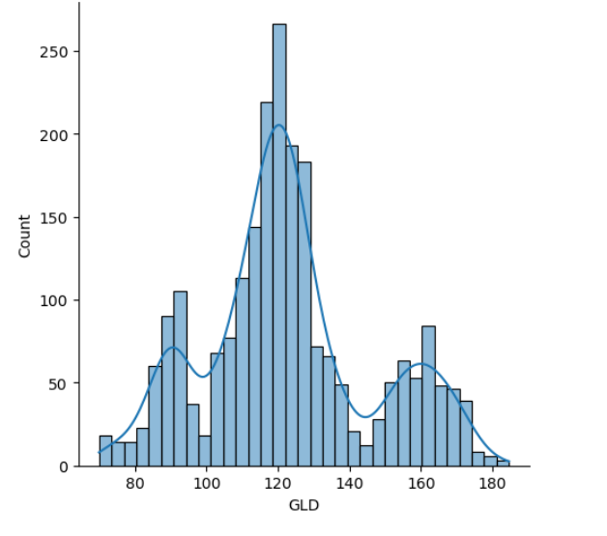
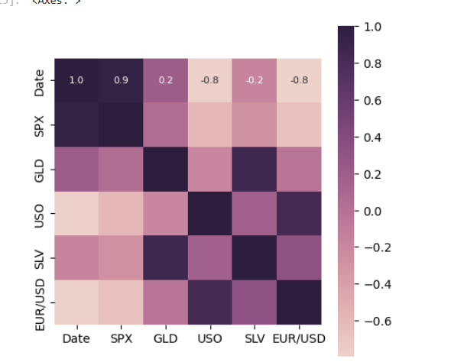
Data collection and loading

Slide 10

Split train and test data
Splitting the data into training and testing sets is a critical step in machine learning.
It involves dividing the dataset into two parts: one for training the model and another for evaluating its performance.
The split helps prevent the model from memorizing the training data (overfitting) and ensures that it can generalize well to new data. The train_test_split function from scikit-learn is commonly used for this purpose, specifying the proportion of data for testing (test_size) and a random state for reproducibility (random_state).

Slide 11
Model training using Random forest Regressor
The Random Forest Regressor is utilized to train the machine learning model for predicting gold prices.
The model is then trained using the fit method by providing the training features (X_train) and the corresponding target variable (Y_train).
The Random Forest Regressor works by constructing multiple decision trees during training and outputting the average prediction of the individual trees. This ensemble approach helps improve the model's accuracy and generalization performance. After training, the model is ready to make predictions on new, unseen data.

Slide 12


Model Evaluation
Model evaluation involves calculating the R-squared error metric for both the training and testing sets.
R-squared measures the proportion of the variance in the gold price that is predictable from the features.
Higher R-squared values indicate better model performance. The r2_score function from scikit-learn is used to compute these scores, providing insight into the model's predictive accuracy and generalization ability.
Train data test data

Slide 13
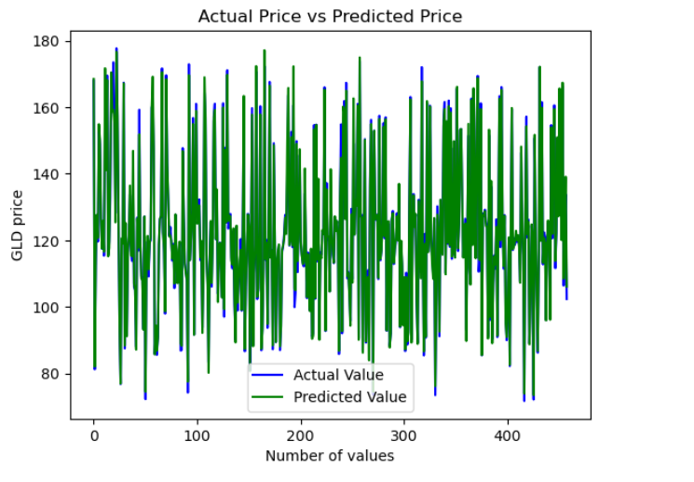
RESULTS

Slide 14
Conclusion:
It utilized a Random Forest Regressor to forecast gold prices based on historical data and relevant features.
The dataset was preprocessed, including converting date strings to datetime objects and exploring data characteristics using statistical measures and visualizations.
The model was trained and evaluated using the R-squared error metric, indicating its ability to predict gold prices. While the model's performance was satisfactory, further refinement and optimization could potentially improve its accuracy. Overall, this project demonstrates the application of machine learning in financial forecasting and provides valuable insights for stakeholders in the gold market.

Slide 15
References
https://www.tensorflow.org/
pandas - Python Data Analysis Library (pydata.org)

Slide 16
THANK YOU

