Slide 1

CIO Hackathon 2014
Team Members:
priyanshu agarwal, aditya bharadwaj, varun bharill, lohit bisen, tushar raibhandare, parag saraogi, sathish vaidyanathan

Slide 2

What am I ?
A
Global
Transparent
Easy-To-Use
Viral
Donation Platform
Powered by

Slide 3
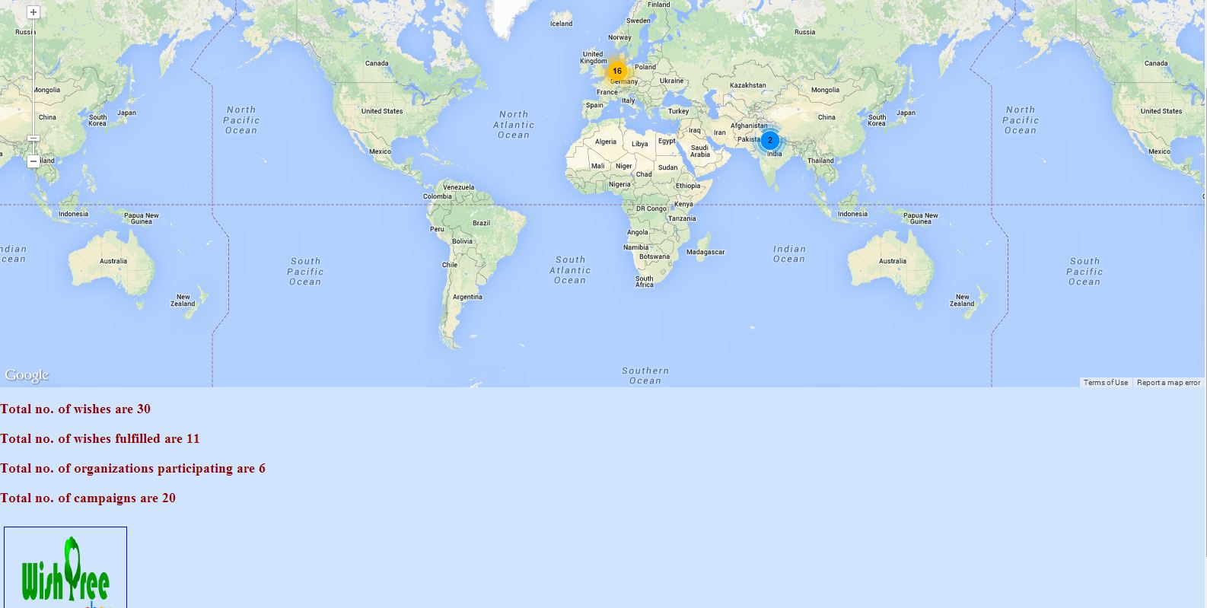
Where am I used ?
everywhere!

Slide 4
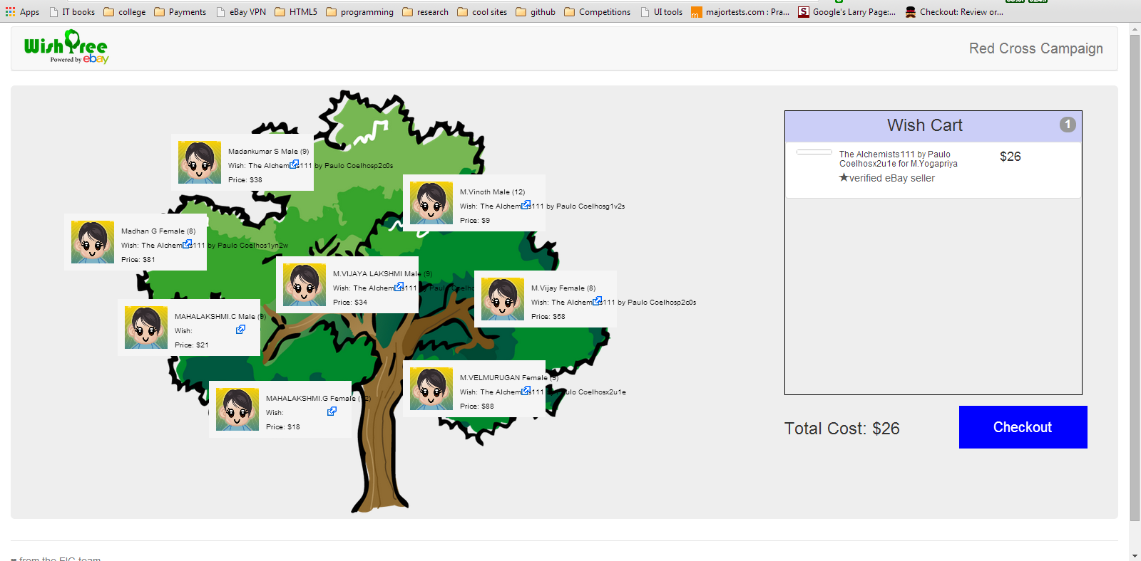
How I look ?

Slide 5
How do I work ?
Step-1: eBay verifies credibility of non-profits
Step-2 : non-profit identifies eBay items that are in need for their beneficiaries.
Step-3 : wish campaign created and vetted wishes populated on a virtual wish-tree
Step-4 : items bought by good-hearted eBay buyers via PayPal, shipping address is that of the beneficiary
Step-5 : wish item shipped to beneficiary by seller
Step-6 : beneficiary responds with a ‘Thank You’ Note

Slide 6
demo

Slide 7
Why Me ? benefits of donations in-kind
need driven - understanding needs of recipient
relevance - determined by informed choices as it comes through solicitation
cash availability - frees up more money for non-profits for infra, better living conditions etc.
access – avails beneficiaries access to products not otherwise locally available
joy - gives a sense of direct connection between donor and beneficiary
trust – eBay verified status instills trust on donor, avoids doubts
economics – supports and augments in-kind donations that are more favorable to economies, aligns with many similar government based welfare schemes that are in kind
eBay Inc. - more charity volume driven through ebay platform

Slide 8
What else can be done ?
provide a tax receipt for the donor, so that donor can benefit out of this
complete a more tighter payment loop
send alerts to donors when a wish from the same beneficiary arrives
have a landing page www.ebay.com/wishtree
Integrate on eBay View Item Page if the show “Wish Tree Button” if item is part of a wish tree (attach screenshot)
Allow non-profits to also upload item IDs of their own

Slide 9
Disadvantages
Matching gifts are not possible
Shipping cost is an overhead spend

