Slide 1
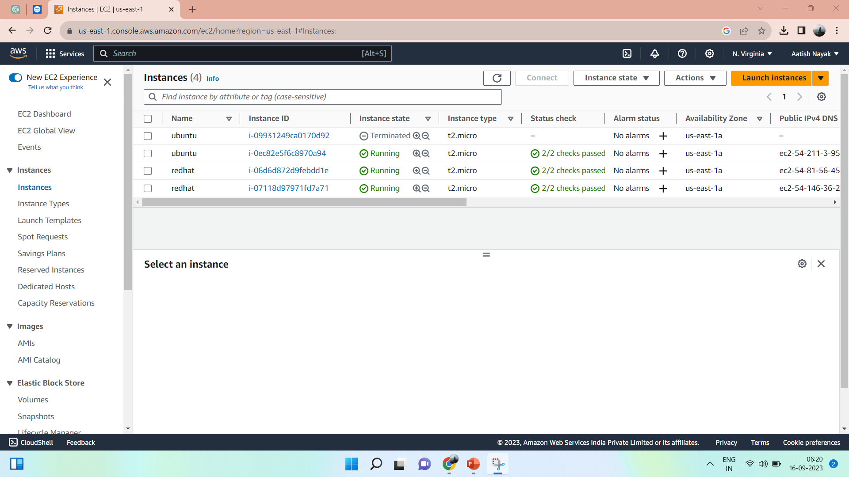


ANSIBLE
Create 1 EC2 instance – Ubuntu (Controller)
Create 2 EC2 instance – Redhat
Note : Use same key (ppk)
Use existing security group to avoid confusion

Slide 2
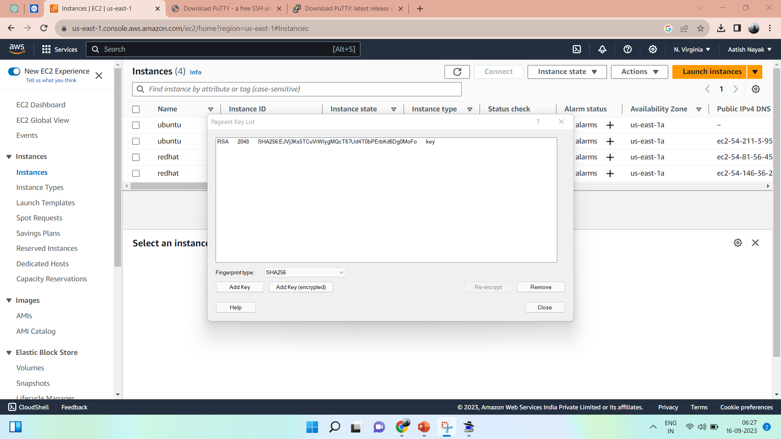






Download Putty pageant from Putty.org
Add key

Slide 3
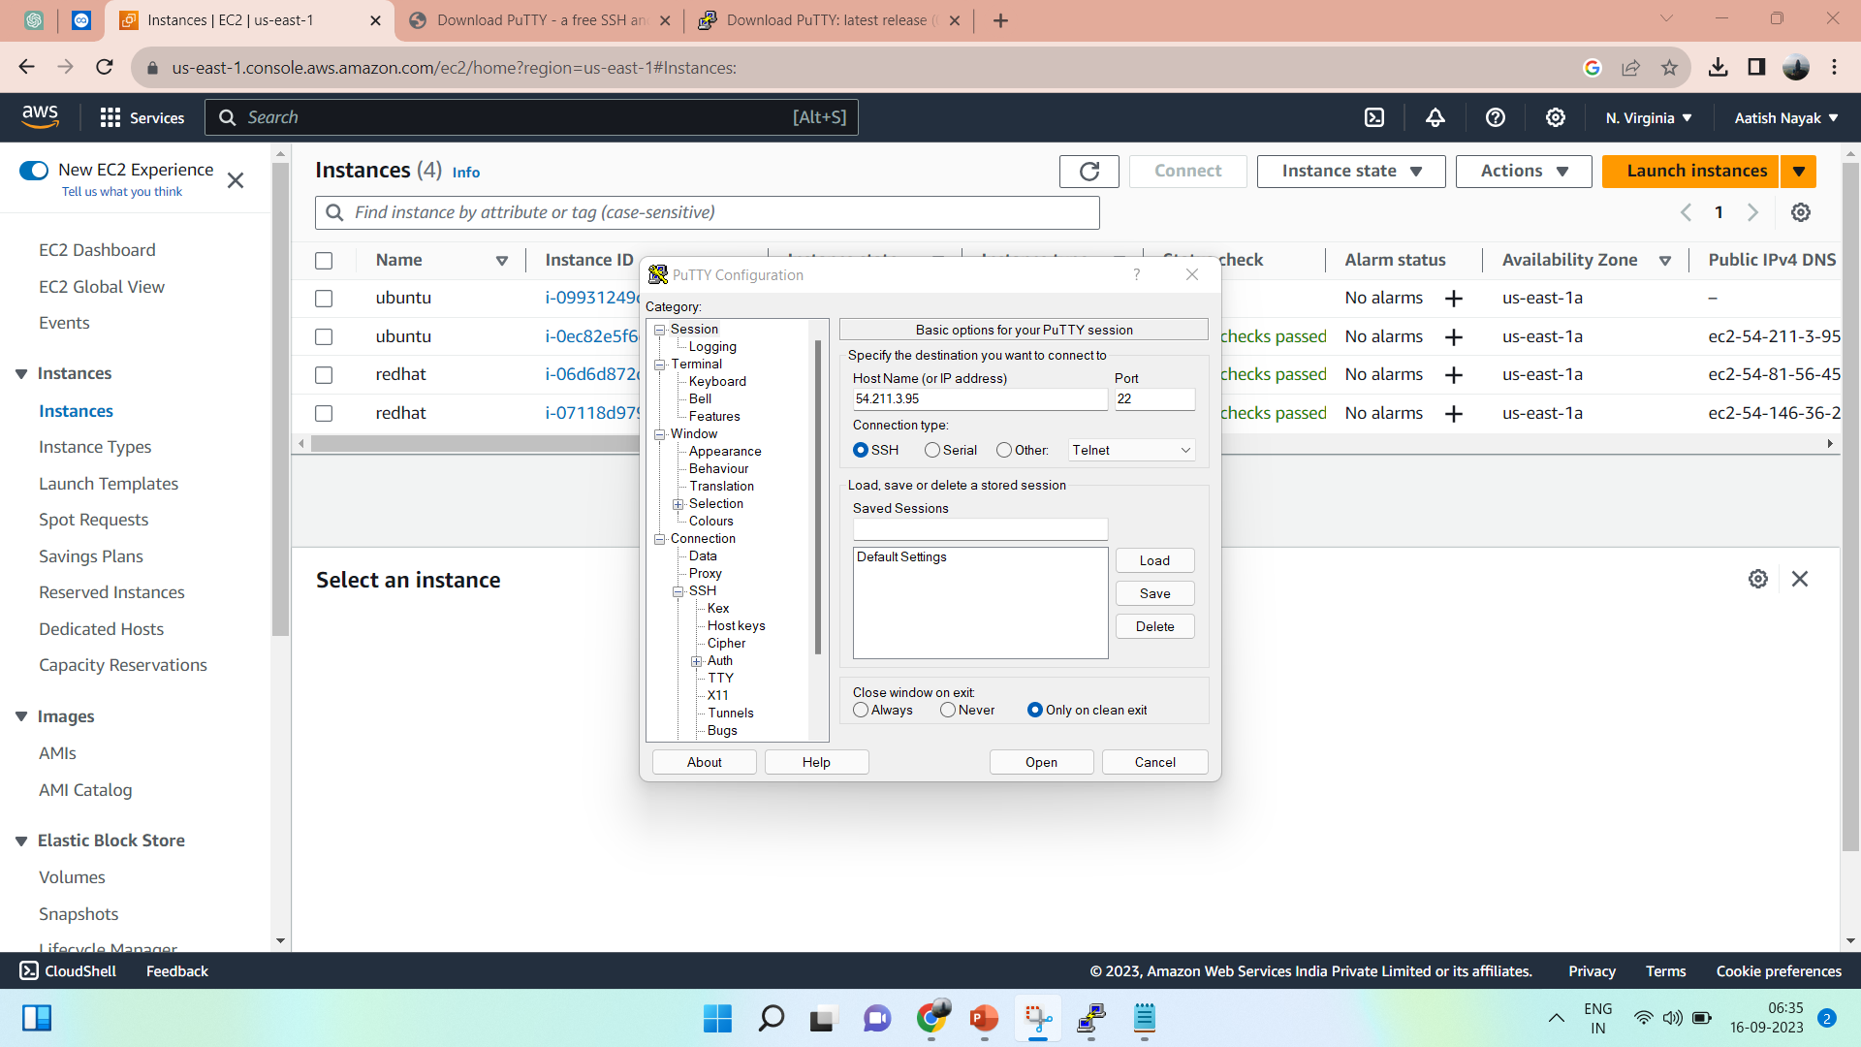
Download Putty from putty.org
Note down public IP of controller
Note down private IP of worker node
Enter public IP of controller

Slide 4
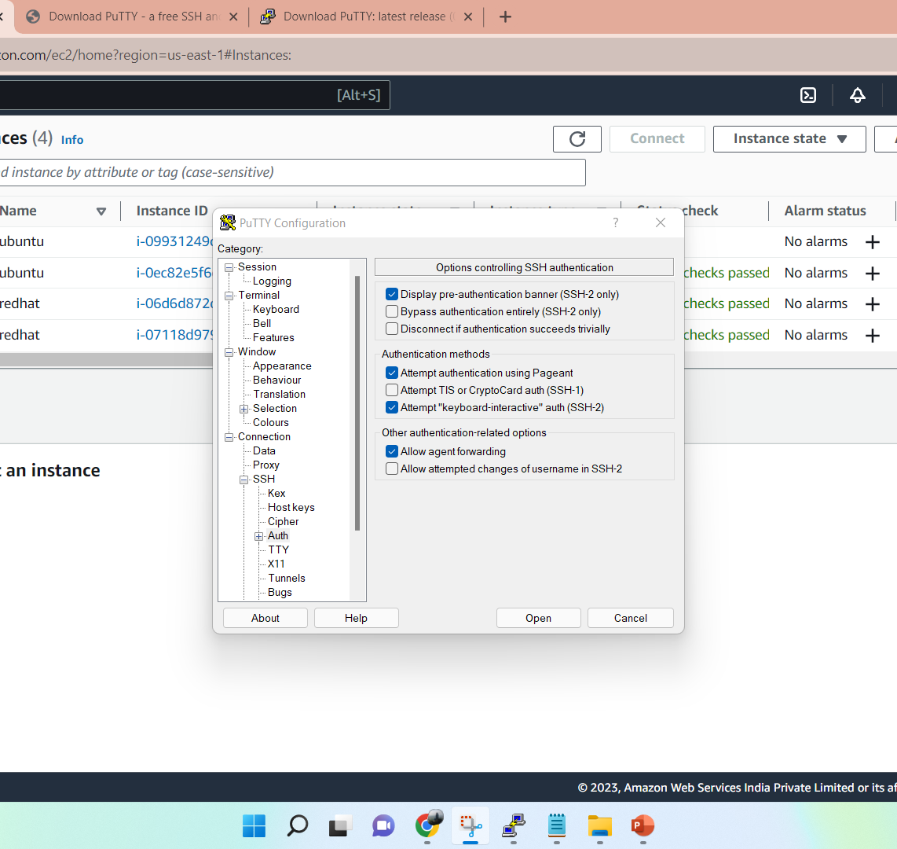
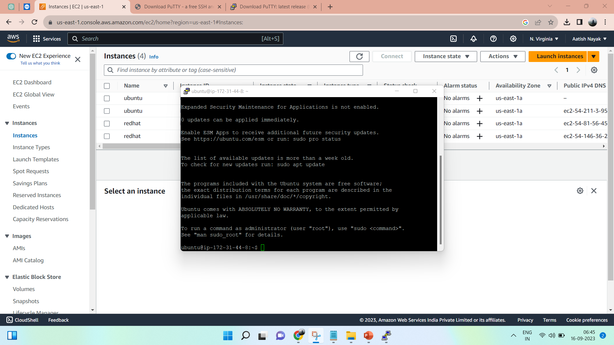
Click on SSH
Auth
Select allow agent forwarding
Get connected

Slide 5
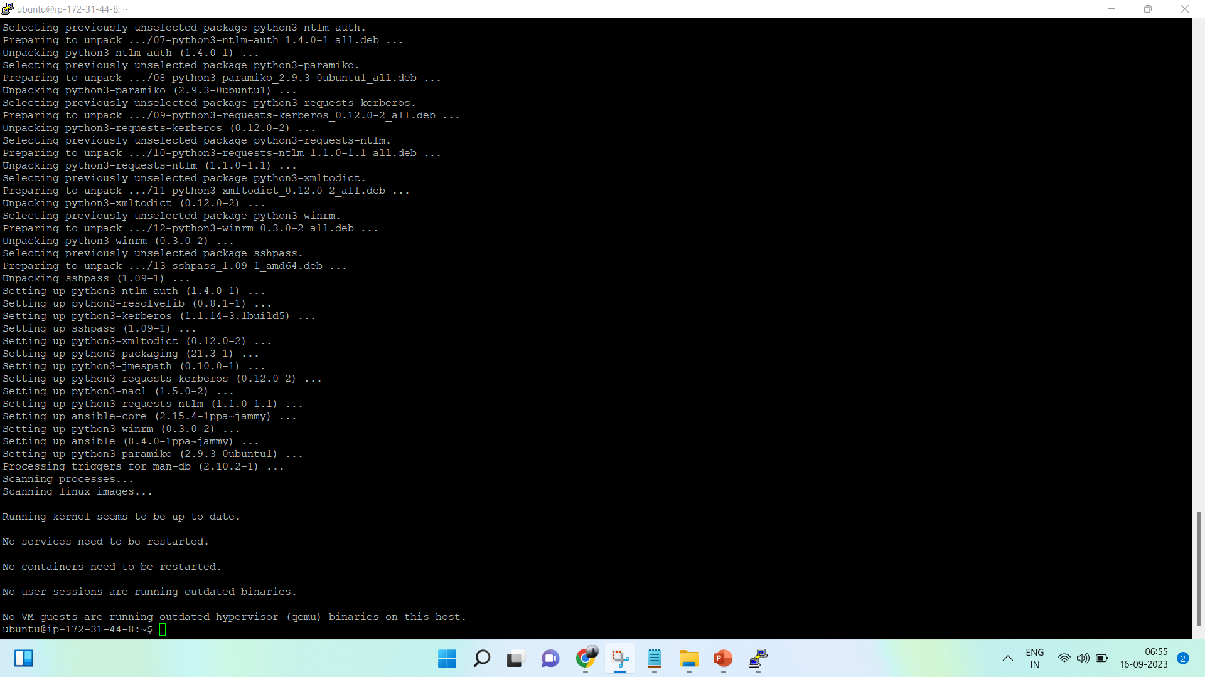
Install Ansible from digital ocean
Below are commands : -
sudo apt-add-repository ppa:ansible/ansible
sudo apt update
sudo apt install ansible

Slide 6
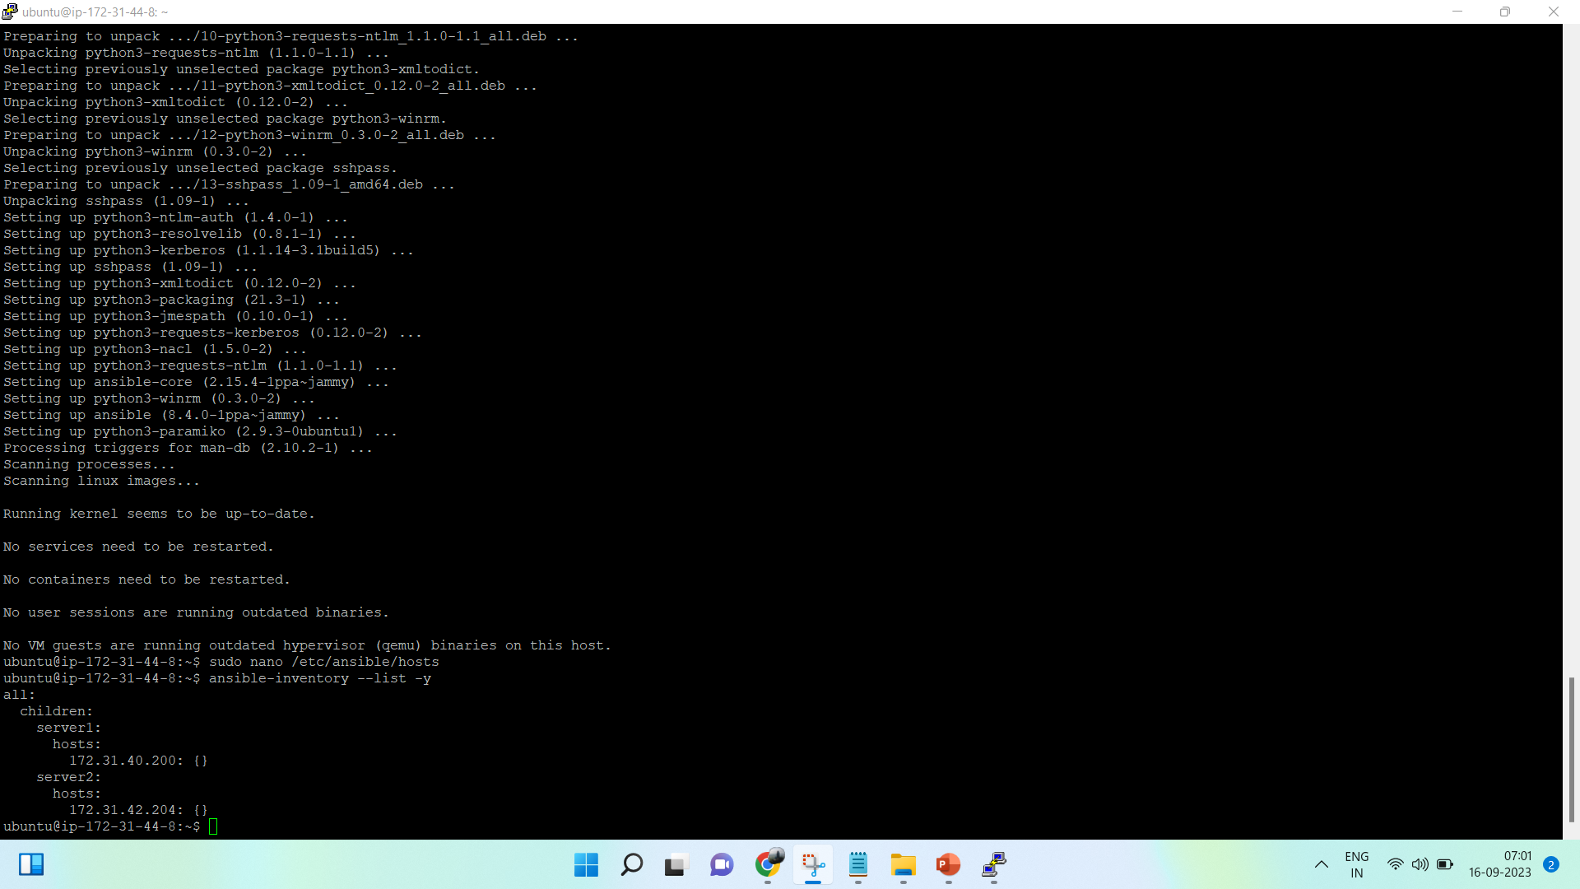
Setting up inventory
Below are the commands :-
sudo nano /etc/ansible/hosts
Add inventory
Then to check list of inventory use below command :-
ansible-inventory –list –y

Slide 7
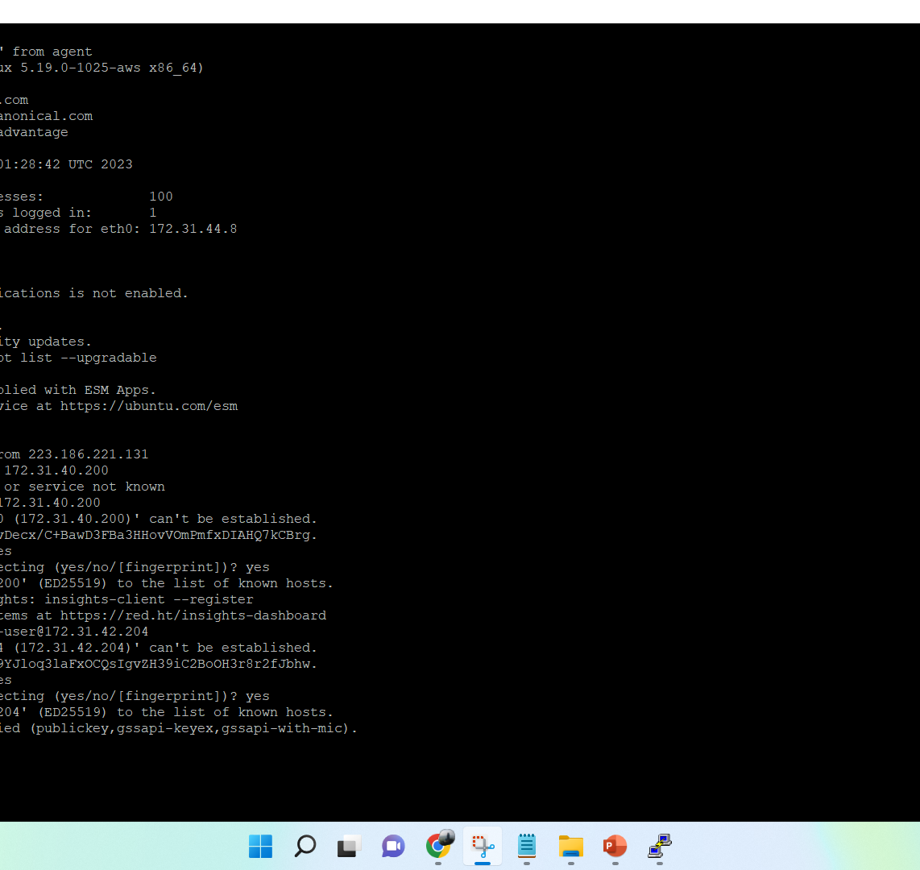
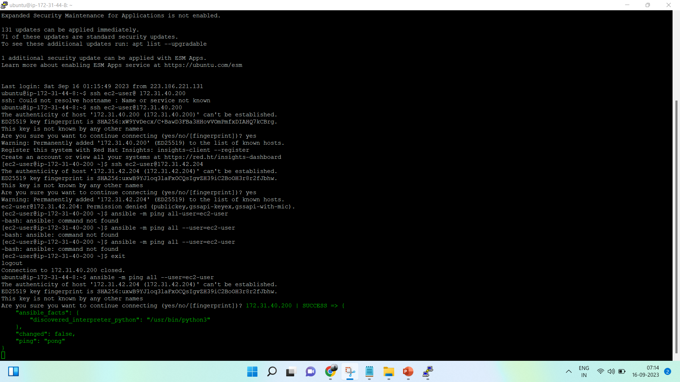
To Add connection Below are command :-
ssh ec2-user@privateIP of worker node
To test connection :-
Ansible –m ping all –-user=ec2-user

