Slide 1
A/B test analysis
Wendy Navarrete September 2021

Slide 2
CONTENT
Introduction
Information of Data
email Strategy
email Strategy Results
email and customer’s behavior
email strategy impact on the other functional teams
Findings and Recommendations

Slide 3

Introduction
This document contains the A/B test analysis of a email campaign.

Slide 4
information of data
Total number of customers: 100,000
Percentage of customers who received the email: 50.01%
Number of customers who did not receive the email: 49.98%
3 markets: Los Angeles, San Francisco and Sacramento
Date Range: Mar/1/2021 – Mar/31/2021

Slide 5
Email CAMPAIGN

Slide 6
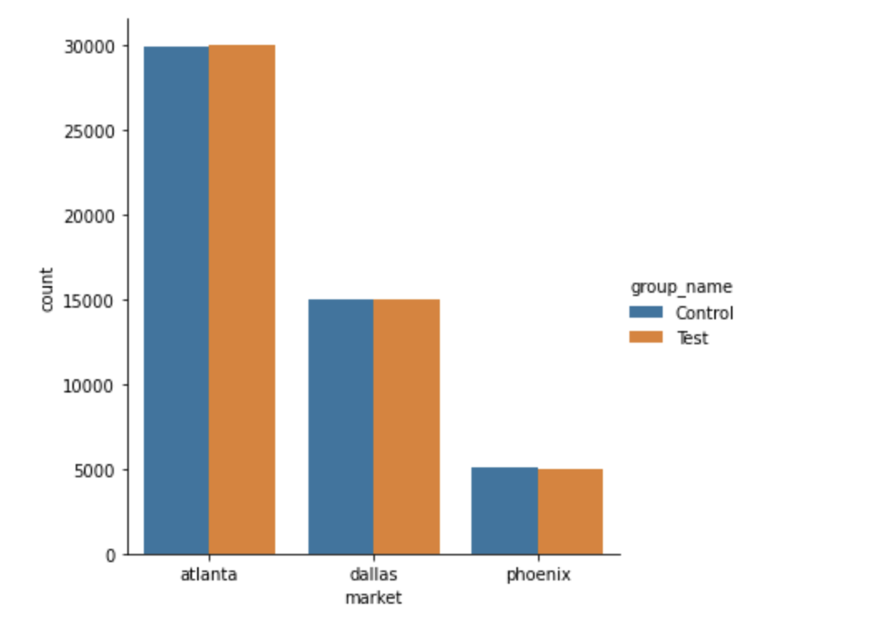
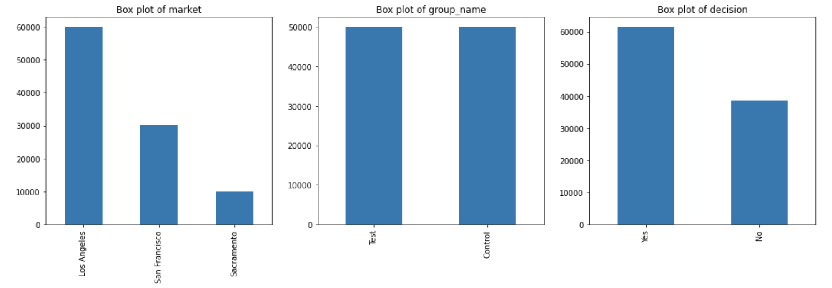
email experiment numbers
Number of customers per market:
Lo Angeles: 59,895
San Francisco: 30,015
Sacramento: 10,090
61,4,84 customers did make a decision
Control and test groups was distributed 50% and 50% in every market

Slide 7
email experiment results
 | Make Decision | Not Make Decision | Total | Percentage of customers did shop home
Control | 29,498 | 20,488 | 49,986 | 59.01%
Test | 31,986 | 18,028 | 50,014 | 63.95%
 |  |  | Increment | 4.94%
The overall result shows that there is an increment on the number of customers who made a decision of 4.94% if they receive an email

Slide 8
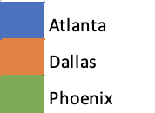
Results per Market
Group | Make a Decision | Not Make a Decision | Total | % of customers did make a decision
Control | 20,129 | 9,766 | 29,895 | 67.33%
Test | 22,462 | 7,538 | 30,000 | 74.87%
 |  |  |  | 7.54%
Group | Make a Decision | Not Make a Decision | Total | % of customers did make a decision
Control | 7,556 | 7,450 | 15,006 | 50.35%
Test | 7,716 | 7,293 | 15,009 | 51.41%
 |  |  |  | 1.06%
Group | Make a Decision | Not Make a Decision | Total | % of customers did make a decision
Control | 1,813 | 3,272 | 5,085 | 35.65%
Test | 1,808 | 3,197 | 5,005 | 36.12%
 |  |  |  | 0.47%
The make decision rate has an increment in all markets when customers received an email

Slide 9
control and test groups difference
Is there any evidence that support a full rollout of the email strategy to all customers decide?
Yes, the evidence is the result of the test of means analysis that indicates
there is a probability of 0.00000…0004 that the increment on the result is occurred by chance. The strategy email is working
(p-value: 4.416208227786792e-58)

Slide 10
Conclusions
The result of the test of means analysis gives a p-value < 0.05, that indicates there is a statistically significance difference between group means
The p-value provides strong evidence that the increment on making-decision rate did not happen by chance
The overall result shows that there could be an increment on the make decision rate so, my recommendation is to rollout the email strategy in the rest of the markets

Slide 11
THANKS
Wendy Navarrete
navarrete.wen@gmail.com

