Slide 1
A/B test analysis
Wendy Navarrete September 2021

Slide 2
CONTENT
Introduction
Information of Data
email Strategy
email Strategy Results
email and customer’s behavior
email strategy impact on the other functional teams
Findings and Recommendations

Slide 3

Introduction
This document contains the A/B test analysis of a email campaign.

Slide 4
information of data
Total number of customers: 100,000
Percentage of customers who received the email: 50.01%
Number of customers who did not receive the email: 49.98%
3 markets: Los Angeles, San Francisco and Sacramento
Date Range: Mar/1/2021 – Mar/31/2021

Slide 5
Email CAMPAIGN

Slide 6
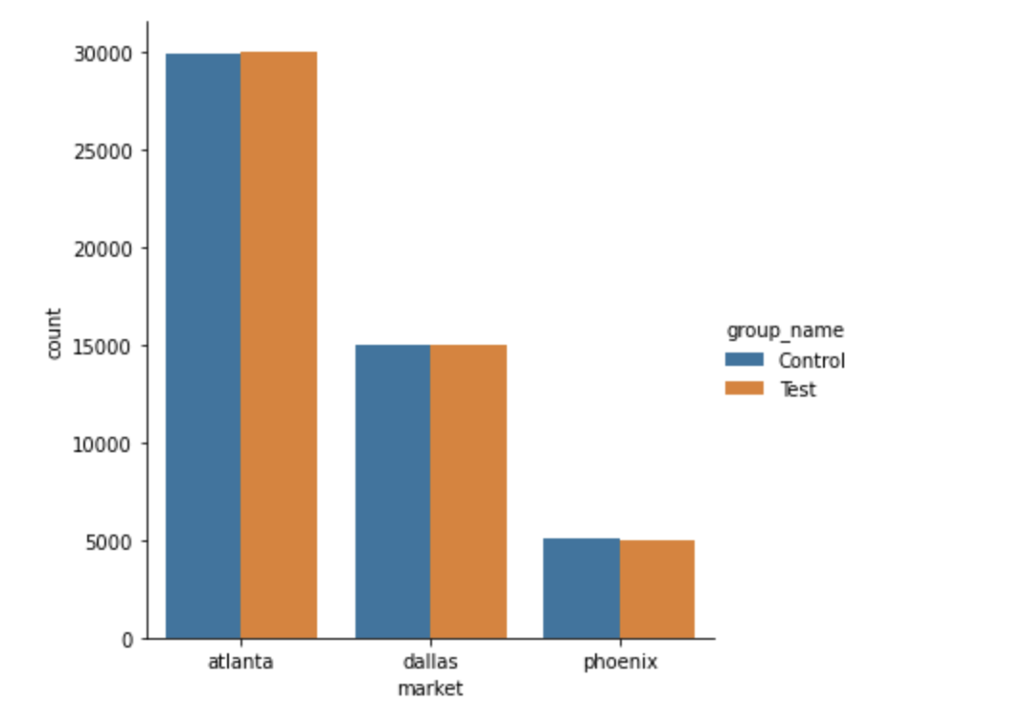
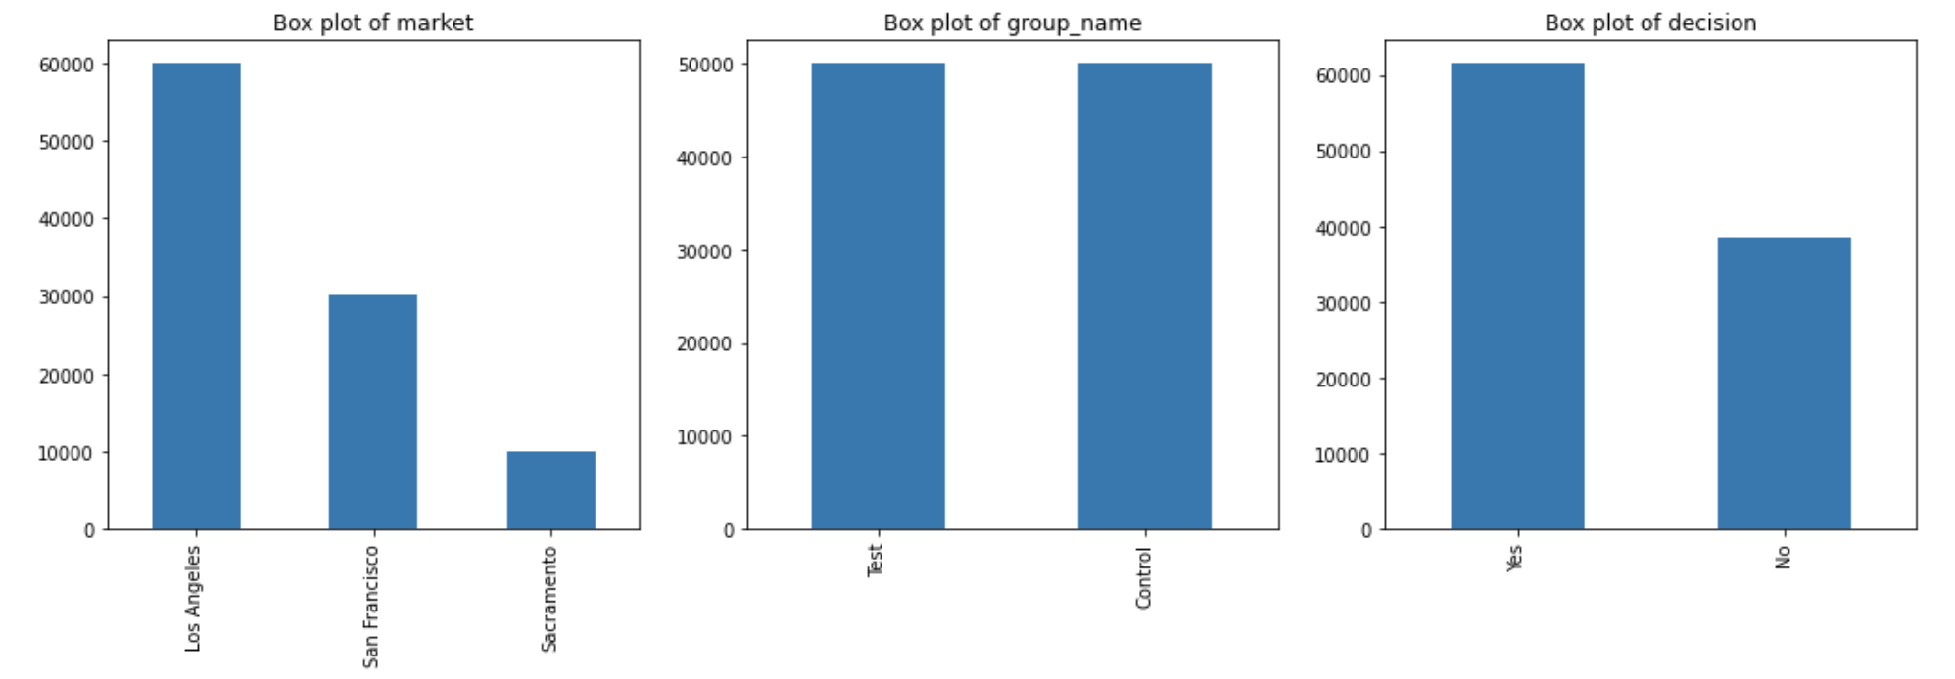
email experiment numbers
Number of customers per market:
Lo Angeles: 59,895
San Francisco: 30,015
Sacramento: 10,090
61,4,84 customers did make a decision
Control and test groups was distributed 50% and 50% in every market

Slide 7
email experiment results
 | Make Decision | Not Make Decision | Total | Percentage of customers did shop home
Control | 29,498 | 20,488 | 49,986 | 59.01%
Test | 31,986 | 18,028 | 50,014 | 63.95%
 |  |  | Increment | 4.94%
The overall result shows that there is an increment on the number of customers who made a decision of 4.94% if they receive an email

Slide 8
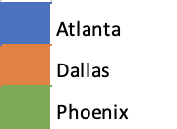
Results per Market
Group | Make a Decision | Not Make a Decision | Total | % of customers did make a decision
Control | 20,129 | 9,766 | 29,895 | 67.33%
Test | 22,462 | 7,538 | 30,000 | 74.87%
 |  |  |  | 7.54%
Group | Make a Decision | Not Make a Decision | Total | % of customers did make a decision
Control | 7,556 | 7,450 | 15,006 | 50.35%
Test | 7,716 | 7,293 | 15,009 | 51.41%
 |  |  |  | 1.06%
Group | Make a Decision | Not Make a Decision | Total | % of customers did make a decision
Control | 1,813 | 3,272 | 5,085 | 35.65%
Test | 1,808 | 3,197 | 5,005 | 36.12%
 |  |  |  | 0.47%
The make decision rate has an increment in all markets when customers received an email

Slide 9
control and test groups difference
Is there any evidence that support a full rollout of the email strategy to all customers decide?
Yes, the evidence is the result of the test of means analysis that indicates
there is a probability of 0.00000…0004 that the increment on the result is occurred by chance. The strategy email is working
(p-value: 4.416208227786792e-58)

Slide 10
THANKS
Wendy Navarrete
navarrete.wen@gmail.com

