Slide 1

Sales Predictions Overview
We are presented with sales prediction data which contains sales data from 1985 – 2010. All of the attributes and its products are defined.

Slide 2
Problem
The problem: The goal is to help the retailer understand the properties of products and outlets that play crucial roles in predicting sales (CodingDojo Learning Platform).
In sum we will utilize the data sets stores properties and products to identify which ones play a key role in optimizing and or increasing sales.

Slide 3
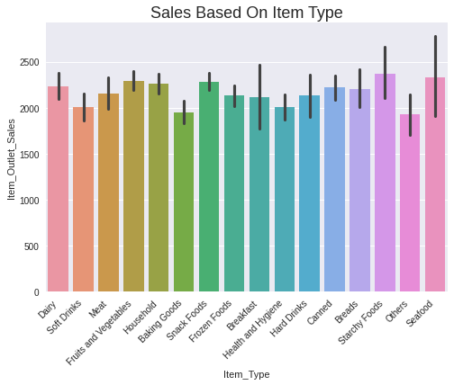
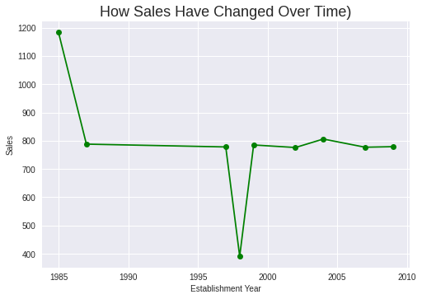
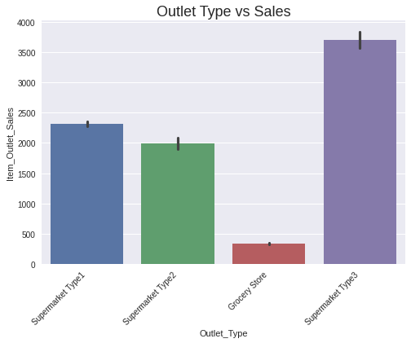
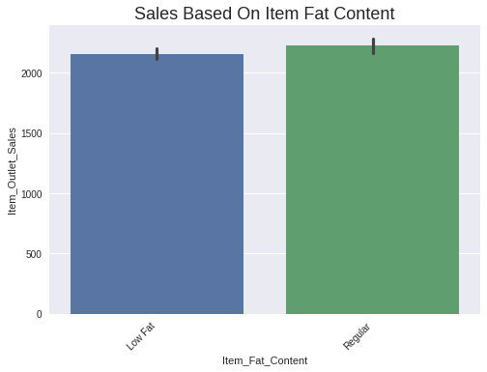

Slide 4
Trends
Starchy foods, canned goods, snack foods and fruits and vegetables have a higher sales record; Indicating that they are popular items.
The sales peak was around 1985 and sales significantly decreased in 1998 and then slightly increased from 2000-2010. However it was not as record breaking as 1985.
Supermarket type 3 has a higher sales record
Products with regular fat content have a higher sales record

Slide 5
Recommendations
Sell more of the favorite/most purchased items (canned goods, snack foods, fruits etc & reg fat content)
Promote most purchased products
Refer to the model used previously in the year 1985 to see what drove sales high and apply implement similar strategies or use it as a prototype
Use supermarket 3 as a base model for others as it is the most successful

