Slide 1

Sales Predictions Overview
We are presented with sales prediction data which contains sales data from 1985 – 2009. All of the attributes and its products are defined.

Slide 2
Problem
The problem: The goal is to help the retailer understand the properties of products and outlets that play crucial roles in predicting sales (CodingDojo Learning Platform).
In sum we will utilize the data sets stores properties and products to identify which ones play a key role in optimizing and or increasing sales.

Slide 3
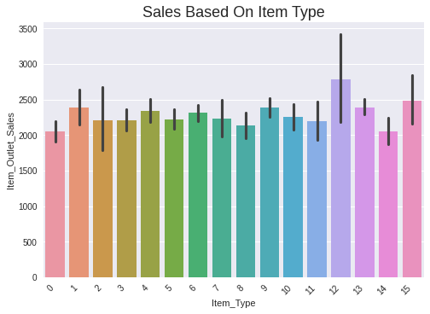
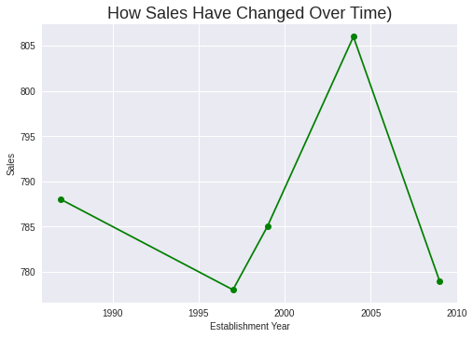
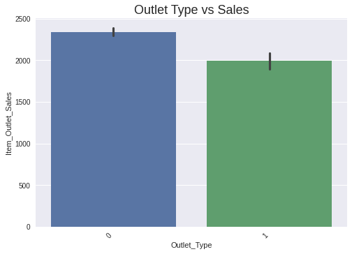
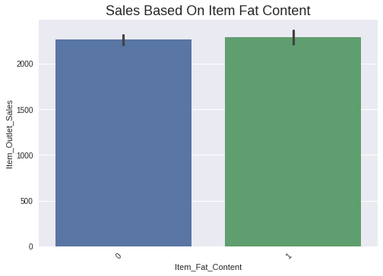

Slide 4
Trends
Canned goods have a higher sales record
The sales peak was around 2004 and sales significantly decreased in 2009.
Supermarket type 1 has a higher sales record
Products with regular fat content have a higher sales record

Slide 5
Recommendations
Sell more of the favorite/most purchased items (canned goods & reg fat content)
Refer to the model used previously in the year 2004 to see what drove sales high
Promote most purchased products
Use supermarket 0 as a base model for others as it is the most successful

