Slide 1
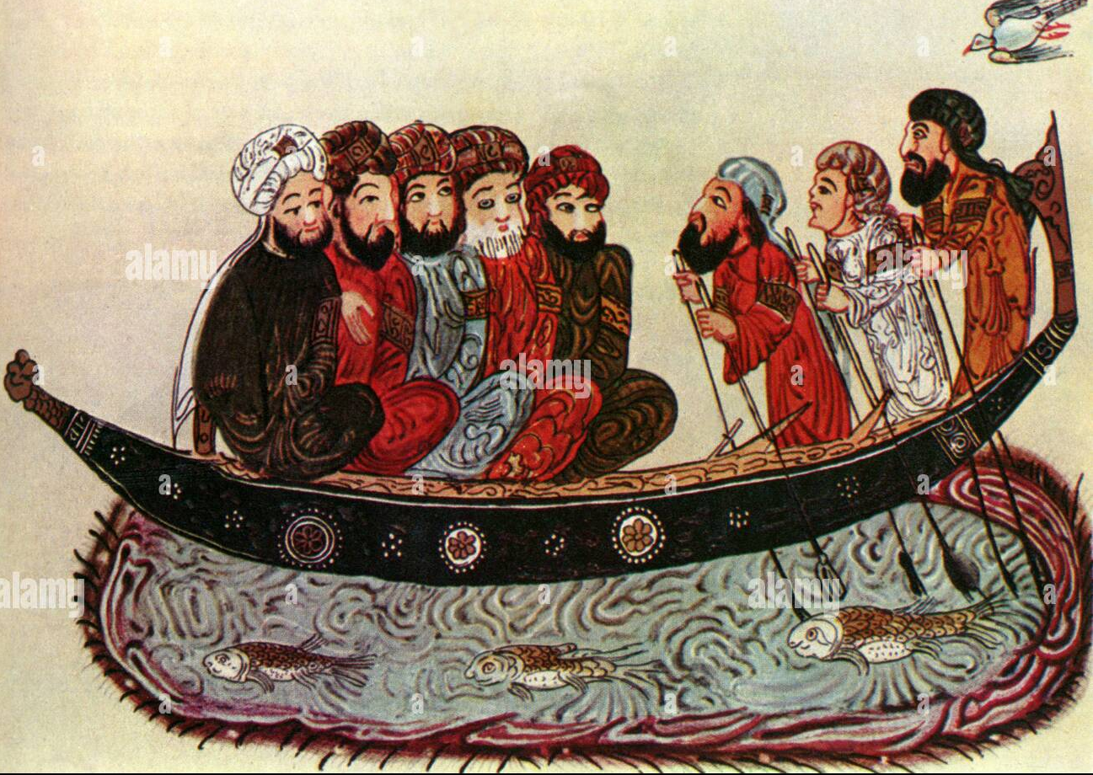
The rise of Islam in Bengal can be trace back to the 7th century in Arab trades first arrived in the region of trade. Bengal was an important center of trade and commerce, and merchants from the Middle East and other parts of the Islamic world had been visiting the region for centuries before the arrival of Islam. This traders brought with them the teachings of Islam and overtime some of the local people begin to convert to Islam

Slide 2
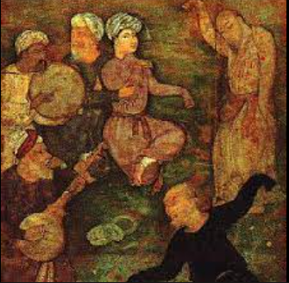
Sufi preachers played an important role in the spread of Islam in Bengal. They emphasized the importance of personal experience and devotion in the practice of Islam, and their message resonated with the local population. They established Khanqahs (Sufi lodges) throughout the region, which became centers of Islamic learning and worship.
In addition to the efforts of Arab traders and Sufi machineries, intermediate Muslim traders and local women also played a significant role in the spread of Islam in Bengal. As the children of these miss marriage were raised as Muslims, they help to further sprint the religion among the local population

Slide 3
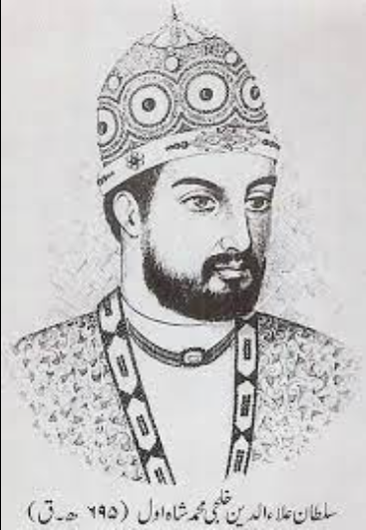
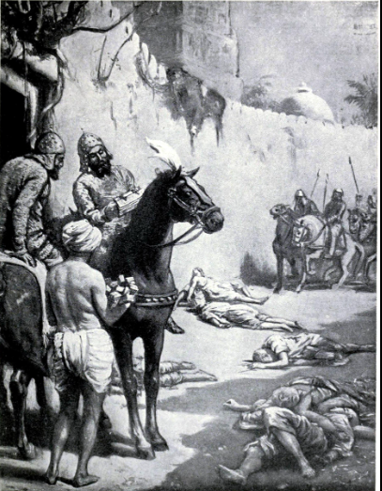
Bakhtiyar Khilji, a Muslim conqueror from Delhi who established Muslim rule in Bengal in the late 12th century.
While it is known that Bakhtiyar Khilji was a devout Muslim and an admirer of Islamic culture, he was primarily known as a military commander and administrator. It is unlikely that he made any significant efforts to promote Islam in Bengal beyond the fact that his conquests and subsequent establishment of Muslim rule may have created an environment in which the religion could spread.

Slide 4
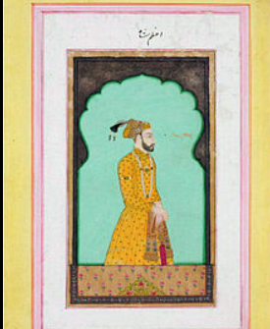
Ghiyasuddin Azam Shah was a muslim ruler of the Bengal Sultanate who reigned from 1390 to 1411.
Ghiyasuddin Azam Shah who is known for his military campaigns and his successful efforts to expand the Bengal Sultanate's territory. While he did not personally spread Islam in Bengal, his reign played an important role in the spread and consolidation of Islam in the region.

Slide 5
Ghiyasuddin Azam Shah, the third ruler of the Bengal Sultanate, is known for his efforts to spread Islam in Bengal during his reign from 1390 to 1411 CE. His achievements in this regard include:
Patronage of Islamic Scholars: Ghiyasuddin Azam Shah was a patron of Islamic scholars, and he invited several scholars from the Middle East to Bengal. He established several madrasas and mosques, including the Adina Mosque, which became one of the largest mosques in the world at that time.
Conversion of Local Populations: Ghiyasuddin Azam Shah actively encouraged the conversion of the local population to Islam. He was known for his generosity and piety, and his personal example helped to attract many converts to the religion.
Promotion of Islamic Practices: Ghiyasuddin Azam Shah promoted Islamic practices and customs throughout Bengal. He ordered the construction of several Islamic monuments, including the Madina Mosque, and he encouraged the practice of Islamic law.
Expansion of the Sultanate: Ghiyasuddin Azam Shah's conquests of neighboring territories helped to spread Islam in those areas. He extended the reach of the Bengal Sultanate to include parts of Assam, Bihar, and Orissa, and he encouraged the spread of Islam in these areas.
Support for Sufi Orders: Ghiyasuddin Azam Shah was a patron of Sufi orders and encouraged their spread in Bengal. He supported the Chishti, Qadiri, and Suhrawardi Sufi orders, among others, and provided them with financial and material support.

Slide 6
Translation of Islamic Texts: Ghiyasuddin Azam Shah commissioned the translation of several important Islamic texts into Bengali. This made them more accessible to the local population and helped to spread knowledge of Islam in the region.
Creation of a Stable Environment: Ghiyasuddin Azam Shah's efforts to maintain stability and security in Bengal helped to create a favorable environment for the spread of Islam. He encouraged trade and commerce, which attracted Muslim merchants to the region, and he established a centralized administration that promoted law and order.
Establishment of Waqf Properties: Ghiyasuddin Azam Shah established several waqf properties, which were religious endowments that supported Islamic institutions such as mosques, madrasas, and hospitals. This helped to ensure the long-term sustainability of these institutions and further cemented the role of Islam in Bengal society.

