Slide 1
Queue
Instructors:
Md Nazrul Islam Mondal
Department of Computer Science & Engineering
Rajshahi University of Engineering & Technology Rajshahi-6204

Slide 2
Outline
Queue
Representation of Queue
Linked Representation of Queue
Deques
Priority Queue
Arrays, Records and Pointers

Slide 3
Queue
Arrays, Records and Pointers

Slide 4
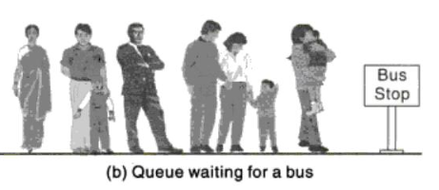
Queue
First-in-First-out (FIFO)
A linear list in which
  deletions can take place only at one end of the list (The front of the list)
  Insertion can take place only at the other end of the list (The rear of the list)
Arrays, Records and Pointers

Slide 5
Representation of Queue
Empty Queue: FRONT := NULL and REAR:= NULL
 | 8
 | 7
 | 6
 | 5
 | 4
 | 3
 | 2
 | 1
Fig. Queue
Arrays, Records and Pointers

Slide 6
Representation of Queue
Delete an Element:
      FRONT := FRONT + 1
Add an Element:
      REAR := REAR + 1
 | 8
 | 7
 | 6
REAR | 5 | 30
 | 4 | 20
FRONT | 3 | 10
 | 2
 | 1
Fig. Queue
Arrays, Records and Pointers

Slide 7
Representation of Queue
Consider Circular Queue:
  If FRONT = N and delete an element , then
    FRONT := 1
FRONT | 8 | 10
 | 7
 | 6
 | 5
 | 4
 | 3
REAR | 2 | 30
 | 1 | 20
Fig. Queue
Arrays, Records and Pointers

Slide 8
Representation of Queue
Consider Circular Queue:
  If REAR = N and add an element, then
    REAR := 1
REAR | 8 | 30
 | 7 | 20
FRONT | 6 | 10
 | 5
 | 4
 | 3
 | 2
 | 1
Fig. Queue
Arrays, Records and Pointers

Slide 9
Representation of Queue
Queue Contain only one Element:
      FRONT = REAR ≠ NULL
Now Delete an element, then
      FRONT = REAR = NULL
 | 8
 | 7
 | 6
 | 5
 | 4
FRONT and REAR | 3 | 10
 | 2
 | 1
Fig. Queue
Arrays, Records and Pointers

Slide 10
Representation of Queue
Queue Full:
      FRONT =1 and REAR =N
      FRONT = REAR +1
REAR | 8 | 77
 | 7 | 69
 | 6 | 87
 | 5 | 78
 | 4 | 45
 | 3 | 10
 | 2 | 30
FRONT | 1 | 20
Fig. Queue
 | 8 | 77
 | 7 | 69
 | 6 | 87
 | 5 | 78
FRONT | 4 | 45
REAR | 3 | 10
 | 2 | 30
 | 1 | 20
Fig. Queue
Arrays, Records and Pointers

Slide 11
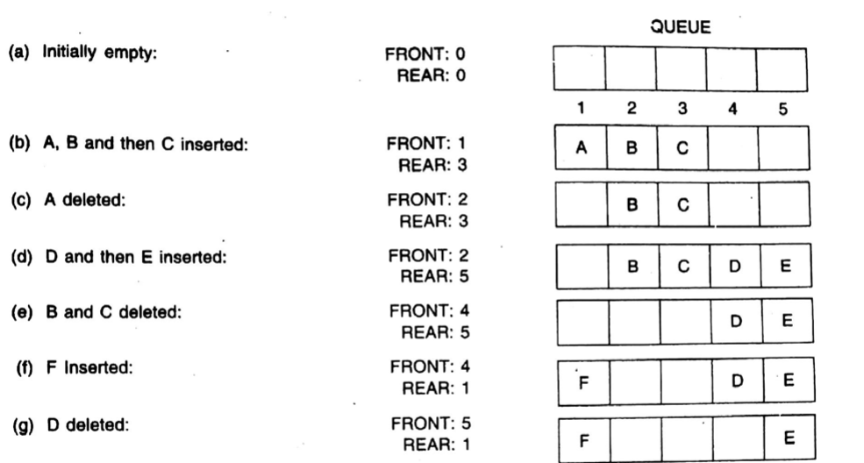
Representation of Queue
Arrays, Records and Pointers

Slide 12
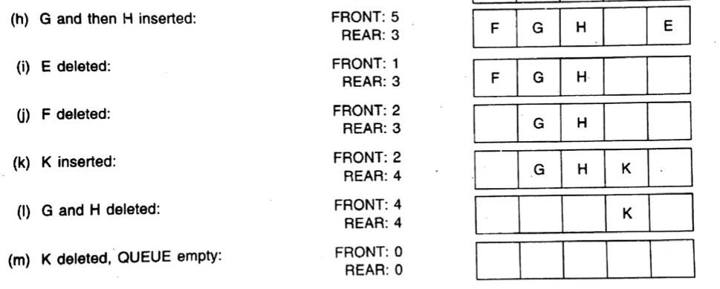
Representation of Queue
Arrays, Records and Pointers

Slide 13
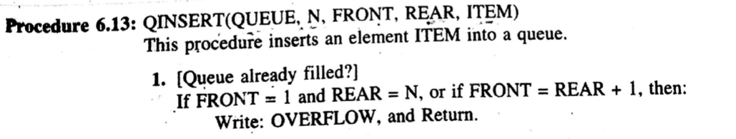
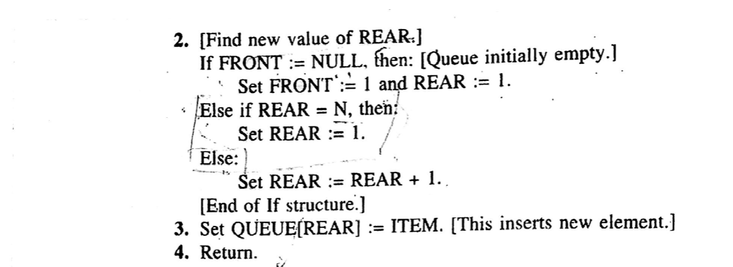
Representation of Queue
Arrays, Records and Pointers

Slide 14
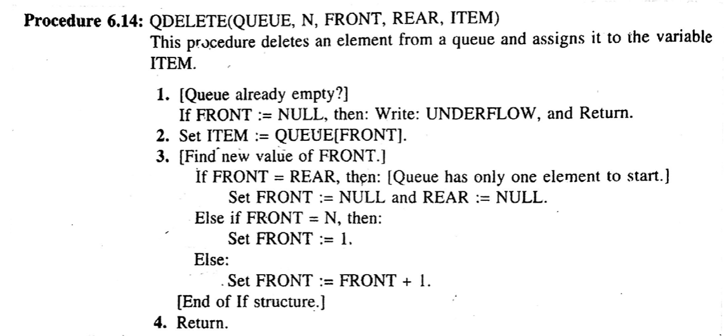
Representation of Queue
Arrays, Records and Pointers

Slide 15
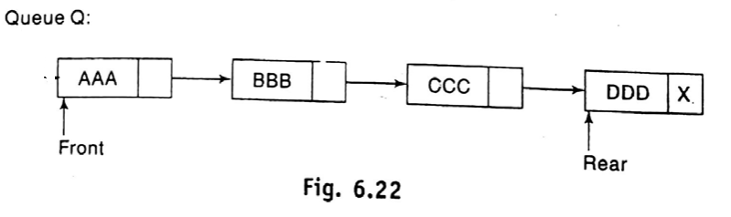
Linked Representation of Queue
Arrays, Records and Pointers

Slide 16
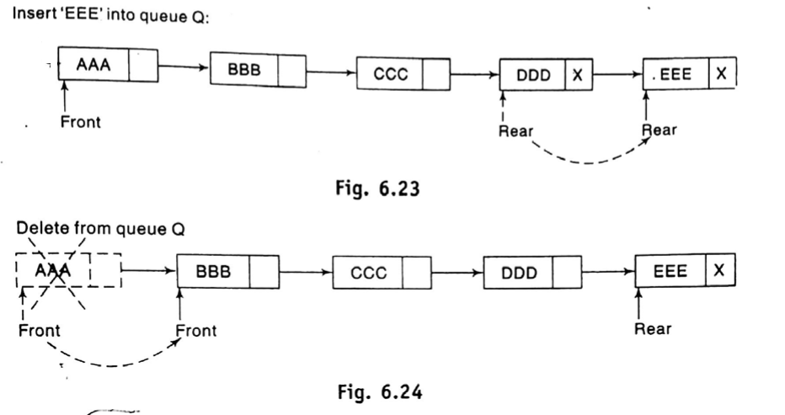
Linked Representation of Queue
Arrays, Records and Pointers

Slide 17
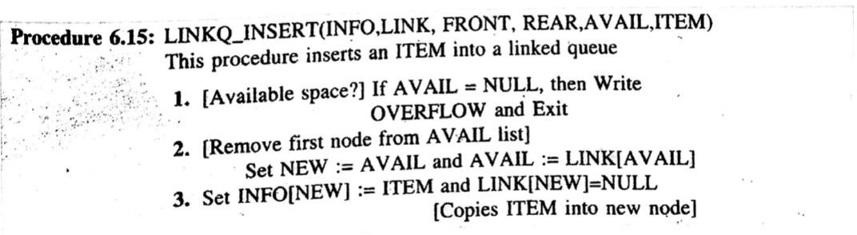
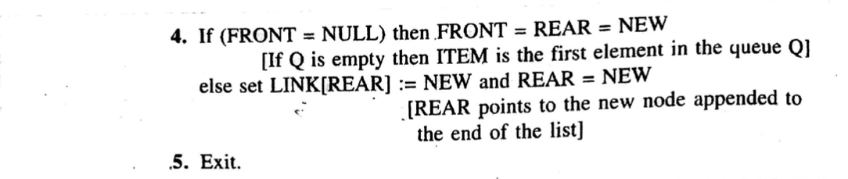
Linked Representation of Queue
Arrays, Records and Pointers

Slide 18
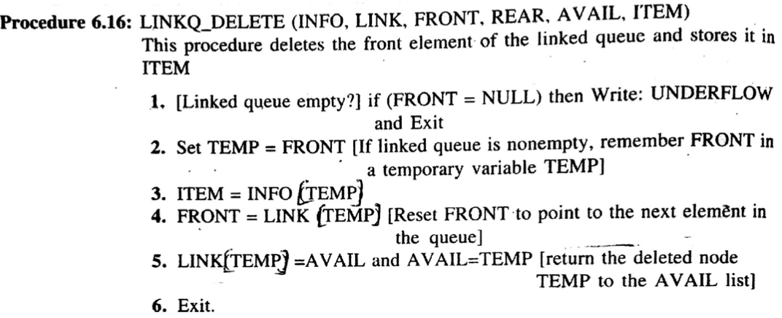
Linked Representation of Queue
Arrays, Records and Pointers

Slide 19
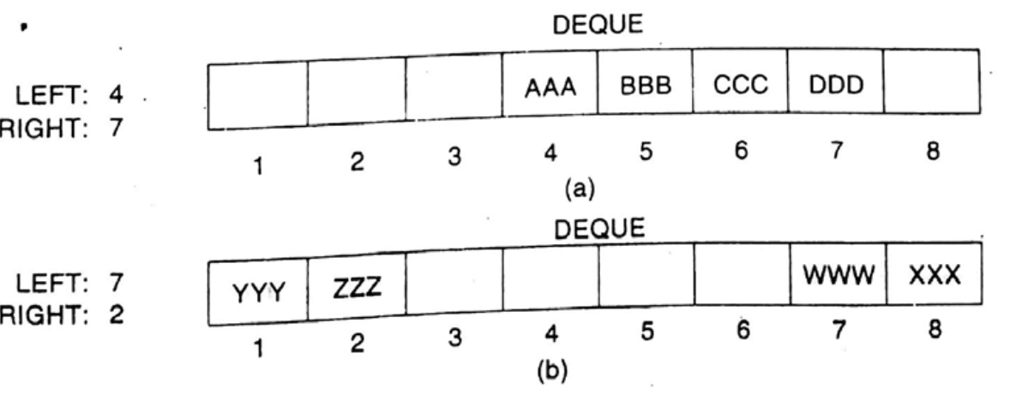
Deque (“deck” or “dequeue”)
A linear list in which elements can be added or removed at either end but not in the middle.
Double ended queue.
Assume, our deque is maintained by a circular array DEQUE with pointers LEFT and RIGHT
Arrays, Records and Pointers

Slide 20
Deque (“deck” or “dequeue”)
Deque is empty: LEFT = NULL or RIGHT = NULL
Deque is full: LEFT = 1 and RIGHT=N or LEFT = RIGHT+1
Deleted two elements from left , LEFT = 3
Added two elements on the right, RIGHT = 2
LEFT = 1 | 2 | 3 | 5 |  |  |  |  | 16
RIGHT = N | 1 | 2 | 3 | …. | …. | … | … | N
LEFT = 3 | 2 | 3 | 5 |  |  |  |  | 16
RIGHT = 2 | 1 | 2 | 3 | …. | …. | … | … | N
Arrays, Records and Pointers

Slide 21
Deque (“deck” or “dequeue”)
Algorithm: DEQINSR (DEQUE, N, LEFT, RIGHT, ITEM)
This procedure inserts an ITEM into a deque at right end.
  [Deque already filled]
  IF LEFT = 1 and RIGHT = N, or If LEFT = RIGHT + 1, then:
  Write: OVERFLOW, and Return.
  IF RIGHT=NULL, then: [Deque initially empty]
  Set LEFT:= 1 and RIGHT :=1.
  Else if RIGHT = N, then:
  Set RIGHT:=1.
  Else:
  Set RIGHT := RIGHT + 1.
  [End of If statement]
  Set DEQUE[RIGHT]:= ITEM.
  Return.
Arrays, Records and Pointers

Slide 22
Deque (“deck” or “dequeue”)
Algorithm: DEQINSL (DEQUE, N, LEFT, RIGHT, ITEM)
This procedure inserts an ITEM into a deque at left end.
  [Deque already filled]
  IF LEFT = 1 and RIGHT = N, or If LEFT = RIGHT + 1, then:
  Write: OVERFLOW, and Return.
  IF LEFT=NULL, then: [Deque initially empty]
  Set LEFT:= 1 and RIGHT :=1.
  Else if LEFT = 1, then:
  Set LEFT:=N.
  Else:
  Set LEFT := LEFT - 1.
  [End of If statement]
  Set DEQUE[LEFT]:= ITEM.
  Return.
Arrays, Records and Pointers

Slide 23
Deque (“deck” or “dequeue”)
Algorithm6.6: DEQDELR (DEQUE, N, LEFT, RIGHT, ITEM)
This procedure deletes an ITEM from a deque at right end and assigns it to the variable ITEM.
  [Deque already Empty]
  IF RIGHT = NULL then: Write: UNDERFLOW, and Return.
  Set ITEM:= DEQUE[RIGHT]
  IF RIGHT=LEFT, then: [Deque contains only one element]
  Set LEFT:= NULL and RIGHT :=NULL.
  Else if RIGHT = 1, then:
  Set RIGHT:=N.
  Else:
  Set RIGHT := RIGHT - 1.
  [End of If statement]
  Return.
Arrays, Records and Pointers

Slide 24
Deque (“deck” or “dequeue”)
Algorithm6.6: DEQDELL (DEQUE, N, LEFT, RIGHT, ITEM)
This procedure deletes an ITEM from a deque at left end and assigns it to the variable ITEM.
  [Dequeue already Empty]
  IF LEFT = NULL then: Write: UNDERFLOW, and Return.
  Set ITEM:= DEQUE[LEFT]
  IF RIGHT=LEFT, then: [Dequeue contains only one element]
  Set LEFT:= NULL and RIGHT :=NULL.
  Else if LEFT = N, then:
  Set LEFT:=1.
  Else:
  Set LEFT := LEFT + 1.
  [End of If statement]
  Return.
Arrays, Records and Pointers

Slide 25
Deque (“deck” or “dequeue”)
Two type of deque –
  Input-restricted deque
    Allows insertions at only one end but allows deletions at both ends of the list
  Output-restricted deque
    Allows deletion at only one end but allows insertions at both ends of the list
Arrays, Records and Pointers

Slide 26
PRIORITY QUEUE
Arrays, Records and Pointers

Slide 27
Priority Queue
A priority queue is a collection of elements such that each element has been assigned a priority and such that the order in which elements are deleted and processed comes from the following rules
  An element of higher priority is processed before any element of lower priority.
  Two elements with the same priority are processed according to the order in which they were added to the queue.
A prototype of a priority queue is a timesharing system:
  Programs of high priority are processed first
  Programs of same priority form a standard queue
Arrays, Records and Pointers

Slide 28
Priority Queue
(One way List Representation)
Each node in the list will contain three items of information: an information field INFO, a priority number PRN and a link number LINK
A node X precedes a node Y in the list (1) when X has higher priority than Y or (2) when both have the same priority but X was added to the list before Y.
INFO | PRN | LINK
Y |  |  |  | X
10 | 2 |  |  | 20 | 5
Arrays, Records and Pointers

Slide 29
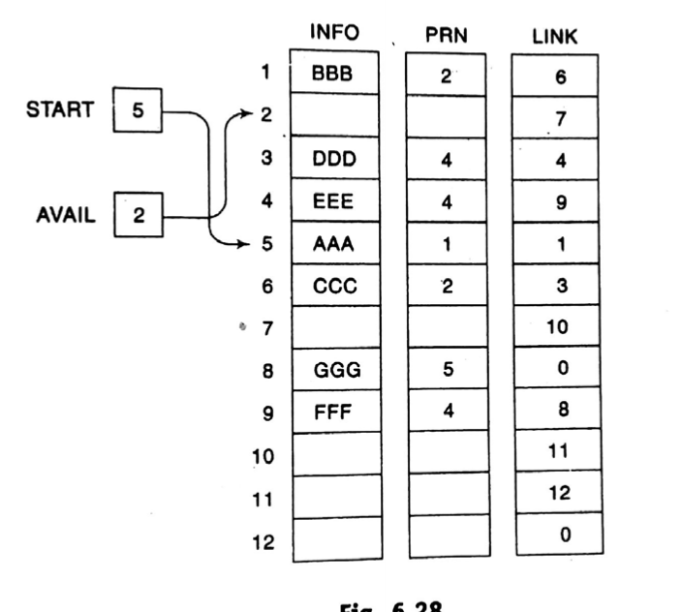
Priority Queue
(One way List Representation)
Arrays, Records and Pointers

Slide 30
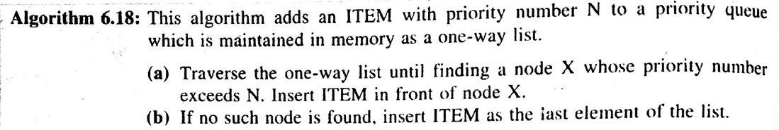
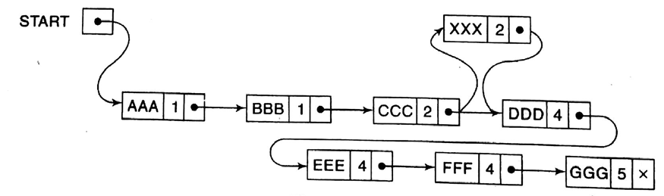
Priority Queue
(One way List Representation)
Arrays, Records and Pointers

Slide 31
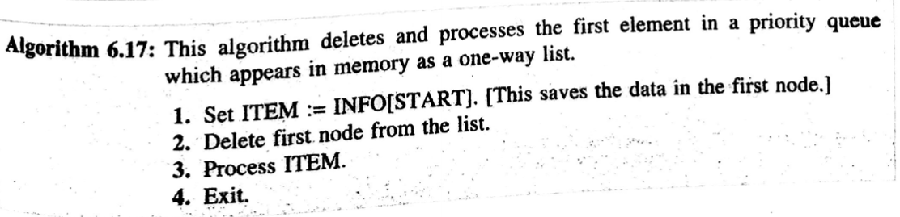
Priority Queue
(One way List Representation)
Arrays, Records and Pointers

Slide 32
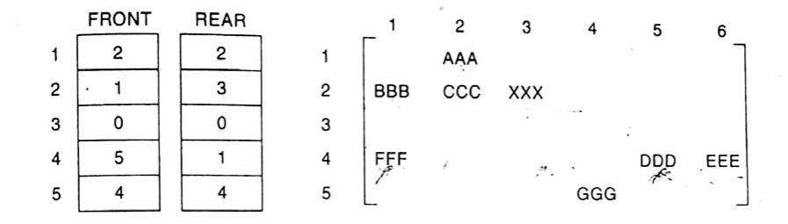
Priority Queue
(Array Representation)
Arrays, Records and Pointers

Slide 33
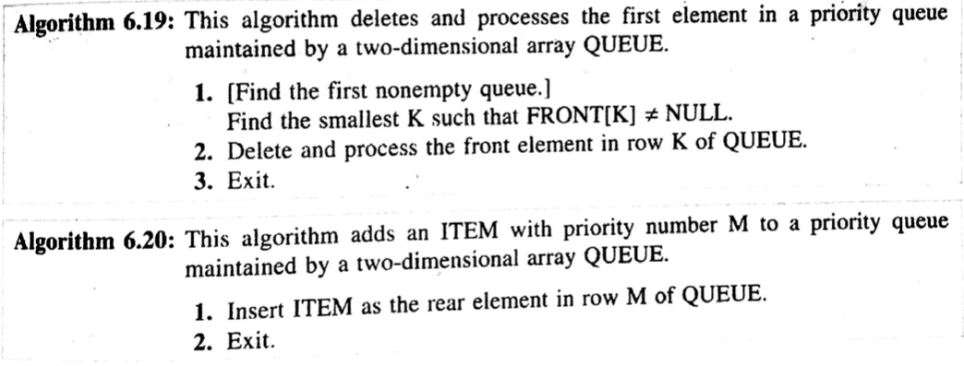
Priority Queue
(Array Representation)
Arrays, Records and Pointers

Slide 34
Any Query?
Arrays, Records and Pointers

