Slide 1
Tree
Instructors:
Md Nazrul Islam Mondal &
Rizoan Toufiq
Department of Computer Science & Engineering
Rajshahi University of Engineering & Technology Rajshahi-6204

Slide 2
Outline
Heap; Heapsort
Path Lengths; Huffman’s Algorithm
General Trees
Rizoan Toufiq, Assistant Prof., CSE, RUET
Arrays, Records and Pointers

Slide 3
Heap; Heapsort
Rizoan Toufiq, Assistant Prof., CSE, RUET
Arrays, Records and Pointers

Slide 4
Heap; Heapsort
H is a complete binary tree with n element.
H is called heap or a maxhip, if each node N of H has the following property:
  The value at N is greater than or equal to the value at each of the children of N.
  (A minheao is defined analogously: The value at N is less than or equal to the value at each of the children of N.)
Rizoan Toufiq, Assistant Prof., CSE, RUET
Arrays, Records and Pointers

Slide 5
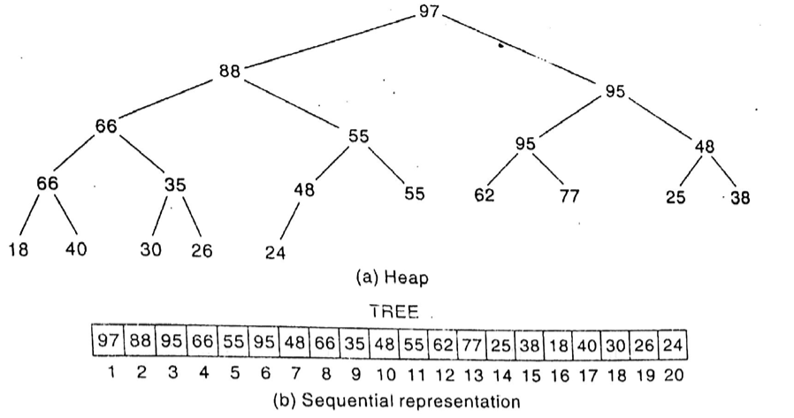
Heap; Heapsort
Tree[1] → root,
Tree[2k] → Left child, Tree[2k+1] → right child
Rizoan Toufiq, Assistant Prof., CSE, RUET
Arrays, Records and Pointers

Slide 6
Heap; Heapsort
(Inserting into a Heap)
Suppose H is a heap with N elements, and suppose an ITEM of information is given. We insert ITEM into the heap H as follows:
  First adjoin ITEM at the end of H so that H is still a complete tree, but not necessarily a heap.
  Then let ITEM rise to its “appropriate place” in H so that H is finally a heap.
Rizoan Toufiq, Assistant Prof., CSE, RUET
Arrays, Records and Pointers

Slide 7
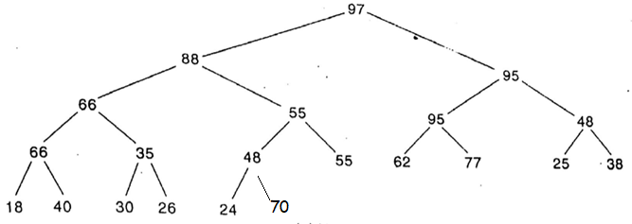
Heap; Heapsort
(Inserting into a Heap)
Insert 70
Rizoan Toufiq, Assistant Prof., CSE, RUET
Arrays, Records and Pointers

Slide 8
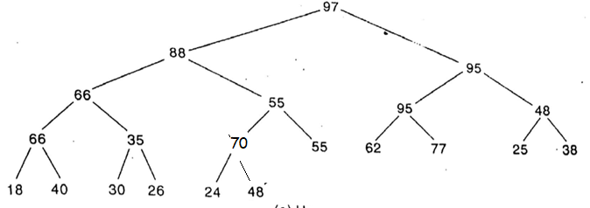
Heap; Heapsort
(Inserting into a Heap)
Insert 70
Rizoan Toufiq, Assistant Prof., CSE, RUET
Arrays, Records and Pointers

Slide 9
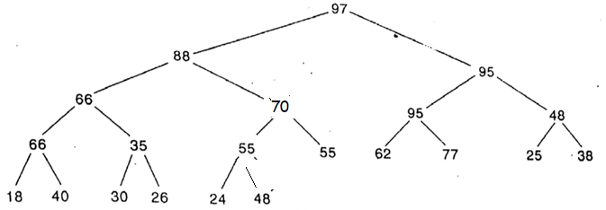
Heap; Heapsort
(Inserting into a Heap)
Insert 70
Rizoan Toufiq, Assistant Prof., CSE, RUET
Arrays, Records and Pointers

Slide 10
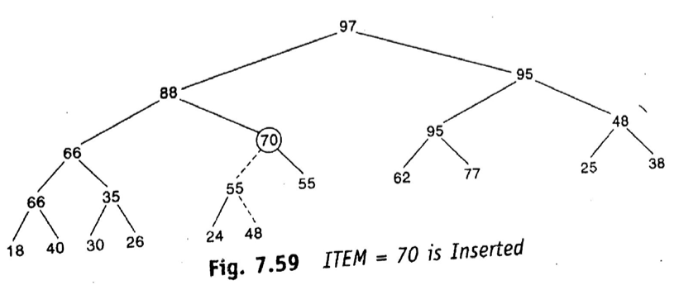
Heap; Heapsort
(Inserting into a Heap)
Rizoan Toufiq, Assistant Prof., CSE, RUET
Arrays, Records and Pointers

Slide 11

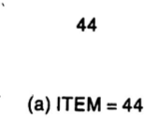
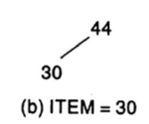
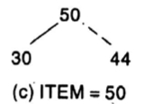
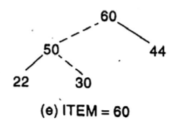
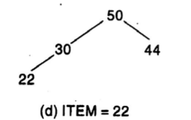
Heap; Heapsort
(Inserting into a Heap)
Rizoan Toufiq, Assistant Prof., CSE, RUET
Arrays, Records and Pointers

Slide 12
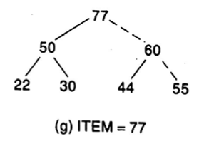
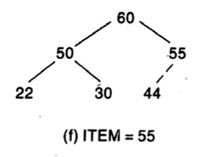
Heap; Heapsort
(Inserting into a Heap)
Rizoan Toufiq, Assistant Prof., CSE, RUET
Arrays, Records and Pointers

Slide 13
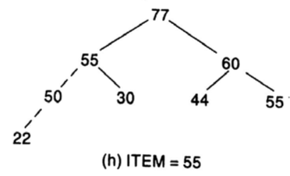
Heap; Heapsort
(Inserting into a Heap)
Rizoan Toufiq, Assistant Prof., CSE, RUET
Arrays, Records and Pointers

Slide 14
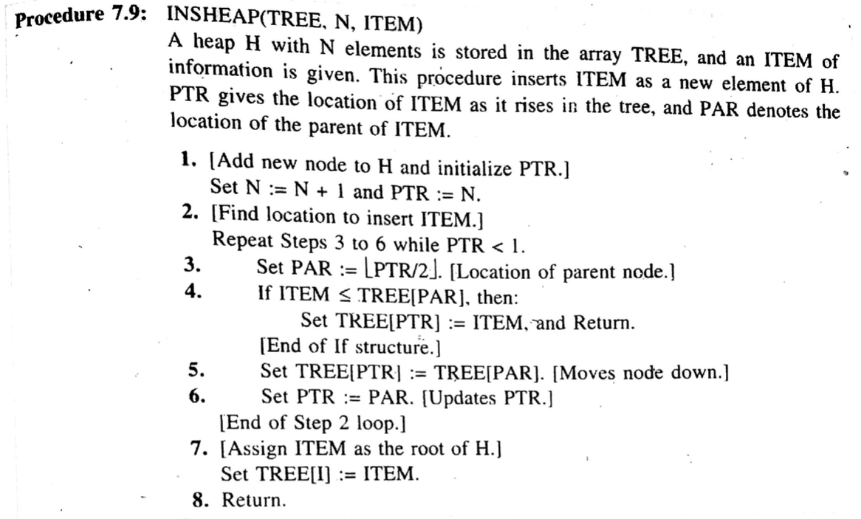
Heap; Heapsort
(Inserting into a Heap)
Rizoan Toufiq, Assistant Prof., CSE, RUET
Arrays, Records and Pointers

Slide 15
Heap; Heapsort
(Deleting the Root of a Heap)
Suppose H is a heap with N elements, and suppose we want to delete the root R of H. This is accomplished as follows
  Assign the R to some variable ITEM i.e. ITEM←R
  Replace the deleted node R by the last node L of H so that H is still a complete tree, but not necessarily a heap.
  (Reheap) Let L sink to its appropriate place in H so that H is a finally a heap
Rizoan Toufiq, Assistant Prof., CSE, RUET
Arrays, Records and Pointers

Slide 16
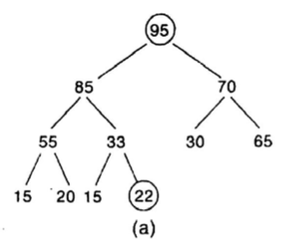
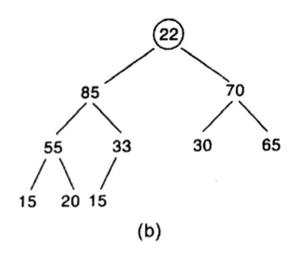
Heap; Heapsort
(Deleting the Root of a Heap)
Delete Root
Rizoan Toufiq, Assistant Prof., CSE, RUET
Arrays, Records and Pointers

Slide 17
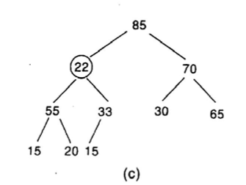
Heap; Heapsort
(Deleting the Root of a Heap)
Delete Root
Rizoan Toufiq, Assistant Prof., CSE, RUET
Arrays, Records and Pointers

Slide 18
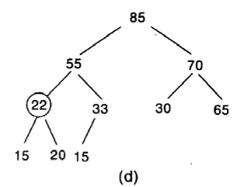
Heap; Heapsort
(Deleting the Root of a Heap)
Delete Root
Rizoan Toufiq, Assistant Prof., CSE, RUET
Arrays, Records and Pointers

Slide 19
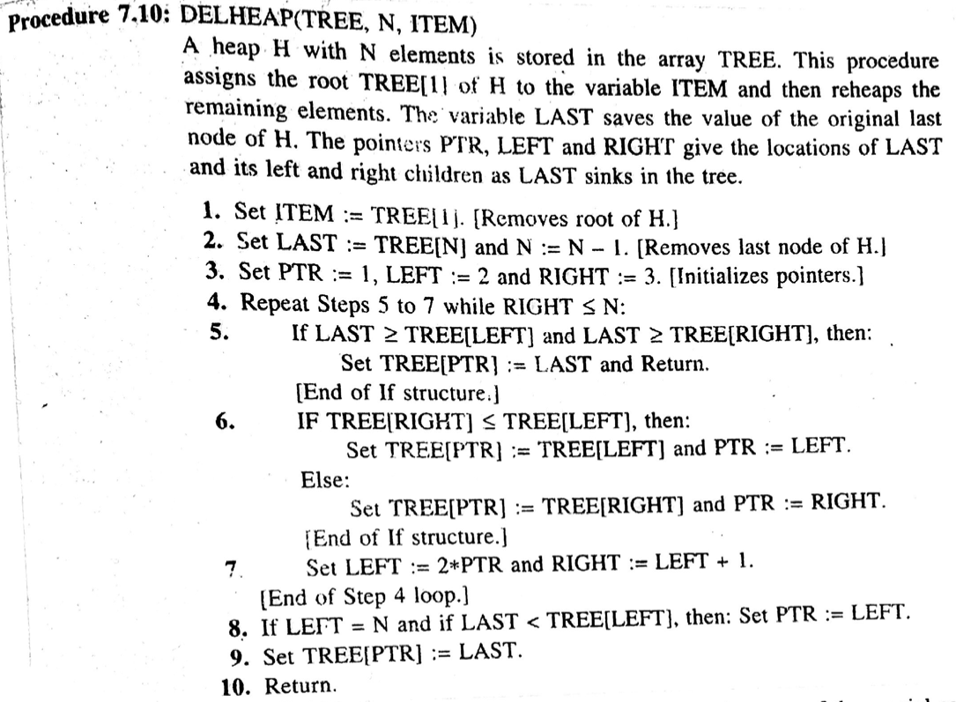
Heap; Heapsort
(Deleting the Root of a Heap)
Rizoan Toufiq, Assistant Prof., CSE, RUET
Arrays, Records and Pointers

Slide 20
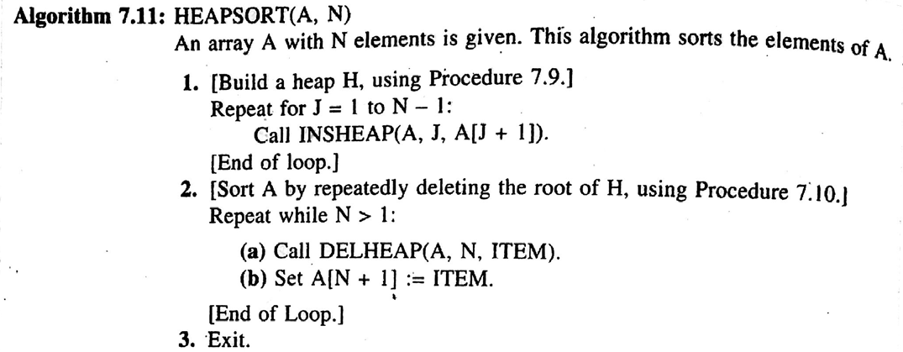
Heap; Heapsort
(Heapsort)
Two Phase
  Build a heap H out of the elements of A
  Repeatedly delete the root element of H
Remember: A[N+1] does not belong to the heap H, it is safe to save the root
Rizoan Toufiq, Assistant Prof., CSE, RUET
Arrays, Records and Pointers

Slide 21
Heap; Heapsort
(Heapsort)
Phase A: f₁(n) = O(nlogn)
Phase B: f₂(n) = O(nlogn)
Heapsort Algorithm: O(nlogn) [Best, Average and Worst]
But best and Average case complexity of QuickSort: O(nlogn)
The worst Case Complexity of QuickSort: O(n²)
The best, average and worst Case Complexity of bubble sort: O(n²)
Rizoan Toufiq, Assistant Prof., CSE, RUET
Arrays, Records and Pointers

Slide 22
Path Lengths; Huffman’s Algorithm
Rizoan Toufiq, Assistant Prof., CSE, RUET
Arrays, Records and Pointers

Slide 23
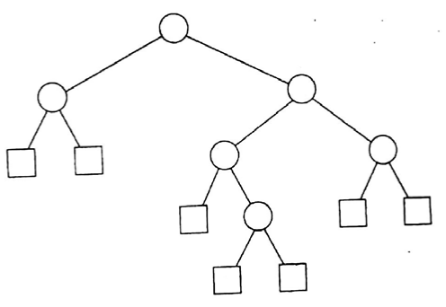
Path Lengths; Huffman’s Algorithm
Extended Binary Tree or 2-tree
  External Node (N_{E}) – the node with 0 children, denoted by square
  Internal Node(N_{I}) – the node with 2 children, denoted by circle
  Equation: N_{E} = N_{I} + 1
Rizoan Toufiq, Assistant Prof., CSE, RUET
Arrays, Records and Pointers

Slide 24
Path Lengths; Huffman’s Algorithm
External Path Length (L_{E}):
  The sum of all path lengths summed over each path from the root R of T to external node.
Internal Path Length (L_{I}):
  The sum of all path lengths summed over each path from the root R of T to internal node.
Rizoan Toufiq, Assistant Prof., CSE, RUET
Arrays, Records and Pointers

Slide 25
Path Lengths; Huffman’s Algorithm
L_{E}= 2+2+3+4+4+3+3 = 21
L_{I}= 0+1+1+2+3+2 = 9
L_{E} = L_{I} + 2n, n← number of internal node
Rizoan Toufiq, Assistant Prof., CSE, RUET
Arrays, Records and Pointers

Slide 26
Path Lengths; Huffman’s Algorithm
Suppose T is a 3-tree with n external nodes,
Suppose each of the external nodes is assigned a nonnegative weight.
The external weighted path length P of the tree is defined to be the sum of the weighted path length i.e.
P = W₁L₁ + W₂L₂ + … + W_{n}L_{n}
    W_{i} ← the weight of an external Node i
    L_{i} ← the path length of an external Node i
Rizoan Toufiq, Assistant Prof., CSE, RUET
Arrays, Records and Pointers

Slide 27
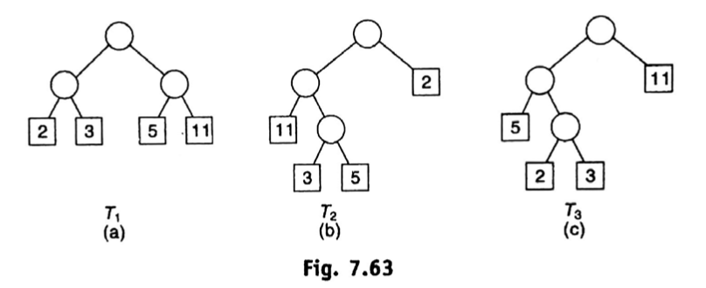
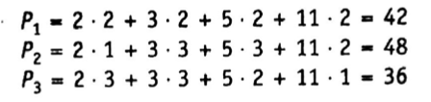
Path Lengths; Huffman’s Algorithm
Rizoan Toufiq, Assistant Prof., CSE, RUET
Arrays, Records and Pointers

Slide 28
Path Lengths; Huffman’s Algorithm
General Problem:
  Suppose a list of n weights is given: w₁ , w₂ , … , w_{n} . Among all the 2 trees with n external nodes with the given n weight, find a tree T with a minimum-weighted path length.
Solution: Huffman’s Algorithm
Rizoan Toufiq, Assistant Prof., CSE, RUET
Arrays, Records and Pointers

Slide 29
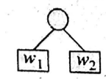
Path Lengths; Huffman’s Algorithm
Huffman’s Algorithm
  Suppose w₁ and w₂ are two minimum weights among the n given weights w₁ , w₂ , … , w_{n.}
  Find a tree T’ which gives a solution for the n-1 weights: w₁ + w₂ , w₃ … w_{n}
  Then in the tree T’, replace the external node w₁ + w₂ by the subtree
  The new 2-tree T is the desired solution
Rizoan Toufiq, Assistant Prof., CSE, RUET
Arrays, Records and Pointers

Slide 30
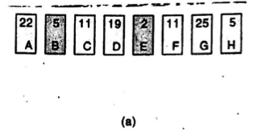
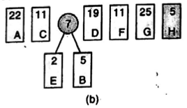
Path Lengths; Huffman’s Algorithm
Huffman’s Algorithm
Rizoan Toufiq, Assistant Prof., CSE, RUET
Arrays, Records and Pointers

Slide 31
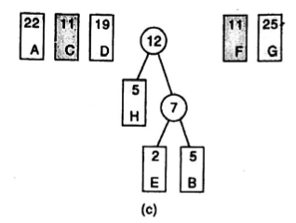
Path Lengths; Huffman’s Algorithm
Huffman’s Algorithm
Rizoan Toufiq, Assistant Prof., CSE, RUET
Arrays, Records and Pointers

Slide 32
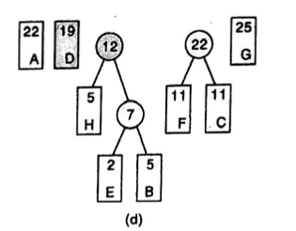
Path Lengths; Huffman’s Algorithm
Huffman’s Algorithm
Rizoan Toufiq, Assistant Prof., CSE, RUET
Arrays, Records and Pointers

Slide 33
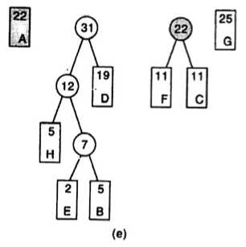
Path Lengths; Huffman’s Algorithm
Huffman’s Algorithm
Rizoan Toufiq, Assistant Prof., CSE, RUET
Arrays, Records and Pointers

Slide 34
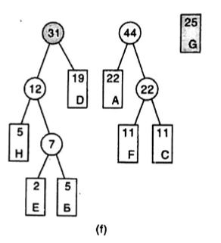
Path Lengths; Huffman’s Algorithm
Huffman’s Algorithm
Rizoan Toufiq, Assistant Prof., CSE, RUET
Arrays, Records and Pointers

Slide 35
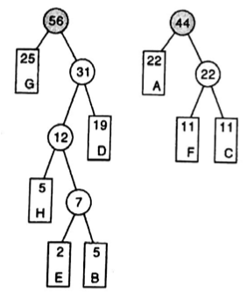
Path Lengths; Huffman’s Algorithm
Huffman’s Algorithm
Rizoan Toufiq, Assistant Prof., CSE, RUET
Arrays, Records and Pointers

Slide 36
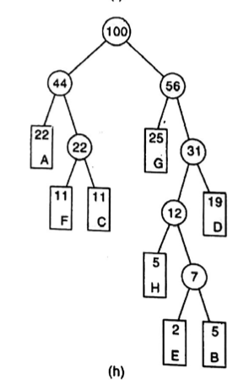
Path Lengths; Huffman’s Algorithm
Huffman’s Algorithm
Rizoan Toufiq, Assistant Prof., CSE, RUET
Arrays, Records and Pointers

Slide 37
Path Lengths; Huffman’s Algorithm
Application to Coding
  Data item don’t occur with the same probability.
  Then memory space may be conserved by using variable-length string
  Items which occur frequently are assigned shorter string
  Item which occur infrequently are assigned longer string.
Rizoan Toufiq, Assistant Prof., CSE, RUET
Arrays, Records and Pointers

Slide 38
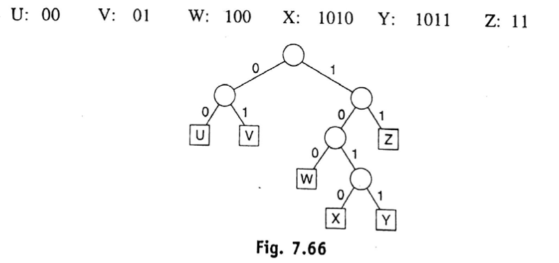
Path Lengths; Huffman’s Algorithm
Application to Coding
  Z, U and V are used frequently
  X and Y are used infrequently
Rizoan Toufiq, Assistant Prof., CSE, RUET
Arrays, Records and Pointers

Slide 39
General Trees
Rizoan Toufiq, Assistant Prof., CSE, RUET
Arrays, Records and Pointers

Slide 40
General Trees
A nonempty finite set T of elements, called nodes, such that
  T contains a distinguished element R, called the root of T
  The remaining elements of T form an ordered collection of zero or more disjoint tree T₁, T₂, …, T_{m}
The trees T₁, T₂, …, T_{m} are called subtrees of the root R
The root of T₁, T₂, …, T_{m} are called successors of R.
Rizoan Toufiq, Assistant Prof., CSE, RUET
Arrays, Records and Pointers

Slide 41
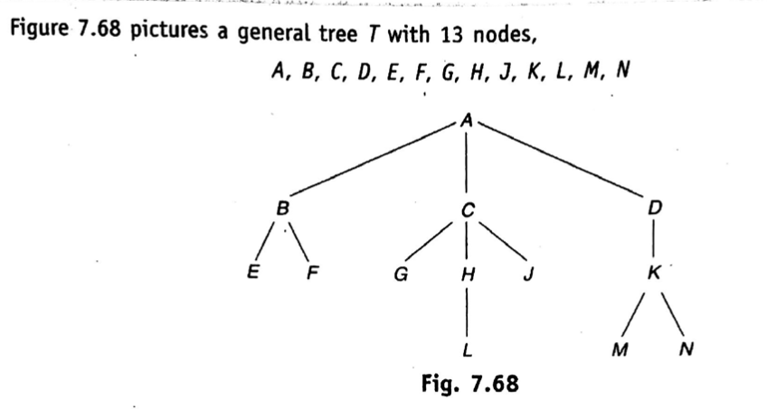
General Trees
If N is a node with successors S₁, S₂, …, S_{m} , then N is called the parent of the S_{i} ‘s.
S_{i} ‘s are called children of N
S_{i} ‘s are called siblings of each other.
Rizoan Toufiq, Assistant Prof., CSE, RUET
Arrays, Records and Pointers

Slide 42
General Trees
Difference between general tree and binary tree
  A binary tree T’ may be empty but a general tree T is nonempty
  Suppose a node N has only one child. Then the child is distinguished as a left child or right child in a binary tree T’, but no such distinction exists in a general tree T.
Rizoan Toufiq, Assistant Prof., CSE, RUET
Arrays, Records and Pointers

Slide 43
General Trees
Two Properties of a Tree
  T has a distinguished node R called the root of T
  T is ordered that is the children of each node N of T have a specific order.
A forest F is defined to be an ordered collection of zero or more distinct tree.
  If we delete the root R from a general tree T, then we obtain the forest F consisting of the subtrees of R (which may be empty)
  Conversely If F is a forest, then we may adjoin a node R to F to form a general tree T where R is the root of T.
Rizoan Toufiq, Assistant Prof., CSE, RUET
Arrays, Records and Pointers

Slide 44
General Trees
(Computer Representation)
Suppose T is a general Tree.
Uses three parallel arrays INFO, CHILD (or DOWN) and SIBL (or HORZ), and a pointer variable ROOT as follows. First of all, each node N of T will correspond to a location K such that
  INFO[K] contains the data at node N.
  CHILD[K] contains the location of the first child of N. The condition CHILD[K} = NULL indicates that N has no children.
  SIBL[K] contains the location of the next sibling of N. The condition SIBL[K] = NULL indicates that N is the last child of its parents.
Rizoan Toufiq, Assistant Prof., CSE, RUET
Arrays, Records and Pointers

Slide 45
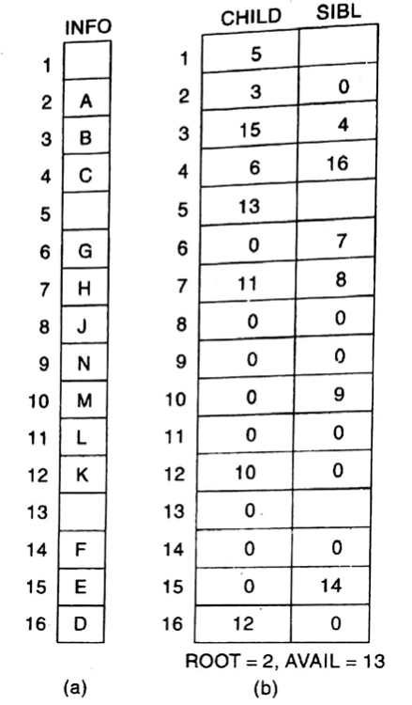
General Trees
(Computer Representation)
Rizoan Toufiq, Assistant Prof., CSE, RUET
Arrays, Records and Pointers

Slide 46
General Trees
(Correspondence between general tree and binary tree)
Suppose T is a general tree.
Then we may assign a unique binary tree T’ to T as follows.
  First of all, the node of binary tree T’ will be the same as the nodes of the general tree T and the root of T’ will be the root of T.
  Let N be an arbitrary node of the binary tree T’
    Then the left child of N in T’ will be the first child of the node N in the general tree T.
    The right child of N in T’ will be the next sibling of N in the general tree T.
Rizoan Toufiq, Assistant Prof., CSE, RUET
Arrays, Records and Pointers

Slide 47
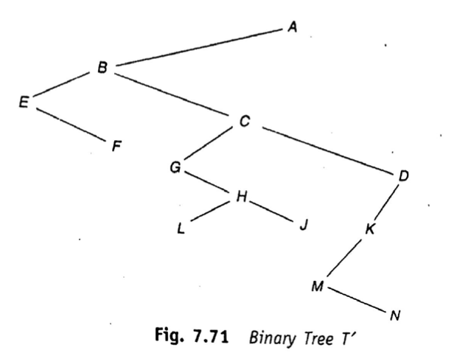
General Trees
(Correspondence between general tree and binary tree)
General Tree T
Binary tree T’
Rizoan Toufiq, Assistant Prof., CSE, RUET
Arrays, Records and Pointers

Slide 48
Any Query?
Rizoan Toufiq, Assistant Prof., CSE, RUET
Arrays, Records and Pointers

