Slide 1
Stack
Instructors:
Md Nazrul Islam Mondal
Department of Computer Science & Engineering
Rajshahi University of Engineering & Technology Rajshahi-6204

Slide 2
Outline
Stacks
Array Representation of Stacks
Linked Representation of Stacks
Arithmetic Expression: Polish Notation
Arrays, Records and Pointers

Slide 3
Stacks
Arrays, Records and Pointers

Slide 4
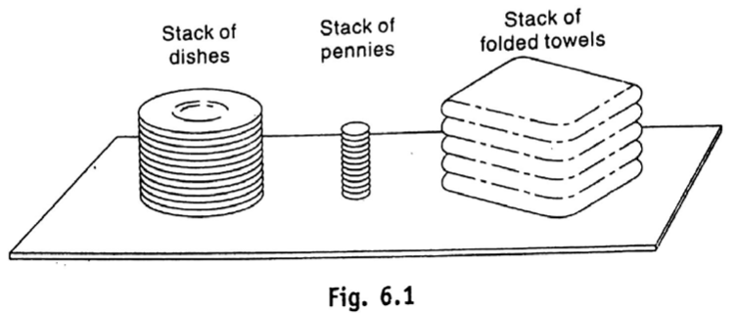
Stacks
Arrays, Records and Pointers

Slide 5
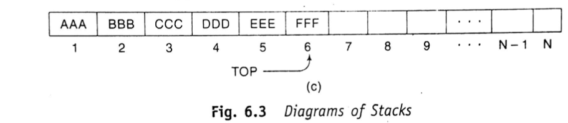
Stacks
An element is inserted or deleted only at one end, called the top of the stack.
Special terminology is used for two basic operations associate with stack:
  “Push” is the term used to insert an element into a stack
  “Pop” is the term used to delete an element from a stack
Arrays, Records and Pointers

Slide 6
Stacks
Postponed Decisions
  Stacks are frequently used to indicate the order of the processing of data when certain steps of the processing must be postponed until other conditions are fulfilled.
  Suppose that while processing some project A we are required to move on to project B, whose completion is required in order to complete project A.
Arrays, Records and Pointers

Slide 7
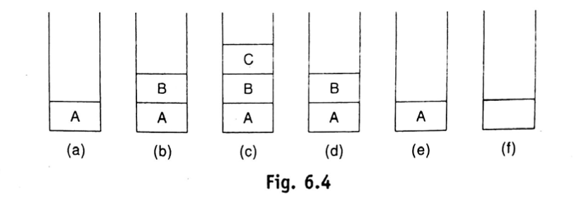
Stacks
Postponed Decisions
Arrays, Records and Pointers

Slide 8
Array Representation of Stack
Arrays, Records and Pointers

Slide 9
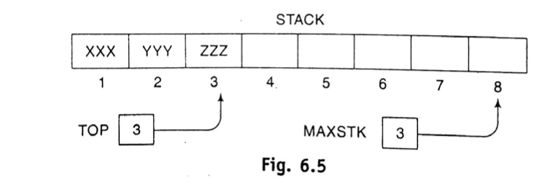
Array Representation of Stack
A linear array STACK
A pointer variable TOP, which contains the location of the top element of the stack
A variable MAXSTK which gives the maximum number of elements that can be held by the stack.
The condition TOP=0 or TOP=NULL will indicate that the stack is empty.
Arrays, Records and Pointers

Slide 10
Array Representation of Stack
PUSH – the operation of adding(pushing) an item into a stack
POP – the operation of removing(Popping) an item from a stack
PUSH is associate with OVERFLOW.
POP is associate with UNDERFLOW.
Arrays, Records and Pointers

Slide 11
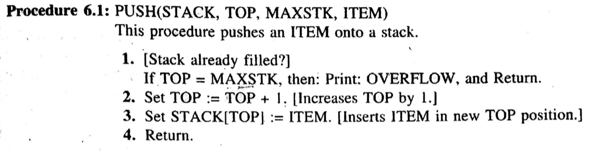
Array Representation of Stack
Arrays, Records and Pointers

Slide 12
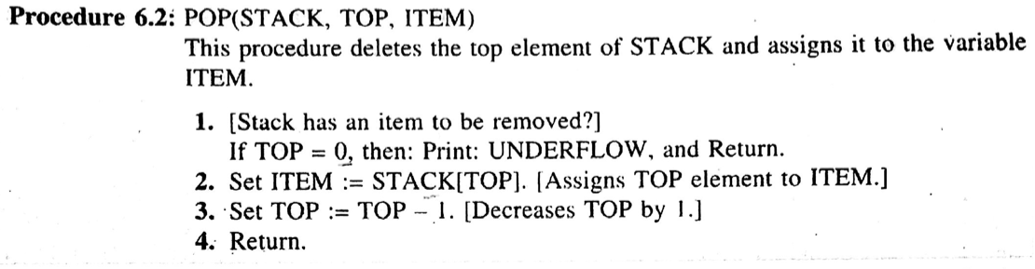
Array Representation of Stack
Arrays, Records and Pointers

Slide 13
Array Representation of Stack
Minimizing Overflow
  There is no direct control by the programmer.
  But programmer sets the amount of memory space reserved for each stack, and this choice does influence the number of time overflow may occur.
  Time-space Tradeoff
    Reserving a great deal of space for each stack will decrees the number of time overflow may occur; however, this may be an expensive use of the space if most of the space is seldom used.
    On the other hand, reserving a small amount of space for each stack may increase the number of time overflow occurs; and the time required for resolving an overflow, such as by adding space to the stack may be more expensive than the space saved.
  Various techniques have been developed which modify the array representation of stacks so that the amount of space reserved for more than one stack may be more efficiently used.
Arrays, Records and Pointers

Slide 14
Linked Representation of Stacks
Arrays, Records and Pointers

Slide 15
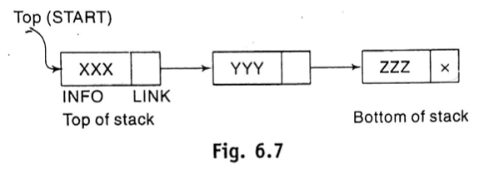
Linked Representation of Stacks
Used One-way List or Singly Linked List
The START pointer of the linked list behaves as the TOP pointer variable of the stack.
Arrays, Records and Pointers

Slide 16
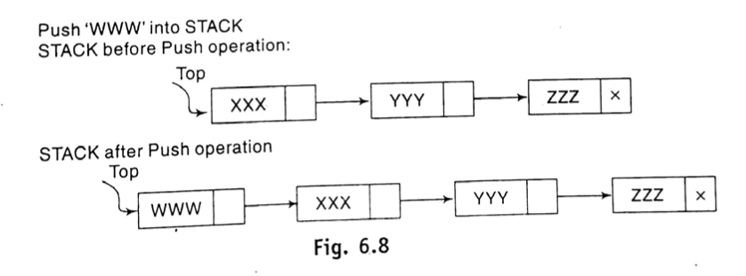
Linked Representation of Stacks
POP and PUSH operation
Arrays, Records and Pointers

Slide 17
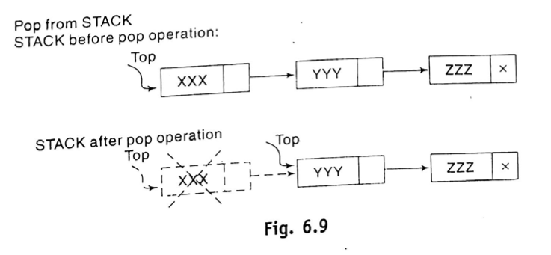
Linked Representation of Stacks
POP and PUSH operation
Arrays, Records and Pointers

Slide 18
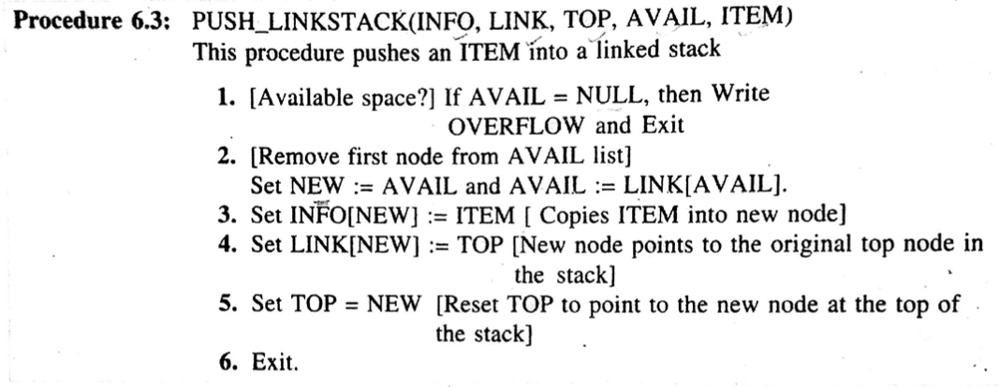
Linked Representation of Stacks
Arrays, Records and Pointers

Slide 19
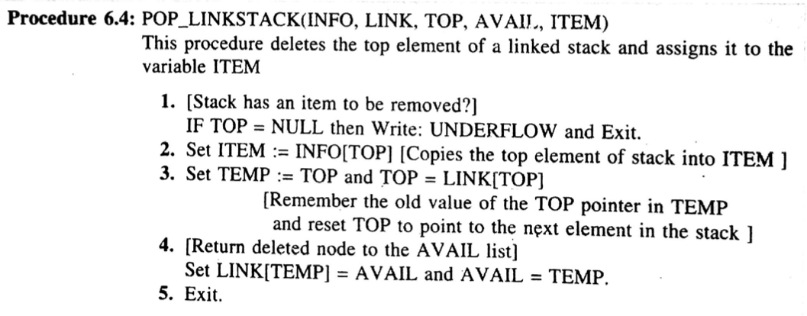
Linked Representation of Stacks
Arrays, Records and Pointers

Slide 20
Arithmetic Expression: Polish Notation
Arrays, Records and Pointers

Slide 21
Arithmetic Expression: Polish Notation
An application of Stack
Let Q be an arithmetic expression involving constants and operations.
The binary operations in Q may have different levels of precedence.
Highest | : | Exponentiation(↑)
Next highest | : | Multiplication(*) and division(/)
Lowest | : | Addition(+) and substraction(-)
Arrays, Records and Pointers

Slide 22
Arithmetic Expression: Polish Notation
Infix Notation:
    A+B A-B A/B A*C
Problem:
  We must distinguish between (A+B)*C and A+(B*C) by using either parentheses or some operator-precedence convention.
To solve this problem:
  Polish Notation, named after the Polish Mathematician Jan Lukasiewicz
  Polish Notation: The operator symbol is placed before its two operands.
        +AB -AB *AB /AB
  This notation is also called Prefix Notation.
Arrays, Records and Pointers

Slide 23
Arithmetic Expression: Polish Notation
Translate the following infix expression into Polish Notation:
      (A+B)*C = [+AB]*C =*+ABC
      A+(B*C) = A+[*BC] = +A*BC
      (A+B)/(C-D) = [+AB]/[-CD] = /+AB-CD
Arrays, Records and Pointers

Slide 24
Arithmetic Expression: Polish Notation
Reverse Polish Notation: the operator symbol is placed after its two operands.
      AB+ CD- EF* GH/
This notation is frequently called postfix (or suffix) notation.
Arrays, Records and Pointers

Slide 25
Arithmetic Expression: Polish Notation
Evaluate an arithmetic expression written in infix notaion in two steps
  Converts the expression to postfix notation (using STACK)
  Evaluate the postfix expression (using STACK)
Arrays, Records and Pointers

Slide 26
Arithmetic Expression: Polish Notation
Transforming Infix Expressions into Postfix Expressions
  Consider the following arithmetic infix expression Q:
        Q: A+(B*C-(D/E↑F)*G)*H
  Initial Step: Push left parenthesis onto STACK
  Add a right parenthesis to the end of Q
  Q: A+(B*C-(D/E↑F)*G)*H)
Symbol Scanned |  | STACK | Expression P
 |  | (
Arrays, Records and Pointers

Slide 27
Arithmetic Expression: Polish Notation
Symbol Scanned |  | STACK | Expression P
 |  | (
(1) | A | ( | A
(2) | + | ( + | A
(3) | ( | ( + ( | A
(4) | B | ( + ( | A B
(5) | * | ( + ( * | A B
(6) | C | ( + ( * | A B C
Q: A+(B*C-(D/E↑F)*G)*H )
Operands → Expression P
Operators and bracket → STACK
Arrays, Records and Pointers

Slide 28
Arithmetic Expression: Polish Notation
Symbol Scanned |  | STACK | Expression P
(6) | C | ( + ( * | A B C
(7) | - | ( + ( - | A B C *
Q: A+(B*C-(D/E↑F)*G)*H)
The subtraction operator send multiplication operator from STACK to Expression P befor it is pushed onto STACK
  (*) operator precedence is higher than (-) operator
Arrays, Records and Pointers

Slide 29
Arithmetic Expression: Polish Notation
Symbol Scanned |  | STACK | Expression P
(7) | - | ( + ( - | A B C *
(8) | ( | ( + ( - ( | A B C *
(9) | D | ( + ( - ( | A B C * D
(10) | / | ( + ( - ( / | A B C * D
(11) | E | ( + ( - ( / | A B C * D E
(12) | ↑ | ( + ( - ( / ↑ | A B C * D E
Q: A+(B*C-(D/E↑F)*G)*H)
Division and Multiplication operator precedence is equal
Arrays, Records and Pointers

Slide 30
Arithmetic Expression: Polish Notation
Symbol Scanned |  | STACK | Expression P
(12) | ↑ | ( + ( - ( / ↑ | A B C * D E
(13) | F | ( + ( - ( / ↑ | A B C * D E F
(14) | ) | ( + ( - | A B C * D E F ↑ /
(15) | * | ( + ( - * | A B C * D E F ↑ /
(16) | G | ( + ( - * | A B C * D E F ↑ / G
Q: A+(B*C-(D/E↑F)*G)*H)
The right parenthesis sends ↑ and / from STACK to P, and then removes the left parenthesis from the top of STACK.
- precedence is less than *
Arrays, Records and Pointers

Slide 31
Arithmetic Expression: Polish Notation
Symbol Scanned |  | STACK | Expression P
(16) | G | ( + ( - * | A B C * D E F ↑ / G
(17) | ) | ( + | A B C * D E F ↑ / G * -
(18) | * | ( + * | A B C * D E F ↑ / G * -
(19) | H | ( + * | A B C * D E F ↑ / G * - H
(20) | ) |  | A B C * D E F ↑ / G * - H * +
Q: A+(B*C-(D/E↑F)*G)*H)
Arrays, Records and Pointers

Slide 32
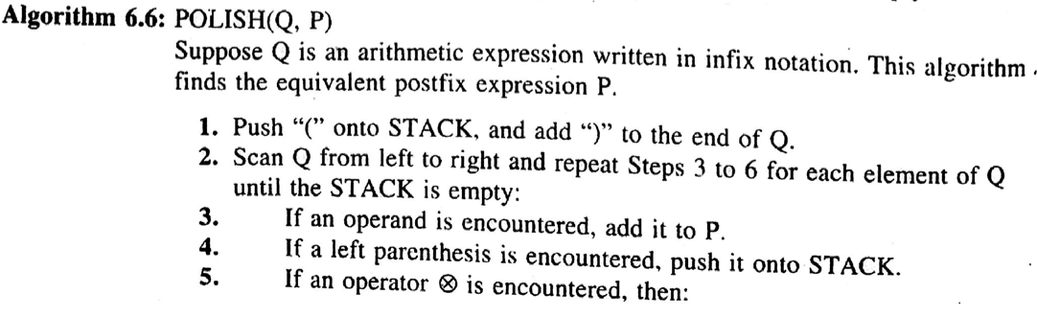
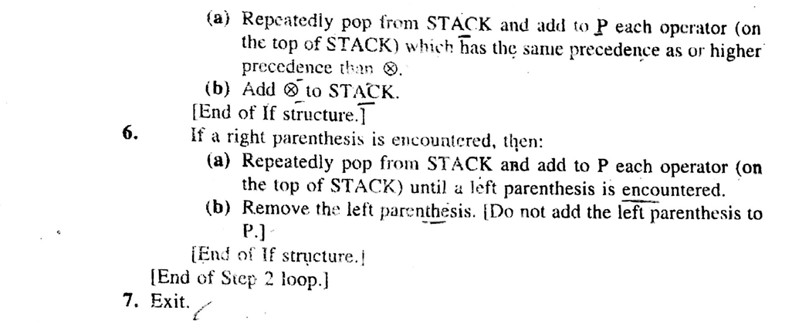
Arithmetic Expression: Polish Notation
Arrays, Records and Pointers

Slide 33
Arithmetic Expression: Polish Notation
Evaluation of a Postfix Expression
  Consider the following arithmetic expression P written in postfix notation
    P: 5, 6, 2, +, *, 12, 4, /, -
  Add a right parenthesis at the end of P
    P: 5, 6, 2, +, *, 12, 4, /, - , )
Arrays, Records and Pointers

Slide 34
Arithmetic Expression: Polish Notation
Symbol Scanned |  | STACK
(1) | 5 | 5
(2) | 6 | 5, 6
(3) | 2 | 5, 6, 2
(4) | + | 5, 8
(5) | * | 40
(6) | 12 | 40, 12
(7) | 4 | 40, 12, 4
(8) | / | 40, 3
(9) | - | 37
(10) | )
P: 5, 6, 2, +, *, 12, 4, /, - , )
Arrays, Records and Pointers

Slide 35
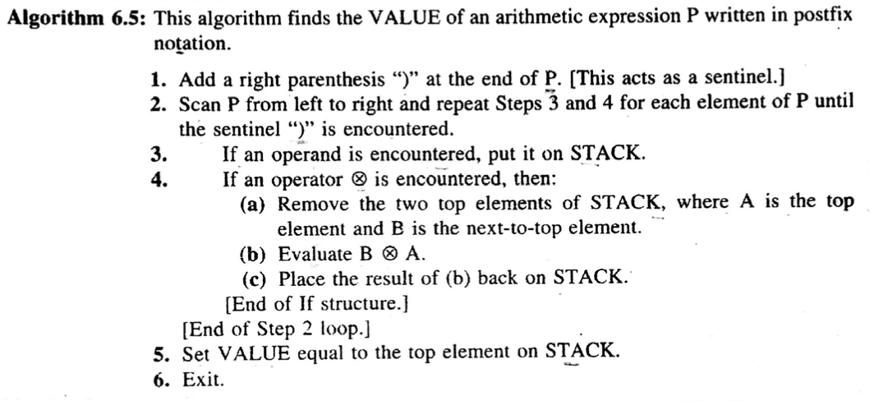
Arithmetic Expression: Polish Notation
Arrays, Records and Pointers

Slide 36
END
Arrays, Records and Pointers

