Slide 1
Recursion
Instructors:
Md Nazrul Islam Mondal
Department of Computer Science & Engineering
Rajshahi University of Engineering & Technology Rajshahi-6204

Slide 2
Outline
Recursion
  Definition
  Factorial Function and Procedure
  Fibonacci Sequence
  Divide-and-conquer Algorithm (definition and example)
  Ackermann Function and Procedure
  Tower of Hanoi
Arrays, Records and Pointers

Slide 3
Recursion
Rizoan Toufiq, Assistant Prof., CSE, RUET
Arrays, Records and Pointers

Slide 4
Recursion
Recursive Procedure –
  A procedure contains either a Call statement to itself or a Call statement to a second procedure that may eventually result in a Call statement back to the original procedure.
  It must have to properties –
    There must be certain criteria, call base criteria, for which the procedure does not call itself.
    Each time the procedure does call itself (directly or indirectly), it must be closer to the base criteria.
  A recursive procedure with these two properties is said to be well-defined.
Base Criteria
Arrays, Records and Pointers

Slide 5
Recursion
Recursive function –
  The function definition refers to itself and have the following two properties
    There must be certain argument, call base values, for which the function does not refer itself.
    Each time the function does refer to itself, the argument of the function must be closer to the base value.
  A recursive function with these two properties is also said to be well-defined
Arrays, Records and Pointers

Slide 6
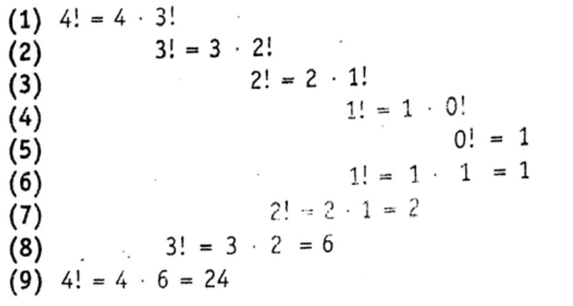
Recursion Function
(Example: Factorial function)
Definition:
  If n = 0, then n! = 1
  If n>0, then n! = n.(n-1)!
Example:
Arrays, Records and Pointers

Slide 7
Recursion Using STACK
Example:
4! = 4 x 3 x 2 x 1
Postfix: 4 3 2 1 x x x
Left to Right Scan (postfix)
PUSH 4
PUSH 3
PUSH 2
PUSH 1
POP ….
STACK
1 2 3 4
Arrays, Records and Pointers

Slide 8
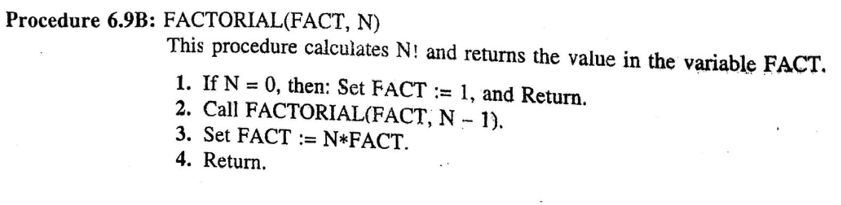
Recursion Procedure
(Example: Factorial Procedure)
STACK
FACTORIAL(FACT,1)
FACTORIAL(FACT,2)
FACTORIAL(FACT,3)
MAIN()
FACTORIAL(FACT, 3)
  FACTORIAL(FACT, 2)
    FACTORIAL(FACT, 1)
      FACTORIAL(FACT, 0)
    FACT := 1 (POP)
  FACT := 1*2 = 2 (POP)
FACT:= 2*3 = 6 (POP)
Arrays, Records and Pointers

Slide 9
Recursion Function
(Example: Fibonacci Sequence)
Definition:
  If n = 0 or n =1, then F_{n} = n
  If n>0, then F_{n} = F_{n-1} +F_{n-2}
Example:
  F₃ = F₂ +F₁
    F₁ = 1
    F₂ = F₁ +F₀
      F₁ = 1
      F₀ = 0
    F₂ = 1
  F₃ = 1+ 1 = 2
Arrays, Records and Pointers

Slide 10
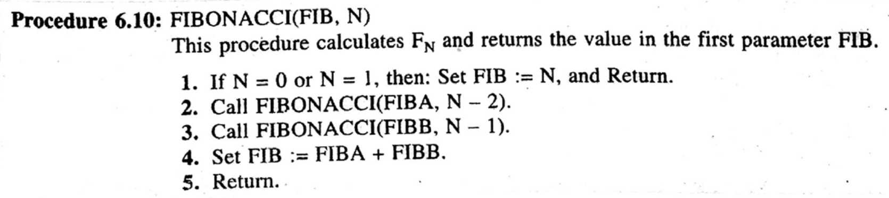
Recursion Procedure
(Example: Fibonacci Procedure)
Arrays, Records and Pointers

Slide 11
Recursion Procedure
(Example: Fibonacci Procedure)
FIBONACCI(FIB, 3)
  FIBONACCI(FIBA, 1)
  FIBA = 1, (POP)
  FIBONACCI(FIBB, 2)
    FIBONACCI(FIBA,0)
    FIBA = 0 (POP)
    FIBNACCI(FIBB,1)
    FIB = 1 (POP)
    FIB = 1+0 = 1
  FIBB = 1
FIB = 1+1 = 2
STACK
FIBONACCI(FIBA,1)
FIBONACCI(FIB,3)
MAIN()
STACK
FIBONACCI(FIBB,1)
FIBONACCI(FIBA,0)
FIBONACCI(FIBB,2)
FIBONACCI(FIB,3)
MAIN()
Arrays, Records and Pointers

Slide 12
Recursion
(Divide-and-Conquer Algorithm)
Consider a problem associated with a set S.
Definition:
  Partitions S into smaller sets such that the solution of the problem P for S is reduced to the solution of P for one or more of the smaller sets.
Example: Binary Search, Merge sort, Quick sort
Arrays, Records and Pointers

Slide 13
Recursion
(Ackermann Function)
Definition:
  If m = 0, then A(m, n) = n+1
  If m ≠ 0 but n =0, then A(m, n) = A(m-1, 1)
  IF m ≠ 0 and n ≠ 0, then A(m, n) = A(m-1, A(m, n-1))
The base criteria are the pairs
    (0, 0), (0, 1), (0, 2), (0, 3) . . ., (0, n) . . .
A(1,3) = ?
Arrays, Records and Pointers

Slide 14
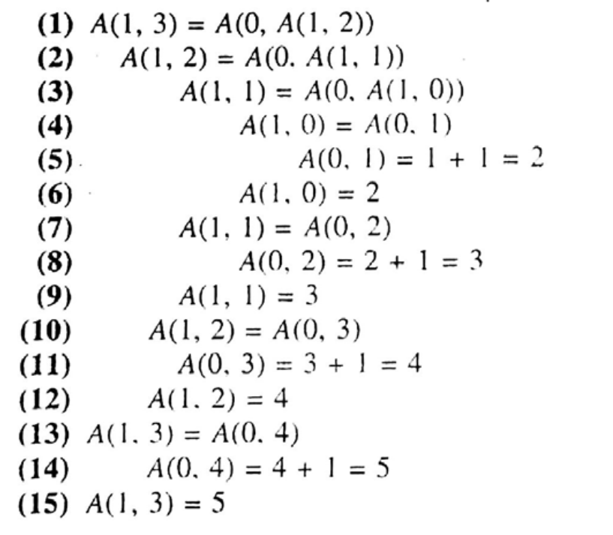
Recursion
(Ackermann Function)
Arrays, Records and Pointers

Slide 15
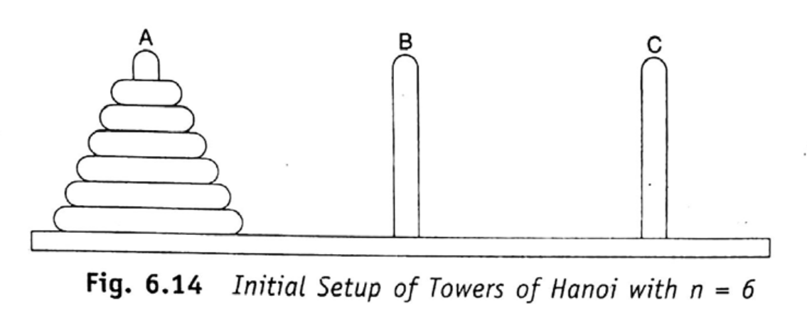
Recursion
(Tower of Hanoi)
The rules of the game are as follows:
  Only one disk may be moved at a time (specially, only the top disk on any peg may be moved to any other peg)
  At no time can a larger disk be paced on a smaller disk.
Arrays, Records and Pointers

Slide 16
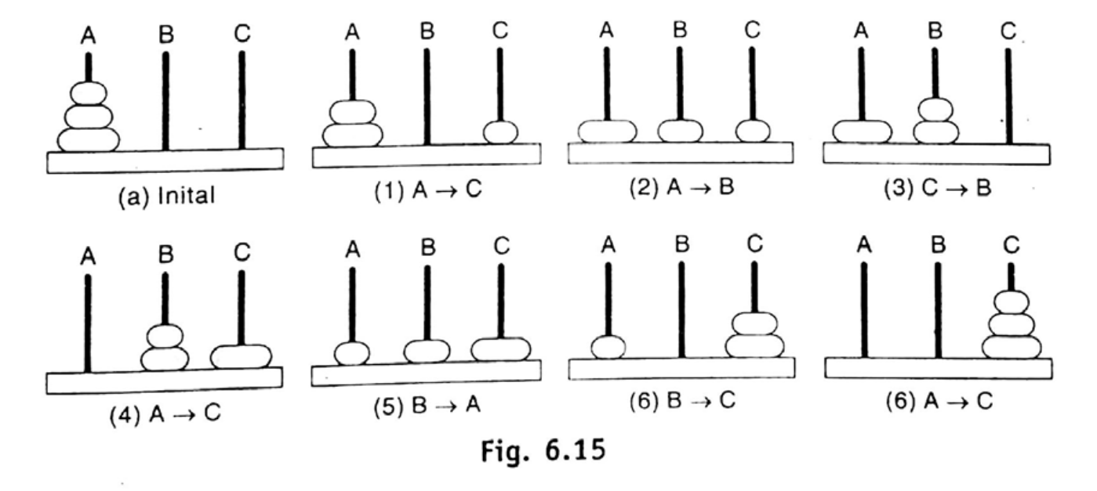
Recursion
(Tower of Hanoi)
Arrays, Records and Pointers

Slide 17
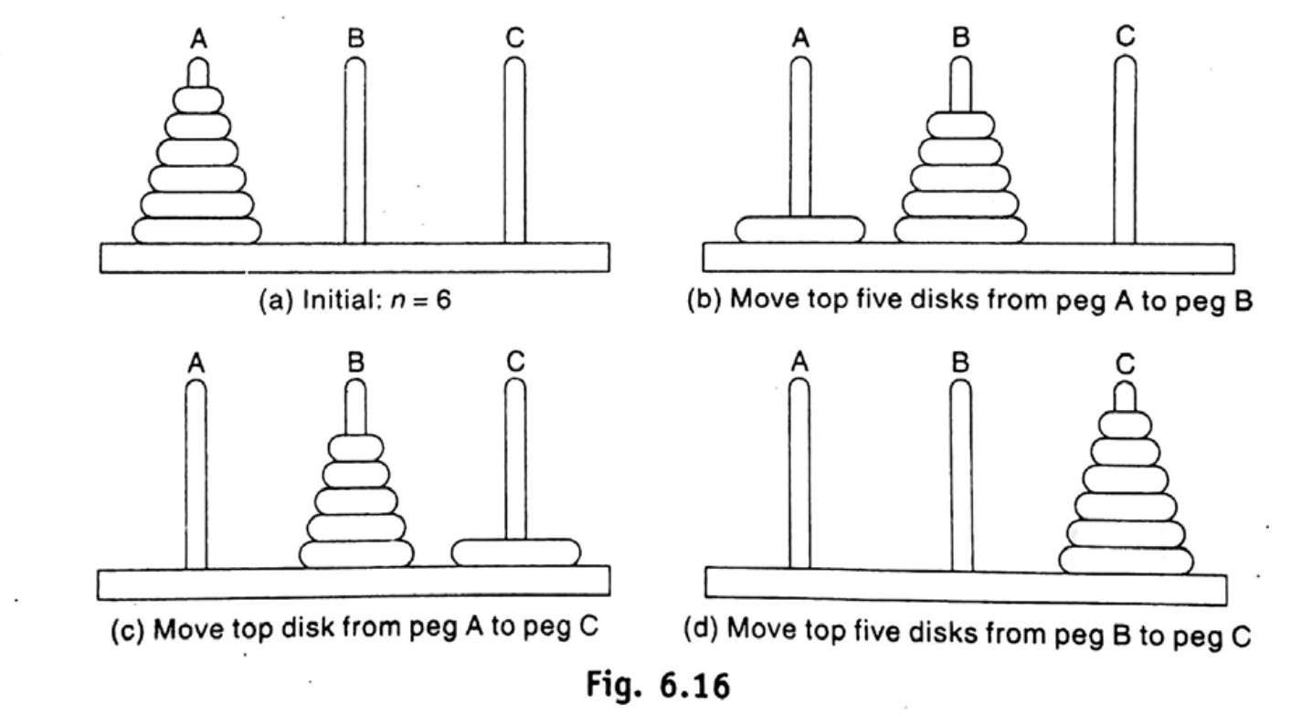
Recursion
(Tower of Hanoi)
Arrays, Records and Pointers

Slide 18
Recursion
(Tower of Hanoi)
General Notation:
      TOWER(N, BEG, AUX, END)
TOWER(N,A,B,C)
Arrays, Records and Pointers

Slide 19
Recursion
(Tower of Hanoi)
TOWER (1, A, B, C) means A→ C
Arrays, Records and Pointers

Slide 20
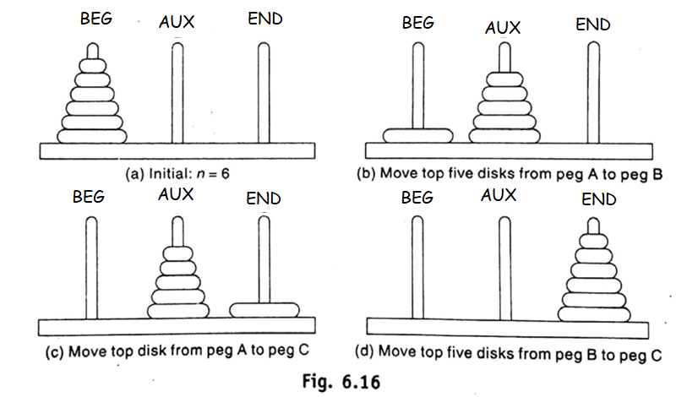
Recursion
(Tower of Hanoi)
TOWER(N, BEG,AUX,END)
TOWER(N-1, BEG,END,AUX)
TOWER(1, BEG,AUX,END)
TOWER(N-1, AUX,BEG,END)
Arrays, Records and Pointers

Slide 21
Recursion
(Tower of Hanoi)
TOWER (4, A, B, C) - Recursive Call
TOWER (4, A, B, C)
  TOWER(3, A, C, B) TOWER(1, A, B, C) or A→C TOWER(3, B,A,C)
  TOWER(2, A, B, C) TOWER(1, A,C,B) TOWER( 2, C, A, B)
  or A →B
  TOWER(1, A, C,B) TOWER(1, A,B,C) TOWER(1, B, A, C)
  or A →B or A→C or B→C
Arrays, Records and Pointers

Slide 22
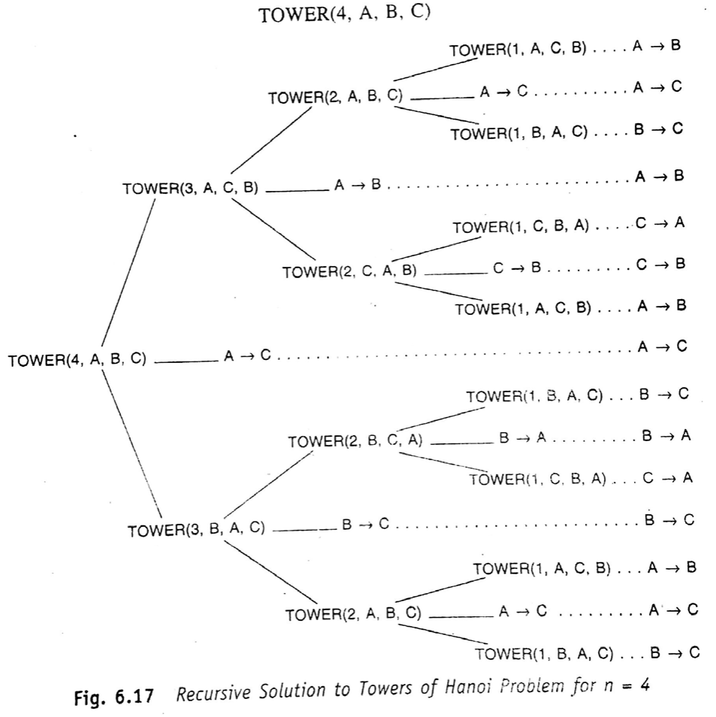
Recursion
(Tower of Hanoi)
Arrays, Records and Pointers

Slide 23
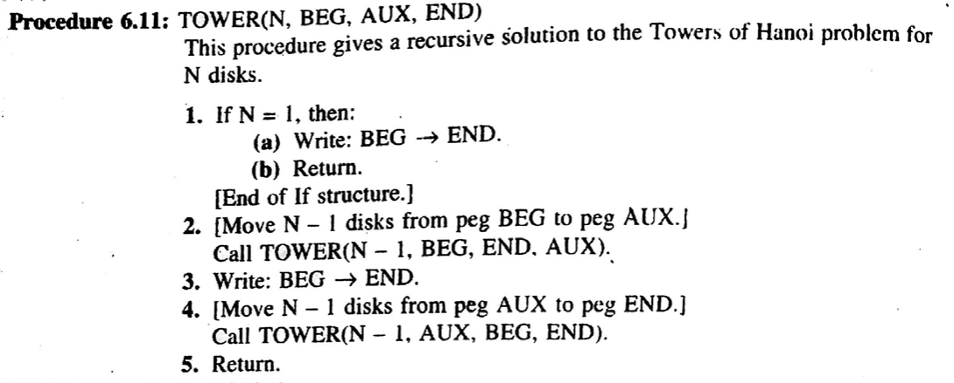
Recursion
(Tower of Hanoi)
Arrays, Records and Pointers

Slide 24
Recursion
(Tower of Hanoi)
Is it divide-and-conquer algorithm?
  Yes, the solution for n disk is reduced to a solution for n-1 disks and a solution for n = 1 disk.
Nonrecursive Procedure (See Book and try yourself, our objective is to learn recursion)
Rizoan Toufiq, Assistant Prof., CSE, RUET
Arrays, Records and Pointers

Slide 25
Any Query?
Arrays, Records and Pointers

