Slide 1
Tree
Instructors:
Md Nazrul Islam Mondal &
Rizoan Toufiq
Department of Computer Science & Engineering
Rajshahi University of Engineering & Technology Rajshahi-6204

Slide 2
Outline
Binary Tree
Representing Binary Trees in Memory
Traversing Binary Trees
Traversal Algorithm using Stacks
Header Nodes: Threads
Binary Search Trees
Searching and Inserting in Binary Search Trees
Deleting in Binary Search Tree
AVL Search Trees
Insertion in an AVL Search Tree
Deletion in an AVL Search Tree
m-way Search Trees
Searching, Insertion and Deletion in an m-way Search Tree
B Trees
Searching, Insertion and Deletion in a B-tree
Rizoan Toufiq, Assistant Prof., CSE, RUET
Arrays, Records and Pointers

Slide 3
Header Nodes: Threads
Rizoan Toufiq, Assistant Prof., CSE, RUET
Arrays, Records and Pointers

Slide 4
Header Nodes: Threads
Approximately half of the entries in the pointer fields LEFT and RIGHT will contain null element.
We will replace certain null entries by special pointers which point to nodes higher in the tree.
These special pointers are called threads.
Binary trees with such pointers are called threaded trees.
Rizoan Toufiq, Assistant Prof., CSE, RUET
Arrays, Records and Pointers

Slide 5
Header Nodes: Threads
There are many ways to thread a binary tree T.
We will discuss about –
  One-way threading
  Two-way threading
Rizoan Toufiq, Assistant Prof., CSE, RUET
Arrays, Records and Pointers

Slide 6
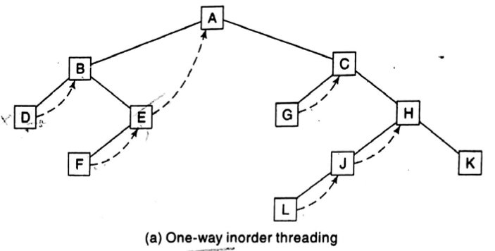
Header Nodes: Threads
One-way Threading –
  A thread will appear in the right field of a node and
  Will point to the next node in the inorder traversal of T
Inorder traverse:
  DBFEAGCLJHK
D uses right pointer to point B
Right pointer of F points to E
Right Pointer of E points to A
Similarly for G J and L
Rizoan Toufiq, Assistant Prof., CSE, RUET
Arrays, Records and Pointers

Slide 7
Header Nodes: Threads
Two-way Threading –
  A thread will appear in the right field of a node and
  Will point to the next node in the inorder traversal of T
  A thread also appear in the LEFT field of a node and
  Will point to the preceding node in the inorder traversal of T
Rizoan Toufiq, Assistant Prof., CSE, RUET
Arrays, Records and Pointers

Slide 8
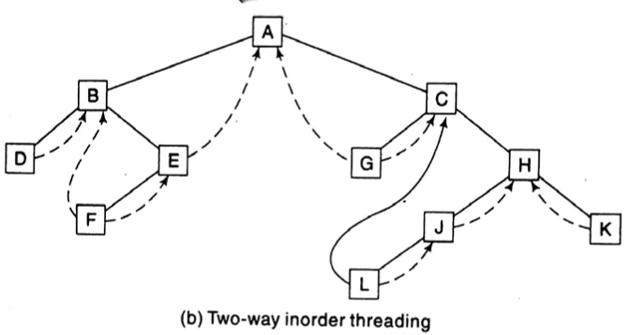
Header Nodes: Threads
  Inorder Traversal: DBFEAGCLJHK
Example:
  The left pointer of D cant use to point any node (No Preceding Node of D)
  The right pointer of D point to B node.
Rizoan Toufiq, Assistant Prof., CSE, RUET
Arrays, Records and Pointers

Slide 9
Header Nodes: Threads
  Inorder Traversal: DBFEAGCLJHK
Example:
  The left pointer of L point to C node (Preceding Node of D)
  The right pointer of L point to J node.
Rizoan Toufiq, Assistant Prof., CSE, RUET
Arrays, Records and Pointers

Slide 10
Header Nodes: Threads
  Inorder Traversal: DBFEAGCLJHK
Example:
  The left pointer of G point to A node (Preceding Node of D)
  The right pointer of G point to C node.
Rizoan Toufiq, Assistant Prof., CSE, RUET
Arrays, Records and Pointers

Slide 11
Header Nodes: Threads
Two-way Threading –
  A thread will appear in the right field of a node and
  Will point to the next node in the inorder traversal of T
  A thread also appear in the LEFT field of a node and
  Will point to the preceding node in the inorder traversal of T
  The left pointer of first node and the right pointer of last node (inorder traversal of T) will contain the null value when T does not have a header node,
  But The left pointer of first node and the right pointer of last node (inorder traversal of T) will pointer to the header node when T does have a header node.
Rizoan Toufiq, Assistant Prof., CSE, RUET
Arrays, Records and Pointers

Slide 12
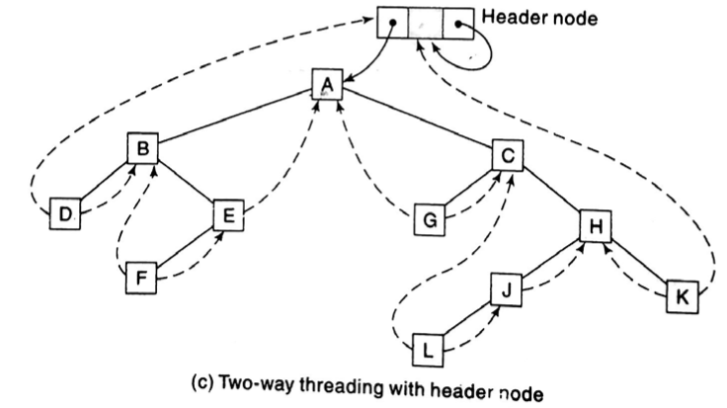
Header Nodes: Threads
The left pointer of first node D is point to header node
The right pointer of last node K is point to header node.
Rizoan Toufiq, Assistant Prof., CSE, RUET
Arrays, Records and Pointers

Slide 13
Binary Search Trees
Rizoan Toufiq, Assistant Prof., CSE, RUET
Arrays, Records and Pointers

Slide 14
Binary Search Trees
A tree T is called a binary search tree (or binary sorted tree) if each node N of T has the following property:
  The value at N is greater than every value in the left subtree of N
  The value at N is less than or equal to every value in the right subtree of N
Traverse inorder to find a sorted list of the elements of T.
Rizoan Toufiq, Assistant Prof., CSE, RUET
Arrays, Records and Pointers

Slide 15
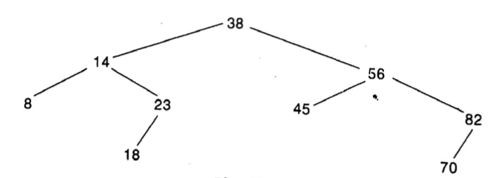
Binary Search Trees
A binary search Tree
Inorder Traversal: 8 14 18 23 38 45 56 70 82
Rizoan Toufiq, Assistant Prof., CSE, RUET
Arrays, Records and Pointers

Slide 16
Searching and Inserting in Binary Search Trees
Rizoan Toufiq, Assistant Prof., CSE, RUET
Arrays, Records and Pointers

Slide 17
Searching and Inserting in Binary Search Trees
Objective:
  An ITEM of information is given.
  Find the location of ITEM in the binary search tree T
  If ITEM is not found, insert ITEM as a new node in its appropriate place in the tree.
Rizoan Toufiq, Assistant Prof., CSE, RUET
Arrays, Records and Pointers

Slide 18
Searching and Inserting in Binary Search Trees
Given ITEM = 20.
LOC ← Location of ITEM
PAR ← Parent node of the ITEM
Rizoan Toufiq, Assistant Prof., CSE, RUET
Arrays, Records and Pointers

Slide 19
Searching and Inserting in Binary Search Trees
Condition -1 :
Condition -2 :
If ROOT ← NULL
  LOC ← NULL
  PAR ← NULL
If INFO[ROOT]=ITEM
  LOC ← ROOT
  PAR ← NULL
Rizoan Toufiq, Assistant Prof., CSE, RUET
Arrays, Records and Pointers

Slide 20
Searching and Inserting in Binary Search Trees
Traversing Pointer:
  PTR ← point current node
  SAVE ← Parent of current node
Rizoan Toufiq, Assistant Prof., CSE, RUET
Arrays, Records and Pointers

Slide 21
Searching and Inserting in Binary Search Trees
ITEM←20
Condition – 3
  If ITEM<INFO[ROOT]
    [search Left subtree] PTR←LEFT[ROOT], SAVE←ROOT
  Else
    [search Right subtree] PTR←RIGHT[ROOT], SAVE←ROOT
Rizoan Toufiq, Assistant Prof., CSE, RUET
Arrays, Records and Pointers

Slide 22
Searching and Inserting in Binary Search Trees
SAVE
ROOT
ITEM←20
PTR
Condition – 3
  ITEM = 20 <ROOT so PTR← LEFT[ROOT], SAVE← ROOT
Rizoan Toufiq, Assistant Prof., CSE, RUET
Arrays, Records and Pointers

Slide 23
Searching and Inserting in Binary Search Trees
SAVE
ROOT
ITEM←20
PTR
Loop -1: Until PTR ≠NULL
  IF INFO[PTR] = ITEM, LOC←PTR, PAR←SAVE, BREAK
  IF ITEM<INFO[PTR], [Search Left subtree], PTR←LEFT[PTR]
  Else [Search right subtree], PTR←RIGHT[PTR]
  SAVE←PTR
Rizoan Toufiq, Assistant Prof., CSE, RUET
Arrays, Records and Pointers

Slide 24
Searching and Inserting in Binary Search Trees
SAVE
ROOT
ITEM←20
PTR
Loop -1: Until PTR ≠NULL
  ITEM>INFO[PTR], PTR←RIGHT[PTR]
  SAVE←PTR
Rizoan Toufiq, Assistant Prof., CSE, RUET
Arrays, Records and Pointers

Slide 25
Searching and Inserting in Binary Search Trees
ROOT
ITEM←20
SAVE
PTR
Loop -1: Until PTR ≠NULL
  ITEM<INFO[PTR], PTR←LEFT[PTR]
  SAVE←PTR
Rizoan Toufiq, Assistant Prof., CSE, RUET
Arrays, Records and Pointers

Slide 26
Searching and Inserting in Binary Search Trees
ROOT
ITEM←20
SAVE
PTR
NULL
Loop -1: Until PTR ≠NULL
  ITEM>INFO[PTR], PTR←RIGHT[PTR]
  SAVE←PTR
  PTR=NULL, BREAK
Rizoan Toufiq, Assistant Prof., CSE, RUET
Arrays, Records and Pointers

Slide 27
Searching and Inserting in Binary Search Trees
ROOT
ITEM←20
PAR
LOC
NULL
Since [Search Unsuccessful] PTR = NULL,
    LOC←NULL, PAR←SAVE
Rizoan Toufiq, Assistant Prof., CSE, RUET
Arrays, Records and Pointers

Slide 28
Searching and Inserting in Binary Search Trees
ROOT
ITEM←20
PAR
LOC
NULL
Insertion Step:
  If [Successful, No insertion] LOC ≠ NULL, Exit
Rizoan Toufiq, Assistant Prof., CSE, RUET
Arrays, Records and Pointers

Slide 29
Searching and Inserting in Binary Search Trees
ROOT
ITEM←20
PAR
LOC
NULL
New
\0 | ITEM | \0
Insertion Step:
  If AVAIL = NULL, Print Overflow
  NEW← AVAIL
  AVAIL← LEFT[AVAIL]
  INFO[NEW]←ITEM, LEFT[NEW]←NULL, RIGHT[NEW]←NULL
Rizoan Toufiq, Assistant Prof., CSE, RUET
Arrays, Records and Pointers

Slide 30
Searching and Inserting in Binary Search Trees
ROOT
ITEM←20
PAR
LOC
NULL
New
\0 | ITEM | \0
Insertion Step:
  If PAR=NULL
    [Empty Tree] ROOT←NEW
Rizoan Toufiq, Assistant Prof., CSE, RUET
Arrays, Records and Pointers

Slide 31
Searching and Inserting in Binary Search Trees
ROOT
ITEM←20
PAR
LOC
NULL
New
\0 | ITEM | \0
Insertion Step:
  If ITEM<INFO[PAR]
    [Left Child of PAR] LEFT[PAR]←NEW
Rizoan Toufiq, Assistant Prof., CSE, RUET
Arrays, Records and Pointers

Slide 32
Searching and Inserting in Binary Search Trees
ROOT
ITEM←20
PAR
LOC
NULL
New
\0 | ITEM | \0
Insertion Step:
  If ITEM≥INFO[PAR]
    [ Right Child of PAR] RIGHT[PAR]←NEW
  20>18, So add new node as right node of PAR
Rizoan Toufiq, Assistant Prof., CSE, RUET
Arrays, Records and Pointers

Slide 33
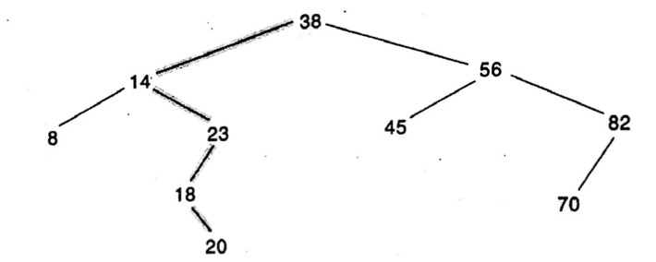
Searching and Inserting in Binary Search Trees
ROOT
PAR
LOC
NULL
Rizoan Toufiq, Assistant Prof., CSE, RUET
Arrays, Records and Pointers

Slide 34
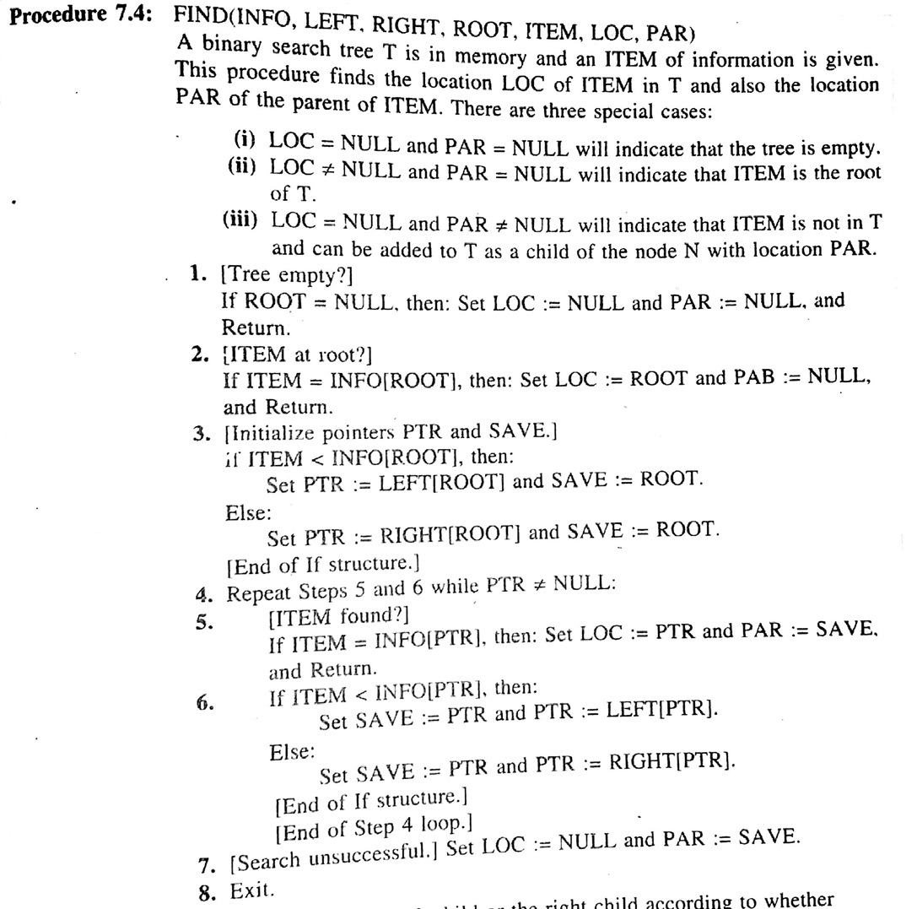
Searching and Inserting in Binary Search Trees
Rizoan Toufiq, Assistant Prof., CSE, RUET
Arrays, Records and Pointers

Slide 35
Searching and Inserting in Binary Search Trees
Rizoan Toufiq, Assistant Prof., CSE, RUET
Arrays, Records and Pointers

Slide 36
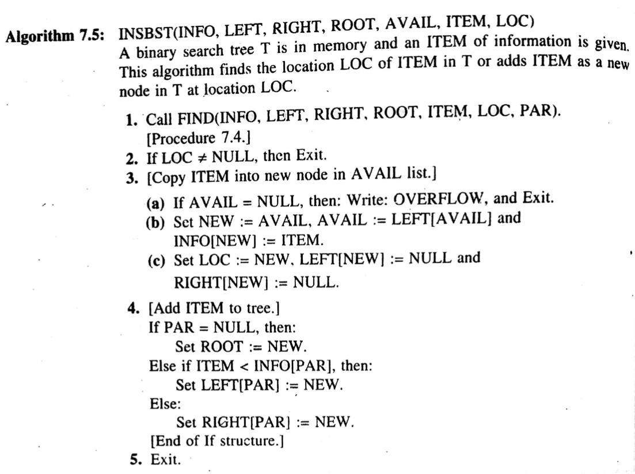
Searching and Inserting in Binary Search Trees
Rizoan Toufiq, Assistant Prof., CSE, RUET
Arrays, Records and Pointers

Slide 37
Searching and Inserting in Binary Search Trees
Complexity of searching: O(log₂n)
Rizoan Toufiq, Assistant Prof., CSE, RUET
Arrays, Records and Pointers

Slide 38
Searching and Inserting in Binary Search Trees
Application:
  Want to find and delete all duplicates in the collection
  Suppose we have
  Observe that the first four numbers (14, 10, 17, 12) are not deleted (check: 0+1+2+3).
  10 is deleted (check: 2 times)
  11 is not deleted (Check: 4)
  20 is not deleted (Check: 5) and To be continue this process
  Final result: 14 10 17 12 11 20 18 25 8 22 23
  Complexity: O(n²)
Rizoan Toufiq, Assistant Prof., CSE, RUET
Arrays, Records and Pointers

Slide 39
Searching and Inserting in Binary Search Trees
Application:
  We can solve this problem using binary search tree effeciently.
  Complexity: O(nlog₂n)
Rizoan Toufiq, Assistant Prof., CSE, RUET
Arrays, Records and Pointers

Slide 40
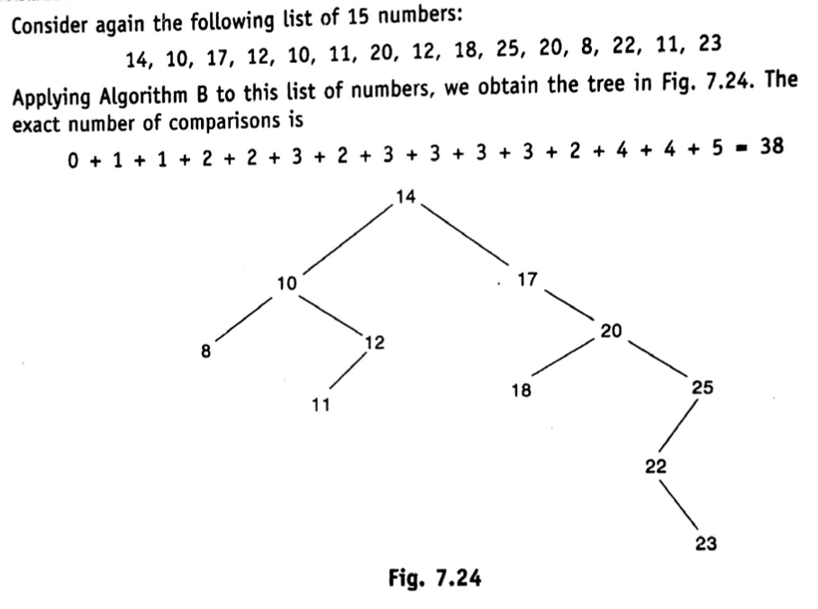
Searching and Inserting in Binary Search Trees
Rizoan Toufiq, Assistant Prof., CSE, RUET
Arrays, Records and Pointers

Slide 41
Deleting in Binary Search Tree
Rizoan Toufiq, Assistant Prof., CSE, RUET
Arrays, Records and Pointers

Slide 42
Deleting in Binary Search Tree
Find the location of node N which contains ITEM (Discuss Previous slid)
The location of the parent node P(N)
The way N is deleted from the tree depends on the number of children of node N.
These are three cases:
  N has no children.
    Then N is deleted from T by simply replacing the location of N in the parent node P(N) by the null pointer
Rizoan Toufiq, Assistant Prof., CSE, RUET
Arrays, Records and Pointers

Slide 43
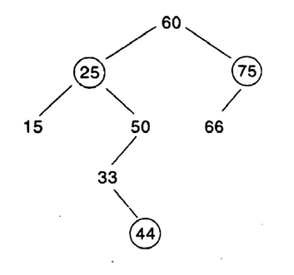
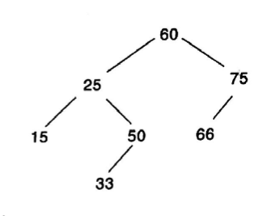
Deleting in Binary Search Tree
These are three cases:
  N has no children. Then N is deleted from T by simply replacing the location of N in the parent node P(N) by the null pointer
Rizoan Toufiq, Assistant Prof., CSE, RUET
Arrays, Records and Pointers

Slide 44
Deleting in Binary Search Tree
These are three cases:
  N has no children. Then N is deleted from T by simply replacing the location of N in the parent node P(N) by the null pointer
  N has exactly one child.
    The N is deleted from T by simply replacing the location N in P(N) by the location of the only child of N.
Rizoan Toufiq, Assistant Prof., CSE, RUET
Arrays, Records and Pointers

Slide 45
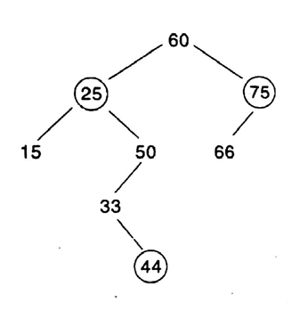
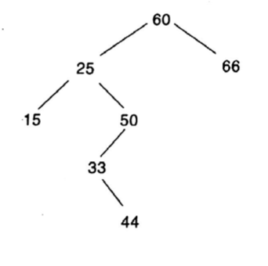
Deleting in Binary Search Tree
Rizoan Toufiq, Assistant Prof., CSE, RUET
Arrays, Records and Pointers

Slide 46
Deleting in Binary Search Tree
These are three cases:
  N has no children. Then N is deleted from T by simply replacing the location of N in the parent node P(N) by the null pointer
  N has exactly one child. The N is deleted from T by simply replacing the location N in P(N) by the location of the only child of N.
  N has two children.
    Let S(N) denote the inorder successor of N
    Delete S(N) using Case (a) or Case (b)
    Replacing node N in T by the node S(N),
Rizoan Toufiq, Assistant Prof., CSE, RUET
Arrays, Records and Pointers

Slide 47
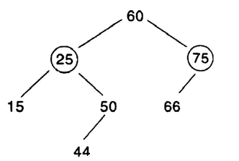
Deleting in Binary Search Tree
15 and 50 are two children of 25
Inorder Successor of 25: 33
  15 25 33 44 50 60 66 75
Delete 33 as Case (b)
Rizoan Toufiq, Assistant Prof., CSE, RUET
Arrays, Records and Pointers

Slide 48
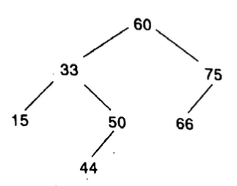
Deleting in Binary Search Tree
15 and 50 are two children of 25
Inorder Successor of 25: 33
  15 25 33 44 50 60 66 75
Delete 33 as Case (b)
Replacing 25 by 33
Rizoan Toufiq, Assistant Prof., CSE, RUET
Arrays, Records and Pointers

Slide 49
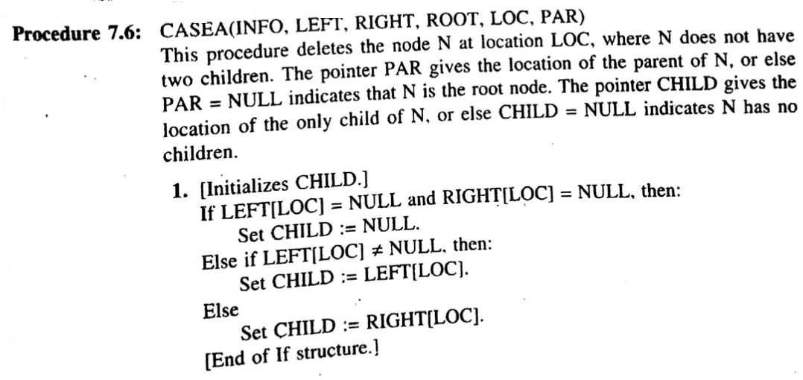
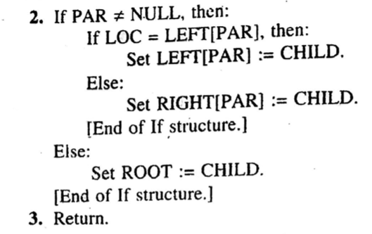
Deleting in Binary Search Tree
CASE A and CASE B
Rizoan Toufiq, Assistant Prof., CSE, RUET
Arrays, Records and Pointers

Slide 50
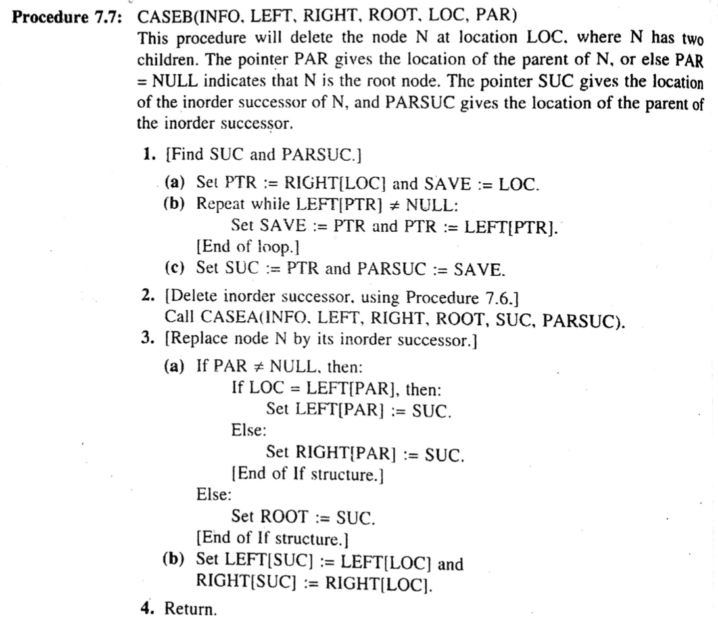
Deleting in Binary Search Tree
CASE C
Rizoan Toufiq, Assistant Prof., CSE, RUET
Arrays, Records and Pointers

Slide 51
Deleting in Binary Search Tree
CASE C
Rizoan Toufiq, Assistant Prof., CSE, RUET
Arrays, Records and Pointers

Slide 52
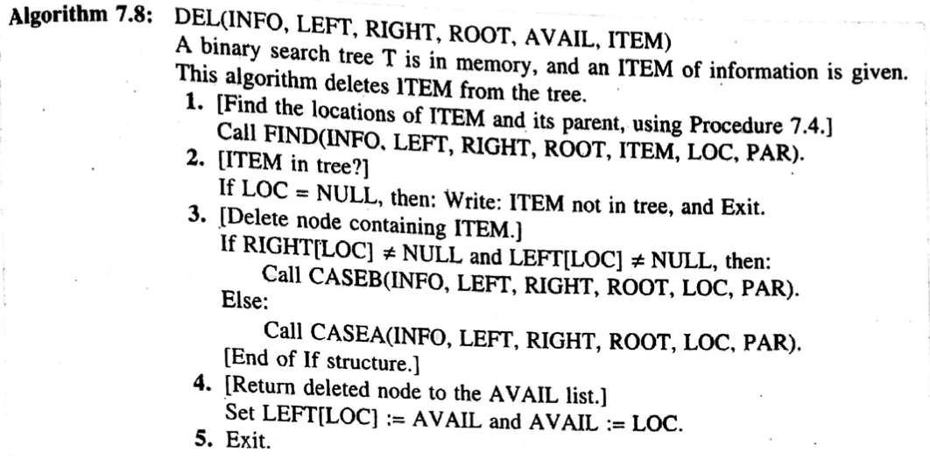
Deleting in Binary Search Tree
Rizoan Toufiq, Assistant Prof., CSE, RUET
Arrays, Records and Pointers

Slide 53
Any Query?
Rizoan Toufiq, Assistant Prof., CSE, RUET
Arrays, Records and Pointers

