Slide 1
Tree
Instructors:
Md Nazrul Islam Mondal &
Rizoan Toufiq
Department of Computer Science & Engineering
Rajshahi University of Engineering & Technology Rajshahi-6204

Slide 2
Outline
Binary Tree
Representing Binary Trees in Memory
Traversing Binary Trees
Traversal Algorithm using Stacks
Header Nodes: Threads
Binary Search Trees
Searching and Inserting in Binary Search Trees
Deleting in Binary Search Tree
AVL Search Trees
Insertion in an AVL Search Tree
Deletion in an AVL Search Tree
m-way Search Trees
Searching, Insertion and Deletion in an m-way Search Tree
B Trees
Searching, Insertion and Deletion in a B-tree
Arrays, Records and Pointers

Slide 3
AVL Search Trees
Arrays, Records and Pointers

Slide 4
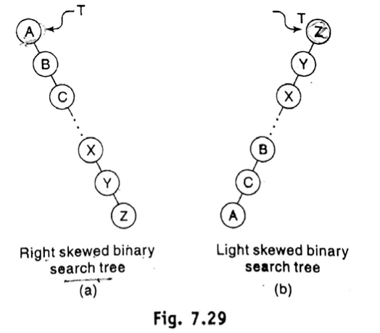
AVL Search Trees
Right Skewed Binary Search Tree
Left Skewed Binary Search Tree
Arrays, Records and Pointers

Slide 5
AVL Search Trees
Disadvantage: Worst case time complexity of a search is O(n).
Solution: Maintain the binary search tree to be of balanced height.
Popular balanced trees was introduced in 1962 by Adelson,Velskii and Landis and was known ad AVL tree.
Arrays, Records and Pointers

Slide 6
AVL Search Trees
Definition:
  An Empty binary tree is an AVL Tree.
  A non empty binary tree T is an AVL tree if and only if (iff)
    Given T^{L} and T^{R} to be the left and right subtrees of T
    h(T^{L}) and h(T^{R}) to be the heights of subtrees T^{L} and T^{R} respectively
    T^{L} and T^{R} are AVL trees and |h(T^{L})-h(T^{R})|≤1
  h(T^{L})-h(T^{R}) is known as the balance factor (BF)
  For an AVL tree, the balance factor of a node can be either 0, 1 or -1
  An AVL search tree is a binary search tree which is an AVL tree.
Arrays, Records and Pointers

Slide 7
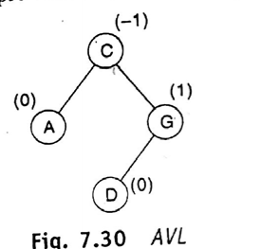
AVL Search Trees
(Representation)
AVL search tree like binary search trees are represented using a linked representation.
Balance Factor of D
  h(T^{L})-h(T^{R}) = 0-0 = 0
Balance Factor of G
  h(T^{L})-h(T^{R}) = 1-0 = 1
Balance Factor of A
    h(T^{L})-h(T^{R}) = 0-0 = 0
Balance Factor of C
  h(T^{L})-h(T^{R}) = 1-2 = -1
Arrays, Records and Pointers

Slide 8
AVL Search Trees
(Searching)
Similar to the method used in a binary search tree.
Arrays, Records and Pointers

Slide 9
Insertion in an AVL Search Tree
Arrays, Records and Pointers

Slide 10
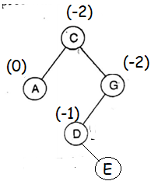
Insertion in an AVL Search Tree
First Phase: Insert an element into AVL binary search tree
Second Phase: The balance factor of any node in the tree is affected, we resort to techniques called Rotation to resort the balance of the search tree.
Example: If we insert E node -
BF(C)=-2
Arrays, Records and Pointers

Slide 11
Insertion in an AVL Search Tree
To perform rotation, it is necessary to identify node A whose BF(A) is either 0, 1 or -1 and which is the nearest ancestor to the inserted node on the path from the inserted node to the root.
The rebalancing rotations are classified as LL, LR, RR and RL based on the position of the inserted node with reference to A
  LL rotation: Insert node is in the left subtree of the left subtree of node A
  RR rotation: Insert node is in the right subtree of the right subtree of node A
  LR rotation: Insert node is in the right subtree of the left subtree of node A
  RL rotation: Insert node is in the left subtree of the right subtree of node A.
Arrays, Records and Pointers

Slide 12
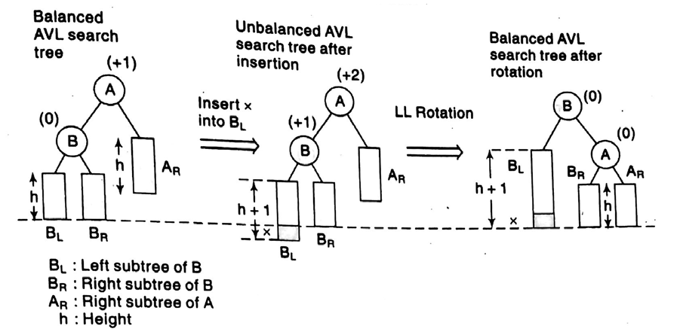
Insertion in an AVL Search Tree
(LL Rotation)
Arrays, Records and Pointers

Slide 13
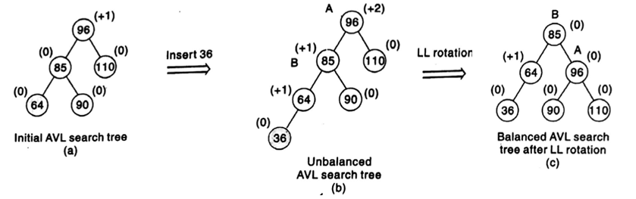
Insertion in an AVL Search Tree
(LL Rotation)
Arrays, Records and Pointers

Slide 14
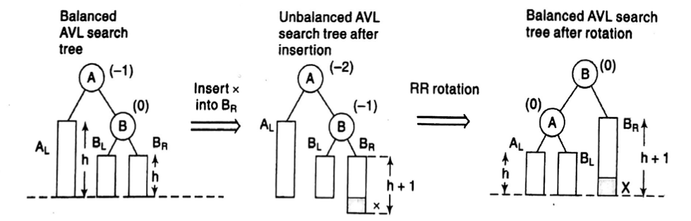
Insertion in an AVL Search Tree
(RR Rotation)
Arrays, Records and Pointers

Slide 15
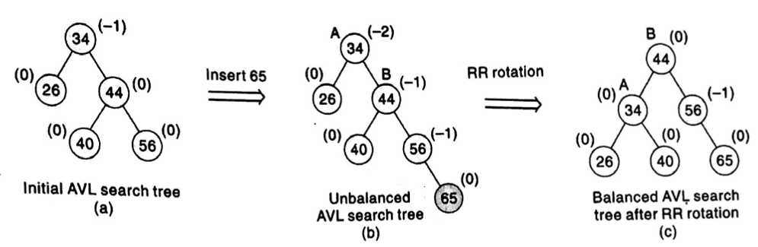
Insertion in an AVL Search Tree
(RR Rotation)
Arrays, Records and Pointers

Slide 16
Insertion in an AVL Search Tree
(LR and RL Rotation)
The balancing Methodology of LR and RL rotations are similar in nature but are mirror images of one another.
Illustrates the balancing of an AVL search tree using LR rotation
Arrays, Records and Pointers

Slide 17
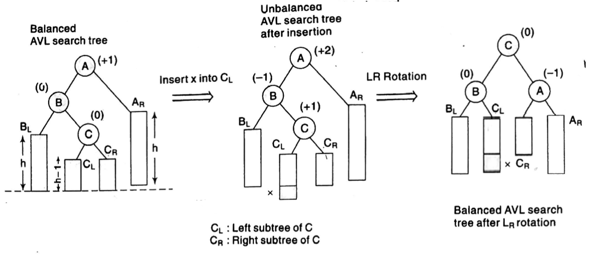
Insertion in an AVL Search Tree
(LR and RL Rotation)
Arrays, Records and Pointers

Slide 18
Insertion in an AVL Search Tree
(LR and RL Rotation)
In this case, the BF value of node A and B after balancing are dependent on the BF value of node C after insertion
  If BF(C) = 0 after insertion then BF(A) = BF(B)=0, after rotation
  If BF(C) = -1 after insertion then BF(A)=0, BF(B)=1, after rotation
  If BF(C)=1 after insertion then BF(A)=-1, BF(B)=0, after rotation (See Previous Slide)
LR and RL are known as double rotation since
  LR can be accomplished by RR followed by LL rotation(See Previous Slide)
  RL can be accomplished by LL followed by RR rotation
LL and RR are known as single rotation
Arrays, Records and Pointers

Slide 19
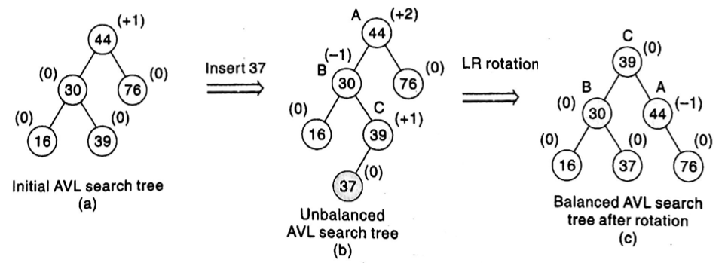
Insertion in an AVL Search Tree
(LR and RL Rotation)
Arrays, Records and Pointers

Slide 20
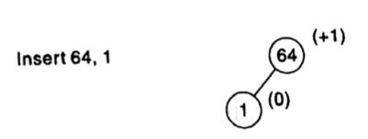
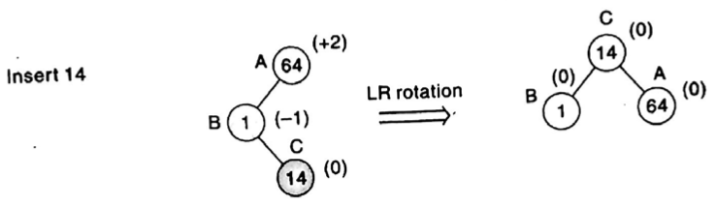
Insertion in an AVL Search Tree
(Example)
Example: Construct an AVL tree by inserting the following elements in the order of their occurrence.
64, 1, 44, 26, 13, 110, 98, 85
Arrays, Records and Pointers

Slide 21
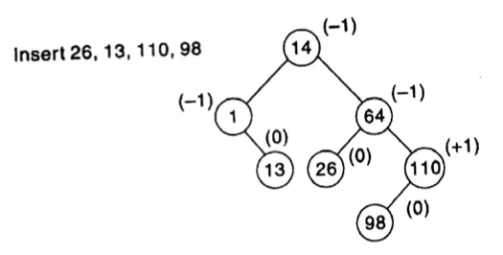
Insertion in an AVL Search Tree
(Example)
Example: Construct an AVL tree by inserting the following elements in the order of their occurrence.
64, 1, 44, 26, 13, 110, 98, 85
Arrays, Records and Pointers

Slide 22
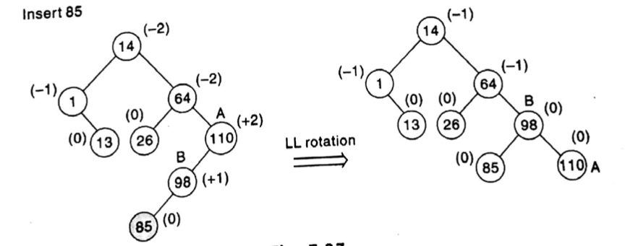
Insertion in an AVL Search Tree
(Example)
Example: Construct an AVL tree by inserting the following elements in the order of their occurrence.
64, 1, 44, 26, 13, 110, 98, 85
Arrays, Records and Pointers

Slide 23
Deletion in an AVL Search Tree
Arrays, Records and Pointers

Slide 24
Deletion in an AVL Search Tree
First Step: Delete an element from an AVL search tree likely as the procedure for deletion of an element in a binary search tree
Second Step: Imbalance occurs due to deletion, one or more rotation need to be applied to balance the AVL search tree.
Arrays, Records and Pointers

Slide 25
Deletion in an AVL Search Tree
Delete X node
A – the closest ancestor node on the path from X to the root node, with balance factor of +2 or -2.
L or R rotation required depending on whether the deletion occurred on the left or right subtree of A.
Arrays, Records and Pointers

Slide 26
Deletion in an AVL Search Tree
Now depending on the value of BF(B), B is the root of the left or right subtree of A, the R or L imbalance is further classified as R0, R1 and R-1 or L0, L1 and L-1.
The L rotation are the mirror image of three kinds of R rotation.
Arrays, Records and Pointers

Slide 27
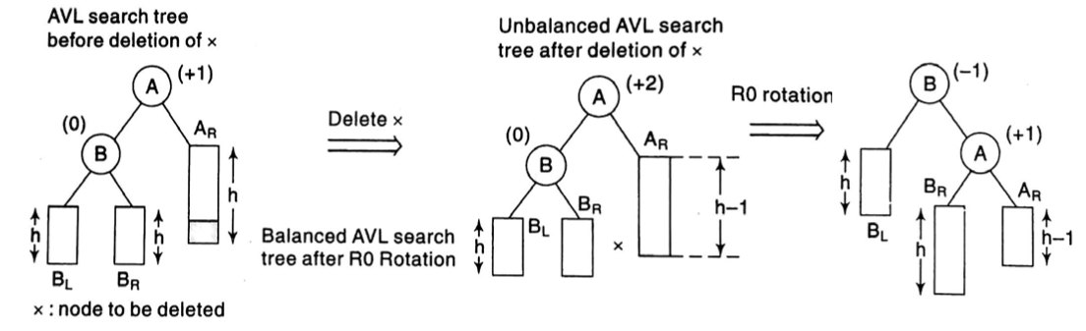
Deletion in an AVL Search Tree
(R0 rotation)
IF BF(B) = 0, R0 is executed
Arrays, Records and Pointers

Slide 28
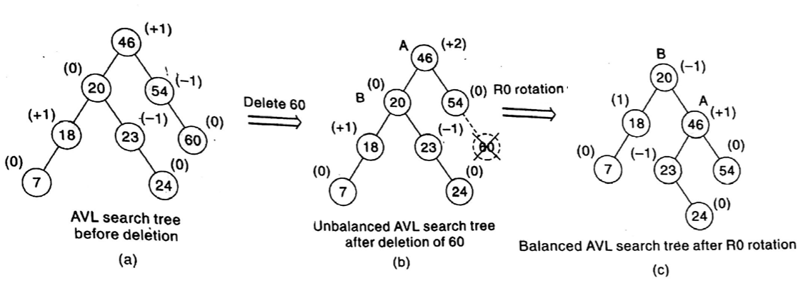
Deletion in an AVL Search Tree
(R0 rotation)
Arrays, Records and Pointers

Slide 29
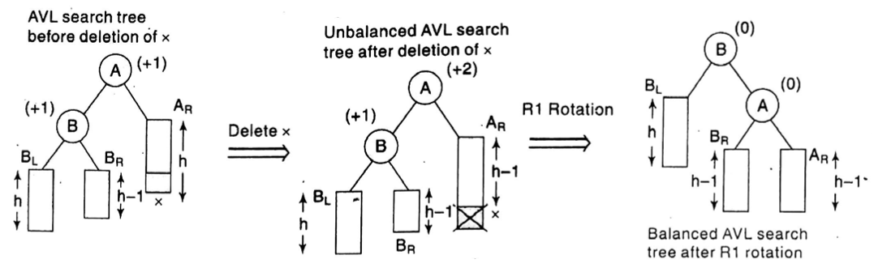
Deletion in an AVL Search Tree
(R1 rotation)
IF BF(B) = 1, R1 is executed
Arrays, Records and Pointers

Slide 30
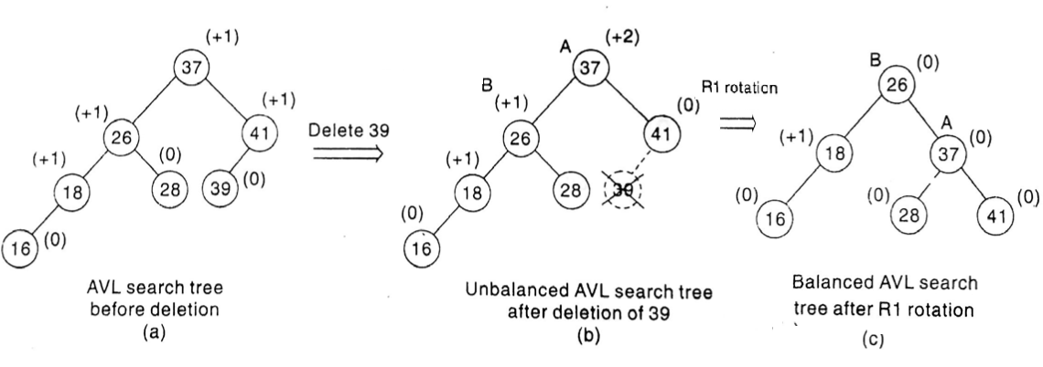
Deletion in an AVL Search Tree
(R1 rotation)
Arrays, Records and Pointers

Slide 31
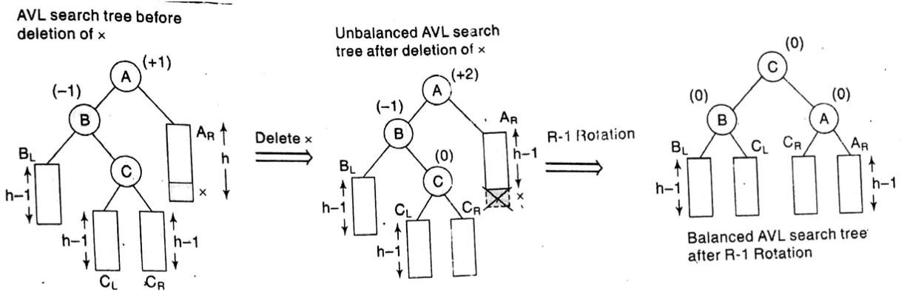
Deletion in an AVL Search Tree
(R-1 rotation)
IF BF(B) = -1, R-1 is executed
Arrays, Records and Pointers

Slide 32
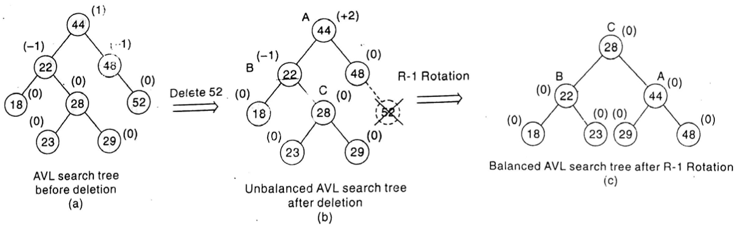
Deletion in an AVL Search Tree
(R-1 rotation)
Arrays, Records and Pointers

Slide 33
Any Query?
Arrays, Records and Pointers

