Slide 1
Tree
Instructors:
Md Nazrul Islam Mondal &
Rizoan Toufiq
Department of Computer Science & Engineering
Rajshahi University of Engineering & Technology Rajshahi-6204

Slide 2
Outline
Binary Tree
Representing Binary Trees in Memory
Traversing Binary Trees
Traversal Algorithm using Stacks
Header Nodes: Threads
Binary Search Trees
Searching and Inserting in Binary Search Trees
Deleting in Binary Search Tree
AVL Search Trees
Insertion in an AVL Search Tree
Deletion in an AVL Search Tree
m-way Search Trees
Searching, Insertion and Deletion in an m-way Search Tree
B Trees
Searching, Insertion and Deletion in a B-tree
Rizoan Toufiq, Assistant Prof., CSE, RUET
Arrays, Records and Pointers

Slide 3
m-way Search Trees
Rizoan Toufiq, Assistant Prof., CSE, RUET
Arrays, Records and Pointers

Slide 4
m-way Search Trees
Application: File Indexing
Goal: to minimize the accesses while retrieving a key from a file
Height of n elements:
  Minimum Height: logm(n+1)
  Maximum Height: n
B trees are balanced m-way search tree.
Rizoan Toufiq, Assistant Prof., CSE, RUET
Arrays, Records and Pointers

Slide 5
m-way Search Trees (Definition)
An m-way search tree T may be an empty tree.
If T is non empty, it satisfies the following properties:
  Each node has at most m (order of the tree) child nodes, a node may be represented as A₀, (K₁, A₁), (K₂, A₂) … (K_{m-1},A_{m-1}) where, K_{i}, 1≤i≤m-1, are keys and A_{i}, 0≤i≤ m-1 are the pointers to subtrees of T
 | K₁ | K₂ | K₃ | K₄
A₀ | A₁ | A₂ | A₃ | A₄
Rizoan Toufiq, Assistant Prof., CSE, RUET
Arrays, Records and Pointers

Slide 6

m-way Search Trees
(Definition)
If T is non empty, it satisfies the following properties:
  If a node has k child where k≤m, then the node have only (k-1) keys, K_{1,} K_{2,} …, K_{k-1} contained nodes such that K_{i} < K_{i+1} and each of the keys partitions all the keys in the subtree into k subsets.
  18<44<76<198
  A₀ point subtree which contain the keys less than 18
  A₁ points subtree which contain the keys less then 44
  So on
  Keys partitions all the keys in the subtree into k subsets
Rizoan Toufiq, Assistant Prof., CSE, RUET
Arrays, Records and Pointers

Slide 7
m-way Search Trees
(Definition)
If T is non empty, it satisfies the following properties:
  For a node A_{0,} (K₁,A₁), (K_{2,}A₂)… (K_{m-1,} A_{m-1}), all key values in the subtree pointed to by A_{i} are less than the key K_{i+1} , 0≤ i ≤m-2, and all key values in the subtree pointed to by A_{m-1} are greater than K_{m-1.}
  Each of the subtrees A_{i} , 0≤i≤m-1 , are also m-way search tree
Rizoan Toufiq, Assistant Prof., CSE, RUET
Arrays, Records and Pointers

Slide 8
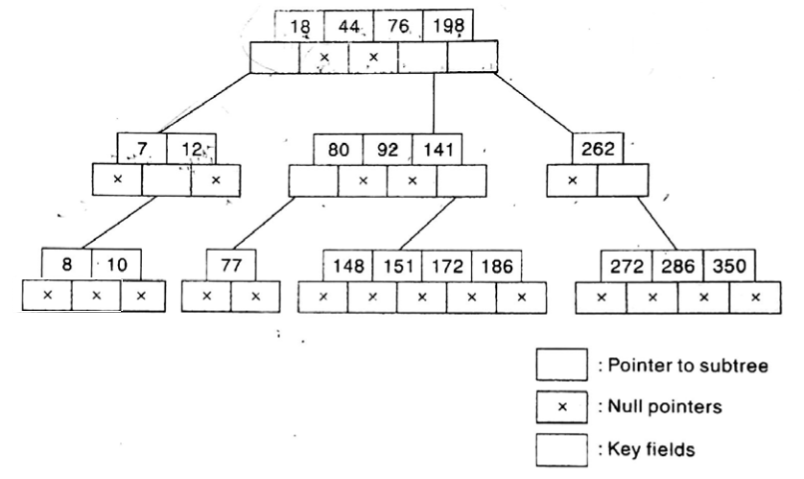
m-way Search Trees
(Definition)
Rizoan Toufiq, Assistant Prof., CSE, RUET
Arrays, Records and Pointers

Slide 9
Searching, Insertion and Deletion in an m-way Search Tree
Rizoan Toufiq, Assistant Prof., CSE, RUET
Arrays, Records and Pointers

Slide 10
Searching
Search 77.
Rizoan Toufiq, Assistant Prof., CSE, RUET
Arrays, Records and Pointers

Slide 11
Searching
Search 13.
13
Unsuccessful
Rizoan Toufiq, Assistant Prof., CSE, RUET
Arrays, Records and Pointers

Slide 12
Insertion
Insert 6
6
Rizoan Toufiq, Assistant Prof., CSE, RUET
Arrays, Records and Pointers

Slide 13
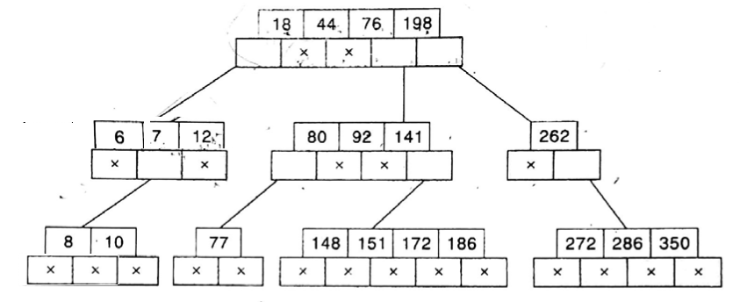
Insertion
Insert 6
Rizoan Toufiq, Assistant Prof., CSE, RUET
Arrays, Records and Pointers

Slide 14
Insertion
Insert 146
146
Rizoan Toufiq, Assistant Prof., CSE, RUET
Arrays, Records and Pointers

Slide 15
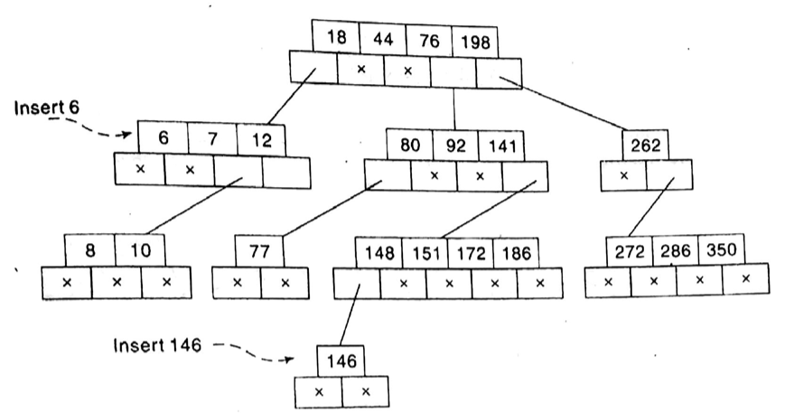
Insertion
Insert 146
Rizoan Toufiq, Assistant Prof., CSE, RUET
Arrays, Records and Pointers

Slide 16
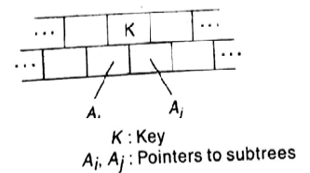
Deletion
If A_{i} = A_{j} = NULL, then delete K
If A_{i} ≠ NULL and A_{j} = NULL , then
  Chose the largest of the key element K’ in the child node pointed to by A_{i}
  Delete K’
  Replace K by K’
If A_{i} = NULL and A_{j} ≠ NULL, then
  Chose the smallest of the key element K” in the child node pointed to by A_{j}
  Delete the key K”
  Replace K by K”
If A_{i} ≠ NULL and A_{j} ≠ NULL, then
  Follow the rule 2 or 3
Rizoan Toufiq, Assistant Prof., CSE, RUET
Arrays, Records and Pointers

Slide 17
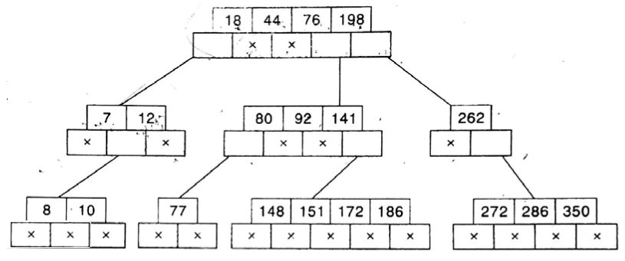
Deletion
Delete 92
Rizoan Toufiq, Assistant Prof., CSE, RUET
Arrays, Records and Pointers

Slide 18
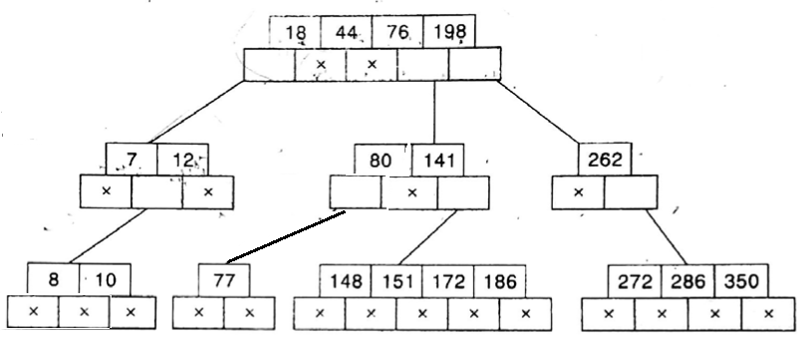
Deletion
Delete 92
Rizoan Toufiq, Assistant Prof., CSE, RUET
Arrays, Records and Pointers

Slide 19
Deletion
Delete 12
Largest key: 10
Rizoan Toufiq, Assistant Prof., CSE, RUET
Arrays, Records and Pointers

Slide 20
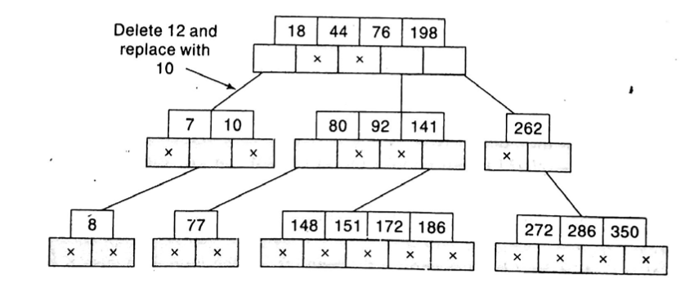
Deletion
Delete 12
Rizoan Toufiq, Assistant Prof., CSE, RUET
Arrays, Records and Pointers

Slide 21
Deletion
Delete 162
Smallest Key: 272
Rizoan Toufiq, Assistant Prof., CSE, RUET
Arrays, Records and Pointers

Slide 22
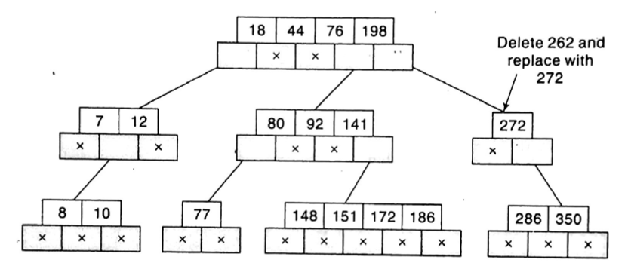
Deletion
Delete 162
Rizoan Toufiq, Assistant Prof., CSE, RUET
Arrays, Records and Pointers

Slide 23
B Trees
Rizoan Toufiq, Assistant Prof., CSE, RUET
Arrays, Records and Pointers

Slide 24
B Trees
(Definition)
A B-tree of order m, if non empty, is an m-way search tree in which:
  The root has at least two child nodes and at most m child nodes
  The internal nodes except root have at least ⎾m/2⏋ child nodes and at most m child nodes
  The number of keys in each internal node is one less than the number of child nodes and these keys partition the keys in the subtrees of the node in a manner similar to that of m-way search trees.
  All leaf nodes are on the same level.
Rizoan Toufiq, Assistant Prof., CSE, RUET
Arrays, Records and Pointers

Slide 25
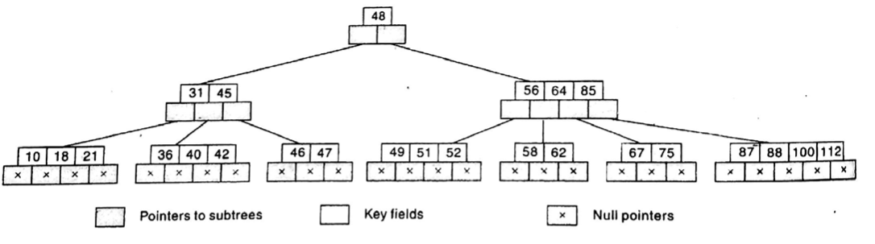
B Trees
(Definition)
B tree with order 5
Rizoan Toufiq, Assistant Prof., CSE, RUET
Arrays, Records and Pointers

Slide 26
B Trees
(Search)
Same as m-way search tree.
Rizoan Toufiq, Assistant Prof., CSE, RUET
Arrays, Records and Pointers

Slide 27
B Trees
(Insertion)
If the leaf node in which the key is to be inserted is not full, then insertion is done in the node.
If the node were to be full, then
  insert the key in order into the existing set of keys in the node,
  split the node at its median into two nodes at the same level,
  pushing the median element up by one level.
  Accommodate the median element in the parent node if it is not full.
  Otherwise repeat the same procedure
Rizoan Toufiq, Assistant Prof., CSE, RUET
Arrays, Records and Pointers

Slide 28
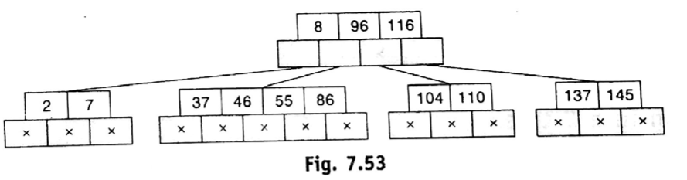
B Trees
(Insertion)
Insert 4,5,58 and 6
B-tree of order 5
Rizoan Toufiq, Assistant Prof., CSE, RUET
Arrays, Records and Pointers

Slide 29
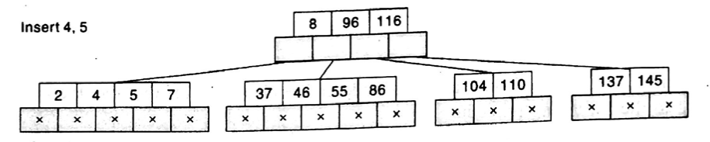
B Trees
(Insertion)
Leaf node is not full
Rizoan Toufiq, Assistant Prof., CSE, RUET
Arrays, Records and Pointers

Slide 30
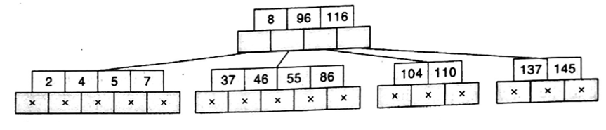
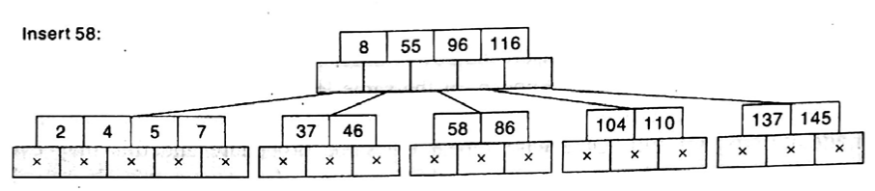
B Trees
(Insertion)
Leaf node is full,
  List: 37 46 55 58 86,
Median: 55,
55 add with parent node since parent node is not full
Rizoan Toufiq, Assistant Prof., CSE, RUET
Arrays, Records and Pointers

Slide 31
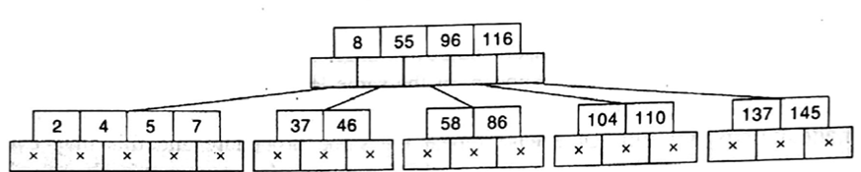
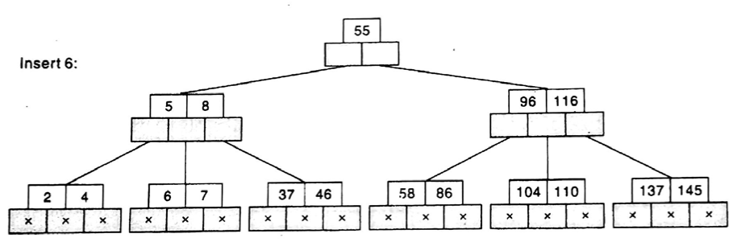
B Trees
(Insertion)
Leaf node is full, List: {2 4} 5 {6 7},
Median: 5,
5 add with parent node since parent node is also full
Rizoan Toufiq, Assistant Prof., CSE, RUET
Arrays, Records and Pointers

Slide 32
B Trees
(Insertion)
Leaf node is full, List: {5 8} 55 {96 116},
Median: 55,
5 add with parent node since parent node is not full (root)
Rizoan Toufiq, Assistant Prof., CSE, RUET
Arrays, Records and Pointers

Slide 33
B Trees
(Deletion)
Objective: the keys in the leaf node are removed
Case: A key that is in an internal node to be deleted
Solution:
  we promote a successor or a predecessor of the key to be deleted, to occupy the position of the deleted key and such key is bound to occur in a leaf node.
Rizoan Toufiq, Assistant Prof., CSE, RUET
Arrays, Records and Pointers

Slide 34
B Trees
(Deletion)
While removing a key from a leaf node, if the node contains more than the minimum number of elements, then the key can be easily removed.
Example (Next Slide)
Rizoan Toufiq, Assistant Prof., CSE, RUET
Arrays, Records and Pointers

Slide 35
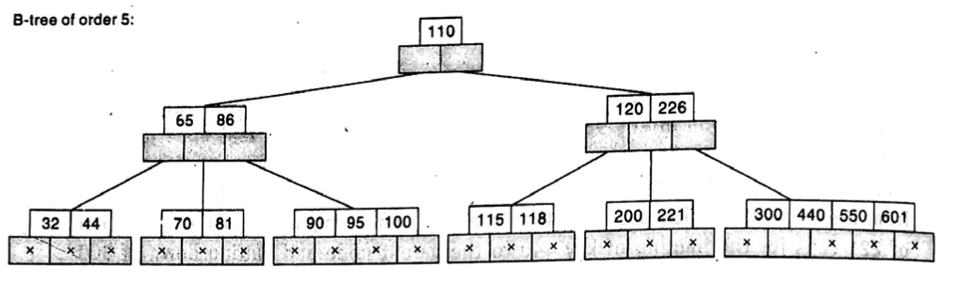
B Trees
(Deletion)
Delete 95
  Minimum number of element for B-tree of order 5 : ⎾m/2⏋=3
4 elements are here
Rizoan Toufiq, Assistant Prof., CSE, RUET
Arrays, Records and Pointers

Slide 36
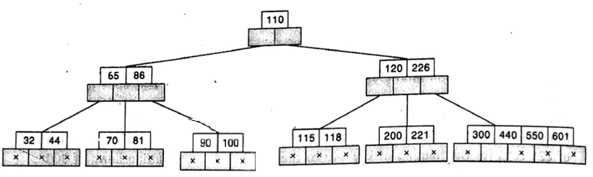
B Trees
(Deletion)
Delete 95
  Minimum number of element for B-tree of order 5 : ⎾m/2⏋=3
Rizoan Toufiq, Assistant Prof., CSE, RUET
Arrays, Records and Pointers

Slide 37
B Trees
(Deletion)
If the leaf node contains just the minimum number of elements, then search for an element from either the left sibling node or right sibling node to fill the vacancy.
  If the left sibling node has more than the minimum number of keys, pull the largest key up into the parent node and move down the intervening entry from the parent node to the leaf node where the key is to be deleted.
  Otherwise, pull the smallest key of the right sibling node to the parent node and move down the intervening parent element to the leaf node.
Rizoan Toufiq, Assistant Prof., CSE, RUET
Arrays, Records and Pointers

Slide 38
B Trees
(Deletion)
Delete 226
– minimum number of element in this node
Smallest - 300
Rizoan Toufiq, Assistant Prof., CSE, RUET
Arrays, Records and Pointers

Slide 39
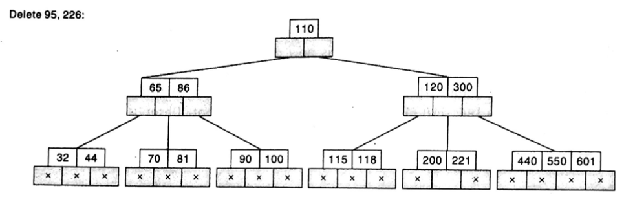
B Trees
(Deletion)
Delete 226
Rizoan Toufiq, Assistant Prof., CSE, RUET
Arrays, Records and Pointers

Slide 40
B Trees
(Deletion)
If both the sibling nodes have only minimum number of entries, then create a new leaf node out of the two leaf node and intervening element of the parent node, ensuring that the total number does not exceed the maximum limit for a node.
  Remember: If while borrowing the intervening element from the parent node, it leaves the number of keys in the parent node to be below the minimum number, then we propagate the process upwards ultimately resulting in a reduction of height of the B-tree.
Rizoan Toufiq, Assistant Prof., CSE, RUET
Arrays, Records and Pointers

Slide 41
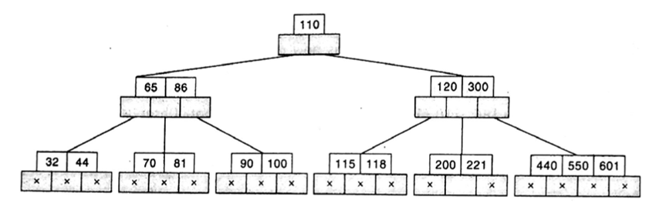
B Trees
(Deletion)
Delete 221
both the sibling nodes have only minimum number of entries
Rizoan Toufiq, Assistant Prof., CSE, RUET
Arrays, Records and Pointers

Slide 42
B Trees
(Deletion)
Delete 221
Intervening element of parent
Rizoan Toufiq, Assistant Prof., CSE, RUET
Arrays, Records and Pointers

Slide 43
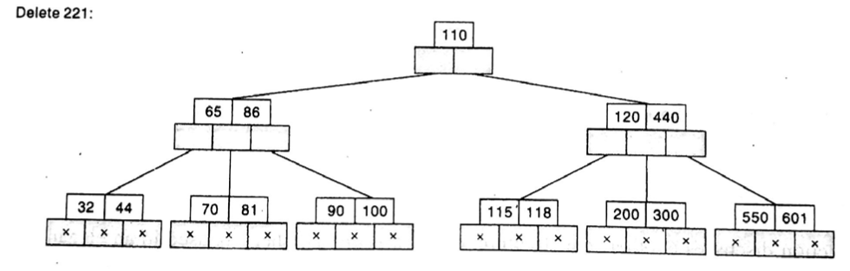
B Trees
(Deletion)
Delete 221
Merge: (200 300) 440 (550 601)
Rizoan Toufiq, Assistant Prof., CSE, RUET
Arrays, Records and Pointers

Slide 44
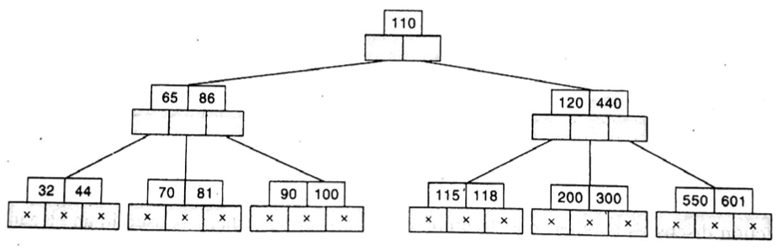
B Trees
(Deletion)
Delete 70
both the sibling nodes have only minimum number of entries
Rizoan Toufiq, Assistant Prof., CSE, RUET
Arrays, Records and Pointers

Slide 45
B Trees
(Deletion)
Delete 70
Parent nodes have only minimum number of entries
Rizoan Toufiq, Assistant Prof., CSE, RUET
Arrays, Records and Pointers

Slide 46

B Trees
(Deletion)
Delete 70
So consider root nodes and two sibling with respect ot root
Merge: 65 86 110 120 440
Borrow 65
See the below figure
Rizoan Toufiq, Assistant Prof., CSE, RUET
Arrays, Records and Pointers

Slide 47

B Trees
(Deletion)
Delete 70
Merge Leaf nodes: (32 44 65 (borrowing) 81) (90 100)
Rizoan Toufiq, Assistant Prof., CSE, RUET
Arrays, Records and Pointers

Slide 48
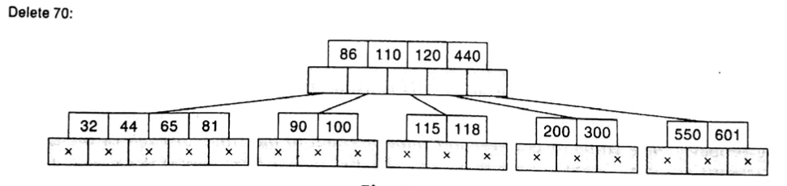
B Trees
(Deletion)
Delete 70
Rizoan Toufiq, Assistant Prof., CSE, RUET
Arrays, Records and Pointers

Slide 49
Any Query?
Rizoan Toufiq, Assistant Prof., CSE, RUET
Arrays, Records and Pointers

