Slide 1
Destinaire
Solution for `mySimpleMessageService` assignment

Slide 2
Assignment
Messages
  Send a message to another contact within the engine.
  Read messages
  Delete a message
  Apply filtering, pagination and sorting
Contacts
  CRUD operations
  Optional Bonus
  Write a document about the architecture of the code, its limitations and considerations.
  Write unit tests
  Use an ORM tool
  Consider API level exception handling (error codes)
  Think about additional features that a real production system would need in the scope given (contacts and messages).
  Deploy it to any online cloud or hosting provider. (AWS and Azure have a free trial option)

Slide 3


Architecture
API
Data layer
Storage
Repository
Entity framework
MessagesAPI
Business logic layer
ContactsAPI
Service

Slide 4
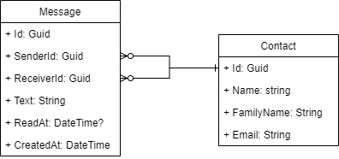
Db model

Slide 5
Improvement options
- Authorization for access of messages by logged in user (out of scope)
- Scaling on Azure – different resource plan
- Implementation of SignalR for messages
- Using Azure provides service for SignalR hubs
- Using dedicated SQL server – instead of SQLite
- Implementation of CQRS with queues
- Cache introduction
  On db level
  On endpoint level

Slide 6
References
https://github.com/dotnet-architecture/eShopOnWeb
https://xunit.net/#documentation
https://code-maze.com/

