Slide 1

Context Ledger
CITED. CROSS-VENDOR. HUMAN-APPROVED.
Two people’s agents share what they know as a cited graph,
and only the two people can agree.
The trust layer between any two agents · Over MCP · Runs locally
Notes:
Open on this slide. AI agents increasingly work across vendors. Context Ledger is the trust layer that lets two agents share context while the people involved keep control.

Slide 2
Every team runs agents from more than one vendor. They can’t share what they know.
01 / THE PROBLEM
user: where did we land on the rollout?
assistant: we agreed to canary first, then…
user: and the MCP adapter?
assistant: Ruslan owns it, see line 48…
user: is Sunday still free?
assistant: no, he is away all of Sunday…
user: what about the pitch numbers?
assistant: the benchmark says 3.8% at…
user: ok, remind me what we decided
assistant: we decided to take the 17:30…
user: wait, which slot again?
assistant: let me re-read the whole chat…
user: summarize everything so far
assistant: here is everything, again…
user: paste it to the other agent
assistant: 1,000 turns, 120 KB of text…
Today the only bridge is pasting the whole chat into the other agent. It is huge, nobody can check where a claim came from, and nobody controls what the agents agree to on our behalf.
26×
$119
bigger: the pasted chat vs a cited graph, for a 1,000-turn session
per 1,000 handoffs of that chat on Claude Opus 5.5, because a pasted chat can’t be cached
PASTED CHAT · 1,000 TURNS
Estimates: characters ÷ 4, synthetic sessions, list prices.
Notes:
Teams are already using agents from different vendors, such as Claude Code and Codex. Today, sharing context means pasting an entire chat, with no reliable way to check claims or control what agents decide. The numbers are estimates on synthetic sessions.

Slide 3
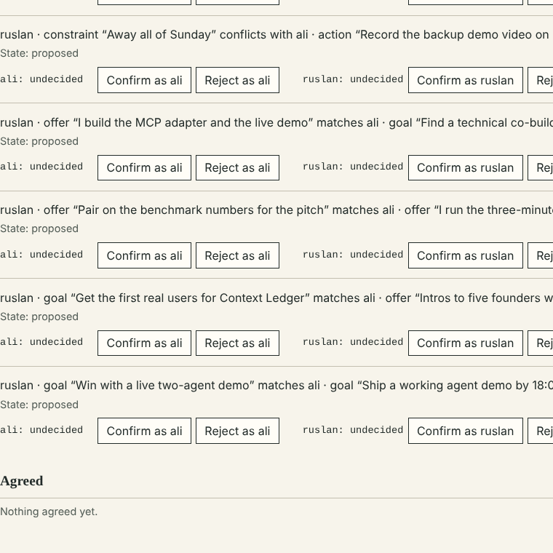
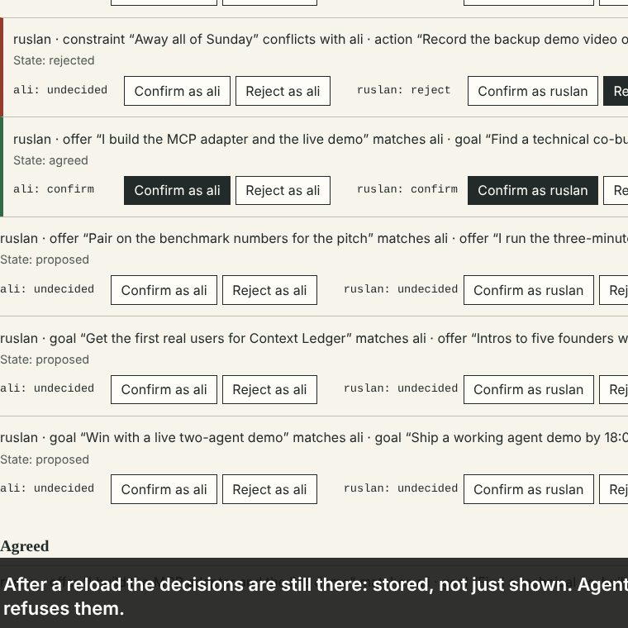
Cite. Propose. Agree.
02 / SOLUTION
ali · cited graph
GOAL
L12
Find a technical co-builder
OFFER
L31
I run the pitch and the Q&A
CONSTRAINT
L57
Leave by 19:00 tonight
QUESTION
L88
Who owns the MCP integration?
Each agent publishes a cited graph
Agents propose links
Only people agree
Every claim points at its exact chat line.
Matches, conflicts and answers. They decide nothing.
Both confirm, or one rejects. Stored after reload.
Notes:
Context Ledger is a layer over MCP that any two agents can share. Each agent publishes a small cited graph of its person’s goals, offers, constraints, decisions and questions. The agents can link the two graphs, but those links are only proposals. Only the two people can agree.

Slide 4
Two layers, one local stack
03 / HOW IT’S BUILT
FOR AGENTS
CORE · TEXT LAYER
LATENT LAYER
MCP server
Node 22 + SQLite
vLLM + Qwen2.5-7B
Six tools for Claude Code and Codex: graph_publish, graph_read, context_for, room_open, room_read, graph_schema.
Cited graphs with seven node kinds. Every citation is checked against a real chat line. Content-addressed IDs, rooms and the savings meter. No build step, no cloud.
A local open model reads the files once and keeps its memory (KV cache) warm for every later call.
FOR PEOPLE
CHECKS
Negotiation room
Quote-verified slices
Confirm or reject each proposal in the browser. No tool can confirm for you.
Every quote must appear in its cited lines. Lines that try to instruct an AI are flagged.
LOCAL BY DESIGN
Runs on loopback only and checks Host and Origin. Imports only the files a person picks. Transcripts never leave the machine.
Notes:
The text layer is a small Node and SQLite service with an MCP server for agents and a browser room for people. The latent layer is a local vLLM runtime: one open model reads the files once and keeps its memory warm, and only a small, quote-checked slice reaches the closed model. Everything runs locally.

Slide 5
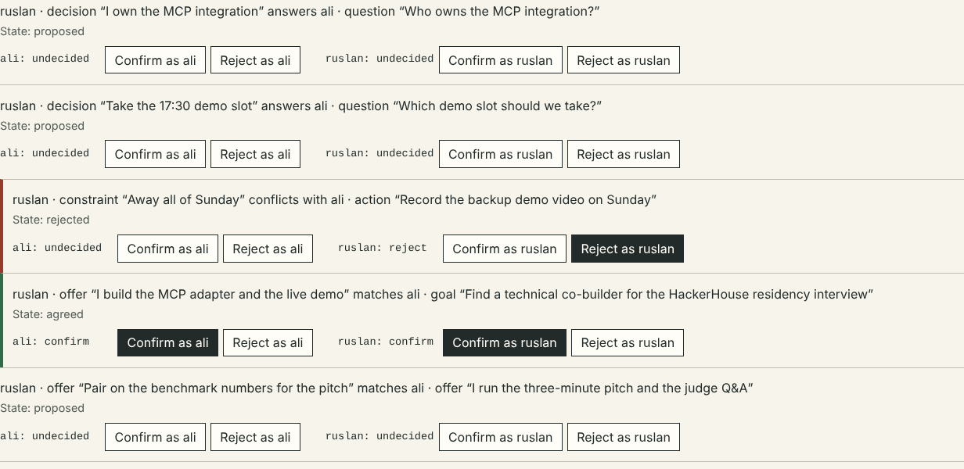
One room. Two people. The agents decide nothing.
04 / DEMO
Notes:
Switch to the live demo. Claude Code and Codex, both on MCP. Each agent publishes what its person wants, offers and can’t do, and cites the line it came from. Open the room: the agents found matches, a conflict and two answers, and decided nothing. Both people confirm the co-builder match: agreed only when both say yes. One person rejects the Sunday conflict: one no is enough. Reload: the decisions are stored. If the live run fails, play docs/demo/networking-demo.mp4.

Slide 6
05 / THE TRUST BOUNDARY
AGENTS PROPOSE.
ONLY PEOPLE AGREE.
0
decisions an agent can record. Confirm and reject need the person’s own click.
A decision is recorded only from the person’s browser. The command line and the MCP tools can open and read a room, but they can’t confirm anything.
Notes:
This is the central trust boundary. Agents can prepare proposals, but a decision can only be recorded from the person’s browser, never by an agent, the command line or an MCP tool. Human approval is deliberately not fast, and it’s the differentiator.

Slide 7
Smaller, cheaper, and every claim cited
06 / THE NUMBERS · TEXT LAYER
Estimates: characters ÷ 4, synthetic sessions, list prices. Building the graph pays for itself from the 2nd handoff. A cache-friendly chat (a format change) would be about as cheap at 50–200 turns.
Notes:
These are estimates from synthetic sessions, using characters divided by four and list prices. At 1,000 turns the graph is 3.8% of the chat, and handing it over is about 96% cheaper than pasting the chat, which can’t be cached. A cache-friendly chat would be about as cheap at shorter lengths. Every claim in the graph cites its source line.

Slide 8
One model reads once. Every call reuses it.
07 / THE NUMBERS · LATENT LAYER
426 ms
98–99%
5–9%
3 / 3
WARM-PREFIX LATENCY
PROMPT TOKENS CACHED
TOKENS FORWARDED
QUALITY GATES PASSED
Down from 1,972 ms.
Served from the warm cache.
Only a small slice reaches the closed model.
Quotes verified against the cited lines.
Measured live with Qwen2.5-7B on a laptop GPU, on a synthetic codebase.
Notes:
On a laptop GPU with a synthetic codebase, Qwen2.5-7B reduced warm-prefix latency from 1,972 milliseconds to 426. Almost every prompt token came from cache, and the closed model received under a tenth of the tokens. Both quality gates passed three out of three runs.

Slide 9
Not another chat dump. A layer over MCP.
08 / ALTERNATIVES
TODAY
COMMON
CONTEXT LEDGER
Paste the chat
Summarize it
Cite, then agree
The whole transcript goes to the other agent: thousands of lines nobody reads or checks.
Small, but a summary drops where each claim came from, so nobody can check it.
Agents exchange cited state over MCP. Links are proposals; people confirm. Works with Claude Code and Codex today.
WHAT WE DO DIFFERENTLY
WHAT WE DO DIFFERENTLY
VS AGENT MESSAGING (A2A)
Send a graph about 4% of the size at 1,000 turns.
Every node cites its exact chat line, and the ledger verifies it.
A2A moves messages. We move cited, human-approved state.
Not a replacement for MCP or agent messaging: the trust layer on top of them.
Notes:
Today people paste the whole chat, or ask for a summary. A chat dump is huge and uncheckable; a summary is small but loses where each claim came from. Context Ledger sends a small cited graph, and only people agree. It is a layer over MCP, not a replacement: A2A moves messages, we move cited, human-approved state.

Slide 10
Wherever two agents must trust each other
09 / WHERE IT GOES
01
02
03
04
FIRST USERS
TODAY’S DEMO
NEXT
NEXT
Code handoffs
Team-forming
Hiring
Across companies
Claude Code hands its context to Codex as a small cited graph instead of the whole chat.
Two people’s agents find matches and conflicts. The people decide.
Candidate and recruiter agents exchange cited claims, not résumés of the chat.
Agents from different vendors coordinate. People approve every agreement.
We start with developer teams that already run Claude Code and Codex side by side.
Notes:
The first users are developer teams running Claude Code and Codex side by side and handing work between them. The same trust layer, unchanged, applies to team-forming, hiring and coordination between companies whose agents come from different vendors.

Slide 11
Local, open, one command
10 / RUN IT
01 · START THE LEDGER
02 · CONNECT ANY AGENT
03 · USE SIX MCP TOOLS
npm ci
npm start
claude mcp add context-ledger \
-- node /path/to/src/mcp.mjs
graph_publish graph_read
context_for room_open
room_read graph_schema
Runs on your machine only. Transcripts never leave it.
Codex connects through the same MCP server.
None of them can confirm a decision.
Notes:
Context Ledger runs locally on loopback and imports only the files a person chooses. Connect Claude Code with the MCP command shown; Codex uses the same server. The six tools can read and publish context, but none can confirm a decision. We want teams who run more than one agent vendor to try it on real sessions.

Slide 12
Thank you
CITED. CROSS-VENDOR. HUMAN-APPROVED.
Context Ledger: the trust layer between any two agents
github.com/PricePepel/context-ledger
Notes:
Thank you. Questions.

