Slide 1
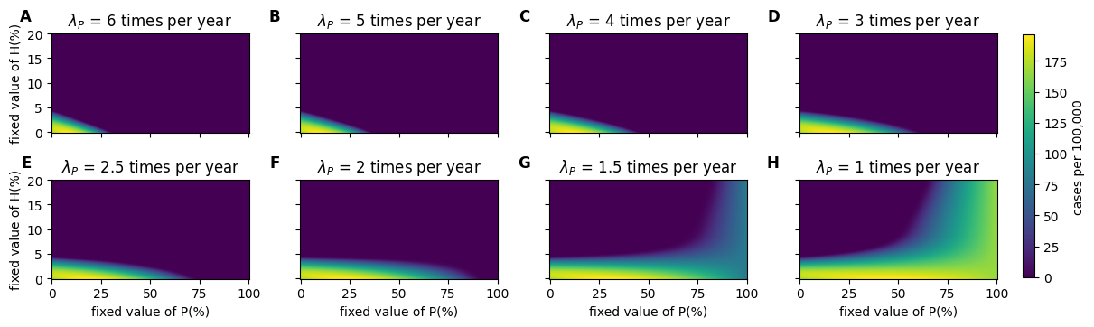
Endemic new infections (i.e., transitions from S to Ia + transitions from S to Is)

Slide 2
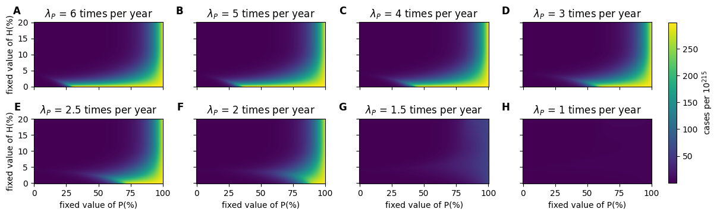
Endemic new asymptomatic infections (i.e., transitions from S to Ia)
Endemic new symptomatic infections (i.e., transitions from S to Is)

Slide 3
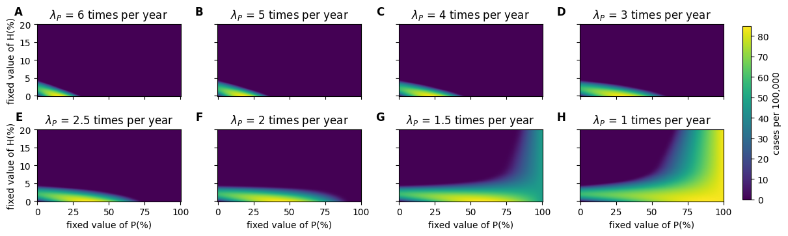
Detected new infections (i.e., transition from Ia to T + Is to T)

Slide 4

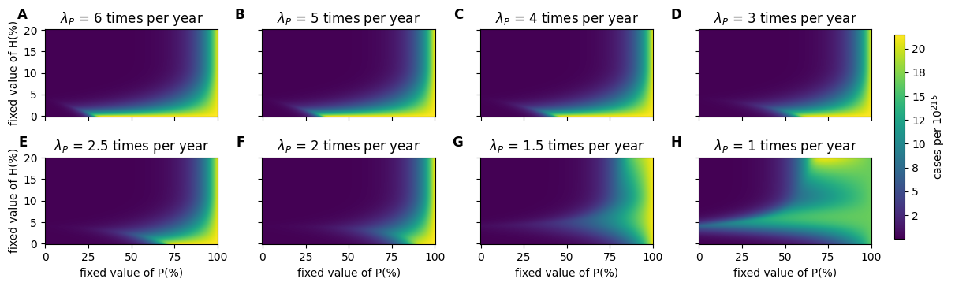
Detected new asymptomatic infections (i.e., transition from Ia to T)
Detected new symptomatic infections (i.e., transition from Is to T)

Slide 5
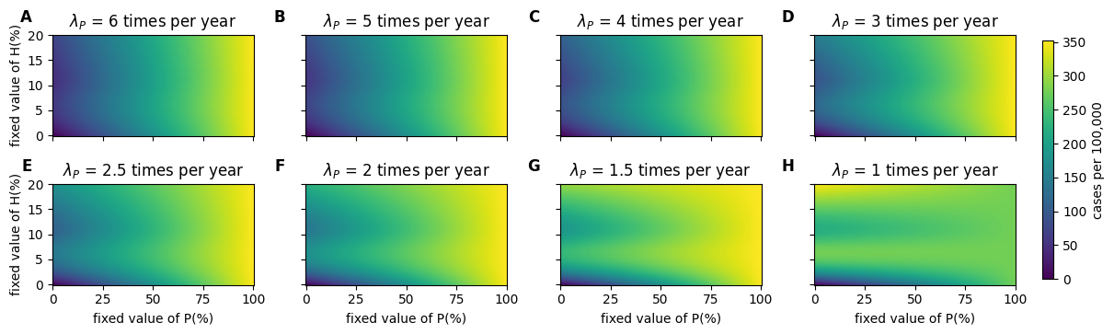
Lambda STI

Slide 6
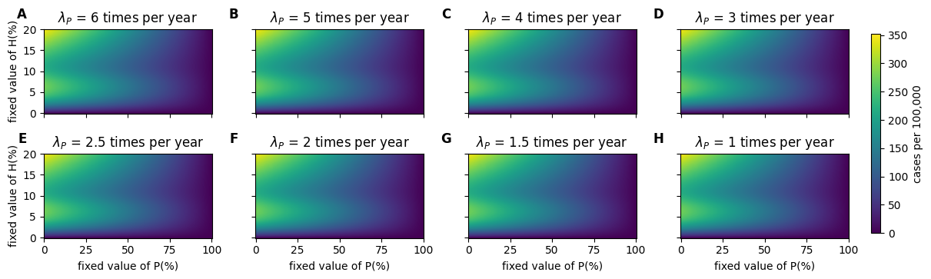
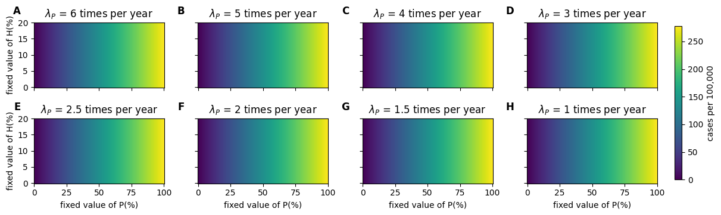
Lambda H
Lambda P

Slide 7
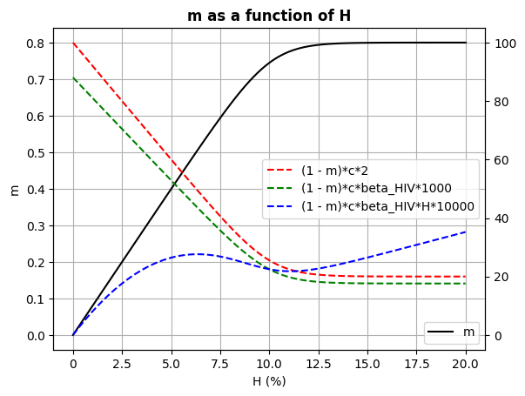

Slide 8
02/08/2024

Slide 10
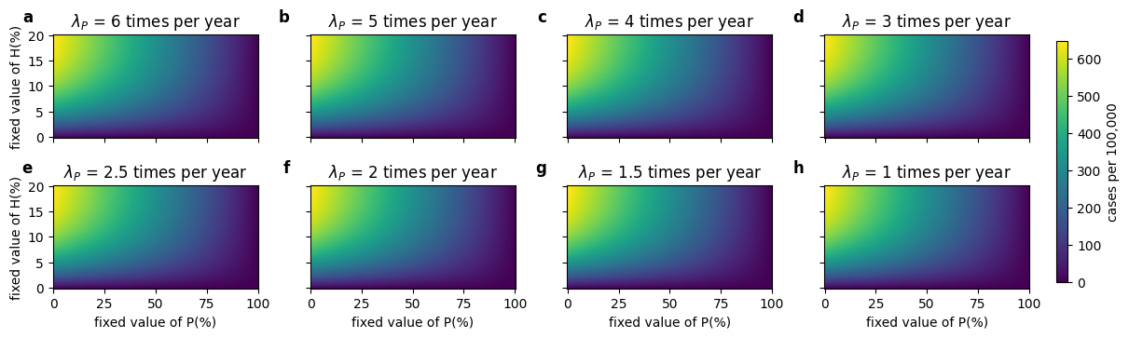

Slide 11
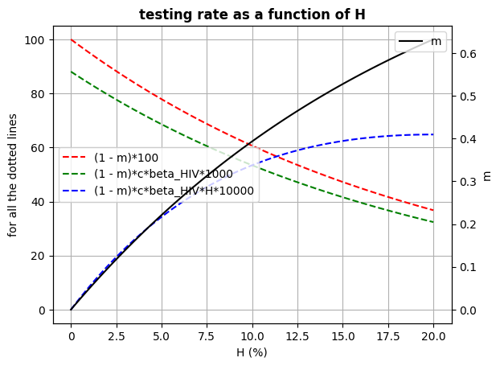

Slide 12
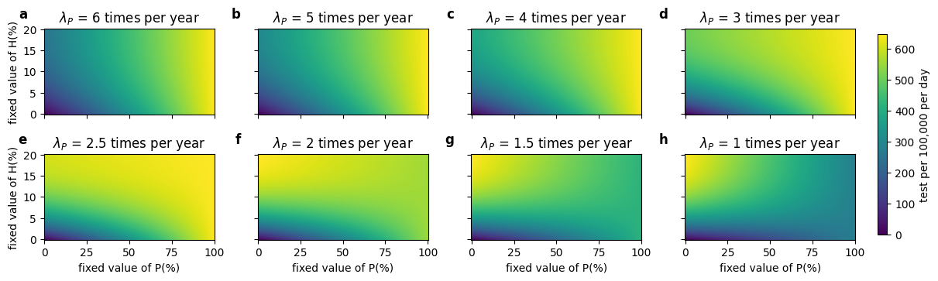

Slide 13
