Slide 1

PYTHON ROCKERS
Python Hackathon September 2022
SMPO : Anuradha Gupta
Team Lead : Prabina Chelladurai (DAML27)
Nirupa Muthumani (DAML27)
Priyanka Gokulakrishnan (DAML27)
Poornima (DAML27)
Devasahayam (DAML 28)

Slide 2
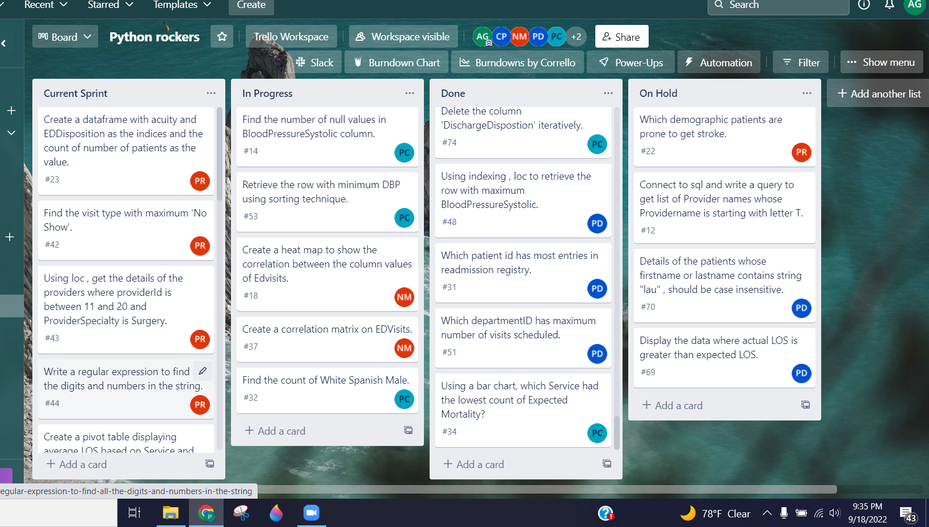
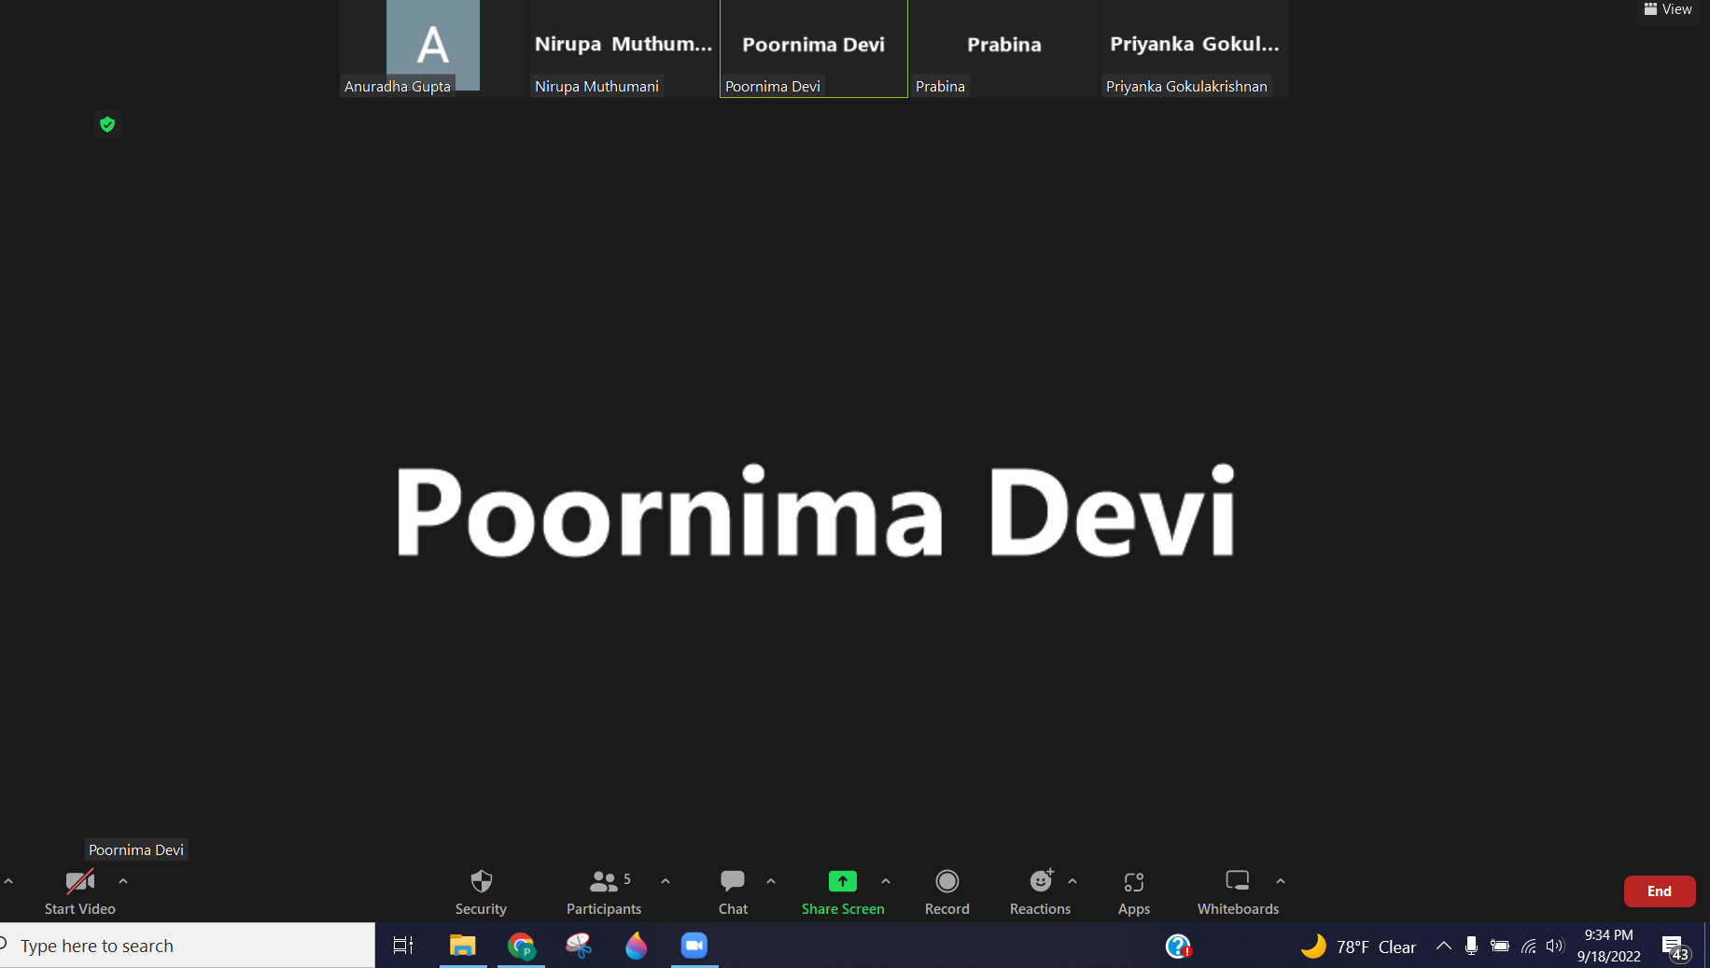
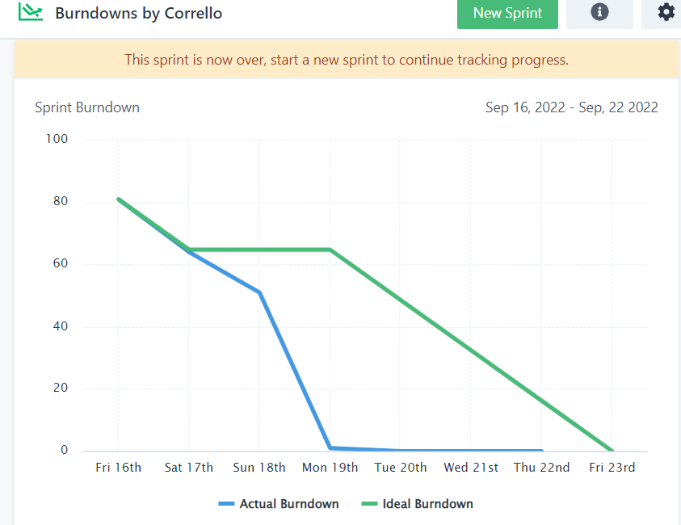
Agile Methodology
Used Scrum as Agile method and allocated the Tasks to One Sprint in the Trello Board
Sprint Planning
Daily stand-up calls
Burndown Chart
Integrated Slack with Trello for team updates

Slide 3


TIMELINE
Day 2
Managed the cards in Trello.
Write Code & Update in GitHub.
Day 4
Write Code & Update in GitHub.
Day 0
Hackathon Launch
Presentation
Sept 22,2022
20%
FEB
30%
25%
25%
Day 1
Opened GitHub Repository.
Allocated 20 questions to each member
Uploaded our code in GitHub at the end of the day.
Day 3
Cleared our doubts through calls.
Write Code & Update in GitHub.
Day 5
Extra Questions
Day 6
Preparing Presentation
Final upload to Github.

Slide 4
NEW FUNCTIONS
Given Questions
Extra Questions
OPTIMIZATION
df.query()
.isin()
nlargest
df.explode()
numpy.quantile
.assign()
df.to_numpy()
To_datetime()
Date.today()
.apply()
Unstack()
Merge()
Pivot_table()
diag()
idx_max()
Lambda()
Filter()
Aggfunc()
Findall()
Split()
Sort_values()
Split_name(
Str.lower()
Char.lower()
Del
Np.where()
.append()
Folium.Map()
psycopg2.connect()
.commit()
.execute()
.distplot()
WordCloud()
set(STOPWORDS)
Pop()
tight layout()
Ellipsis()
df.sample()
df.select_dtypes()
df.dtypes()
df.crosstab()
df.cumsum()
Stats.mean()
Stats.median()
Displayed only the required parameters in the output.
Used built-in functions wherever possible.

Slide 5
Day 1
16
Day 2
20
Day 3
24
Day 4
20
Extra Questions
45
44
80
45
Extra Questions
New Functions
Hackathon Questions

Slide 6
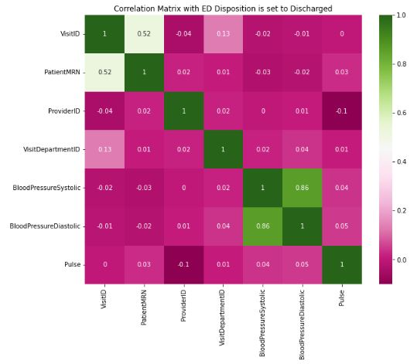
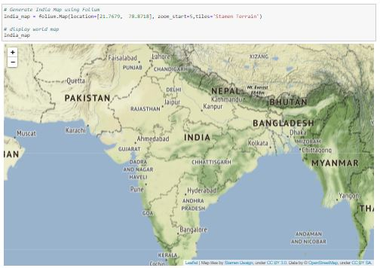

Visualization in Additional Questions
Generated India Map using folium library
Correlation Matrix
Word Cloud

Slide 7

Thank You

